Slide 1
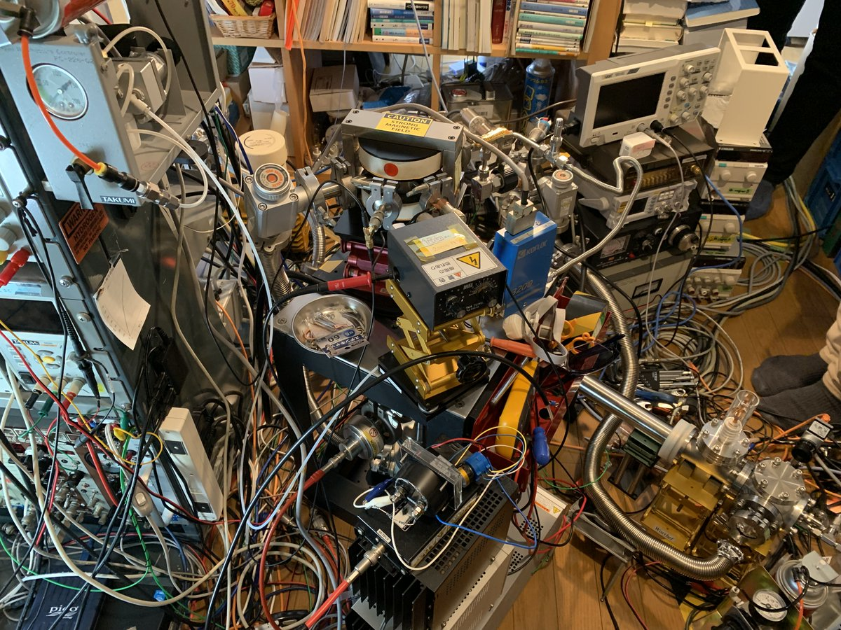
https://togetter.com/li/1884364

