Slide 1
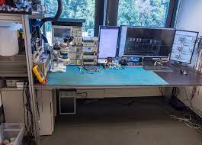
https://encrypted-tbn0.gstatic.com/images?q=tbn:ANd9GcTaPIMEz1nJn7y-1a8nCfdbz-7B8dVxLGYyJHctS53tlPAEQvBC3ctAd3CHtoQ1shG11D8&usqp=CAU

