Slide 1
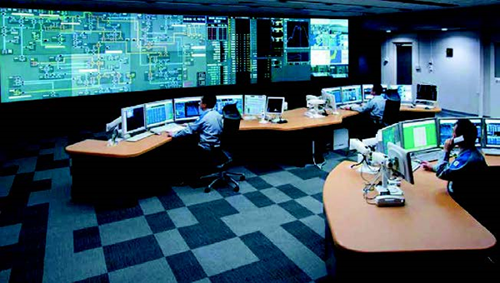
https://ieei.or.jp/2018/01/special201310_01_050/

