Slide 1
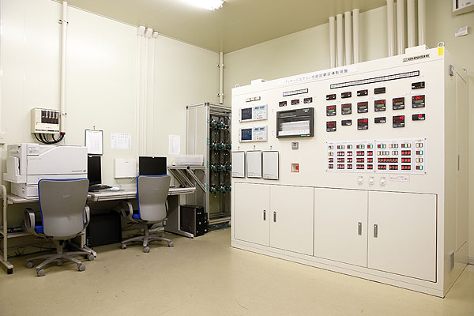
https://www.jatl.or.jp/testing-facilities.html

