Slide 1


SUMMER DEVELOPERS MEETUP – Q1 2022
Basic Concepts Of C# & Debugging Tips
Faisal Pathan
[Project Manager | The Code Hubs | C# CORNER MVP | Speaker]

Slide 2
Agenda
OOPS concept
Difference between Abstract Class and Interface in c#
Static keyword c#
Override vs virtual c#
Inheritance in c#
Types of constructor in c#
Readonly vs const in c#
dependency injection c#
Debugging Tips

Slide 3
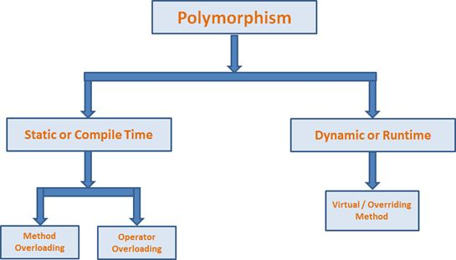
OOPS concept
OOPs is a concept of modern programming language that allows programmers to organize entities and objects.
Four key concepts of OOPs are abstraction, encapsulation, inheritance and polymorphism
OOP Features
Object
Abstraction
Encapsulation
Inheritance
Polymorphism

Slide 4
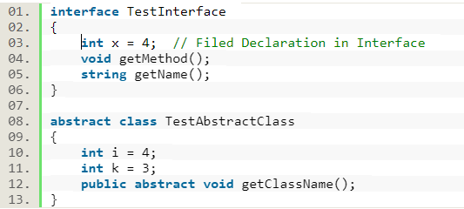
Difference between Abstract Class and Interface
The most frequent question being asked in .Net interview.
A class can implement any number of interfaces but a subclass can at most use only one abstract class.
An abstract class can have non-abstract Methods(concrete methods) while in case of Interface all the methods has to be abstract.
An abstract class can declare or use any variables while an interface is not allowed to do so.

Slide 5
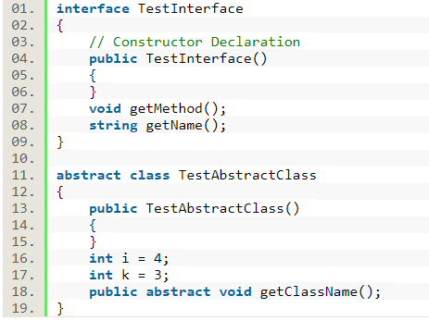
An abstract class can have constructor declaration while an interface can not do so.

Slide 6

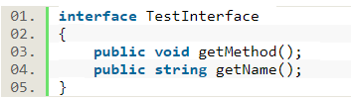
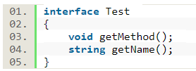
An abstract Class is allowed to have all access modifiers for all of its member declaration while in interface we can not declare any access modifier(including public) as all the members of interface are implicitly public.

Slide 7
Static keyword
The static keyword in C# language is used to declare static classes and static class members. The static classes and static class members such as constructors, fields, properties, methods, and events are useful when only one copy of the object (class or class members) are needed and shared among all instances (objects) of a type (and members).
Let's simplify it. Let's say, you've a class “CodeHubs" that represents The Code Hubs website, its properties, and its functions. The CodeHubs class has four properties, Domain, YearFounded, Location, and Description. We know that all these properties are fixed and they will not change regardless of how many instances of CodeHubs type are created by various programs or classes. This is a perfect example of a static class and static properties.
Can we update static member values?

Slide 8
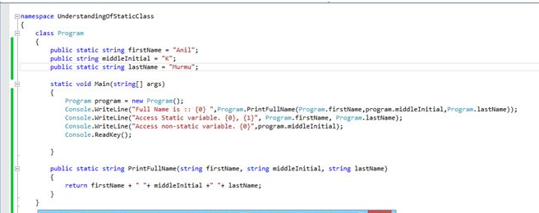
Can a static method access non-static fields?
The Answer is Yes. Static methods can directly access static fields without using class name also. However, to access non-static fields an object needs to be created. An example has been shown in the below image.

Slide 9
If in a static class, we don’t have non static members/functions then does it hold any default constructor?
Yes, it does hold a constructor but it is also declared as static.

Slide 10
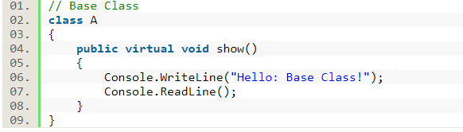
Override vs Virtual
The Virtual keyword is used for generating a virtual path for its derived classes on implementing method overriding. The Virtual keyword is used within a set with an override keyword. It is used as:

Slide 11
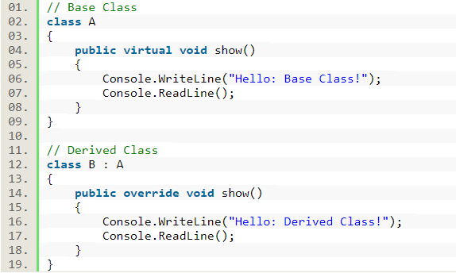
Override vs Virtual
The Override keyword is used in the derived class of the base class in order to override the base class method. The Override keyword is used with the virtual keyword, as in:

Slide 12
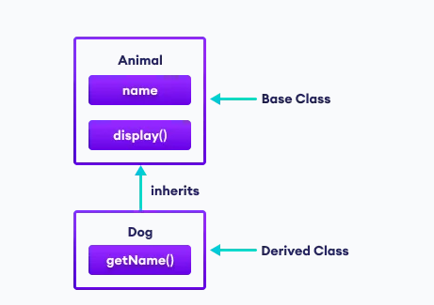
Inheritance
In C#, inheritance allows us to create a new class from an existing class. It is a key feature of Object-Oriented Programming (OOP).
The class from which a new class is created is known as the base class (parent or superclass). And, the new class is called derived class (child or subclass)
The derived class inherits the fields and methods of the base class. This helps with the code reusability in C#.

Slide 13
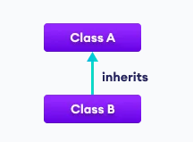
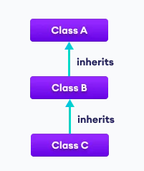
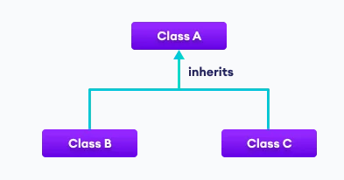
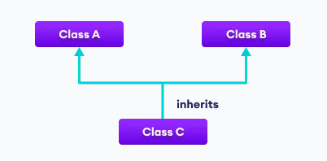
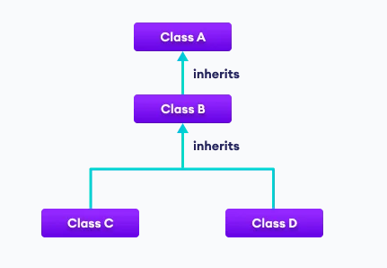
Types of inheritance
1. Single Inheritance
2. Multilevel Inheritance
3. Hierarchical Inheritance
4. Multiple Inheritance
5. Hybrid Inheritance

Slide 14
Constructor
What is a constructor in C#?
A special method of the class that is automatically invoked when an instance of the class is created is called a constructor. The main use of constructors is to initialize the private fields of the class while creating an instance for the class. When you have not created a constructor in the class, the compiler will automatically create a default constructor of the class. The default constructor initializes all numeric fields in the class to zero and all string and object fields to null.
Some of the key points regarding constructor are
A class can have any number of constructors.
A constructor doesn't have any return type, not even void.
A static constructor can not be a parametrized constructor.
Within a class, you can create one static constructor only.

Slide 15
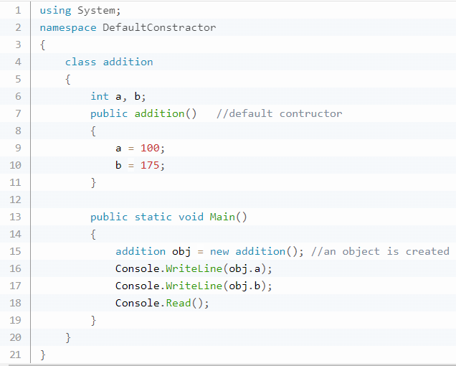
Constructors can be divided into 5 types
Default Constructor
A constructor without any parameters is called a default constructor; in other words, this type of constructor does not take parameters. The drawback of a default constructor is that every instance of the class will be initialized to the same values and it is not possible to initialize each instance of the class with different values.
The default constructor initializes:
All numeric fields in the class to zero.
All string and object fields to null.

Slide 16
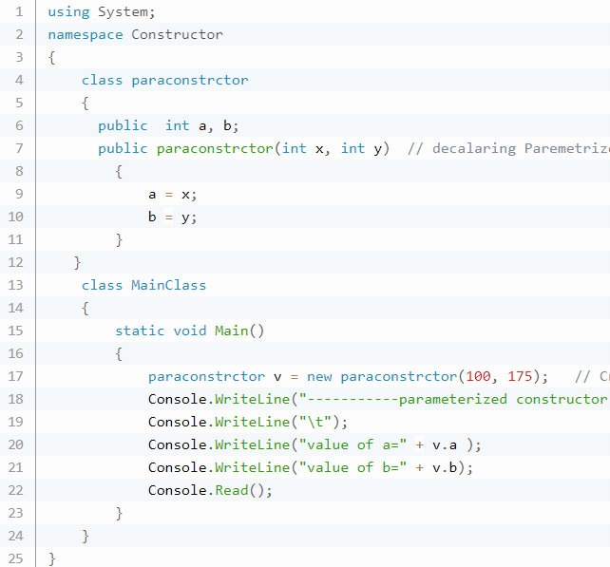
Constructors can be divided into 5 types
Parameterized Constructor
A constructor with at least one parameter is called a parameterized constructor. The advantage of a parameterized constructor is that you can initialize each instance of the class with a different value.

Slide 17
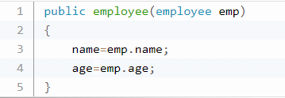
Constructors can be divided into 5 types
Copy Constructor
The constructor which creates an object by copying variables from another object is called a copy constructor. The purpose of a copy constructor is to initialize a new instance to the values of an existing instance.

Slide 18
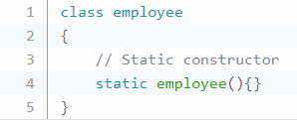
Constructors can be divided into 5 types
Static Constructor
When a constructor is created using a static keyword, it will be invoked only once for all of the instances of the class and it is invoked during the creation of the first instance of the class or the first reference to a static member in the class. A static constructor is used to initialize static fields of the class and to write the code that needs to be executed only once.
Some key points of a static constructor are:
A static constructor does not take access modifiers or have parameters.
A static constructor is called automatically to initialize the class before the first instance is created or any static members are referenced.
A static constructor cannot be called directly.
The user has no control over when the static constructor is executed in the program.
A typical use of static constructors is when the class is using a log file and the constructor is
used to write entries to this file.

Slide 19
Constructors can be divided into 5 types
Private Constructor
When a constructor is created with a private specifier, it is not possible for other classes to derive from this class, neither is it possible to create an instance of this class. They are usually used in classes that contain static members only.
Some key points of a private constructor are:
One use of a private constructor is when we have only static members.
It provides an implementation of a singleton class pattern.

Slide 20
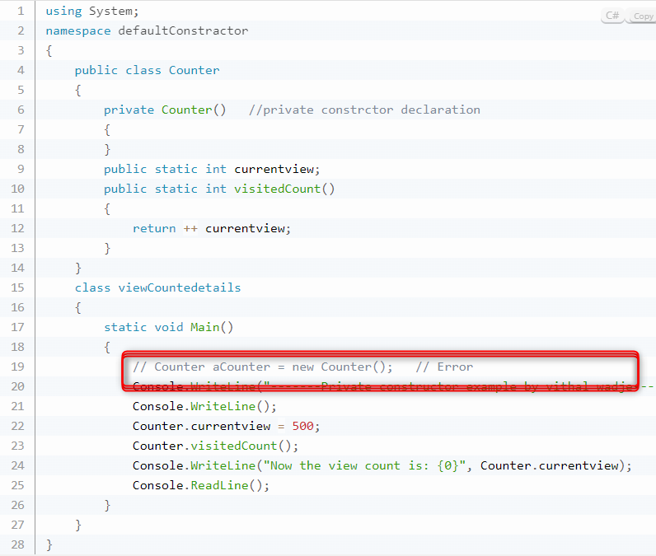

Slide 21
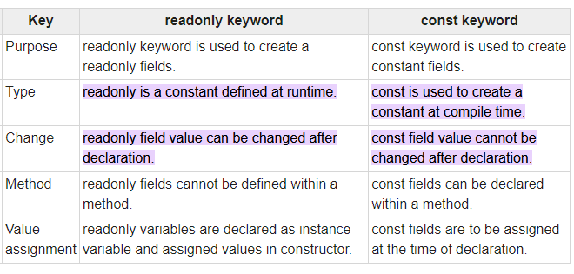
Readonly vs Const
readonly keyword is used to define a variable which can be assigned once after declaration either during declaration or in constructor.
Const keyword is used to define a constant to be used in the program

Slide 22
Dependency injection
Dependency Injection (DI) is a software design pattern. It allows us to develop loosely-coupled code. The intent of Dependency Injection is to make code maintainable. Dependency Injection helps to reduce the tight coupling among software components. Dependency Injection reduces the hard-coded dependencies among your classes by injecting those dependencies at run time instead of design time technically.
Types of DI
Constructor Injection
Property Injection
Method Injection

Slide 23
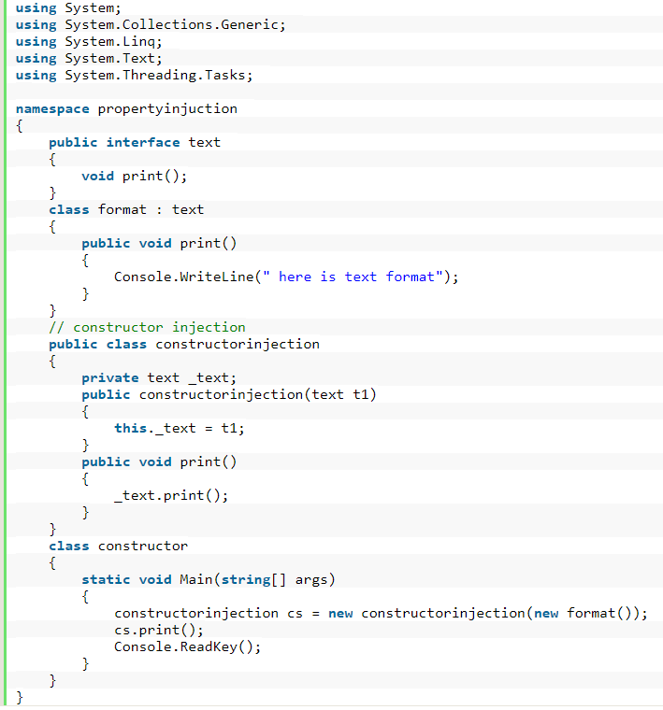
Constructor Injection
Construction injection is the most commonly used dependency pattern in Object Oriented Programming. The constructor injection normally has only one parameterized constructor, so in this constructor dependency there is no default constructor and we need to pass the specified value at the time of object creation. We can use the injection component anywhere within the class. It addresses the most common scenario where a class requires one or more dependencies.

Slide 24
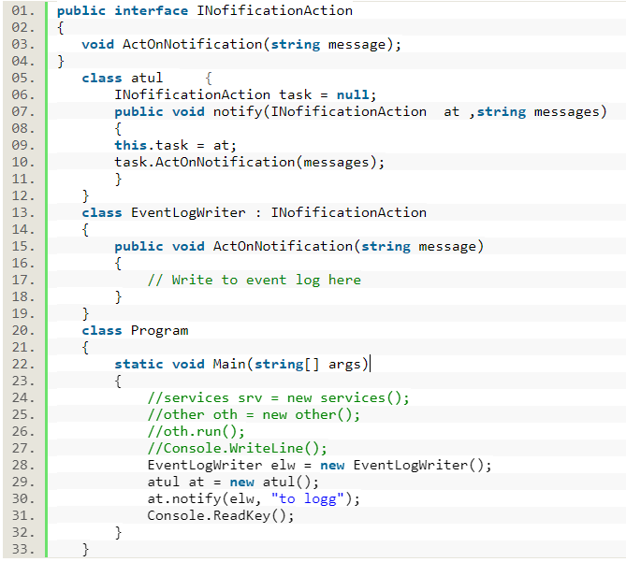
Property Injection
We use constructor injection, but there are some cases where we need a parameter-less constructor so we need to use property injection.

Slide 25
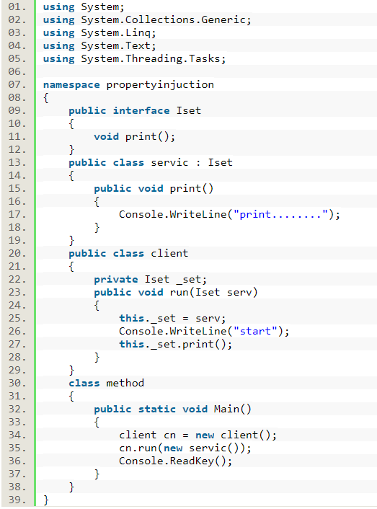
Method Method Injection
In method injection we need to pass the dependency in the method only. The entire class does not need the dependency, just the one method. I have a class with a method that has a dependency. I do not want to use constructor injection because then I would be creating the dependent object every time this class is instantiated and most of the methods do not need this dependent object.

Slide 26



