Slide 1

Team - EXCEPTION
Book Recommendation System
Team Members – Dimple Shah(201711001)
Mitalee Shingala(201711015)
Ahwini Upasani(201711020)
Urvi Oza(201711044)

Slide 2
Hybrid Approach
Item – Item based Collaborative Filtering
Content based Filtering
Matrix Factorization
Learning to Rank
Reinforcement Learning

Slide 3


Pre processing
Dataset
Learning to rank algorithm
Reinforcement learning

Slide 4

Pre- Processing
Item – Item based Collaborative filtering
Correlation Based Similarity calculation of books based on ratings given to that book.
Output Matrix– Similarity value of each book with other books

Slide 5
Content based Filtering (applies on Title of book)
TF – IDF method used on title of books
Output – similar books based on title of book
Matrix factorization Applied
SVD is used for rating prediction
Output – Rating prediction of user based on his rating similarity with other users.

Slide 6
Learning To Rank (For existing user)
Get list of Books (L1) from user’s past history which have high reward
Find Books list (L2) similar to list L1, using similarity values calculated by correlation based similarity
Calculate Rank of each book in List L2 and show top 8 books + 2 books (serendipity & exploration)

Slide 7
How Rank is Calculated?
How L2 is generated using L1 ?
Number of similar books included in L2 = n + j*α*k
n = Minimum number of books to be include
j = Variable based on reward
α = Learning rate
k = Constant
This calculation will be done for each book in list L1 , according to output of this equation books will be added in list L2 (using correlation based similarity)

Slide 8
How Rank is Calculated?
Rank of a book = α1* Item-item similarity value + α2 * Content based similarity value + α3 * Predicted rating (Using SVD)
+ α4 * Popularity (global rating)
+ α5 * Frequency
α1 , α2, α3, α4, α5 = weights

Slide 9
Exploration Vs Exploitation
Explored_items = Exploration_Rate * K
Exploited_items = K- Explored_items
K=Constant-total number of items to be recommended
Exploited Items will come from highest rated items and Exported items will come from Serendipity factor.

Slide 10
States and Actions
State represent the list of recommended items
Actions that can be performed by user on the state
Click
Like
Dislike
Rate

Slide 11
Current_State will be stored in users state table(History)
Click
Like
Dislike
Rate
Current_State
Change in reward based on the actions
Next_State

Slide 12
Reward Calculation
Reward = Click_Reward + Like_Reward + Dislike_penalty + Rating_Reward
The values of the reward will be ,
Dislike_penalty: -2
Click_Reward : 1
Like_Reward : 2
Rating_Reward: {2,3,4}
Note : The value of Rating Reward will be based on rating given by users.
The values of Rewards will be updated into State Table.

Slide 13
Recommendation In Cold Start
New User
Show 2 new arrivals + 3 random books + 5 popular books.
New Item
For existing user it will be covered in exploration part.

Slide 14
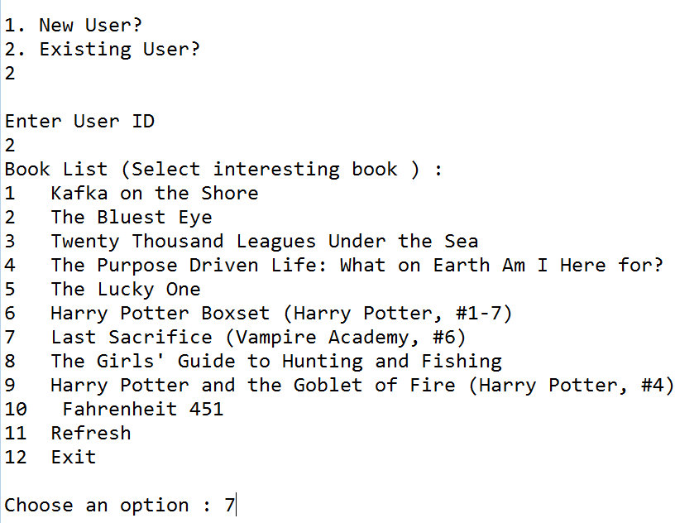

Slide 15
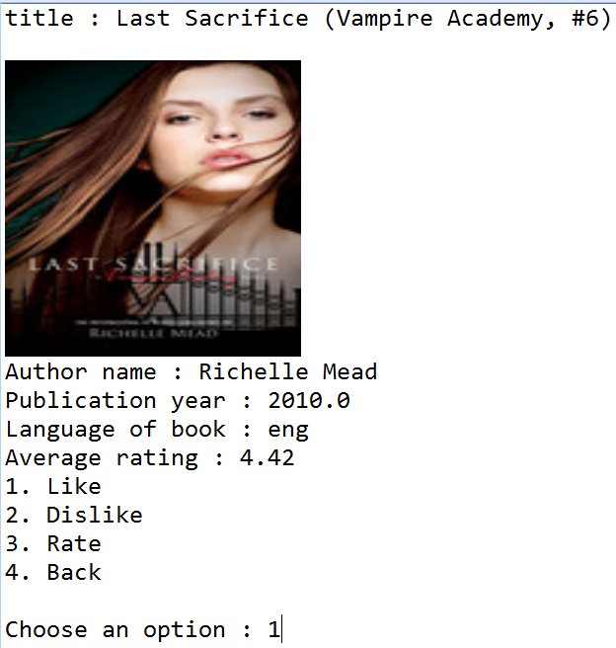

Slide 16
Thank You

