Slide 1

Exploratory Data Analysis
G2M Insight For Cab Investment Firm
31st OCT’23

Slide 2
Background –G2M(cab industry) case study
XYZ is a private equity firm in US. Due to remarkable growth in the Cab Industry in last few years and multiple key players in the market, it is planning for an investment in Cab industry.
Objective : Provide actionable insights to help XYZ firm in identifying the right company for making investment.
The analysis has been divided into four parts:
Data Understanding
Forecasting profit and number of rides for each cab type
Finding the most profitable Cab company
Recommendations for investment

Slide 3
Dataset
There are 4 datasets:
Cab_Data.csv – this file includes details of transaction for 2 cab
companies.
Customer_ID.csv – this is a mapping table that contains a unique
identifier which links the customer’s demographic details.
Transaction_ID.csv – this is a mapping table that contains transaction
to customer mapping and payment mode.
City.csv – this file contains list of US cities, their population and number
of cab users.

Slide 4
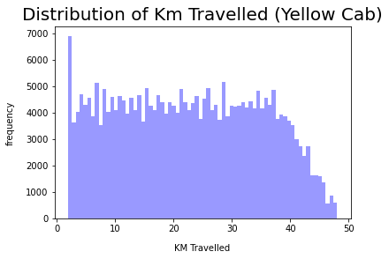
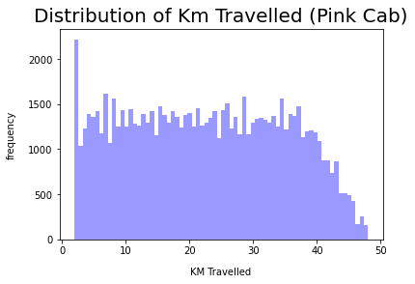
Distance Travelled (Yellow cab vs Pink cab)
For both the companies the distance travelled is between 2 to 48km

Slide 5
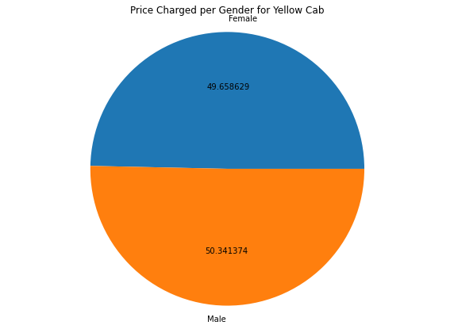
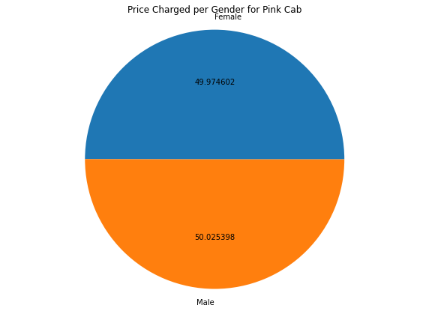
Price charged per Gender
Yellow Cab charge less from Female Customers whereas Pink Cab charges same for both Male and Female Customers

Slide 6
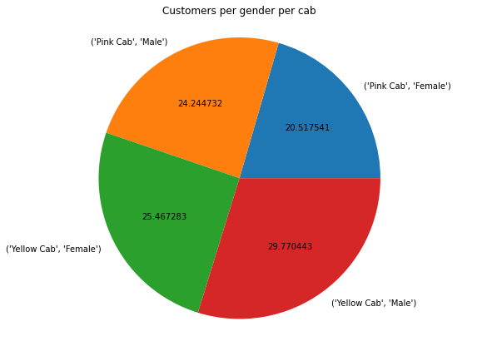
Customers per Gender
Females in Yellow cab are higher than males.

Slide 7
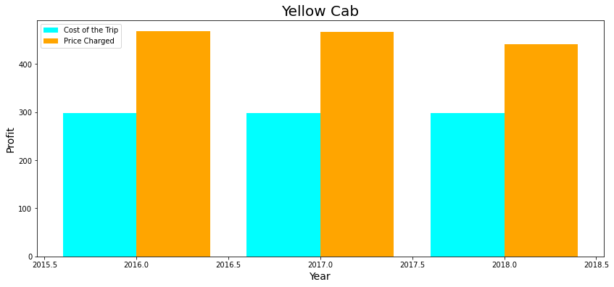
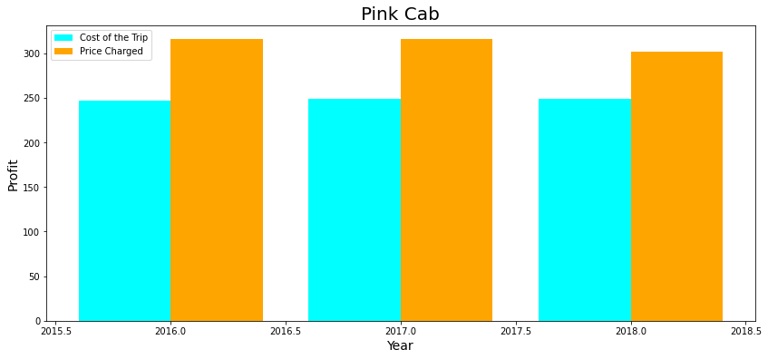
Profit Analysis
The Yellow cab has a higher Profit Margin compared to Pink cab

Slide 8
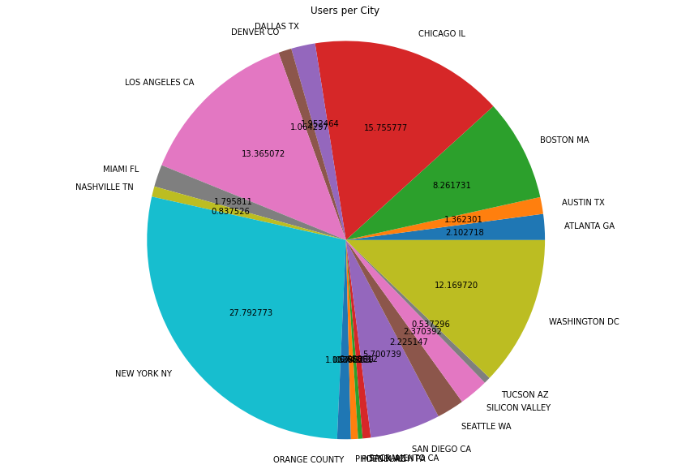
City Wise Cab Users Covered By Company

Slide 9
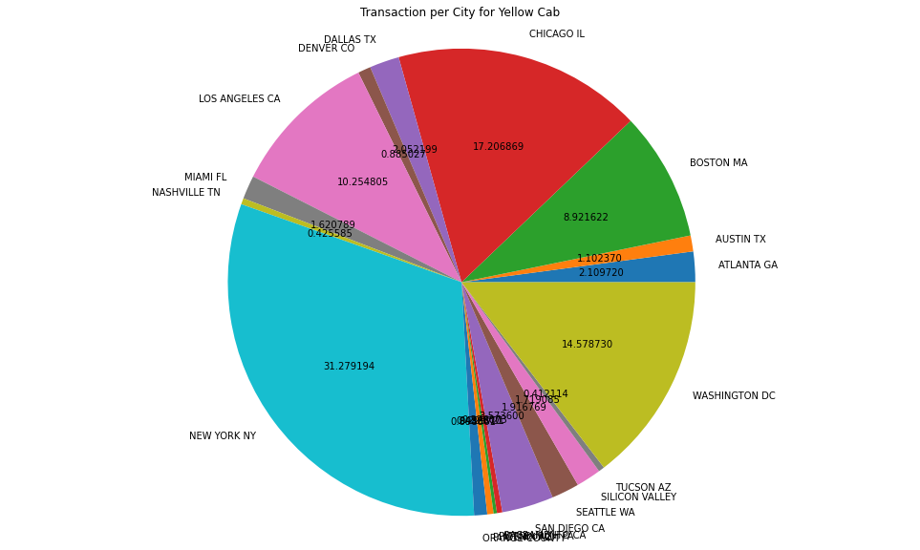
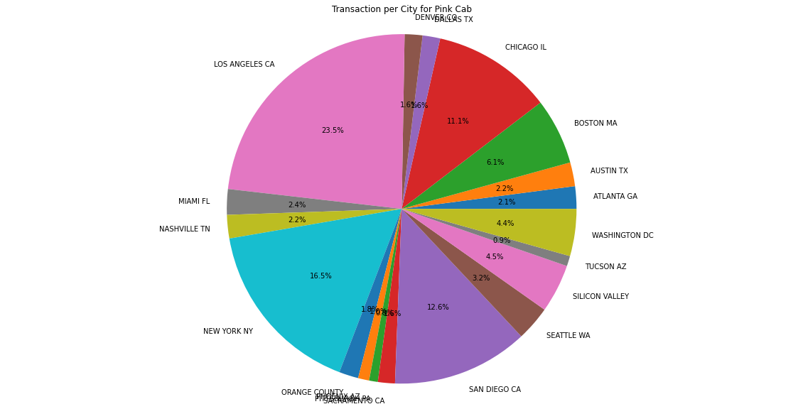
Transactions of Yellow and Pink cab city wise

Slide 10
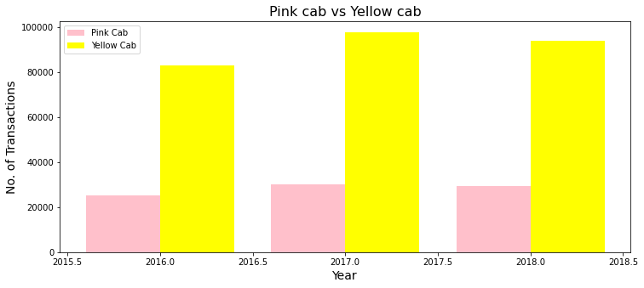
Yearly Transactions of Yellow vs Pink Cab
On yearly basis no. of transactions for Yellow cab is higher than Pink cab

Slide 11
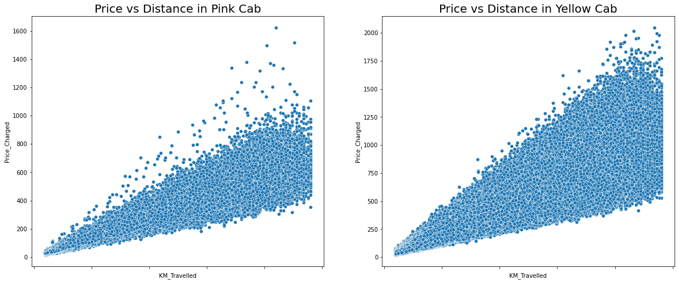
Price Vs Distance for Cab Companies

Slide 12
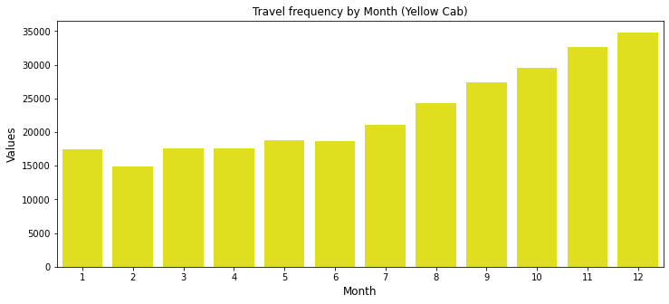
Travel Frequency By Month (Yellow cab)

Slide 13
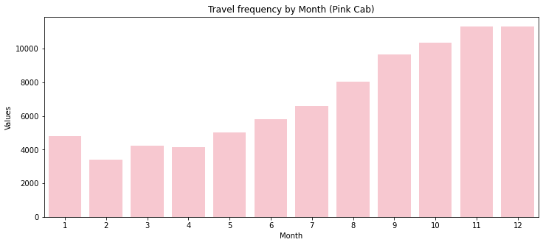
Travel Frequency By Month (Pink cab)

Slide 14
Recommendations
After evaluating both the companies, below are few points to take in consideration:
Yellow cab has more transactions than pink cab.
Pink cab charges the same for both genders but yellow cab charges less for females.
Transaction for Yellow Cab is highest in New York City(31%) and New York City has the highest Cab Users of 28% as per the previous slide and Transaction for Pink Cab is highest in Los Angeles City.
Pink cab’s profit is low in comparison to that of yellow cab
In the holiday season yellow cab had more transaction in comparison to pink cab.
On the basis of above point , we will recommend Yellow cab for investment.

Slide 15
Thank You

