Slide 1

Testing Web Forms in Selenium Java
By Mitali Mittal
Batch Code- 2023-11123
Enrollment No.- EBEON0124863730

Slide 2
Introduction to Selenium Java
Benefits of Selenium
Selenium is a powerful open-source tool for automating web browsers. It provides the capability to simulate user interactions with web applications and automate the testing of web forms. This saves time and improves the accuracy and completeness of testing. With Selenium, web forms can be tested in a consistent and repeatable manner.
Selenium Framework
Selenium supports multiple programming languages, including Java, making it versatile for different project requirements. Its rich set of APIs simplifies the automation of web form testing. Additionally, Selenium WebDriver, one of the core components, allows direct communication to the web browser, enabling precise control over form interactions.
Relevance in Java
Java is widely used in enterprise web application development. Selenium's seamless integration with Java allows for efficient testing of web forms in Java-based applications. Leveraging Java's object-oriented approach, test scripts can be organized and maintained, enhancing the scalability and maintainability of web form testing projects.

Slide 3
TestNG
TestNG is an automation testing framework
NG stands for “Next Generation”.
TestNG is inspired by JUnit which uses the annotations (@).
TestNG overcomes the disadvantages of JUnit and is designed to make end-to-end testing easy.
Using TestNG, you can generate a proper report, and you can easily come to know how many test cases are passed, failed, and skipped.
You can execute the failed test cases separately.
Maven
Maven is a build automation tool used primarily for Java projects.
Dependency Management: Automatically downloads and manages libraries and dependencies.
Build Automation: Provides a uniform build system.
Project Structure: Standardizes project layout.
Plugins: Extensible through plugins for various tasks (e.g., testing, deployment).
Pom.xml: Uses Project Object Model (POM) file to define project configuration.

Slide 4
Locators and Interactions
Demonstration of Interactions
Importance of Locators
Interactions with Selenium
Demonstrating Selenium's interaction capabilities through code examples in Java will illustrate the simplicity of performing form actions. This can include showcasing input field validations, submission of forms, and validation of form processing, reinforcing the proficiency of Selenium in testing web forms.
Locators are essential for identifying and accessing web elements within a web page. Selenium provides various locator strategies such as ID, Name, XPath, CSS selector, etc. This aids in accurately targeting form elements for interaction, ensuring thorough testing of web forms in Java applications.
Selenium empowers testers to simulate diverse user interactions with web forms, including inputting text, selecting options, clicking buttons, and handling dropdowns. By utilizing these interaction capabilities in Java, comprehensive form behavior can be verified, promoting robustness and reliability in web form testing.

Slide 5
Handling Forms and Input Validations
Process of Handling Forms
Testing web forms involves handling various form elements, such as text fields, checkboxes, radio buttons, and file uploads. Selenium in Java facilitates the systematic addressing of these components, enabling comprehensive testing of form functionalities and behaviors, including form submissions and redirections.
Challenges and Solutions
Web forms often entail input validations to ensure data accuracy and integrity. Selenium's Java capabilities can address these validations by simulating input scenarios, handling validation messages, and verifying error states. Understanding and addressing common form validation challenges will enhance the effectiveness of testing web forms.
Specific Solutions with Selenium
Highlighting specific code solutions in Java using Selenium to address common form validation scenarios will provide practical insights into overcoming challenges. This can include handling dynamic input validations, capturing validation messages, and verifying form behavior under different input scenarios.

Slide 6
Data-Driven Testing
Concept of Data-Driven Testing
Data-driven testing allows executing test scripts with varying input data sets, enhancing test coverage and accuracy. In the context of web form testing, data-driven approaches using Selenium in Java can validate form behavior across different data permutations, effectively uncovering potential issues and edge cases.
Implementation using Selenium
Demonstrating the implementation of data-driven testing in Java with Selenium will showcase the flexibility and scalability it offers for testing web forms. This can include parameterizing test data, executing tests with varied data sets, and evaluating form behavior, exemplifying the effectiveness of data-driven testing.
Application in Web Form Testing
Applying data-driven testing to web form scenarios can involve populating form fields with different data sets, including valid and invalid inputs, special characters, and boundary values. Selenium's data handling capabilities in Java enable the systematic execution of such data-driven tests to validate form behavior comprehensively.

Slide 7
Best Practices and Tips
Essential Best Practices
Adhering to best practices such as maintaining a modular and reusable test framework, using descriptive and meaningful locators, and implementing robust error handling enhances the efficiency and maintainability of web form testing in Java with Selenium. These practices promote code quality and resilience in form test automation.
Optimization and Efficiency
Optimizing test execution speed, parallel test execution, and selective test data generation can significantly enhance the efficiency of web form testing using Selenium in Java. Additionally, leveraging design patterns, keyword-driven testing, and Page Object Model can streamline form test automation, making it more manageable and scalable.
Effective Reporting and Logging
Implementing comprehensive reporting and logging mechanisms in Selenium Java tests enables clear visibility into form test execution and results. Customizing test reports, capturing screenshots on failures, and logging detailed test steps enhance traceability and facilitate effective debugging and analysis for web form testing.

Slide 8
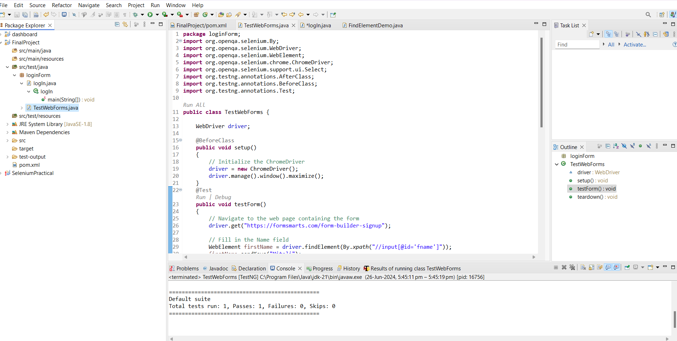

Slide 9
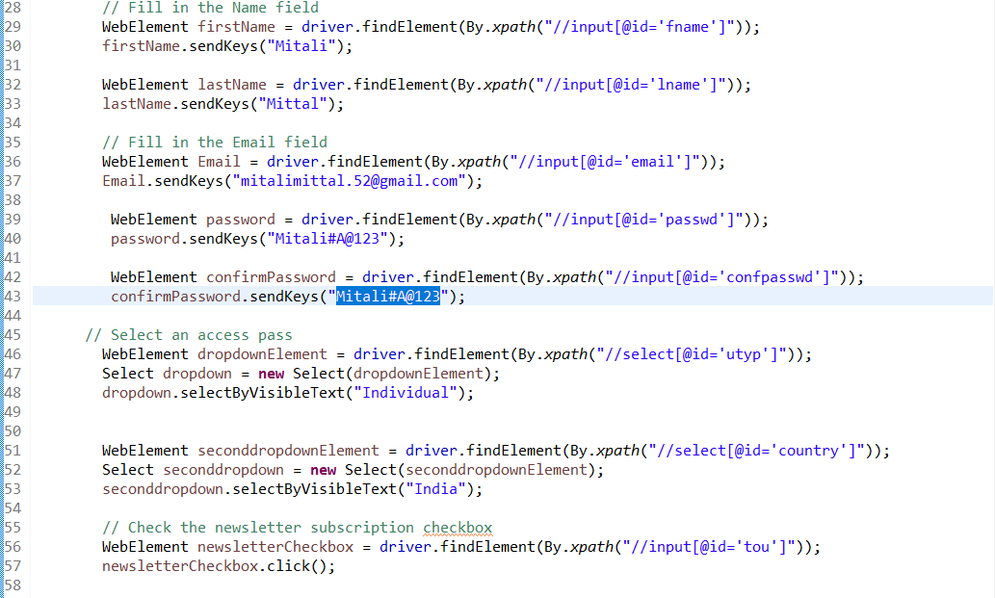
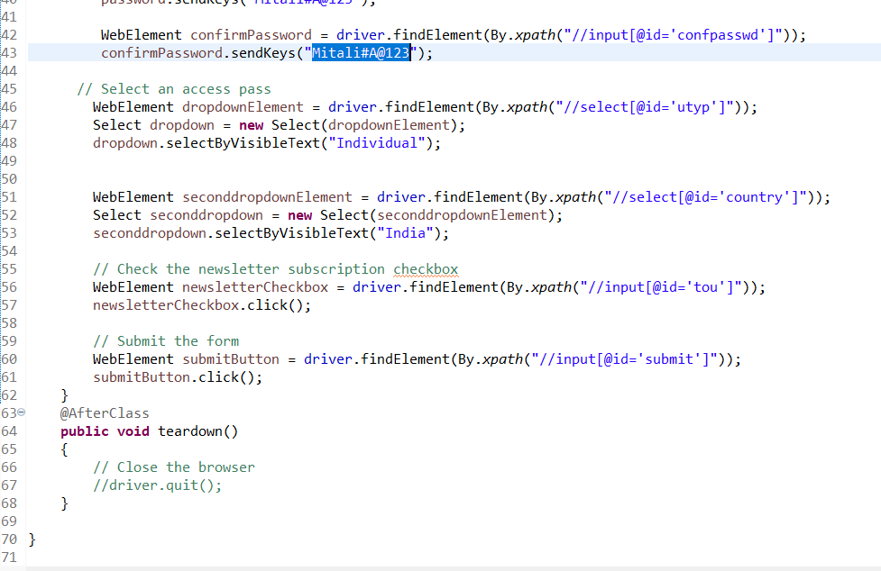

Slide 10
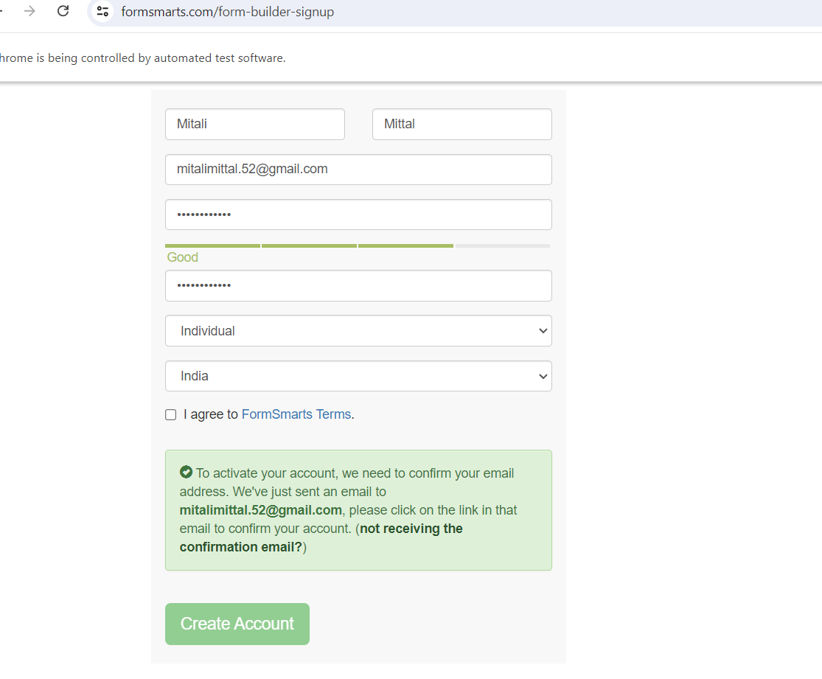
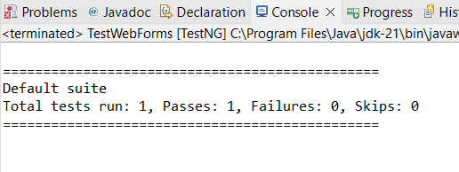
Output

Slide 11
Conclusion
To conclude, we performed an end to end testing of the formsmarts website where we started from registering the user and then Sign-in in the website using that user and then verifying the create account summary.
Initialize the browser driver (e.g., ChromeDriver).
Navigate to the form URL.
Locate and interact with form fields with test data. Fill in the form fields with test data.
Submit the form.
Result Verification
Ensure form submission success.
Check for specific elements or messages on the resulting page

Slide 12
THANK YOU

