Slide 1
Extracting Mentions of Interacting Drugs/Substances, interaction triggers and specific interactions at sentence level.
Student: Mitali Kulkarni, Darshan Prakash

Slide 2
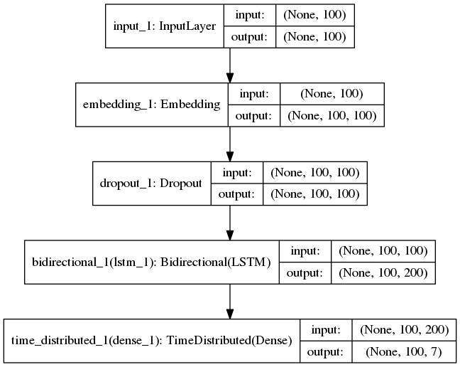
Project Method
BIO Tagging
Word2Vec embedding
Data Statistics
Input Files: 22
Concepts to be
extracted: 3
No. of Sentences: 964
No. of Unique Words: 2101
No. of Classification
tags used in model: 7
K Fold Cross Validation
Notes:
Parse XML file to get sentence and mentions from the sentences.
For every sentence we do the BIO tagging for the concepts based on the annotation provided in the training files.
List of words for every sentence is given as input to the Word2Vec model.
The output is the dictionary of all words with their embedding weight vectors. The words and tags are indexed for the input to the model. We use KFold for spliting the data. We used both number of folds as 5 and 10 and we will explain the results later. Our input is of shape 100 as length of our input. We pass this input to Embedding layer. The Embedding layer has input_dim as the unique words, output_dim is 100, embedding weight matrix and the input length is 100. So every word has embedding vector of length 100. The first argument to this layer definition is the number of rows of our embedding layer = unique_words (2101) the second is the size of each word’s embedding vector (the columns) = 100. We are also using dropout of 0.1 to avoid overfitting. Used BiLSTM. Then used an output dense layer with an activation function of softmax and we use neurons as 7 as per our tags.

Slide 3
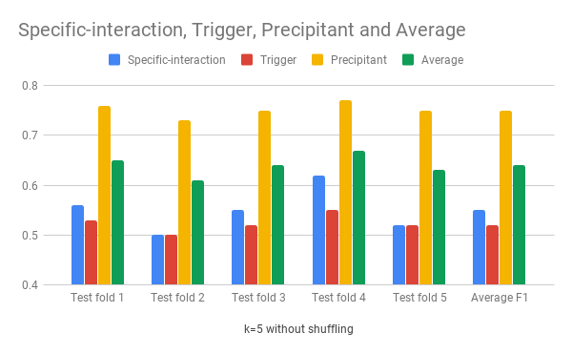
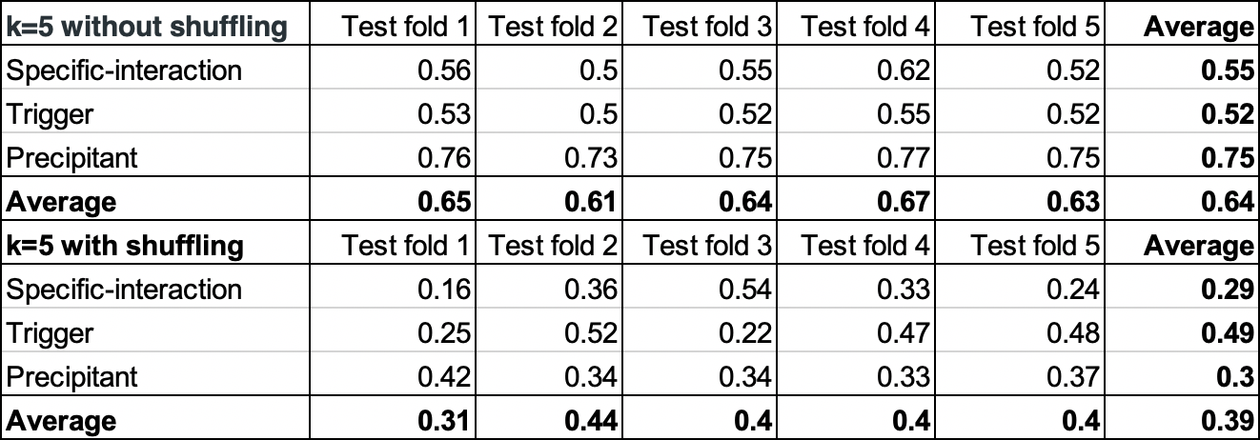
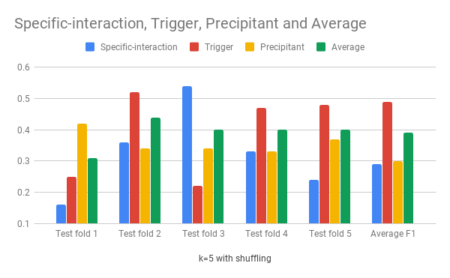
Results and Learnings

