Slide 1
Topic: Extract Mentions of Interacting Drugs/Substances, interaction triggers and specific interactions at sentence level. This is similar to many NLP named entity recognition (NER) evaluations.
Approach:
Model to use: Bidirectional LSTM
Project Plan:
Phase 1:
Study the general structure of the training files
Parse the training file
Create list of words, pos and BIO tag.
Create dictionary and create list of list indexing of words with padding
Set matrix for training and test data to fit BiLSTM model
Test the model with varying the epochs, testing size and validation size
Phase 2:
Parse the file to identify the PK, PD, unspecified interaction tags
Fit the model to identify the PK, PD, unspecified interactions
Increase the accuracy and minimize loss for recognition of interactions
Contribution:
Darshan: parsing the xml files to generate the list of tuples of pos and BIO tag
Mitali: word index, tag index, model generation
GitHubLink: https://github.com/MitaliK/DDI
Notes:
Slide 1: what your project is
how you are doing it
who is doing what

Slide 2
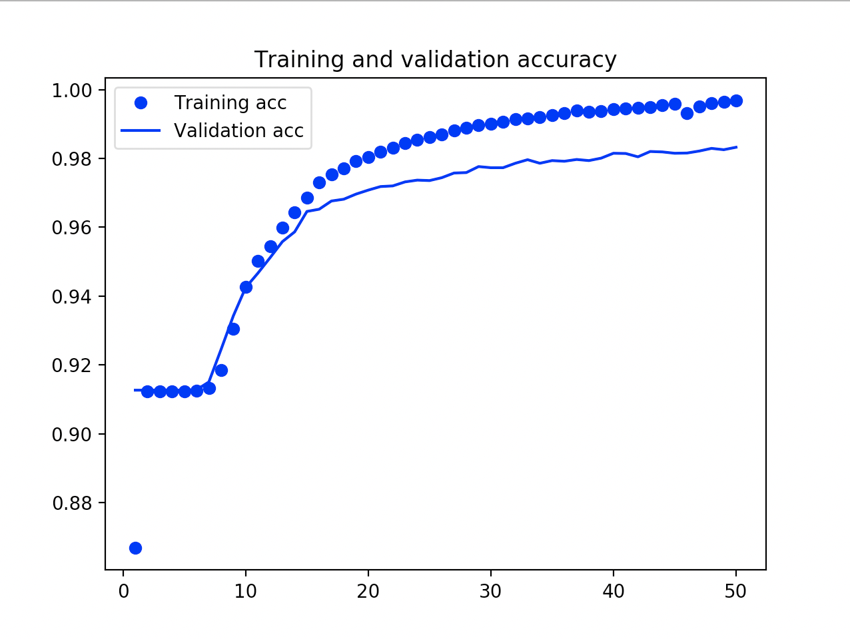
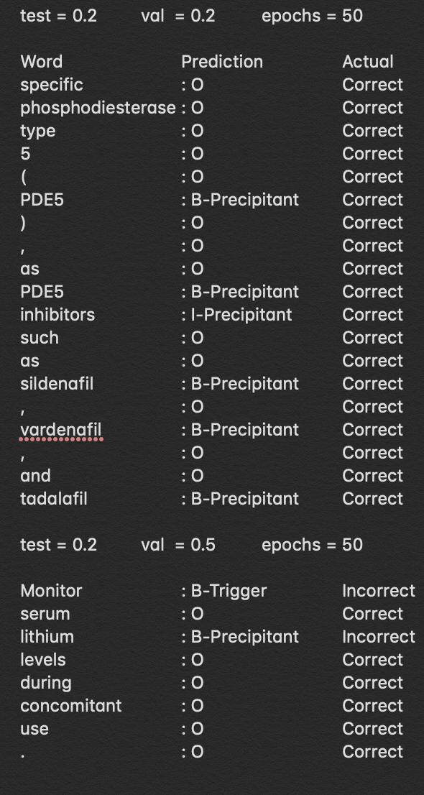
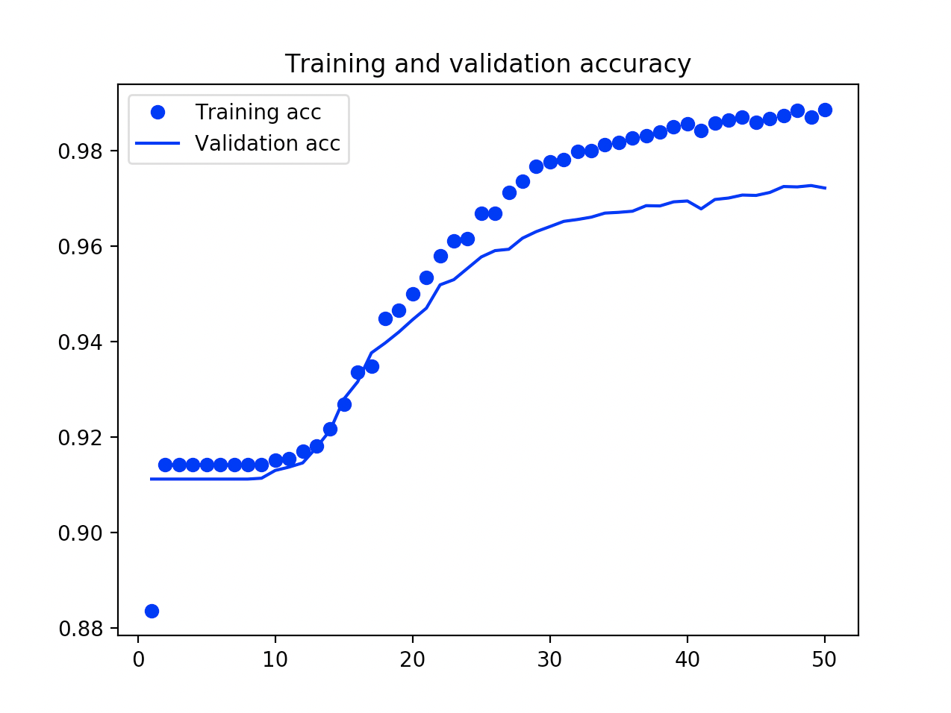
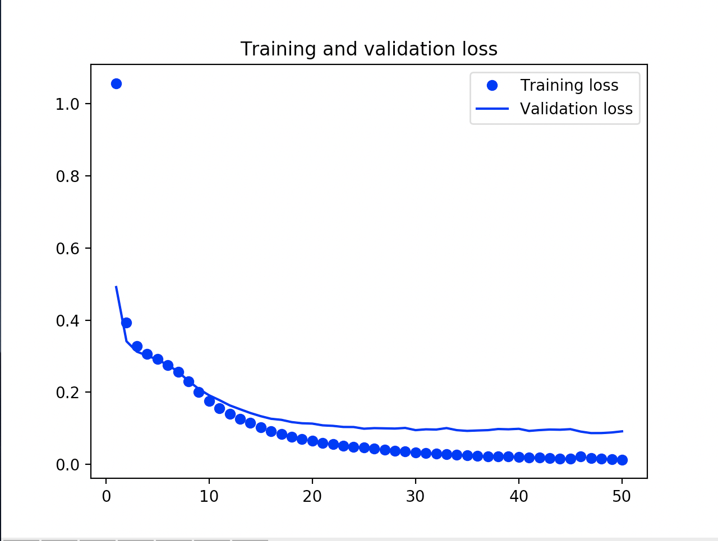
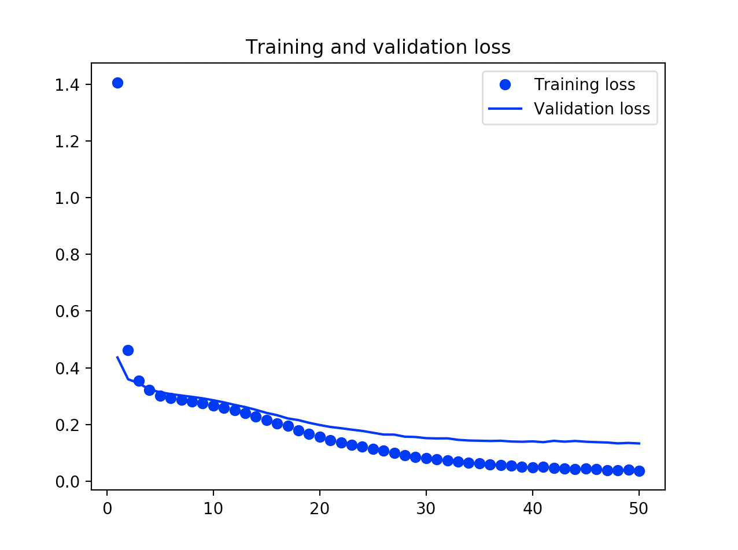
Test = 0.2 Val = 0.2 Epoch = 50
Test = 0.2 Val = 0.5 Epoch = 50
Notes:
Slide 2: Progress report (what has been done so far)

