Slide 1
EXPOSYS DATA LABS INTERNSHIP PROJECT ON SOFTWARE DEVELOPMENT
By : Mitali dilip thorat
branch : B.E. Computer engineering
College : Marathwada mitra mandal’s institute of technology, lohgaon

Slide 2
Abstract
Let us consider a case where the user sends a text or file from his phone to his friend.
The risk of the data being accessed by a third party is high when the data enters the cloud platform.
Hence a new method to secure the messages/file is to be done either by building a new algorithm or by modifying the existing one which can give more security and consume less time.
The identity of the user must also be verified by using the authentication, verification and validation methodologies.

Slide 3
Table of contents
Introduction
Existing Method
Proposed method with Architecture
Methodology
Implementation
Conclusion

Slide 4
introduction
Cyber security and privacy breaches is a growing concern across the world today.
If data gets into the wrong hands and gets alterted before it reaches the right destination a can have tremendous effects on organizations and people.
What if I told you there is a way to keep your privacy and at the same time mind data?
One of the ways this can be achieved is by using cryptography or in simple terms encryption and decryption of data.
In this project, we will change an existing algorithm to secure data send by the user and also verfify the identity of the other user.
We will use python and ML to perform the task.

Slide 5
Existing method
Homomorphic encryption is a form of encryption that permits users to perform computations on its encrypted data without first decrypting it.
Homomorphic encryption includes multiple types of encryption schemes that can perform different classes of computations over encryted data.
Some types of homomorphic encryption are partially homomorphic ,levelled fully homomorphic and fully homomorphic encryption.
In the project we will we using the partially homomorphic encryption (phe).

Slide 6
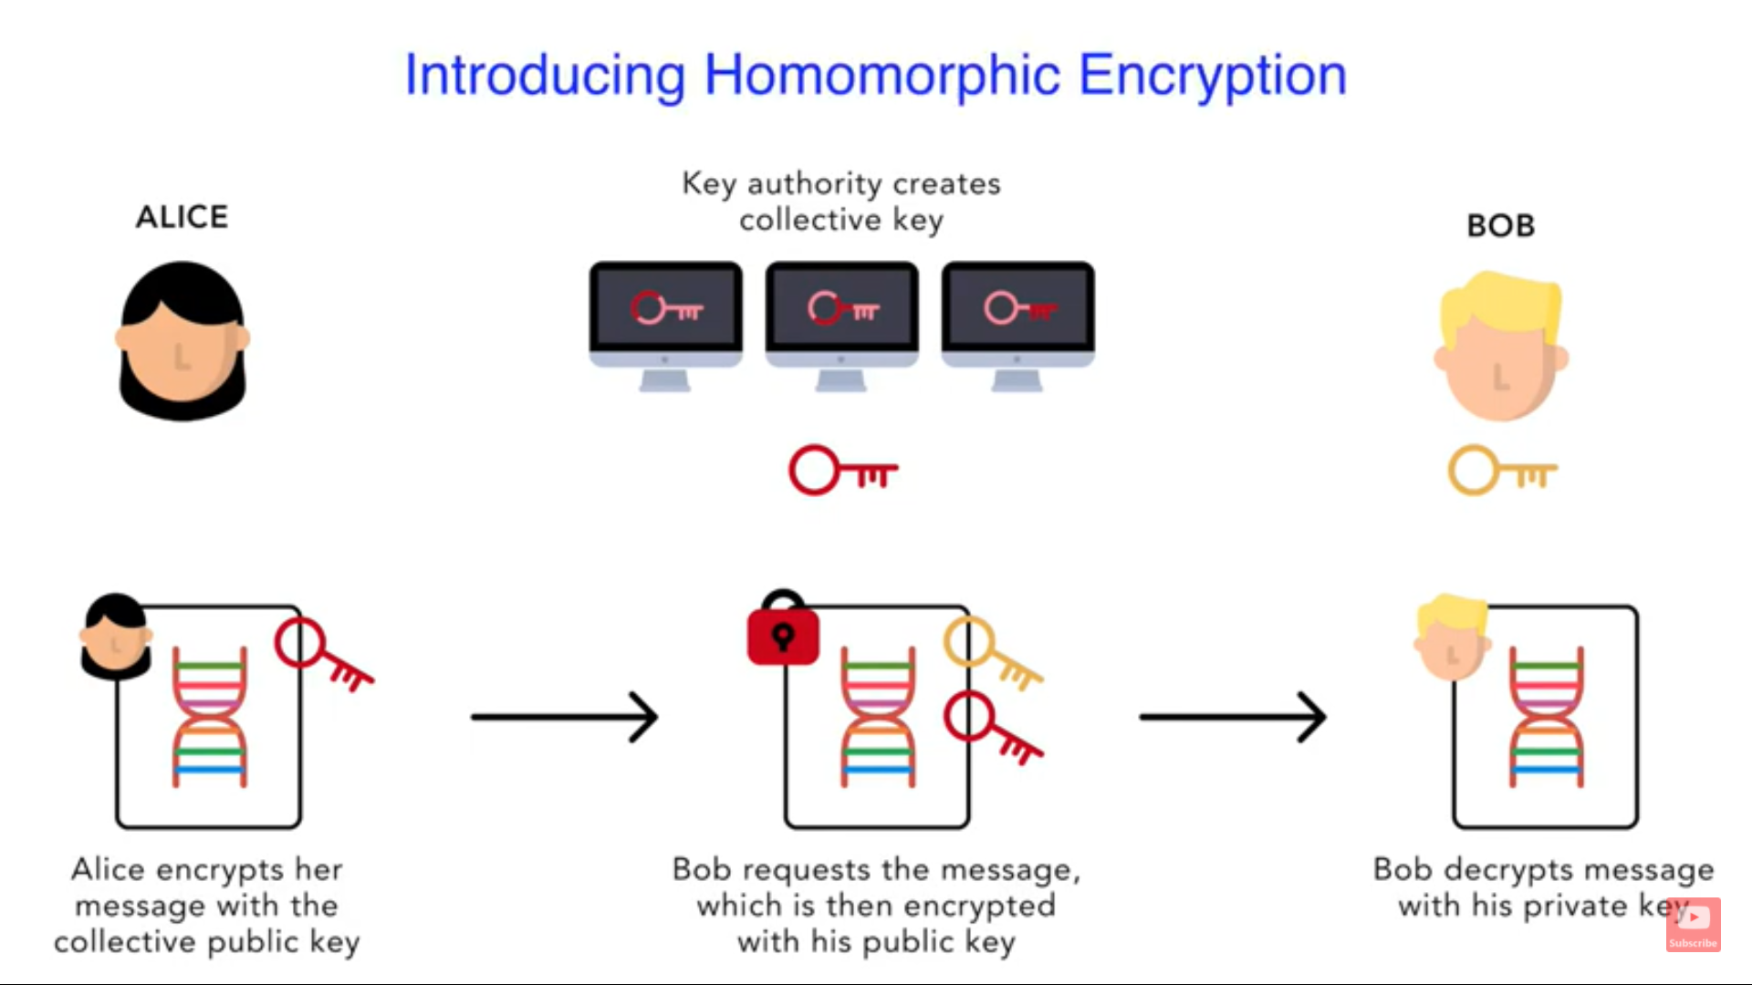
Proposed method with Architecture

Slide 7
Methodology
Customer generates encrypted data using a public key.
Customer then sends this encrypted data to the Company along with the public key.
The data send is in encrypted format and is hidden from the company.
The company takes its ML model and applies it against the encrypted data.
Which will produce the required result that is also in the encrypted form.

Slide 8
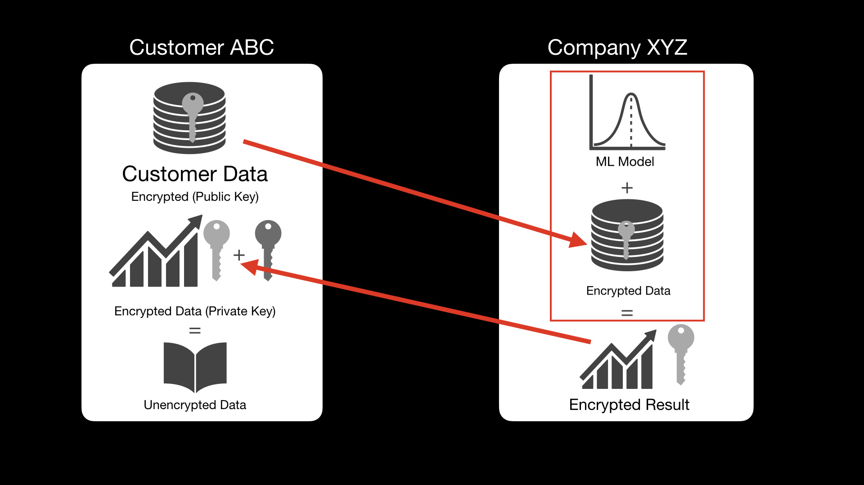
This encrypted result is send to the customer along with the previously received public key.
The customer then matches this public key with his own public key.
If both the keys match the customer uses his private Key to decrypt the data and receive the result.

Slide 9
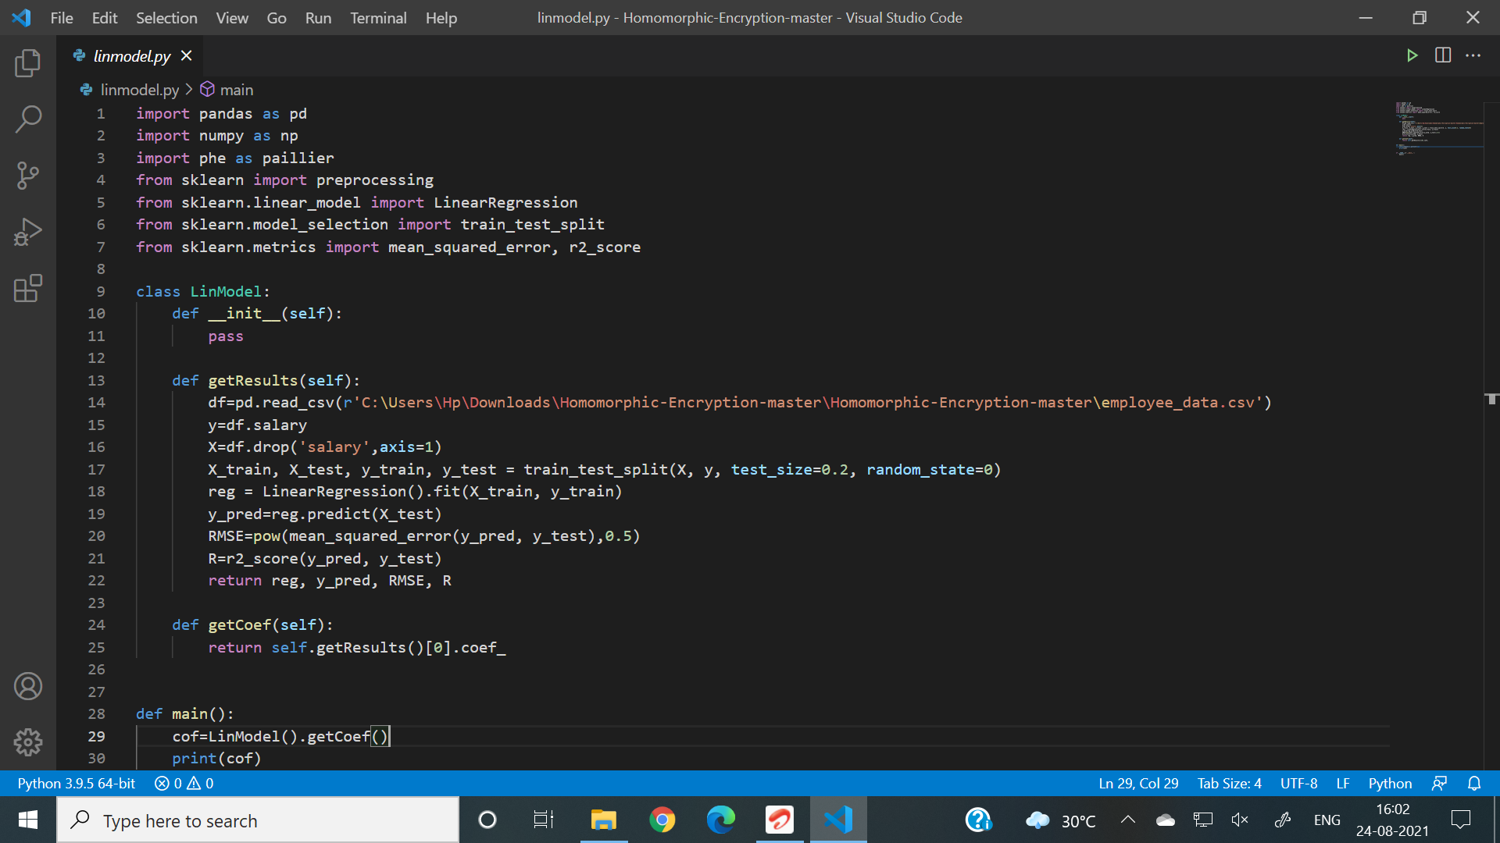

Implementation
We are going to build a project where we predict someones salary based on their age,healthy eating,active lifestyle and gender.
Firstly we create a file called linmodel.py , this will be the company’s ML model , in this model we will read data from employee_data.csv file.
Linmodel.py
Employee_data.csv

Slide 10
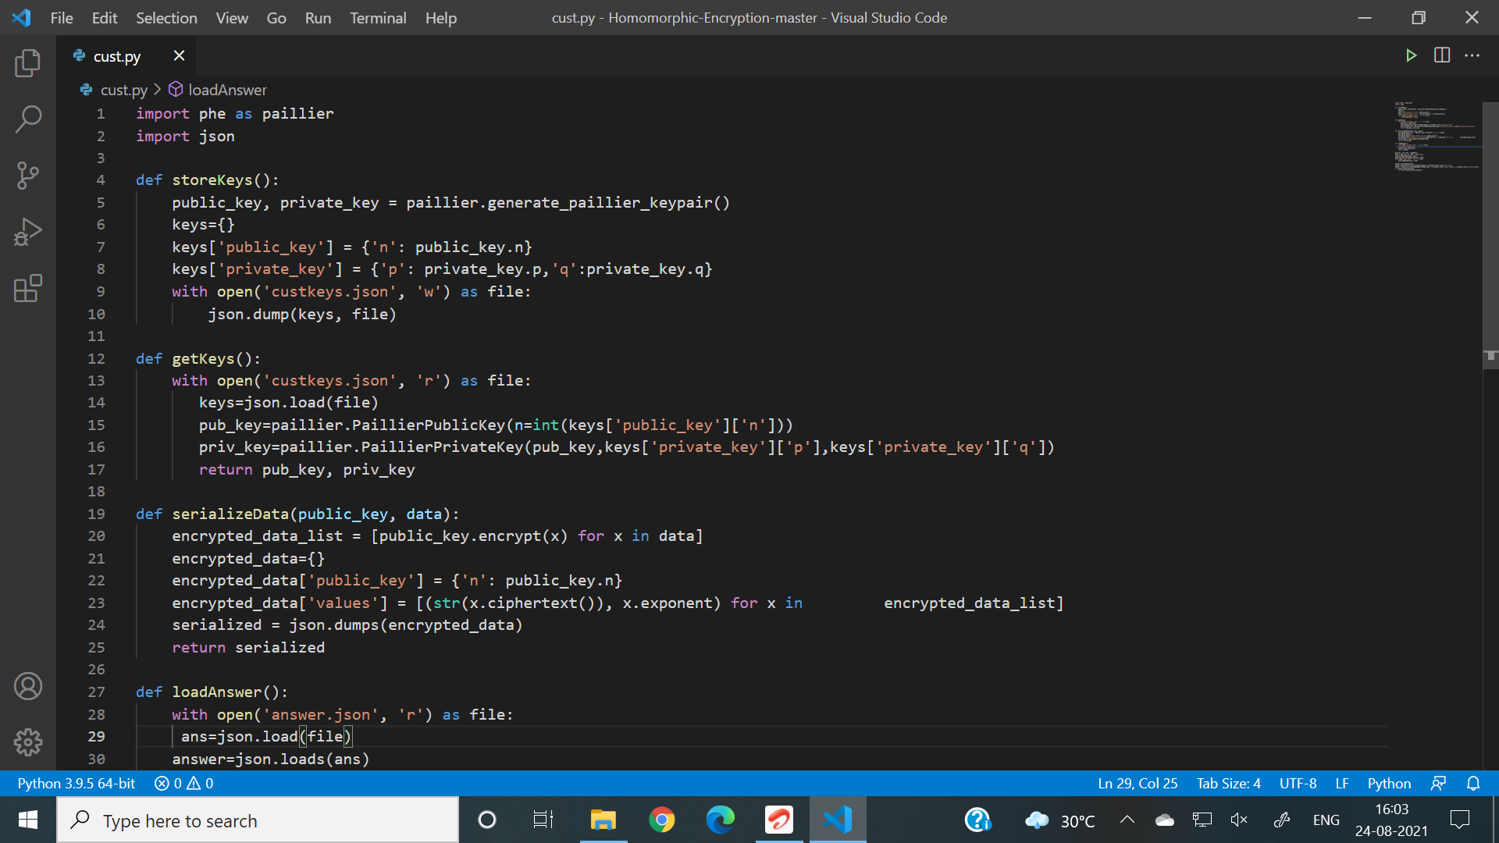
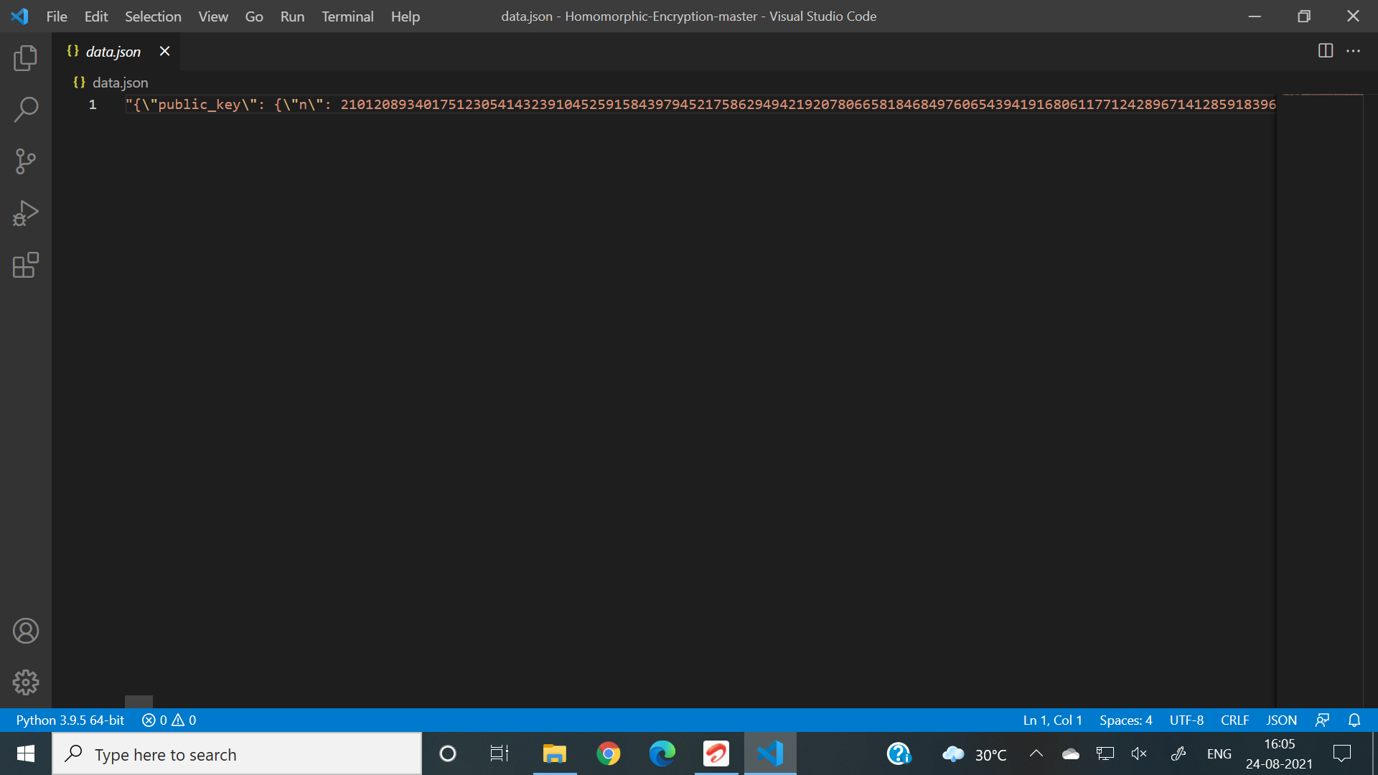
Then we create a cust.py file
In this file we create an instance of public and private keys, store them in custkeys.json file, then send the encrypted data along with the public key , stored in a file called data.json to the company.
Cust.py
Data.json

Slide 11
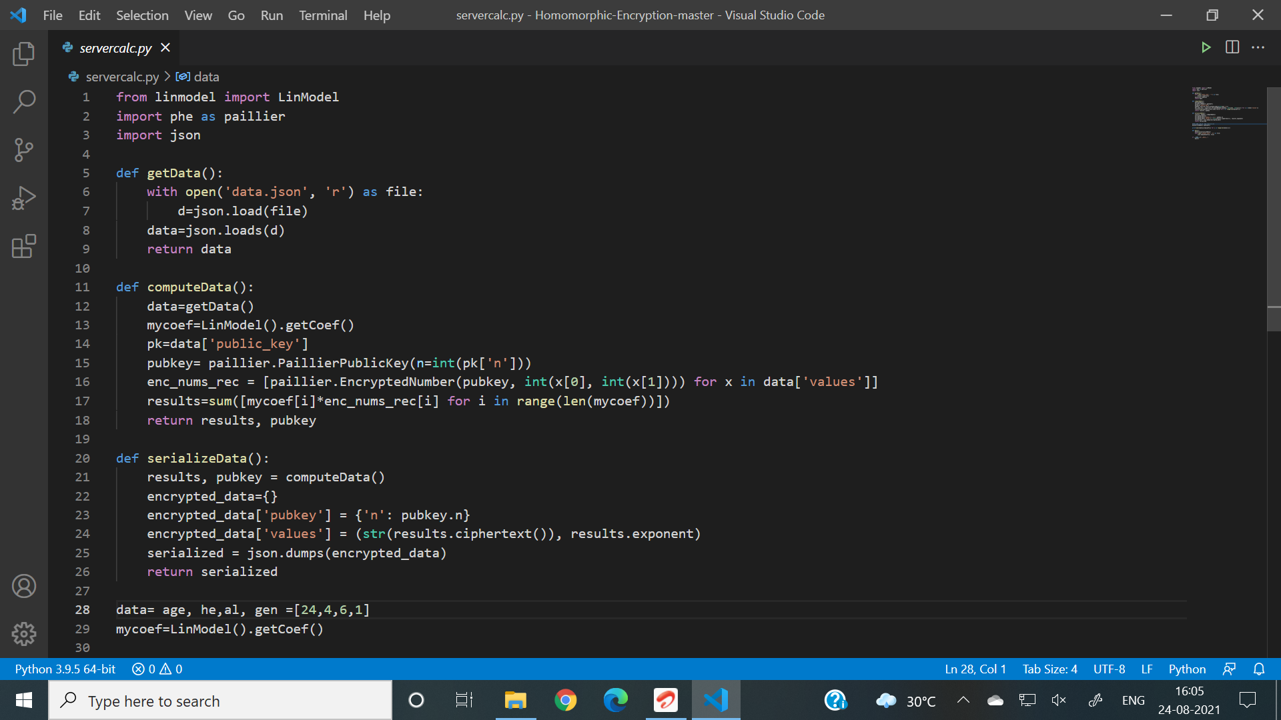
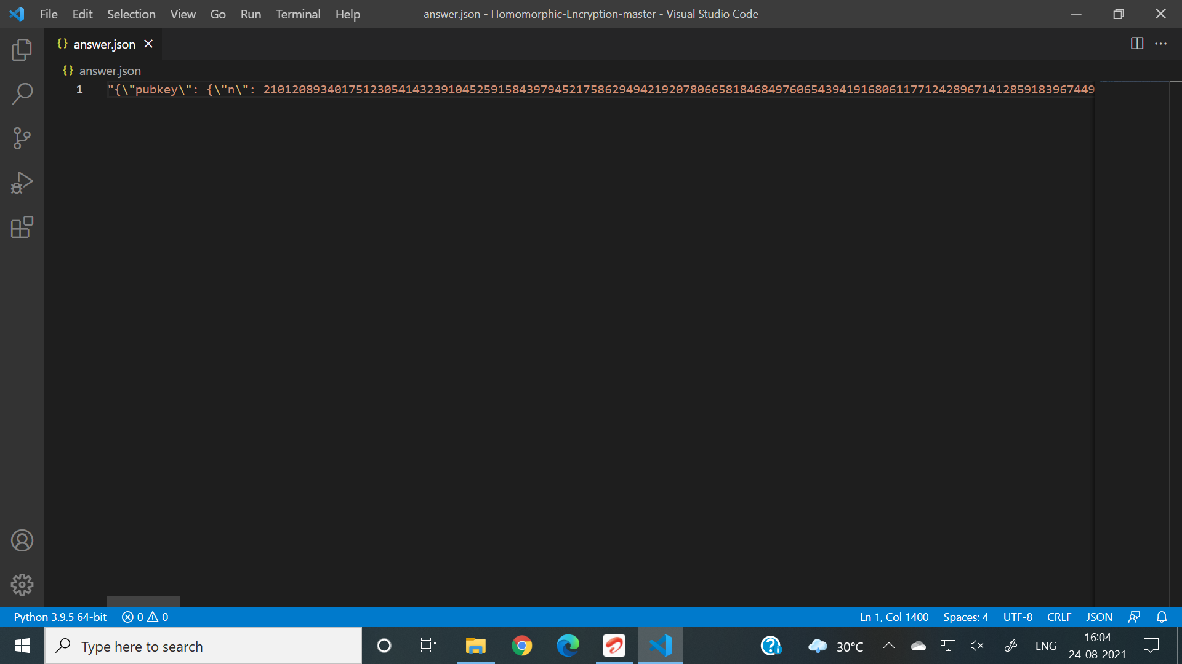
Now we create a file called servercalc.py.
This file gets data from data.json file send by the customer, performs calculations using the data from customer and the companies ML model, generates a encrypted result, stores it in a answer.json file,and sends it to the customer along with the previously send public key.
Severcalc.py
Answer.json

Slide 12
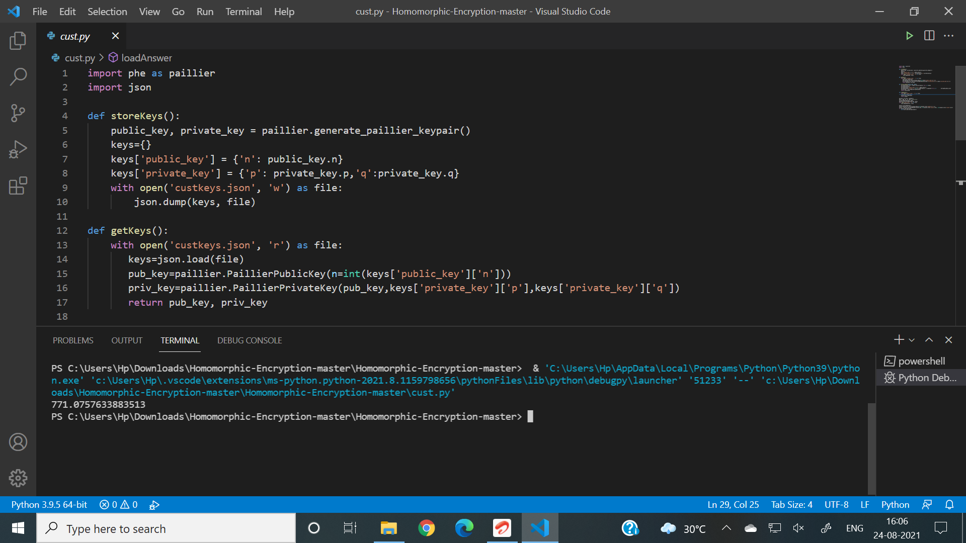
Now the customer opens the cust.py file, loads the answer.json file send by the company, matches the public key send by the company with its own public key, if matched decrypts the data using their private key and gets the result.
771.0757633883513 is the calculated salary

Slide 13
Conclusion
The customer was successfully able to send data to company in encrypted form.
The company was able to apply their machine learning model against the encrypted data send by the customer and produce the encrypted result.
Since both the public keys were identical therefore the customer could successfully get the produced result.
Therefore , in this project, we were able to change an existing algorithm to secure data send by the user and also verify the identity of the other user.
We were able to implement python and ML functions effectively.

