Slide 1
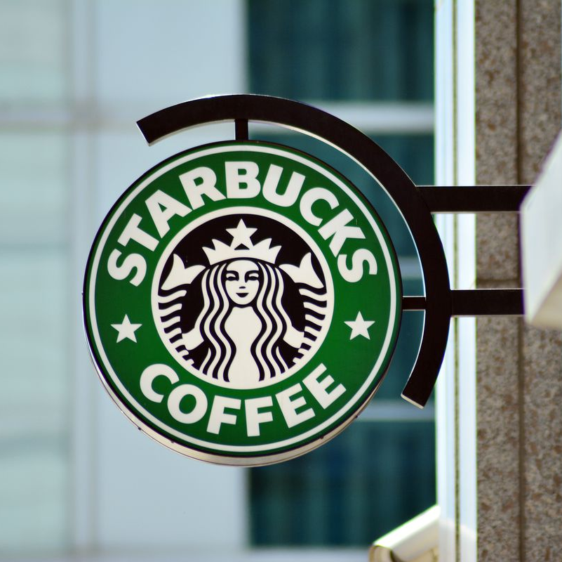
Starbucks Offer Predictions
Group Number: 13
Group members:
Rina Odedara 0771298
Vaibhavi Jariwala 0771600
Mitanshi Patel 0775260
Course: DAB 402 Capstone Project
Submitted to: Prof. Abiodun Sodiq Shofoluwe

Slide 2

Outline
Introduction
Business Problem
Challenges
Tools
Ethical Principles
Visualization
Models
Website

Slide 3
Introduction
In today's era, Machine learning and AI has become an essential part of business.
Marketing plays a very important role in every business of the world. So various marketing strategies are being applied, so company can grow and expand their business in different segments.
It generates more revenue by attracting more people.

Slide 4
Business Problem
This project of Starbuck's will be based on the offers and discounts for the new customers and are everyday visitors of the coffee shop.
We will be dealing through that how the single casual customer would be transformed into our regular and the loyal customer of Starbuck's with various offerings, deals, discounts, points to maintain its integrity in market with other competitors.

Slide 5
Data Cleaning
We have three different .json files named portfolio.json, transcript.json, profile.json which we converted into .csv files and later merged into one dataset.
Dropped null values from Gender, income and age column.
When merged dataset the values was approx. to100000 but when applied NaN many rows were removed.
Our Dataset consists of 66,502 and 21 columns.
We separated Transaction column from the event column.

Slide 6
Challenges
Stuck in how to find the data set related to specific marketing strategy and moreover, it was difficult to understand the business operation, current business model and all for us.
Time was consumed more rather than expected in searching and learning that how new business model for Starbuck’s should be implemented.

Slide 7
Challenges
We also faced difficulty in combining our target variable into one column as they were in three different columns.
The accuracy we got for every model was 1 as the data was overfitting for the models.

Slide 8

Goal
Our project goal is to analyze and predict the offers and to be highest accepted by the people which can help them to build good marketing strategies and increase the profit of the Starbucks.

Slide 9
Tools/Technology
Python
Machine Learning
Tableau
Jupiter Notebook
Flask to develop web application

Slide 10
Ethical Principles
Clarity : The goal of using this dataset is very much clear. And it doesn’t cause any harm to nobody.
Consent : We found dataset from Kaggle, which is an independent and open source for getting datasets. Our main purpose is to use this dataset for analysis on Starbucks offer and not against the company.
Control : The data obtained from the source is in their control. We are ready to accept every terms and conditions if they state any.
Consequences : In our data set there is no personal information about any user which can harm or expose any user identity.
Consistency : We would maintain the trust of the source and won’t circulate data anywhere without its permission if it becomes private anytime.

Slide 11
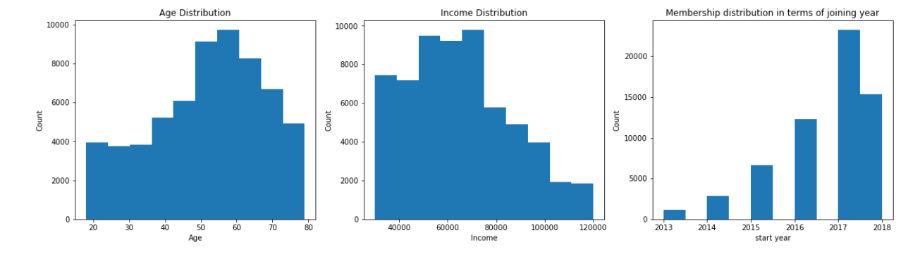
Visualization
From the Age distribution plot, we can say that highest group of people coming in Starbuck belongs to age group of 50 to 70 approximately, with the income between 50K to 80K.

Slide 12
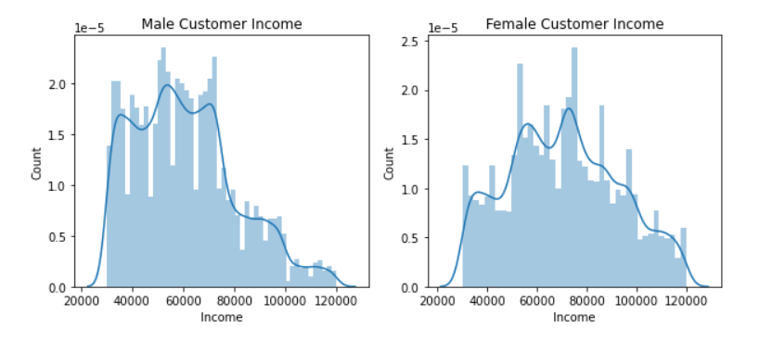
Above plots depicts the income for male and female, the count of male customers in low-income is slightly high whereas the female customers have high income.

Slide 13
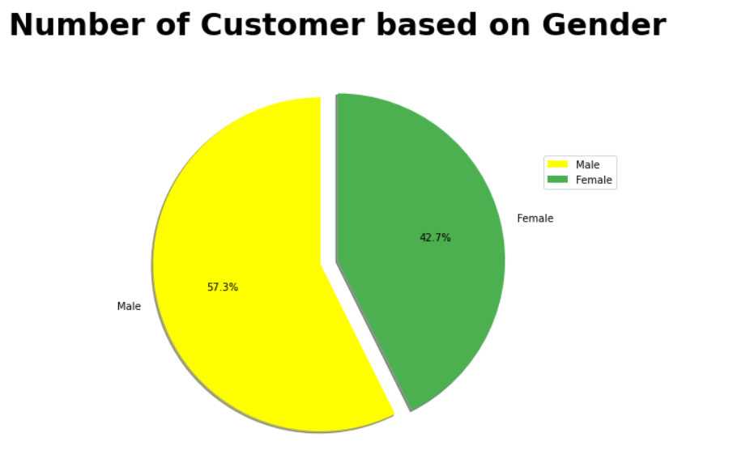
From above pie chart,we can say that mostly people coming in Starbucks are men. However, the difference between men and women is not too huge.

Slide 14
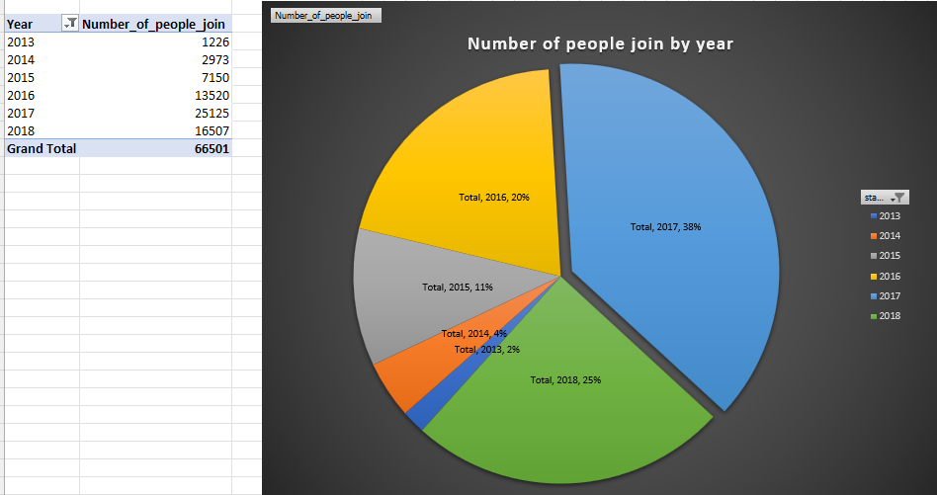
Above pie chart represent the number of people join by the year from 2013 to 2018

Slide 15
Models for OFFERS as target variable
~ The accuracy for Random Forest Model for Training Data is 0.89 and for test data is 0.89
~ The accuracy for Logistic Regression for training data is 0.85 and for test data is 0.85
~ The accuracy for K-Nearest Neighbors is 0.85
~ The accuracy for XGBoost is 0.89
Models for OFFER SUCCESSFUL as target variable
~ The accuracy for Random Forest Model for Training Data is 0.90 and for test data is 0.90
~ The accuracy for Logistic Regression for training data is 0.85 and for test data is 0.85
~ The accuracy for K-Nearest Neighbors is 0.86
~ The accuracy for XGBoost is 0.89

Slide 16
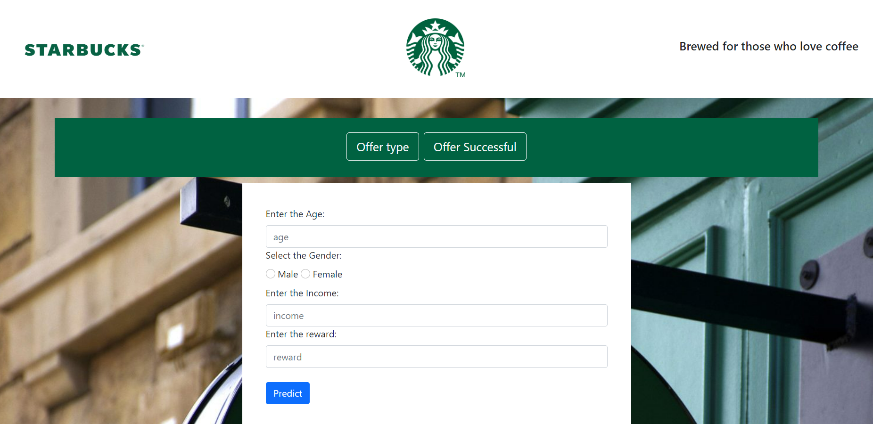
Starbucks Offer Prediction web-site design(Offer Type)

Slide 17
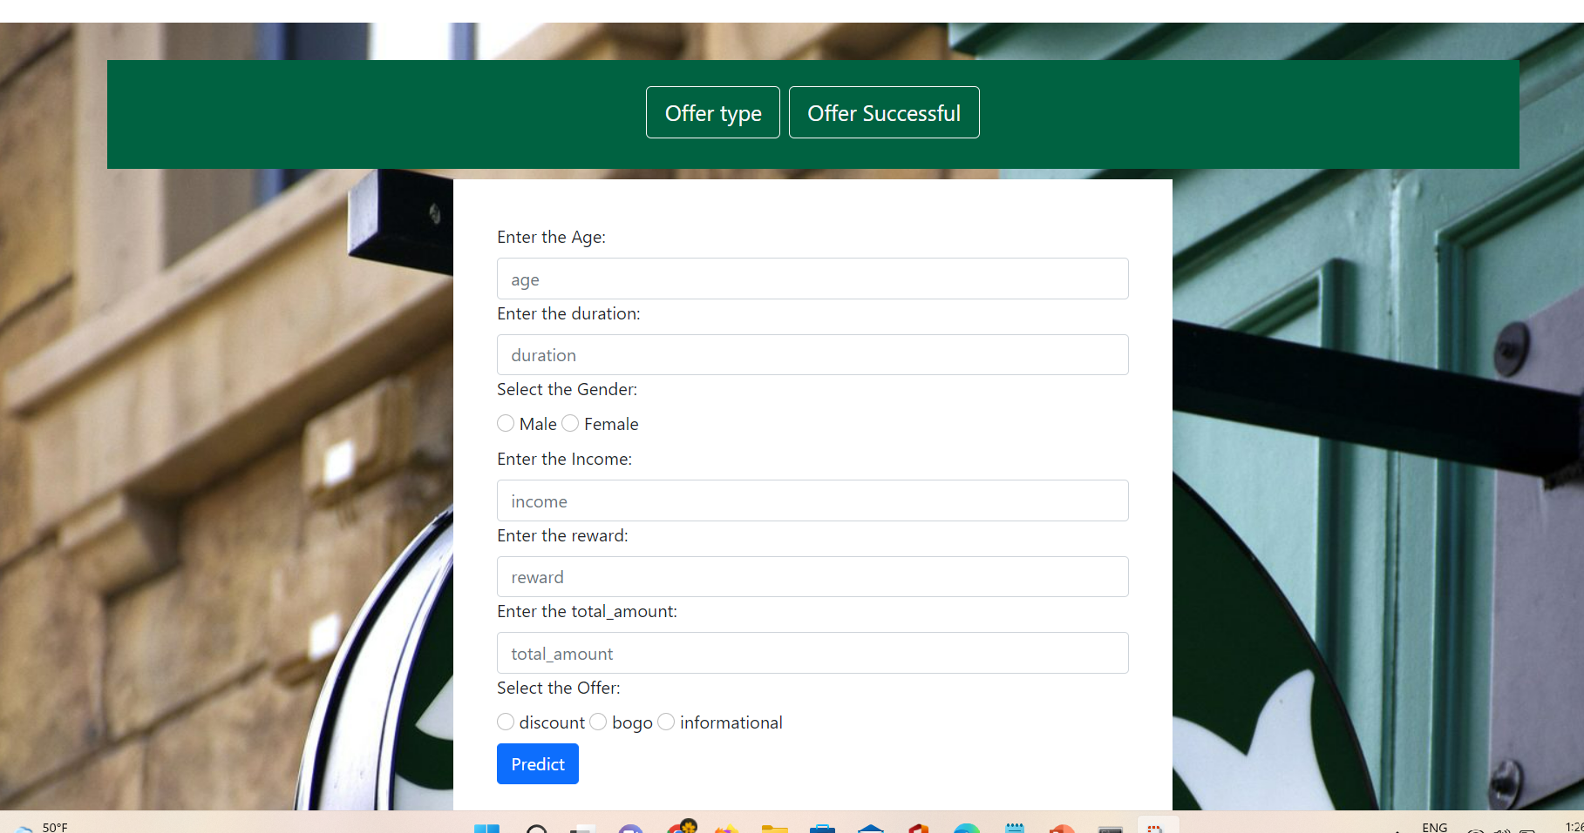
Starbucks Offer Prediction web-site design (offer successful)

Slide 18
Conclusion
We explored the data of Starbuck's customers, preprocessed it and visualized it for better understanding.
Then, We performed various machine learning models that can improve the performance of the models.
After getting good accuracy ,we built web application using flask that predicts the suitable offer which is given to the customers (using both Offer Type and Offer Successful as target variable).

Slide 19
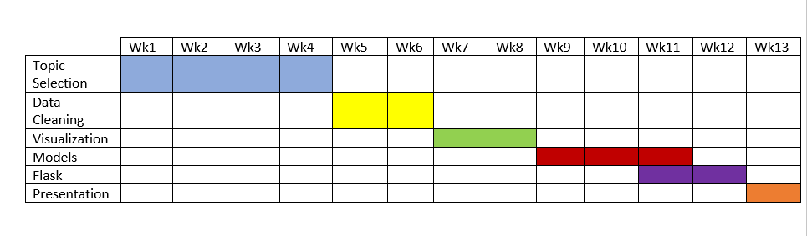
Activity Timeline

Slide 20
Reference
https://customerservice.starbucks.com
https://www.geeksforgeeks.org/xgboost-for-regression/#:~:text=XGBoost%20is%20a%20powerful%20approach%20for%20building%20supervised,function%20contains%20loss%20function%20and%20a%20regularization%20term.
https://www.tutorialspoint.com/flask/flask_variable_rules.htm
https://www.youtube.com/watch?v=Z1RJmh_OqeA&t=245s

Slide 21
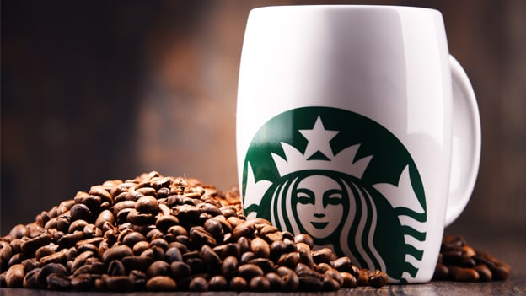
Thank you
This Photo by Unknown Author is licensed under CC BY-SA-NC

