Slide 1
Network Intrusion Detection
CAPSTONE PROJECT
Presented By:
1. MITANSHI-GRAPHIC ERA DEEMED TO BE UNIVERSITY-B.TECH CSE

Slide 2
OUTLINE
Problem Statement
Proposed System/Solution
System Development Approach
Algorithm & Deployment
Result (Output Image)
Conclusion
Future Scope
References

Slide 3

Problem Statement
The exponential growth of networked systems, IoT devices, and digital communications has dramatically increased the surface area for cyber threats. Attackers now use sophisticated techniques that easily bypass traditional security mechanisms.
Manual monitoring is time-consuming and inefficient, while static rule-based systems are rigid and often fail to adapt to new or evolving threats.

Slide 4
Proposed Solution
Data Collection
Source: Kaggle "Network Intrusion Detection" dataset.
The dataset contains simulated network connection records, generated by mimicking US Air Force LAN activity under normal and attack conditions. Each connection is defined by 41 features, with labels specifying "Normal" or various "Anormal" (attack) classes.
Content: Features encapsulate connection metadata (e.g., duration, protocol, service), traffic statistics, and error indicators, enabling multi-dimensional analysis of network behavior.
Data Preprocessing
Data Cleaning: Address missing or inconsistent values, remove duplicates, and handle outliers. Proper normalization is performed to ensure all features contribute equally to learning algorithms.
Feature Engineering
Extract and encode protocol types, services, and flags.
Aggregate session-based statistics.
Use correlation analysis and dimensionality reduction methods (e.g., PCA) to identify the most relevant features, helping mitigate issues with high dimensionality and improve model efficiency.

Slide 5
Proposed Solution
Handling Class Imbalance: Employ strategies such as oversampling (SMOTE), under-sampling, or class weight adjustments, as the dataset can be skewed toward normal vs. attack samples.
Model Selection
AutoAI Pipelines (in Watsonx): Automatically test ML pipelines.
Algorithms: Random Forest, Decision Tree, XGBoosting.
Evaluation Metrics: Train a model to detect intrusions in real-time using IBM Watsonx.ai AutoAI pipelines
Deployment
Platform: Deploy best-performing model using Watsonx.ai Deployment Space.
Endpoint: REST API generated for real-time intrusion prediction.
Monitoring: Use IBM Cloud Monitoring to track model usage and logs.
Evaluation
Test Interface: Predict on new traffic data via Watsonx UI.
Reporting: Display prediction probabilities and logs.
Confidence Score: Provided by the deployed model API (e.g., 98% intrusion confidence).

Slide 6
System Approach
System requirements
IBM Cloud Setup
IBM Cloud Account – Register at cloud.ibm.com
Watsonx.ai Studio – For building and training the model (AutoAI + Notebook).
IBM Cloud Object Storage – To upload CSV datasets and share across projects.
Watson Machine Learning Runtime – Required to run AutoAI experiments and deploy models.
Development Environment
Browser: Chrome/Edge
Internet: Stable connection for IBM Cloud access
Python version: 3.8+ (for notebook-based extensions)
Jupyter Notebooks: Used inside Watsonx.ai Studio
Library required to build the model
pandas, numpy, sklearn, matplotlib, seaborn
scikit-Learn,xgboost, imbalanced-learn
IBM SDKs: ibm-watson-machine-learning

Slide 7
Algorithm & Deployment
Algorithm Selection We selected XGBoost Classifier, a powerful ensemble method known for its high performance on structured data. It was chosen based on its ability to handle class imbalance, noisy features, and its success in classification challenges involving tabular datasets. IBM Watsonx.ai AutoAI pipelines automatically compared XGBoost against models like Random Forest, Decision Tree .
Data Input The input features include: duration – length of the network connection protocol_type, service, flag – encoded network protocol details Statistical features – src_bytes, dst_bytes, count, srv_count, etc. Attack indicators – land, wrong_fragment, urgent
All 41 features from the Kaggle dataset were used as inputs, with the target being class (Normal/Abnormal type).

Slide 8
Algorithm & Deployment
Training Process:
Dataset split into training and test sets using AutoAI’s internal CV mechanism • AutoAI performed automated preprocessing, feature selection, and hyperparameter tuning • Evaluation metrics used: Accuracy, Precision, Recall, F1-score • XGBoost with tuned parameters emerged as the top performer
Prediction Process:
The trained model predicts whether a new network connection is "normal" or an "intrusion." • Inputs: Real-time connection attributes streamed or uploaded via UI • The model returns a class prediction along with a confidence score • Deployment is done via IBM Watsonx.ai REST API, allowing real-time detection in practical environments

Slide 9
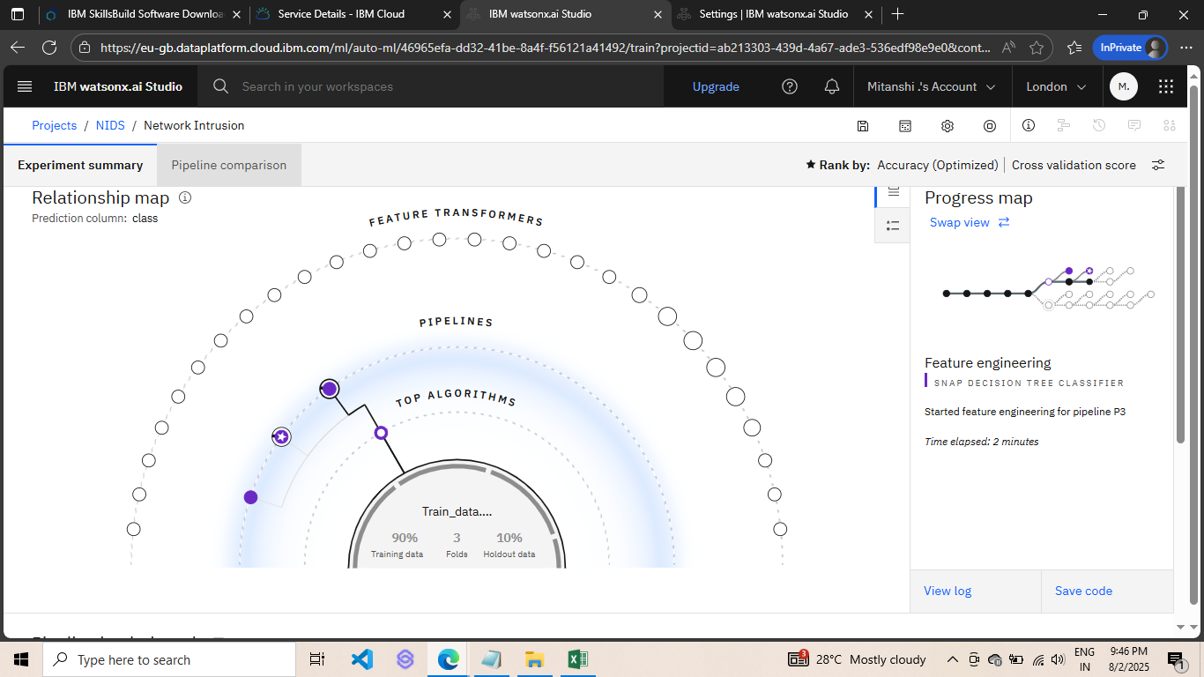
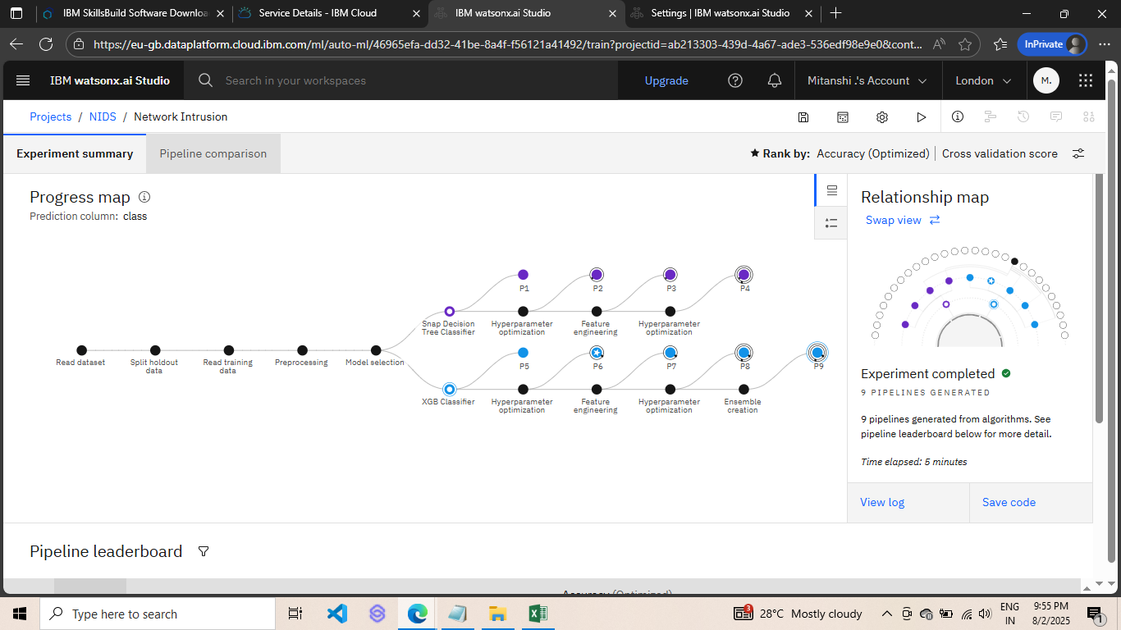
Result
FIG:Experimental Summary
FIG:Pipeline Map

Slide 10
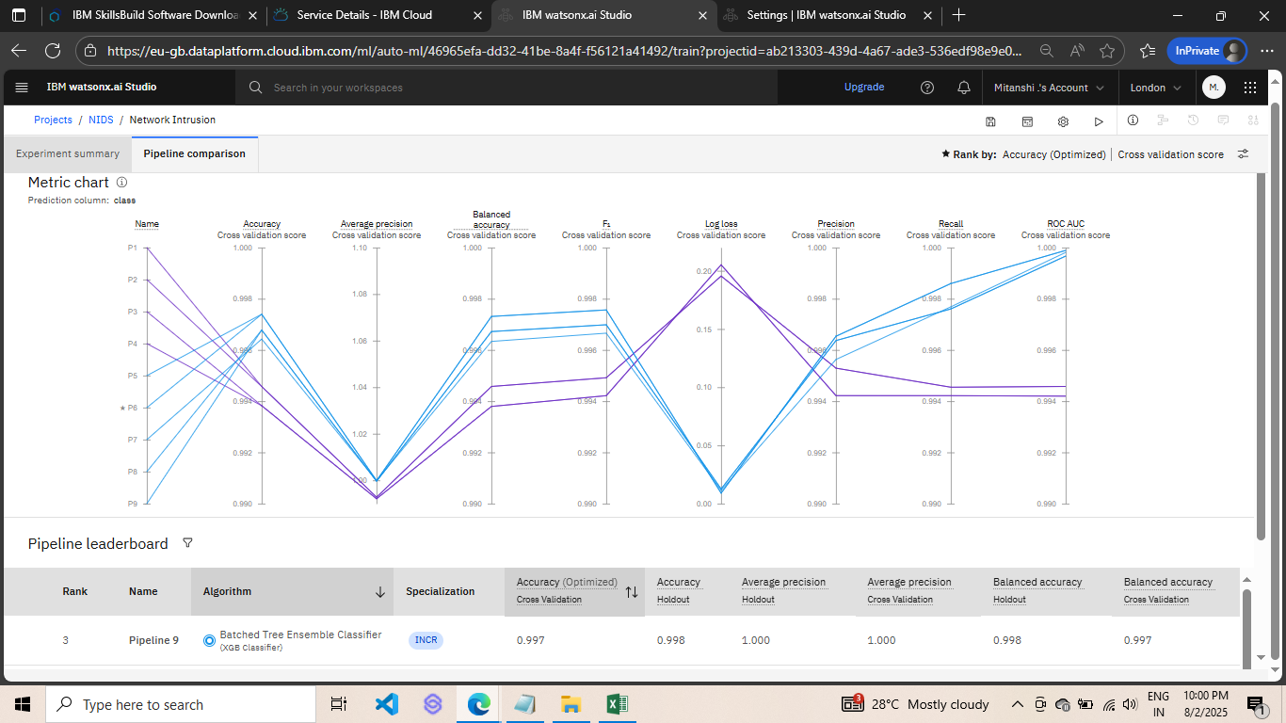
FIG:Metric Chart
Pipeline 6 had highest cross-validation accuracy: 0.997
Holdout accuracy: 0.998
Average precision, recall, and F1-score: ~1.00
Result

Slide 11
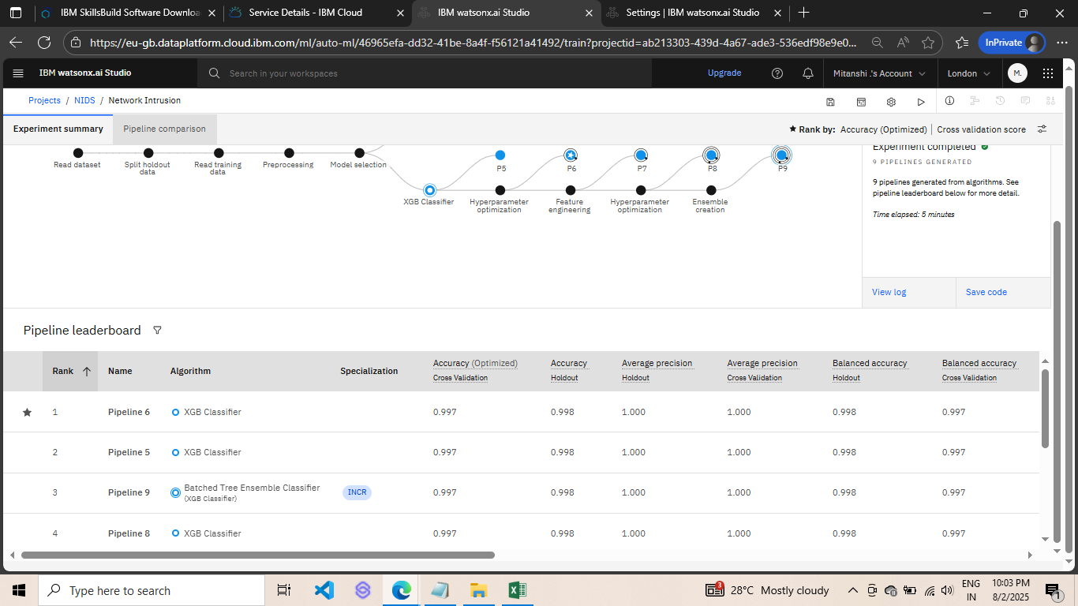
Fig:pipeline Leaderboard
Top 4 pipelines were all variations of XGBoost Classifier
Shows AutoAI robustness and consistency in performance
Final selected: Pipeline 6
Result

Slide 12
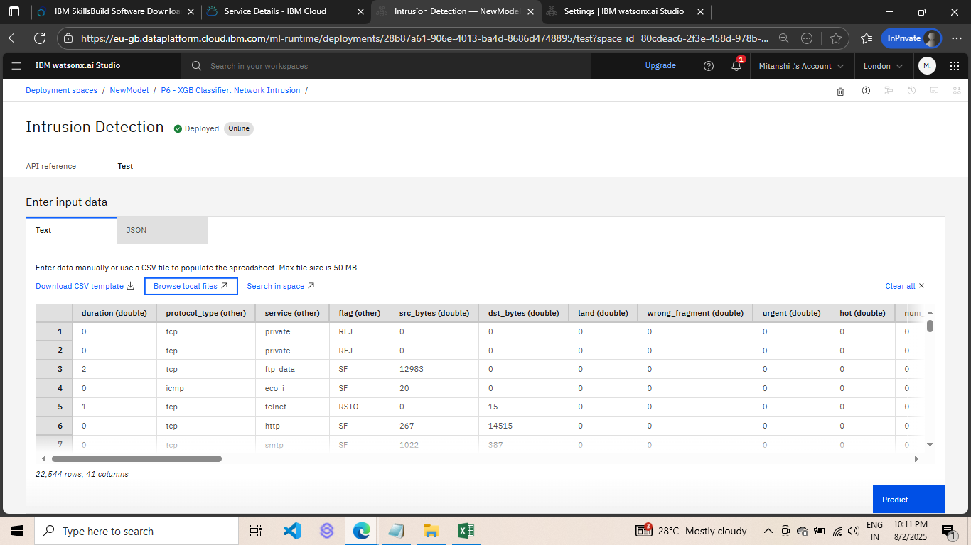
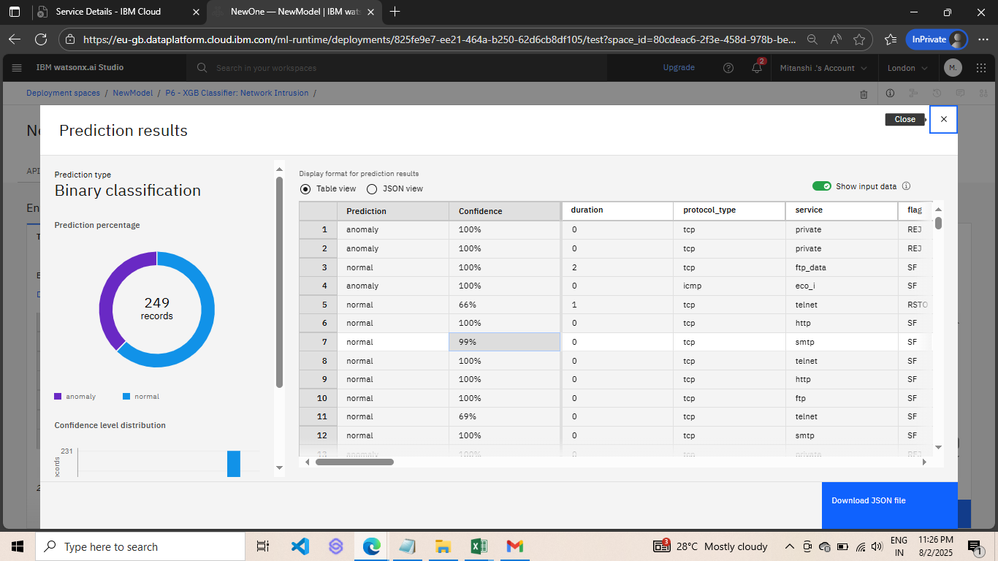
Result
Fig:Testing
FIG:Prediction

Slide 13
Conclusion
AutoAI efficiently selected the best pipeline with ~99.8% accuracy
Minimal manual effort due to AutoAI automation
Effective in detecting normal vs anomalous traffic
Model deployed and ready for real-time detection

Slide 14
Future Scope
Use real-time packet sniffers to feed live data
Integrate advanced deep learning models like CNN-LSTM
Enhance system with feedback-based retraining
Extend to detect zero-day attacks using anomaly detection

Slide 15
References
Dataset: https://www.kaggle.com/datasets/sampadab17/network-intrusion-detection
IBM Cloud: https://cloud.ibm.com
Tools: IBM Watsonx.ai Studio, AutoAI

Slide 16
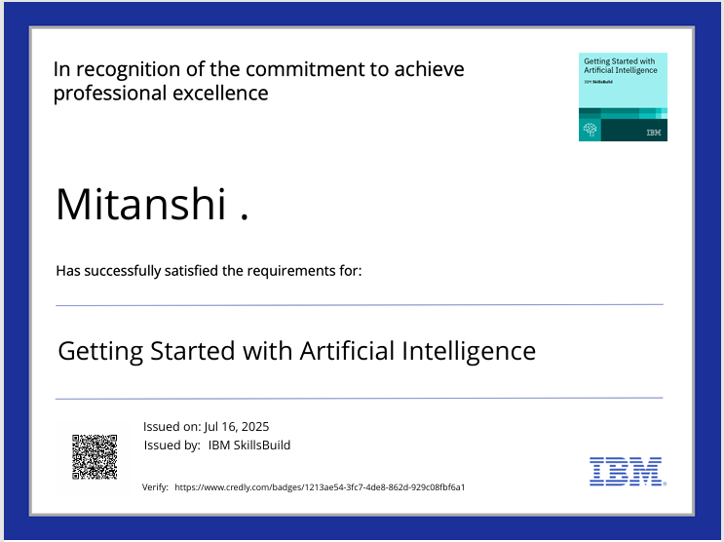
IBM Certifications
Screenshot/ credly certificate( getting started with AI)

Slide 17

IBM Certifications
Screenshot/ credly certificate( Journey to Cloud)

Slide 18

IBM Certifications
Screenshot/ credly certificate( RAG Lab)

Slide 19
THANK YOU

