Slide 1


VSLAM / Monocular SLAM
Siddharth Tourani
K Madhava Krishna

Slide 2
Acknowledgements
CAIR
Siddharth
Marc Pollefys Slides
MVG Book of Hartley and Zisserman
Oxford Univ Slides of AZ’s group
Nikos Sunderhauf’s thesis
Slides of Shankar Shastry and Jana Koseca
Frank Dellart’s papers

Slide 3
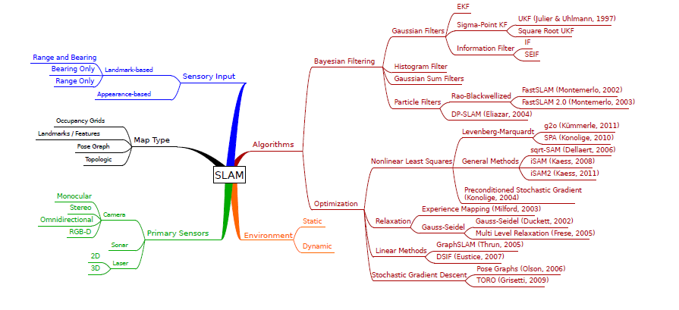
The SLAM Taxonomy

Slide 4
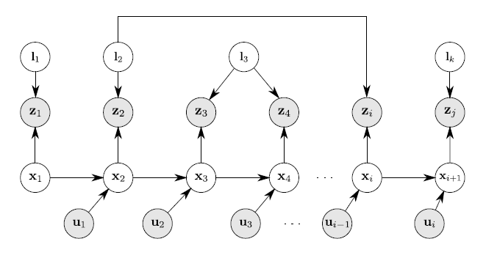
The SLAM as a Graphical Model

Slide 5

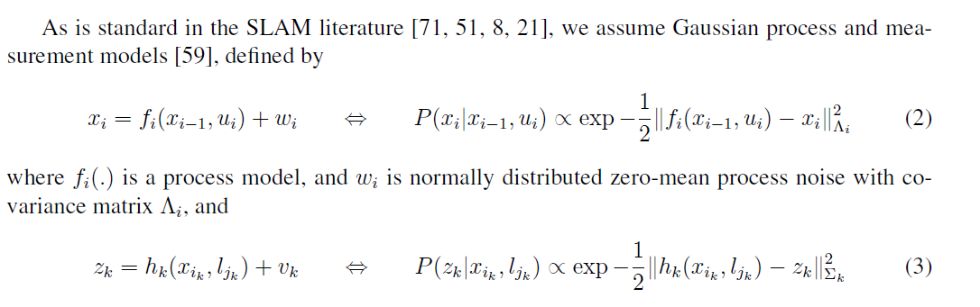
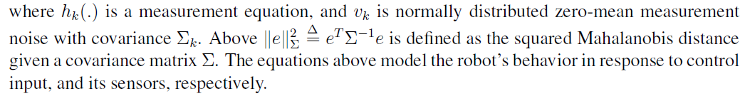
SLAM as a Least Squares Problem

Slide 6
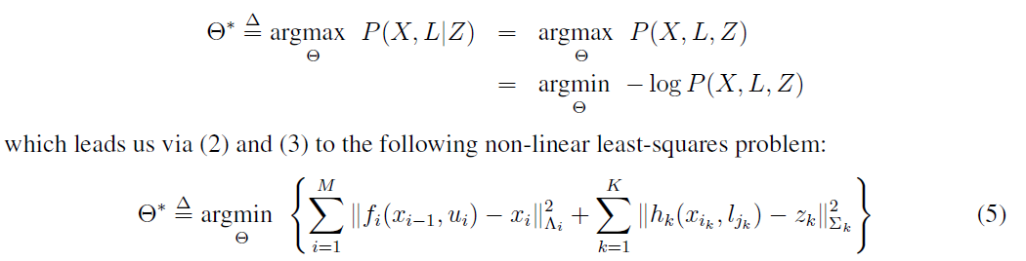
SLAM as a Least Squares
The above is a convenient form to solve by NLS methods such as Gradient Descent/ Gauss Newton/LM
One can also introduce loop closure as a constraint in the above such as in Pose Graph formalisms

Slide 7
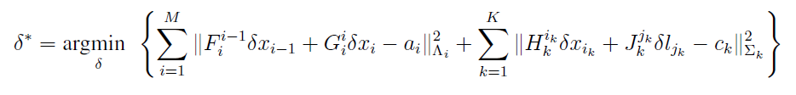

SLAM as a Least Squares
However one can proceed to linearize it and get it into a least squares form
Which can be further reduced to

Slide 8
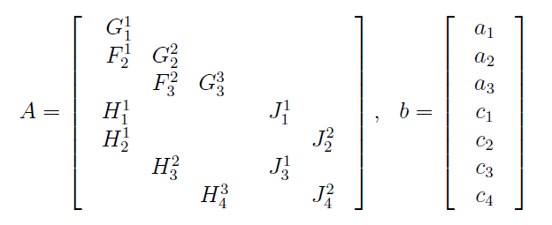
SLAM as Least Squares

Slide 9
VSLAM vs SLAM
VSLAM is also essentially solved as a Non Linear Least Squares also popularly termed as Bundle Adjustment then what is the difference:
Motion models and measurement models are quite straightforward in regular SLAM (Range Based SLAM)
Or initialization is straightforward in Range Based SLAM
VSLAM motion and measurement models are NON TRIVIAL
Since VSLAM projects 3D world onto a 2D image it encounters variety of paradigms, formalisms and degeneracies most critically the formalism based on Projective Geometry

Slide 10
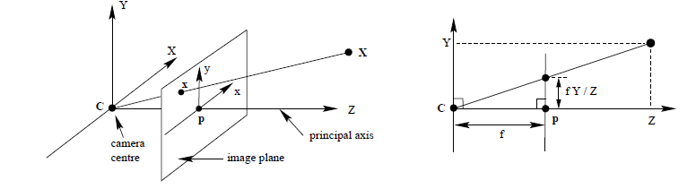
Projective Geometry: The Pinhole Camera
Pinhole camera geometry. C is the camera centre and p the principal point.
The camera centre is here placed at the coordinate origin.
Note the image plane is placed in front of the camera centre.

Slide 11

The Pinhole Camera
Note However:
(λX, λY, λZ)^{T} also projects to (fλX/λZ, fλY/λZ)^{T} OR
(fX/Z, fY/Z)^{T}
Thus the pinhole camera projects any world point X along the ray that passes through the camera center and the image point x back again to x

Slide 12

The Pinhole Camera
The central projection in homogenous coordinates:
Again note any λX will project to the same image coordinate x

Slide 13
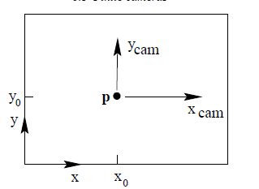




The Pinhole Camera
The above represents the central projection formulation
Again note any λX will project to the same image coordinate x
K represents the internal camera calibration matrix

Slide 14
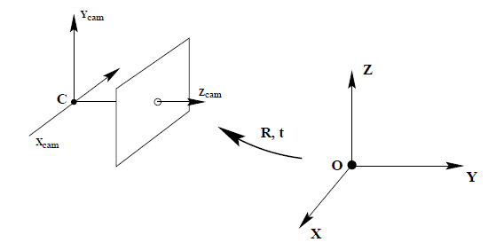
The Pinhole Camera
When camera frame is rotated and translated wrt world frame
Is a inhomogenous vector in world frame
Is camera location measured in world frame
then represents in camera frame ;
where R is the rotation of world wrt camera

Slide 15


The Pinhole Camera
When camera frame is rotated and translated wrt world frame

Slide 16
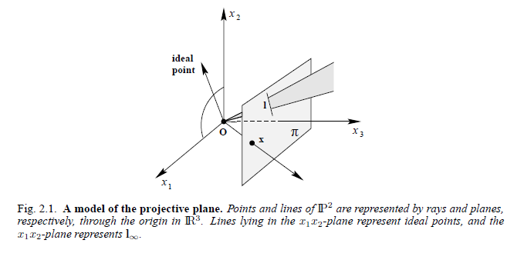
Model of the Projective Plane

Slide 17
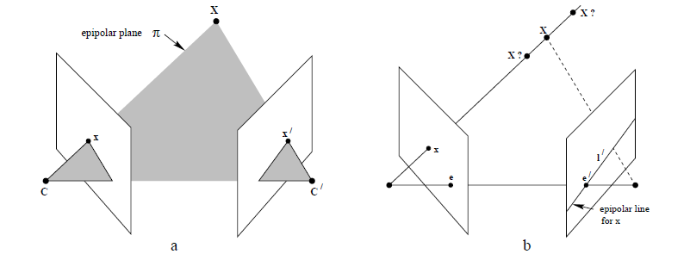
Epipolar Geometry
Point correspondence geometry.
The two cameras are indicated by their centres C and C and image planes. The camera centres, 3-space point X, and its images x and x lie in a common plane π.
(b) An image point x back-projects to a ray in 3-space defined by the first camera centre, C, and x. This ray is imaged as a line l in the second view. The 3-space point X which projects to x must lie on this ray, so the image of X in the second view must lie on l.

Slide 18
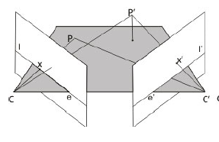
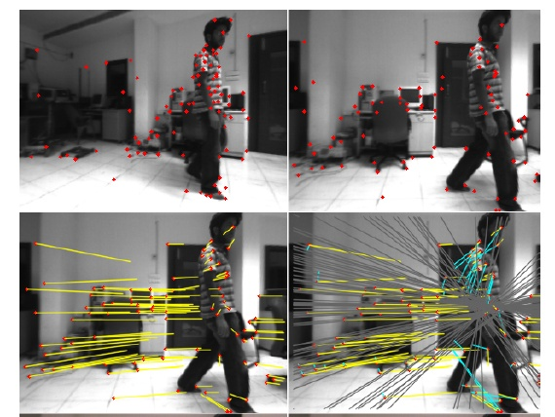
Epipolar Geometry

Slide 19
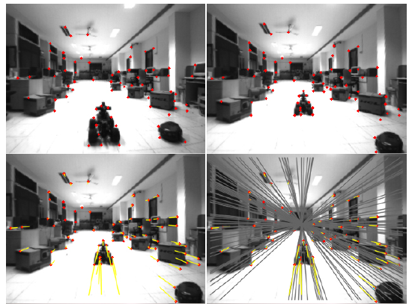
Epipolar Geometry

Slide 20

The Fundamental Matrix
The above equation represents the solution for the back projection problem of PX = x.
The first term on the RHS represents the particular solution
The second term on the right is the span of the Null Space for PX = x has N of rank 1
The Null Space is spanned by the homogenous camera center coordinates as PC equals the zero vector

Slide 21


The Fundamental Matrix
Two points imaged by the second camera:
The line that joins the above two points in the second camera:
The first point P’C represents the epipole e’ of the first camera in the second image
Then
where F is the Fundamental Matrix

Slide 22

The Fundamental Matrix
F then satisfies
The above expression can be considered as one of the landmark expressions in MVG and used ubiquitously in:
SLAM
Motion Segmentation
Feature Matching for Geometric Validation
Correspondence search

Slide 23

Computation of F
For a pair of corresponding points (x,y,1) and (x’, y’,1) in two images we now have:
Represent this as an inner product

Slide 24
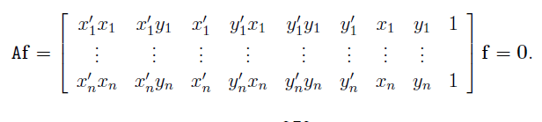
Computation of F
From a set of such n corresponding points
The above is a set of homogenous equations and A can have a rank of at most 8 when correspondences are precise
And f can be determined only upto a scale

Slide 25
Computation of F
The non normalized algorithm
~10000
~10000
~100
~10000
~10000
~100
~100
~100
1
!
Orders of magnitude difference
between column of data matrix
→ least-squares yields poor results

Slide 26
Computation of F
Transform image to ~[-1,1]x[-1,1]
(0,500)
(700,500)
(-1,1)
(1,1)
(0,0)
(0,0)
(700,0)
(-1,-1)
(1,-1)
normalized least squares yields good results (Hartley, PAMI´97)

Slide 27
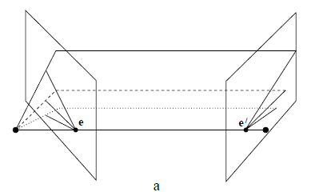
Computation of F
F has a non trivial Null Space as Fe = e’^{T}F = 0 where e and e’ ≠ 0

Slide 28
Computation of F
To Tackle Null Space Constraint
SVD from linearly computed F matrix (rank 3)
Compute closest rank-2 approximation

Slide 29
Computation of F
Further refinement of F is done over n correspondences by iterating over RANSAC and finding F for the best possible inliers
Other methods of refinement include using the normalized 8 point algorithm as an initialization of F and further refine it by estimating through a cost function involving reprojection error that is minimized by LM algorithm

Slide 30
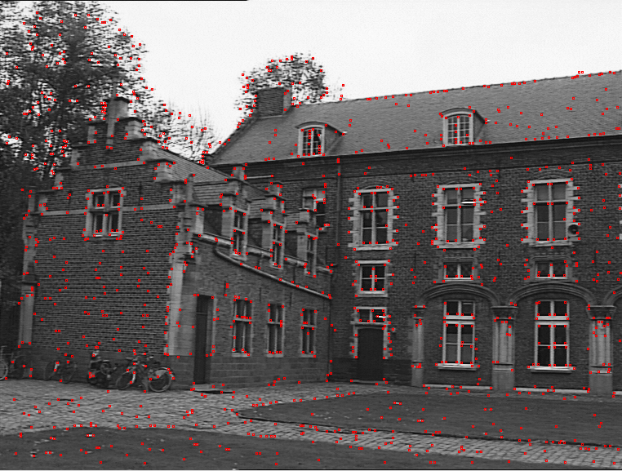
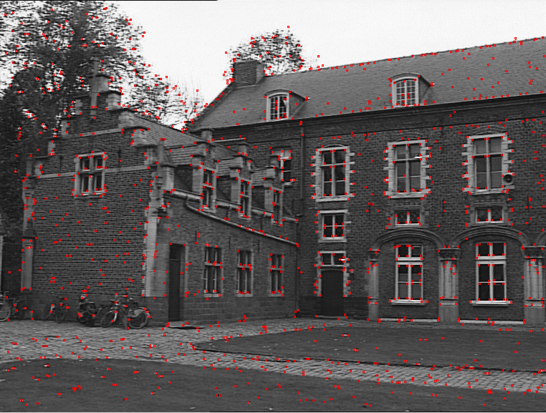
Computation of F
From a pair of such images obtain correspondences typically with SIFT
Obtain F by 8 point algorithm with singularity constraint or 7 point algorithm
Refine with RANSAC

Slide 31
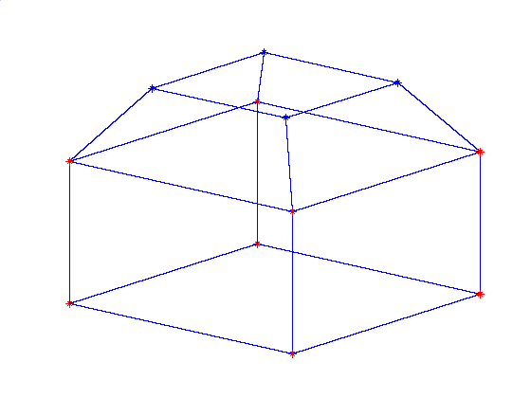

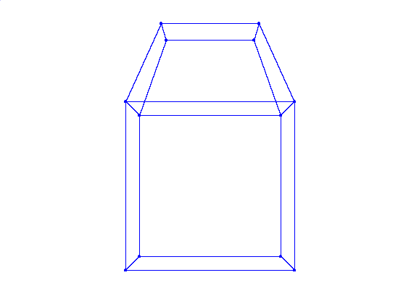
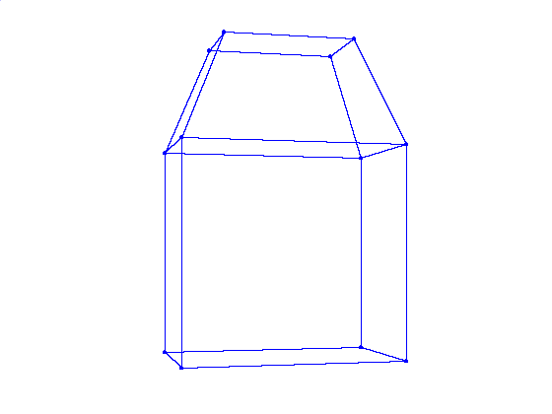


The Essential Matrix
When camera calibration, K, is known we can get rid of the cameras by multiplying the image points with inv(K) and getting the image in normalized coordinates

Slide 32

The Essential Matrix

Slide 33
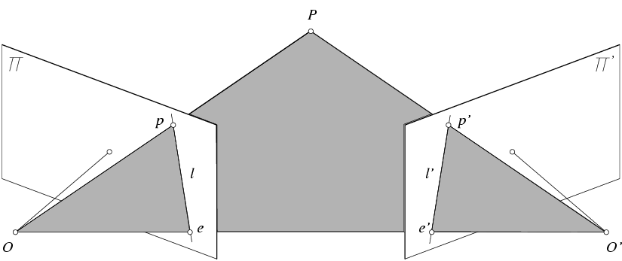
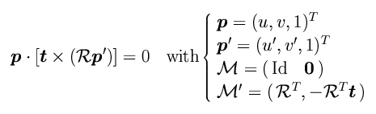


Epipolar Constraint: Calibrated Case
Essential Matrix
(Longuet-Higgins, 1981)

Slide 34

Properties of the Essential Matrix
T
E p’ is the epipolar line associated with p’.
E^{T}p is the epipolar line associated with p.
E e’=0 and E^{T}e=0.
E is singular.
E has two equal non-zero singular values
(Huang and Faugeras, 1989).
Another way of finding E is from F as
T

Slide 35
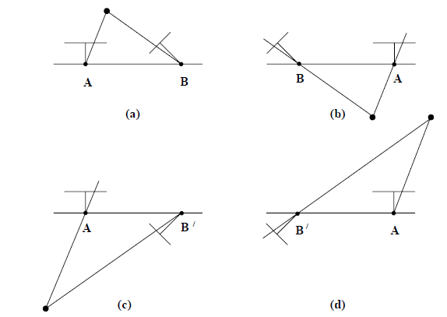
Pose Recovery from E
The four possible solutions for calibrated reconstruction from E. Between the left and right sides there is a baseline reversal. Between the top and bottom rows camera B rotates 180◦ about the baseline. Note, only in (a) is the reconstructed point in front of both cameras.

Slide 36
Camera Recovery from F
Cameras can be recovered only upto a projective transform:
In other words given F we cannot recover the cameras whose locations relative to each other is known upto a scale or similarity transform
Cannot extract motion, structure and calibration from one fundamental matrix (two views)
allows reconstruction up to a projective transformation (as we will see soon)
encodes all the geometric information among two views when no additional information is available

Slide 37


Camera Recovery from F
The general formula for a pair of canonic camera matrices corresponding
to a fundamental matrix F is given by

Slide 38
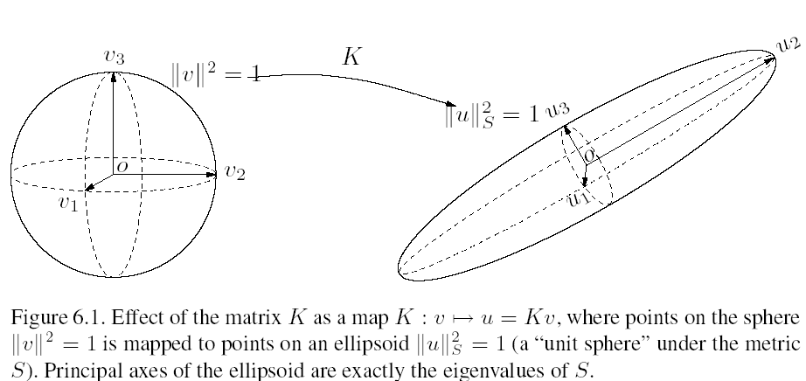
F vs E or Calibrated vs Uncalibrated

Slide 39

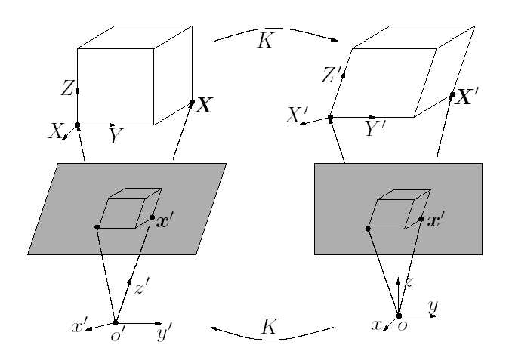
F vs E

Slide 40
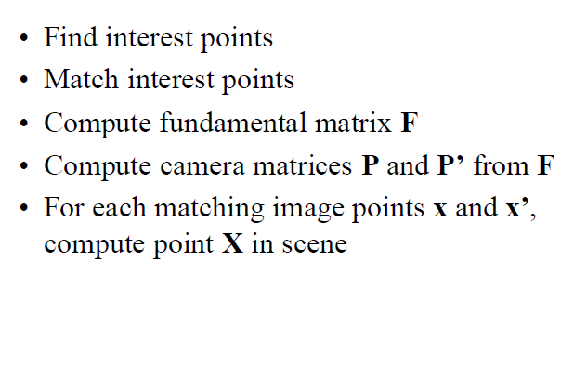
3D Reconstruction from Cameras

Slide 41
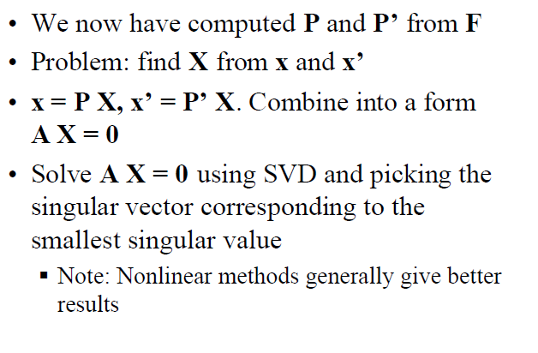
3D Reconstruction from Cameras

Slide 42
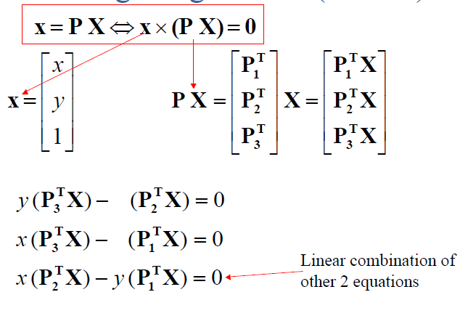
3D Reconstruction from Cameras

Slide 43
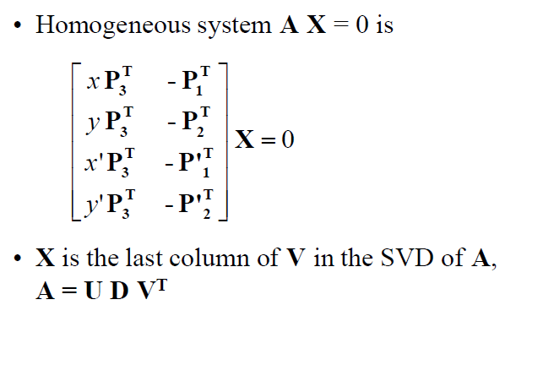
3D Reconstruction from Cameras

Slide 44
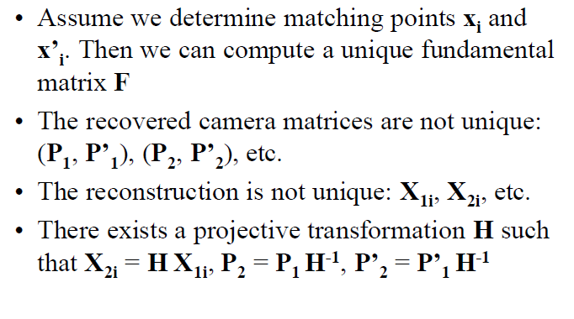
3D Reconstruction from Cameras

Slide 45
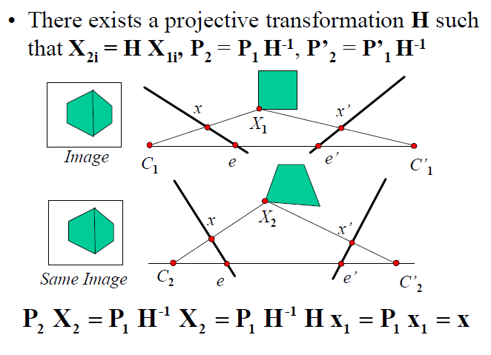
3D Reconstruction from Cameras

Slide 46

3D Reconstruction from Cameras
Projective reconstruction ambiguity from a pair of cameras. The cup in the center is the true cup.

Slide 47
3D Reconstruction from Cameras
Upto scale reconstruction with E, when K is known
The translation magnitude is unknown between cameras, however its direction is known

Slide 48
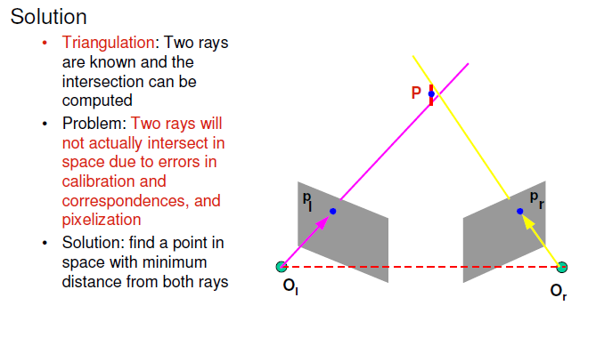
3D Reconstruction from Cameras
When both K and magnitude of T is known
Metric reconstruction is obtained by Trinagulation
Similar to Stereo

Slide 49
3D Reconstruction from Cameras
Left
Camera
Principle
axis
Right
Camera
Principle
axis
Object
Px(x,y,z)
By similar triangle,
w.r.t left camera lens center
z
Left
Image
plane
Right
Image
plane
X’_{l}
X’_{r}
Focal
Length
f
b (Baseline)
By similar triangle,
w.r.t right camera lens center
Left camera center
(reference point)
Horizontal
Disparity=x_{L}-x_{R}
One major problem is to locate x’l and x’r The correspondence problem

Slide 50
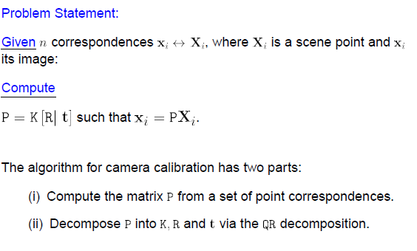
Camera Resectioning

Slide 51
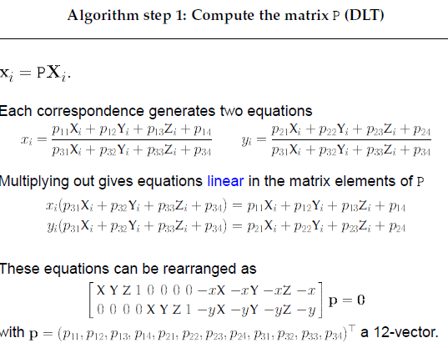
Camera Resectioning

Slide 52
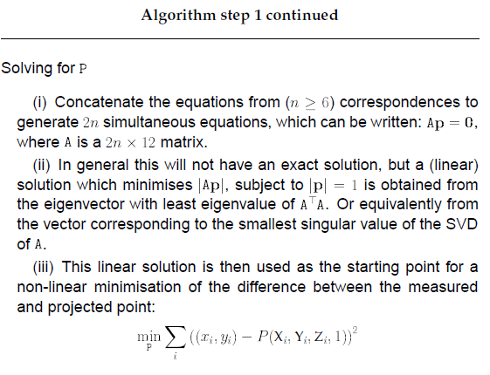
Camera Resectioning

Slide 53
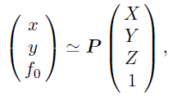
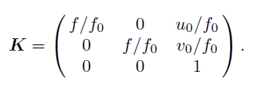
The Bundle Adjustment: BA
The routine projection equation, f₀ is typically set as unity
The camera calibration matrix K is assumed to be known. They are typically calibrated by a separate calibration procedure

Slide 54
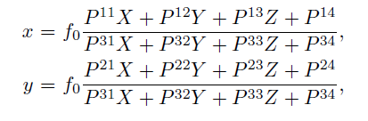
The BA
One can rewrite the central projection equation as
Suppose we take M images of N points (Xα, Yα,Zα), α = 1, ..., N, in the scene.
Let (x_{ακ}, y_{ακ}) be the projection of the α^{th} point onto the κ^{th} image.
Let Pκ be the projection matrix of the κ^{th} image.

Slide 55

The BA
We define the reprojection error as the sum square of differences between the predicted projection of world points and their observed locations summed over N points and across M images
where I_{ακ} is the visibility index , taking 1 if the α^{th} point is visible in the κth image and 0 otherwise.

Slide 56
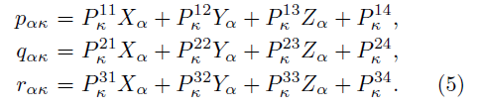
The BA
Define
BA tries to refine the estimates of the projection matrices and 3D points such that the reprojection error goes to zero or converges at a very low value

Slide 57
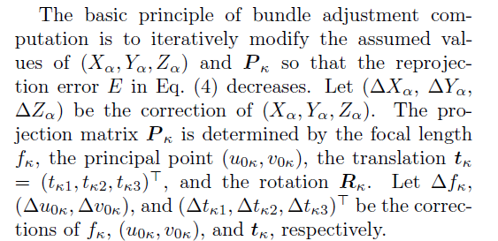
The BA

Slide 58
The BA
Expressing the correction of R_{κ} needs care.
The orthogonality relationship R_{κ}R_{κ}^{T} = I imposes three constraints on the nine elements of R_{κ}, so R_{κ} has three degrees of freedom.
From R_{κ}R_{κ}^{T} = I we get
And hence we have a skew symmetric matrix in

Slide 59
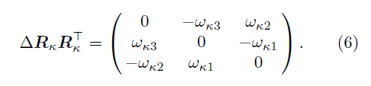

The BA
And hence
From (6) we can obtain (7) below

Slide 60
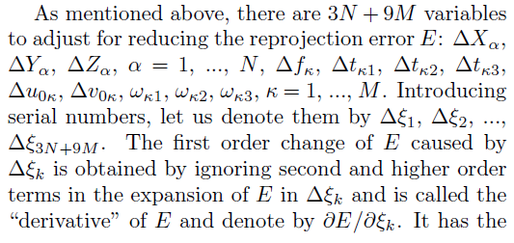
The BA

Slide 61
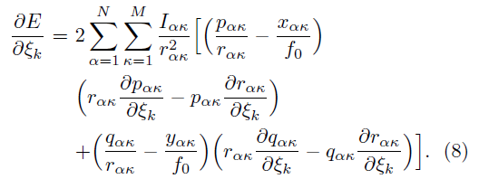
The BA
The Jacobians then take the form:
The Hessian is approximated as the transpose of the Jacobian times Jacobian in LM

Slide 62
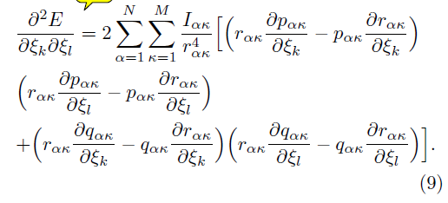
The BA
And hence Hessian is approximated as
Thus both J and J^{T}J have only single derivative terms

Slide 63
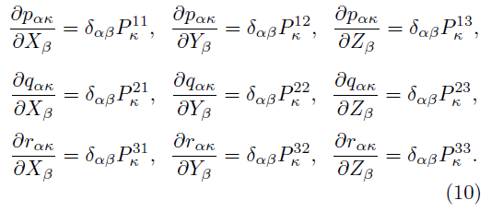
The BA
Derivatives of 3D positions

Slide 64
The BA
Similarly the derivatives with respect to translation components, principal point, focal length, rotation components are all evaluated
Finally the LM algorithm is used to compute the update rule for the state vector

Slide 65
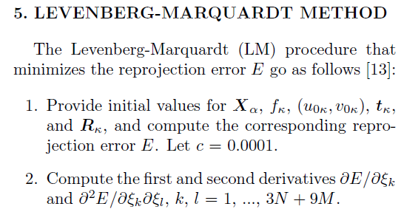
The BA

Slide 66
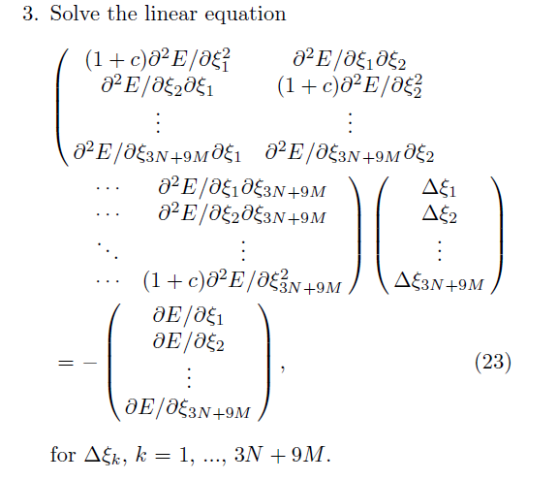
The BA

Slide 67
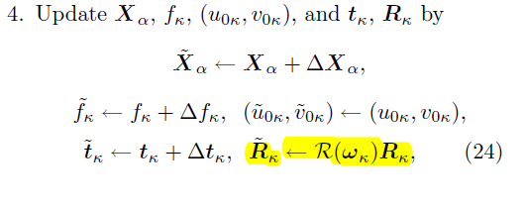
The BA

Slide 68

The BA

Slide 69

The BA with Constraints [IROS 2015]

Slide 70

The BA with Constraints [IROS 2015]

Slide 71

The BA with Constraints [IROS 2015]

Slide 72


The BA with Constraints [IROS 2015]

Slide 73

The BA with Constraints [IROS 2015]

Slide 74

The BA with Constraints [IROS 2015]

Slide 75

Results

