Slide 1
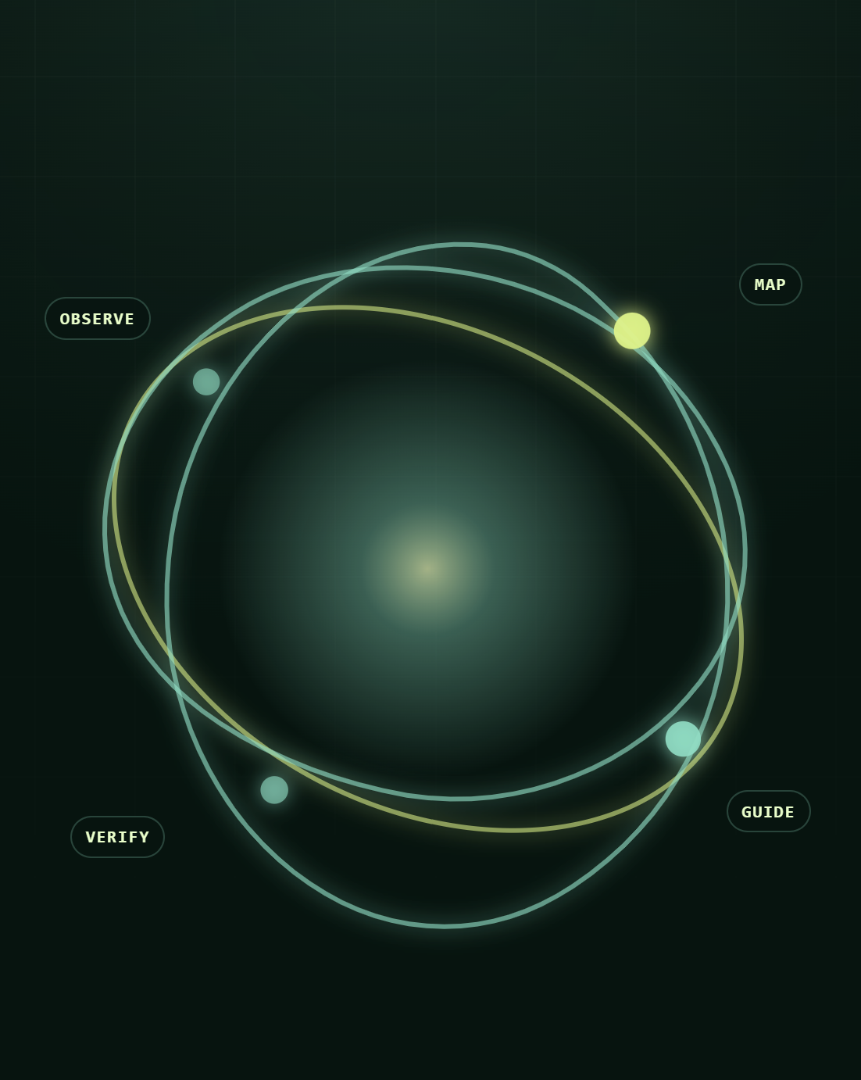

TETRATHON 2026 · EDTECH TRACK
PRISM
Personalized Remediation and Intelligent Scaffolding for Mastery
From “I am stuck” to a clear next step.
Adaptive microlearning + evidence-grounded doubt resolution for mixed-ability Grade 8 classrooms.
TEAM WEEKEND DEVS
Mitansh Prajapati · Aryan Motiani · Dweep Desai · Pranshul Soni
Weekend-Devs

Slide 2
PROBLEM STATEMENT
One grade. Many starting points.
FOUNDATIONAL
GRADE-LEVEL
ADVANCED
Prerequisite gaps in integer operations, equality, or inverse operations make the shared lesson feel too hard.
Core procedure is present, but one misconception or stopping error blocks independent progress.
The learner is ready for variation, modeling, and explanation—not more repetition of the same steps.
TEACHER WORKLOAD
ACCESS AT THE POINT OF NEED
Teachers cannot inspect every learner’s misconception pattern in real time or translate completion data into a specific intervention.
Always-online, answer-first products fail when bandwidth is weak—or repair the answer without repairing the underlying concept.
THE REAL PROBLEM IS NOT CONTENT SCARCITY.
It is deciding the next learning action from limited evidence.

Slide 3
WHY CURRENT APPROACHES BREAK
A generic chatbot or one-size-fits-all LMS misses the decision behind the answer.
TYPICAL APPROACH | WHAT IT MISSES | PRISM RESPONSE
Same lesson for every learner | Starting point and prerequisite readiness | Short diagnostic + differentiated entry path
Generic “ask AI” chat | The concept beneath the question | Taxonomy-linked root-gap hypothesis
Correct / incorrect score only | Why the learner answered that way | Misconception tags + evidence ledger
Completion dashboard | What the teacher should do next | Ranked intervention recommendation
Cloud-only delivery | Classroom connectivity constraints | Cached text-first learning + queued sync
DESIGN PRINCIPLE
Technology should augment teacher judgment—not silently replace it.

Slide 4
THE CLOSED LEARNING LOOP
PRISM: Observe → Map → Guide → Verify
01 · OBSERVE
02 · MAP
03 · GUIDE
04 · VERIFY
Capture evidence
Locate the gap
Teach the next step
Close the loop
5-question probe, answer, time band, confidence, hint use, and learner doubt.
Concept + error evidence model, prerequisites, related weak areas, and uncertainty.
Micro-lesson, tutor scaffold, targeted practice, and authored fallback.
Transfer check, mastery update, next action, and teacher intervention signal.
EVERY RECOMMENDATION ANSWERS FOUR QUESTIONS
1. What should this learner do next?
2. What evidence led to that recommendation?
3. How certain is PRISM?
4. What should the teacher do if the learner remains stuck?

Slide 5
REQUIREMENT COVERAGE
One integrated prototype. Two connected experiences.
LEARNER EXPERIENCE
EVALUATOR EXPERIENCE
LEARNER EVIDENCE
5-question diagnostic Foundational / Grade-Level / Advanced path 10-minute personalized micro-lesson 3 embedded practice questions + instant feedback Text doubt + optional handwritten-photo intake Socratic or direct explanation Concept graph + session history
Level distribution and completion status Common error-pattern clusters Learner-level evidence and likely blocker Recommended short intervention Offline / pending-sync visibility Cohort trends without public learner ranking Evidence-led follow-up
TEACHER ACTION
Learner interactions produce the teacher’s intervention signal—there is no second, manually maintained system.

Slide 6
THE 5-QUESTION DIAGNOSTIC
GRADE 8 MATH · LINEAR EQUATIONS
Five signals to choose a better beginning
Q1 · NUMBER SENSE
TRANSPARENT CLASSIFICATION POLICY
−7 + 12 = ? | Detects integer-operation readiness.
FOUNDATIONAL
Q2 · EQUALITY MEANING
Prerequisite signal missing or inconsistent → begin with equality and inverse operations.
Which values keep x + 5 = 12 balanced? | Checks equation-as-balance.
GRADE-LEVEL
Q3 · INVERSE OPERATION
Core procedure present with one misconception → targeted repair + grade-level application.
Solve x − 8 = 15. | Tests inverse-operation selection.
ADVANCED
Q4 · MULTI-STEP STRUCTURE
Independent solution and transfer explanation → variation, modeling, or extension.
Solve 3x − 5 = 16. | Reveals whether the learner stops before isolating x.
INSUFFICIENT EVIDENCE
Q5 · TRANSFER / CHECK
Low confidence, skips, or conflicting signals → ask one clarifying item; do not over-label.
Is x = 7 valid for 2x + 4 = 18? Why? | Tests substitution and explanation.
STORED PER RESPONSE
answer · correctness · error tag · time band · hint use · confidence · concept IDs · timestamp

Slide 7
THREE MICROLEARNING PATHS
Same curriculum goal. Different next step.
FOUNDATIONAL
GRADE-LEVEL
ADVANCED
10-MINUTE LESSON SHAPE
10-MINUTE LESSON SHAPE
10-MINUTE LESSON SHAPE
Equality-as-balance visual → inverse-operation worked example → guided self-explanation
Multi-step worked example → common stopping error → guided repair
Compare valid paths → model a word problem → justify method efficiency
3 EMBEDDED PRACTICES
3 EMBEDDED PRACTICES
3 EMBEDDED PRACTICES
One-step equation · identify operation · check solution
Solve multi-step · error analysis · contextual application
Multi-step variation · create an equation · explain why a method works
COMPLETION CONDITION
COMPLETION CONDITION
COMPLETION CONDITION
One independent transfer response—or a clear retry recommendation
Correct strategy on an independent transfer item
Explanation + independent application
Worked example → self-explanation → independent attempt → immediate feedback → next-step choice
Specific feedback: “You added 5 to both sides. x is still multiplied by 3—what inverse operation is left?”

Slide 8
DOUBT RESOLUTION
Do not only answer the doubt. Repair its root cause.
GROUNDED PIPELINE
LEARNER INPUT
01
Text / photo intake
TEXT DOUBT
“I added 5, but why can’t I stop at 3x = 21?”
02
OCR candidate → learner confirmation
03
Curriculum-scoped concept retrieval
HANDWRITTEN PHOTO PLACEHOLDER
Add a verified notebook capture / OCR confirmation screen.
04
Attempt pattern + prerequisite graph + context
05
Root-gap hypothesis + confidence
06
Socratic or direct scaffold + citation
OCR is confirmed by the learner before reasoning begins.
07
Transfer check + graph update
ROOT-GAP EXAMPLE
SURFACE DOUBT
LIKELY ROOT CONCEPT
FIRST USEFUL RESPONSE
Why is 3x = 21 not the final answer?
Inverse operations / isolating the variable
Is x alone yet? What reverses multiplying by 3?

Slide 9
TUTOR BEHAVIOR
The tutor escalates help only when the learner needs it
STEP | LEARNER STATE | PRISM MODE | EXAMPLE BEHAVIOR
1 | First attempt | Socratic hint | What must happen to both sides before x is alone?
2 | First incorrect attempt | Explain error | You removed 5 correctly, but x is still multiplied by 3.
3 | Second incorrect attempt | Worked step | From 3x = 21, divide both sides by 3: x = 7.
4 | Third attempt or “show me” | Direct explanation | Full curriculum-linked worked solution.
5 | After explanation | Check thinking | Isomorphic transfer question; learner applies it independently.
TUTOR CONTRACT
Uses only the active grade, subject, concept, prerequisite, and authored lesson scope. Returns mode, concept IDs, curriculum citations, confidence, and next action.
Rejects unsupported claims, unknown concept IDs, and unjustified high confidence. Falls back to deterministic authored hints and feedback if the LLM is unavailable.

Slide 10
CONCEPT GRAPH + MASTERY HISTORY
A resolved doubt should change what happens next
CONCEPT GRAPH — LINEAR EQUATIONS
WHAT EACH CONCEPT NODE SHOWS
Multi-step equations
MASTERY STATE
Needs prerequisite support / developing / likely ready for transfer
Integer operations
Equality as balance
Inverse operations
EVIDENCE
Independent correct responses, hint-assisted responses, and recent misconception tags
Checking a solution
RELATED WEAK AREA
RECENCY + UNCERTAINTY
integer sign errors
When evidence was observed and how strong it is
EVIDENCE LANGUAGE — NOT LEARNER LABELS
LIMITED EVIDENCE
Learner: “Let’s rebuild this idea.”
Teacher: “Needs prerequisite repair.”
DEVELOPING EVIDENCE
Learner: “Getting there—one more check.”
Teacher: “Developing; evidence still limited.”
INDEPENDENT TRANSFER
Learner: “Ready for the next challenge.”
Teacher: “Likely mastered; confirm with transfer.”

Slide 11
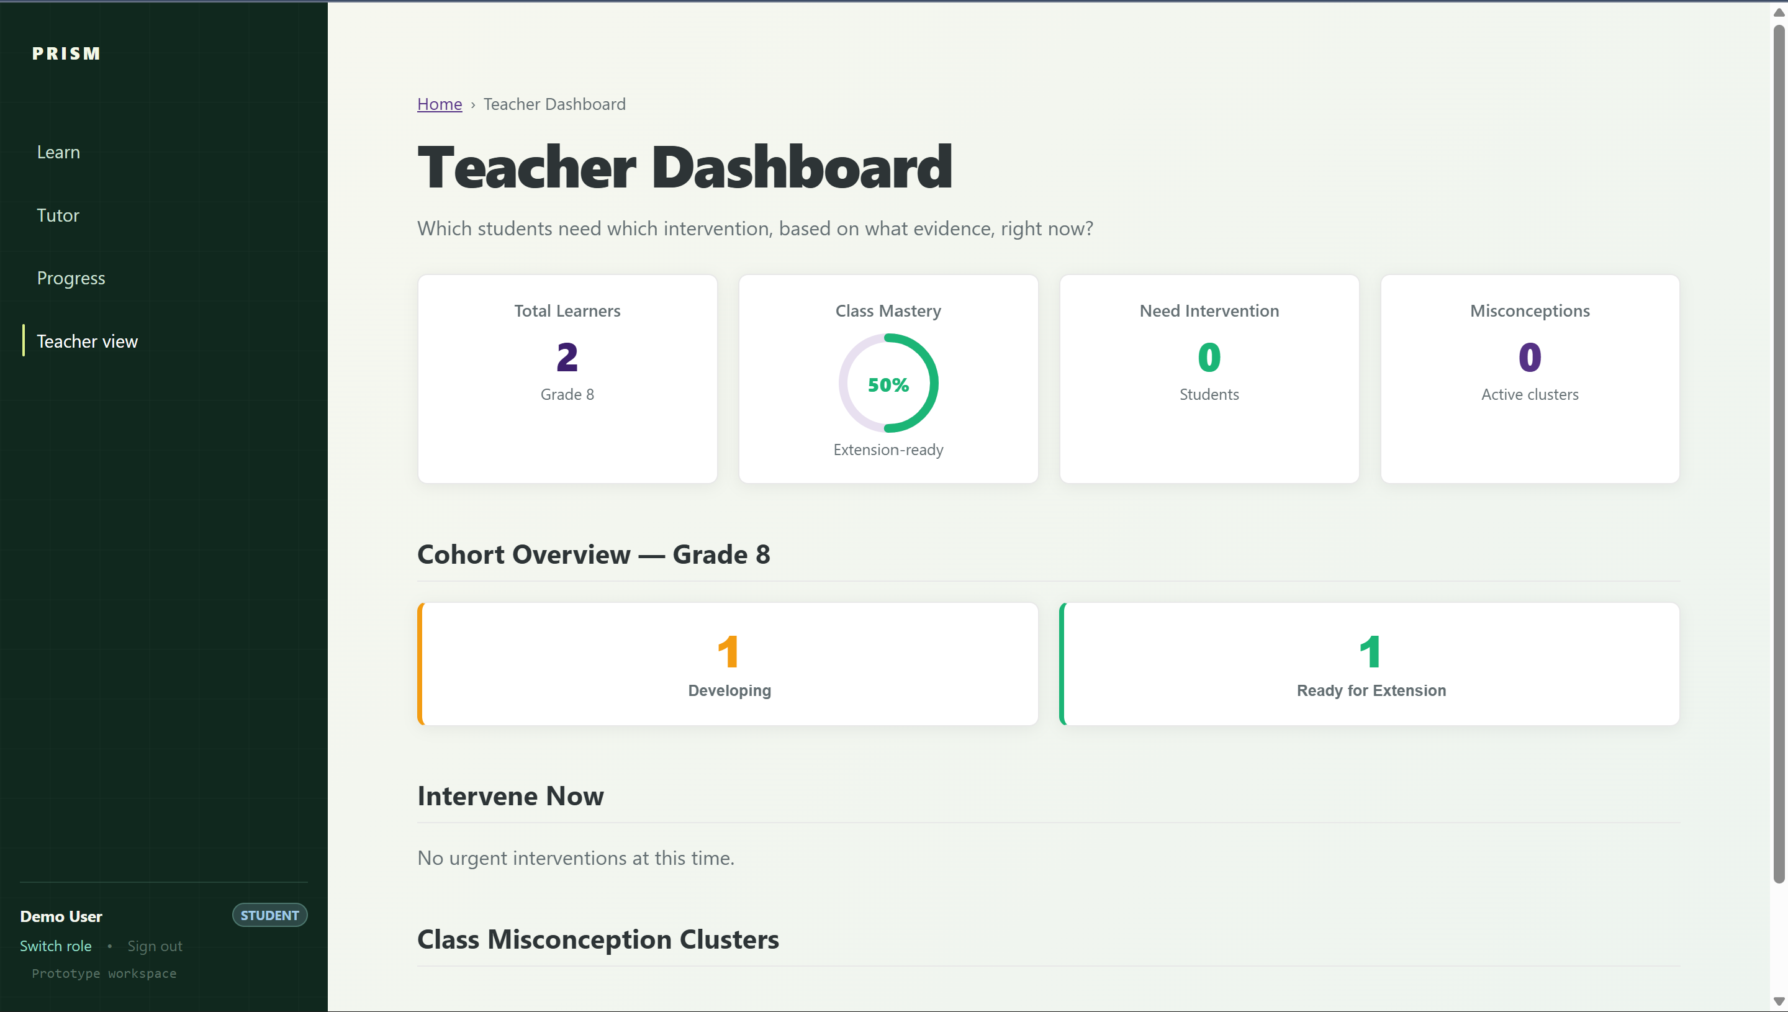
EVALUATOR DASHBOARD
The teacher view turns evidence into a 2-minute intervention
VERIFIED DASHBOARD SCREENSHOT PLACEHOLDER
STUDENT INTERVENTION CARD
Suggested crop: cohort route distribution + misconception cluster + intervention panel. Use pseudonymous learner data only.
Learner: [Pseudonymous learner] Path: Grade-Level · Target: Multi-step equations Likely blocker: Inverse operations · confidence: medium Evidence: repeatedly stops before dividing coefficient 2-minute action: solve 3x = 21 on a mini-whiteboard Sync: 2 local attempts pending upload
CLUSTER INTERVENTION CARD
Cluster: Stops before dividing the coefficient Concept: Inverse operations Why it matters: prerequisite for multi-step equations Teacher move: “In 3x = 21, is x alone yet? What undoes ×3?”
COHORT COMMAND VIEW
Starting routes · completion + offline-pending sessions · misconception clusters ranked by impact and recency
Learner evidence + likely blocker · one ranked intervention recommendation · cohort trends without public ranking

Slide 12
OFFLINE-FIRST, LOW-BANDWIDTH ARCHITECTURE
Useful before the network is perfect
LEARNER PWA
FASTAPI SERVICE
POSTGRESQL
OPTIONAL LLM
Cached app shell + text-first micro-lessons Local concept / question bundle IndexedDB outbox for attempts and progress Visible sync state
Deterministic diagnostic and mastery logic Curriculum-scoped tutor orchestration Idempotent event reconciliation
Curriculum sources and concepts Attempts + mastery history Teacher read models and intervention clusters
Cited, schema-validated phrasing only Bounded to supplied curriculum context Core loop remains available without inference
WHY THESE CHOICES ARE CREDIBLE
PWA + CACHE
TEXT-FIRST
LOCAL OUTBOX
IDEMPOTENT EVENTS
OPTIONAL LLM
Useful during poor connectivity.
Low data cost and quick first paint.
Learner work is not discarded.
Retries cannot duplicate attempts.
Diagnosis and authored fallback remain available.

Slide 13
TRUST, SAFETY, PRIVACY, AND FAIRNESS
Trust is a feature—not a footer
RISK | PRISM CONTROL
Overconfident diagnosis from five answers | Confidence state + insufficient-evidence path + revisable placement
Hallucinated tutor explanation | Curriculum-scoped retrieval, citation IDs, schema validation, deterministic fallback
Tutor gives the answer too early | Fixed ladder: hint → error explanation → worked step → direct explanation → transfer check
OCR misreads handwriting | Learner confirmation before diagnosis
Learner labeling / public comparison | Evidence-based wording, role-protected teacher views, no public ranking
Personal data exposure | Data minimization, pseudonymous demo data, least-privilege roles, no secrets in client
Connectivity loss | Local queue + visible sync state + eventual idempotent reconciliation
PROTOTYPE BOUNDARY
PRISM demonstrates the complete decision model and user journey. Any unverified feature is labelled as planned product direction—not live capability.

Slide 14
MARKET FIT + REAL-WORLD RELEVANCE
A classroom intervention layer—not a replacement LMS
INITIAL USERS
RESPONSIBLE SCALE
GRADE 8 LEARNERS
INITIAL DEPLOYMENT WEDGE
Authored curriculum packs
Immediate, non-judgmental support when stuck.
1
Concepts, prerequisites, diagnostic items, misconceptions, lesson cards, hint ladders, citations
ONE GRADE
↓
SUBJECT TEACHERS / TUTORS
2
Reusable platform architecture
ONE SUBJECT
Only the pedagogical content graph changes per subject or unit
A short list of evidence-backed interventions instead of manual error hunting.
↓
ONE HIGH-LEVERAGE CONCEPT FAMILY
Deterministic core
SCHOOLS + BRIDGE PROGRAMS
3
Useful without paid LLM calls or perfect connectivity
Curriculum-aligned remediation under constrained connectivity.
Grade 8 Math → linear equations → prerequisite repair + doubt resolution
4
Teacher-compatible workflow
Recommendations fit existing instruction instead of replacing it
START NARROW. PROVE THE LOOP. EXPAND THROUGH REVIEWED CONTENT PACKS.

Slide 15

WHY PRISM WINS
PRISM turns evidence into action
PRISM DIFFERENTIATOR | WHY IT MATTERS
Starting-point diagnosis | Learners get an appropriate first action quickly
Root-gap reasoning | Doubts repair misconceptions instead of repeating them
Attempt-aware scaffolding | Help is calibrated; answers are not revealed prematurely
Evidence graph + uncertainty | Learners and teachers can understand the recommendation
Teacher intervention board | The product creates a class-level action, not just more data
Offline-first direction + fallback | The loop remains useful when network or LLM access fails
Curriculum citations + safety controls | AI support is grounded, inspectable, and safer for schools
RESOLVED LEARNING ORBIT — IMAGE PLACEHOLDER
Return to the PRISM orbit: scattered learner evidence resolves into one highlighted path ending in a teacher-action card.
PRISM makes the next learning step clear—for the learner who is stuck and the teacher responsible for the whole room.

Slide 16
TETRATHON 2026 · EDTECH TRACK
THANK YOU
TEAM WEEKEND DEVS
Mitansh Prajapati · Aryan Motiani · Dweep Desai · Pranshul Soni
Weekend-Devs

