Slide 1


Data Visualization in Python using Matplotlib
Prepared by :
Mitashi Bansal
A2305219684
Data Analytics
Submitted to:
Nirbhay Kashyap

Slide 2
What is Data Visualization?
Data visualization refers to the graphical or visual representation of information and data using visual elements like charts, graphs , maps etc.
It is immensely useful in decision making to understand the meaning of data to drive business decision.
For data visualization in Python, the Matplotlib library’s pyplot is used.
Pyplot is a collection of methods within matplotlib library(of python) to construct 2D plot easily and interactively.
Matplotlib library is preinstalled with Anaconda distribution.
In order to use pyplot for data visualization,
pyplot module as follows:
import matplotlib.pyplot as plt
user needs to import the

Slide 3
Working with Matplot Library
The pyplot interface provides many methods for 2D plotting of data in multiple ways such as line chart, bar chart, pie chart, scatter chart etc.
But before proceeds, it is recommended to have an idea of using numpy
library and some of it s functions, as:
Numpy offers some useful function to create arrays of data, which provides useful while plotting data.
Numpy arrays which is like a list supports vectorized operation that is not supported by list object in python.
To use numpy arrays one needs to import the respective module as:
import numpy as np
We can also create a numpy array from a list object as follows:
import numpy as np L= [1,2,3,4]
ar= np.array(L) print(ar)

Slide 4
Commonly used chart type:
Histogram:
A histogram is basically used to represent data provided in a form of some groups.
It is a type of bar plot where X-axis represents the bin ranges while Y-axis gives information about frequency.
Bar chart:
It is the graphical display of categorical data using bars of
different height using bar( ).
horizontal
Pie chart:
It can be either vertical or
It is a circular statistical graph which is divided into slices to illustrate the numerical proportion.
Scatter chart:
Scatter plots are used to plot data points on horizontal and vertical axis in the attempt to show how much one variable is affected by another(correlation).

Slide 5

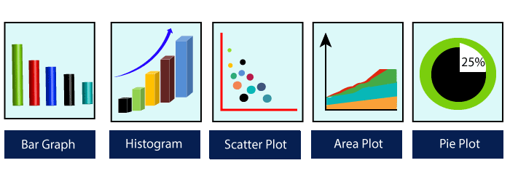
Commonly used chart type

Slide 6
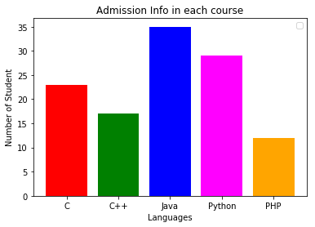
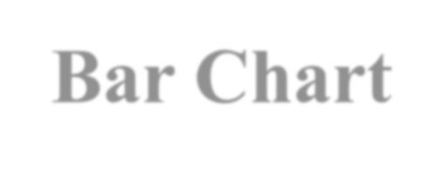
import matplotlib.pyplot as plt
langs = ['C', 'C++', 'Java', 'Python', 'PHP'] students = [23,17,35,29,12]
plt.bar(langs, students, color = ['red', 'green',‘ blue', ‘magenta', 'orange']) plt.xlabel('Languages')
plt.ylabel('Number of Student') plt.title('Admission Info in each course') plt.show()
Bar Chart

Slide 7
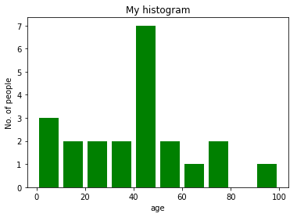

import matplotlib.pyplot as plt
# frequencies
ages= [2,5,70,40,30,45,50,45,43,40,44, 60,7,13,57,18,90,77, 32,21, 20,44]
# setting the ranges and no. of intervals
range = (0, 100)
bins = 10
# plotting a histogram
plt.hist(ages, bins, range, color = 'green', histtype = 'bar', rwidth=0.8) plt.xlabel('Age')
plt.ylabel('No. of people') plt.title('My histogram') plt.show()
Histogram

Slide 8
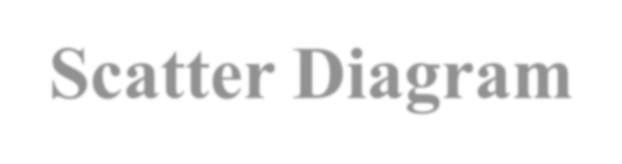
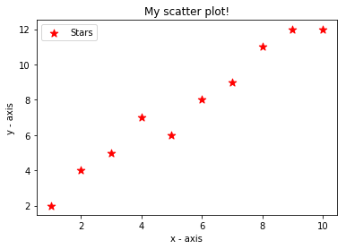
import matplotlib.pyplot as plt
# x-axis values
x = [1,2,3,4,5,6,7,8,9,10]
# y-axis values
y = [2,4,5,7,6,8,9,11,12,12]
# plotting points as a scatter plot
plt.scatter(x, y, label= "Stars", color= "red", marker= "*", s=80)
# x-axis label plt.xlabel('x - axis') # frequency label plt.ylabel('y - axis') # plot title
plt.title('My scatter plot!') # showing legend plt.legend()
# function to show the plot plt.show()
Scatter Diagram

Slide 9
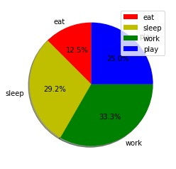
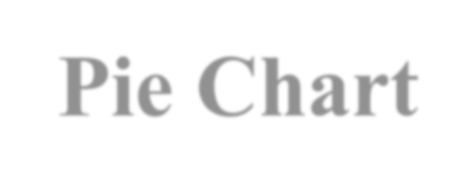
import matplotlib.pyplot as plt
activities = ['eat', 'sleep', 'work', 'play']# defining labels
slices colors
= [3, 7, 8, 6]
= ['r', 'y', 'g', 'b']
# portion covered by each label # color for each label
# plotting the pie chart
plt.pie(slices, labels = activities, colors=colors, startangle=90, shadow = True, autopct = '%1.1f%%')
plt.legend()
plt.show()
Pie Chart

Slide 10
Benefits
Matplotlib is designed to be as usable as MATLAB, with the ability to use Python and the advantage of being free and open-source.
It is a cross-platform library for making 2D plots from data in arrays.
This library is built on the top of NumPy arrays and consist of several plots like line chart, bar chart, histogram, etc.
It provides a lot of flexibility but at the cost of writing more code.

