Slide 1
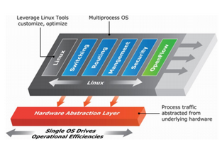
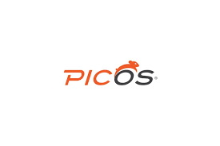
Leverage Linux tools customize, optimize
MULTI PROCESS OS
MITASHI BANSAL
4CSE11Y
Ms. MADHULIKA
Process traffic abstracted from underlying hardware

Slide 2
Introduction
PicOS: A Bare-Metal, White-Box Switching Operating System (OS).
PicOS (formerly known as XorPlus) is a network operating system (NOS) that Pica8 has developed based on XORP , an extensible Open Router Platform. The operation system works on an unmodified Linux kernel and is extended with a range of network and switching services.
PicOS bare metal switch operating system integrate OpenFlow-based applications and business-logic policies into existing Layer-2 / Layer-3 networks.

Slide 3
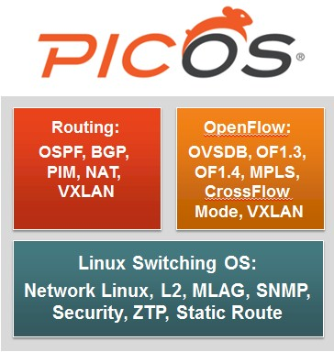
Contents
General Architecture
Traditional Routing and Switching
SDN: OpenFlow and OVSDB
Mixing SDN and Traditional Routing and Switching
Advantages
Conclusion

Slide 4
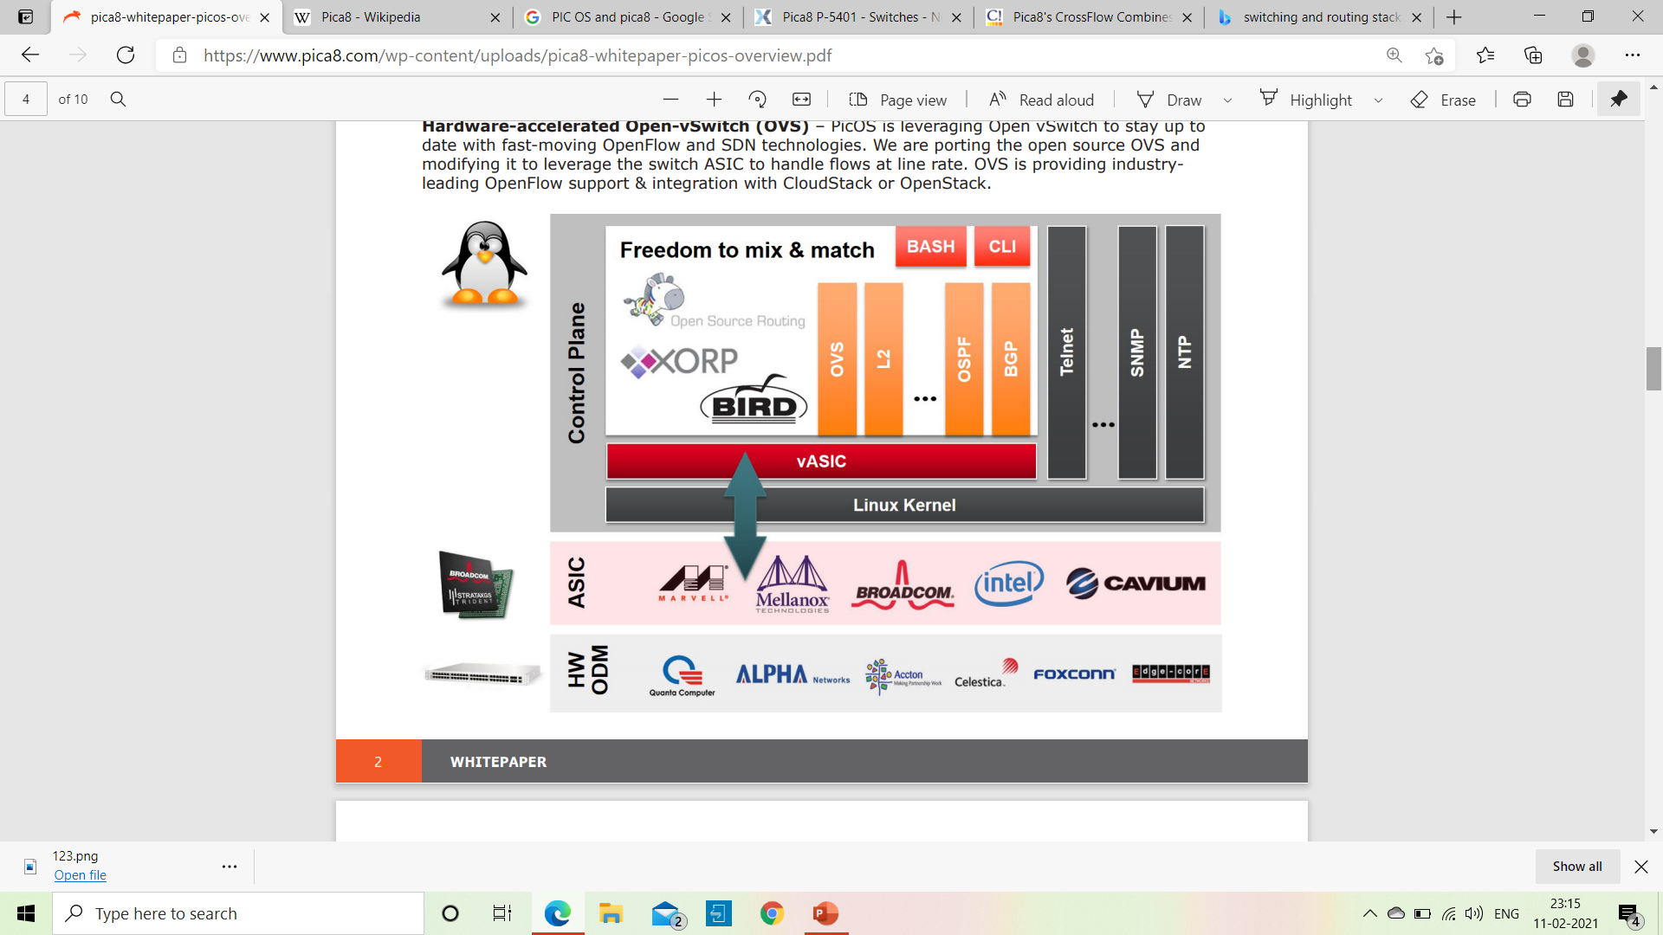
General Architecture
An unmodified Linux kernel
A virtual ASIC Technology (vASIC®)
Traditional switching and routing protocols
Hardware-accelerated Open-vSwitch (OVS)

Slide 5
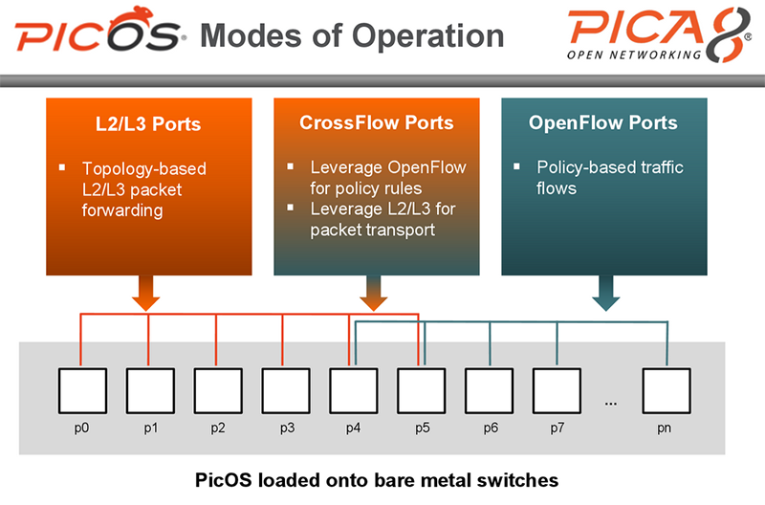
Traditional Routing and Switching
High-Level Architecture
Robustness
Fast Convergence
Routing stack

Slide 6
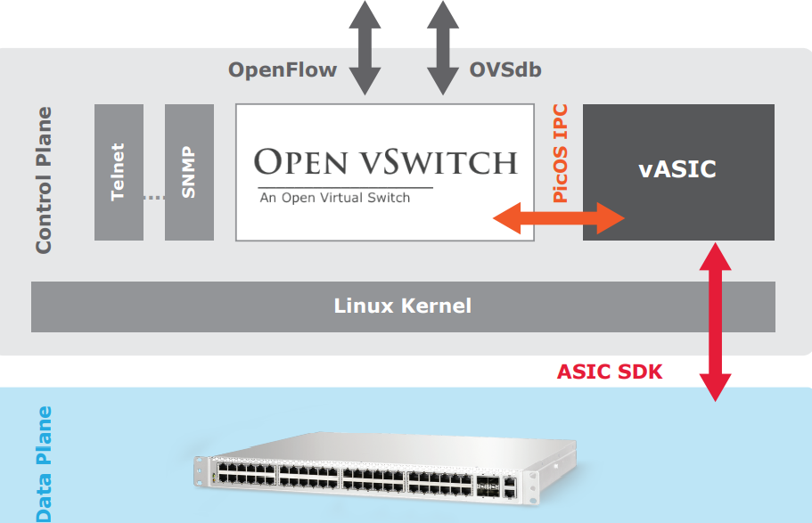
SDN: OpenFlow and OVSDB
PicOS leverages Open vSwitch a production quality, multi-layer virtual switch licensed under the open source Apache 2.0 license.
OVS runs as a process within PicOS.
The OpenFlow protocol governs three essential components of SDN.

Slide 7
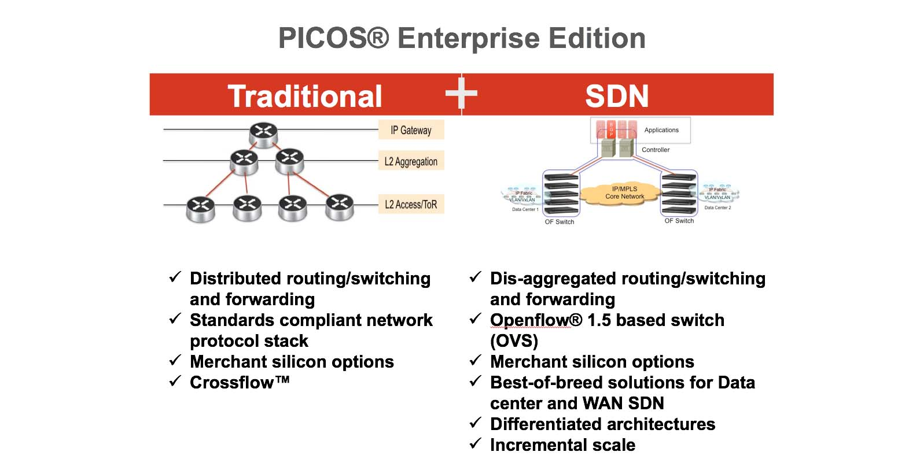
Mixing SDN and Traditional Routing and Switching
Cross Flow Mode The “Cross Flow” mode is what we call the mode of operation using both OpenFlow and L2/L3 on the same switch.
In PicOS, we can use OpenFlow and traditional switching/routing simultaneously.

Slide 8
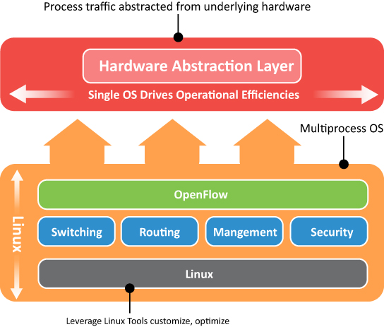
advantages
The hardware agnostic nature of PicOS
PicOS is a user space application
Switching and routing stack built on the XORP
PicOS has complete OpenFlow support, through Open vSwitch

Slide 9
CONCLUSION
The evolution of networking to a new software led model, PicOS is the OS that can bridge the gap, and help your organization seamlessly migrate from a world of lock in to a world of freedom.
PicOS has both conventional tools and APIs and new SDN technology to support any network. Whether you are a traditional network engineer or Linux guru, PicOS can meet the demand of yours

Slide 10


