Slide 1


DELHI DUKAAN
Empower offline market
with Ecommerce!
Mitashi Bansal | Dhruvi Bansal
Amity University, Noida | BVCOE, Paschim Vihar
Phone :
8826532520 Email id : dhruvibansal555@gmail.com

Slide 2

WE ARE ADDRESSING
Goal 8: Promote sustained, inclusive and sustainable economic growth, full and productive employment and decent work for all

Slide 3

1. POVERTY 2. UNEMPLOYMENT 3. MODERN SLAVERY 4. LOW G.D.P
CHALLENGES
- OVERCOME

Slide 4

OUR TARGET
Achieve higher levels of economic productivity through diversification, technological upgrading and innovation, including through a focus on high-value added and labor-intensive sectors.
Promote development-oriented policies that support productive activities, decent job creation, entrepreneurship, creativity and innovation, and encourage the formalization and growth of micro-, small- and medium-sized enterprises, including through access to financial services

Slide 5
FEASIBILITY & ITS BENEFITS
Surviving in COVID-19
Providing a platform to small vendors .
Safety, Surety, & Security
Increasing G.D.P
ENHANCING "OFFLINE MARKETS" TO "ONLINE MARKETS"

Slide 6
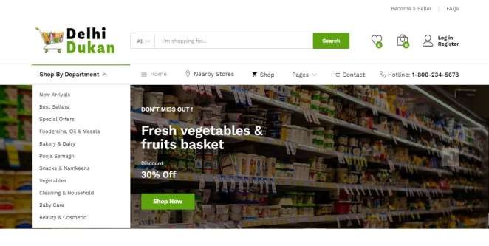
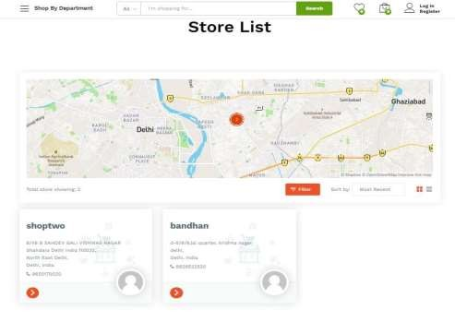
IMPLEMENTATION
1. Buyer will visit our website and choose his/her nearby trusted store.

Slide 7
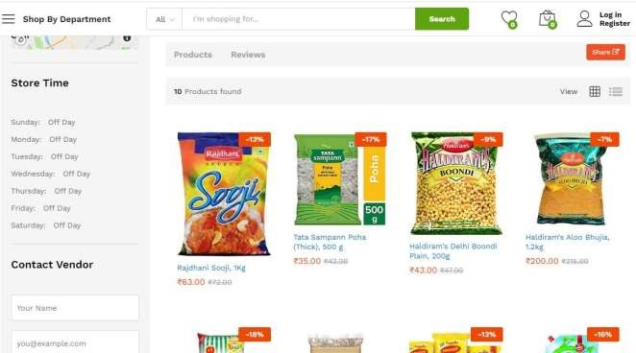
Stores showing under store lists are offline vendors of nearby places.
Buyers can search store by store name of their choice.
Buyers can filter nearby stores according to distance.
Buyers can also give ratings & reviews for their preferred shops.
Buyers can contact directly to shop owners for any query.
2. After selecting a store, it will feel like visiting a nearby shop virtually on the internet. Buyer will add products to his/her cart and will proceed further to place an order from specific nearby shops of their choice.

Slide 8
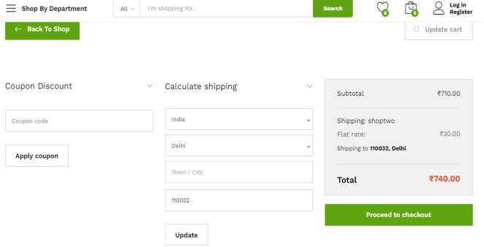
3. Next step is to checkout, buyer can choose COD (Cash on Delivery) or online payment methods.
After successful order placement, vendor could know orders received in his/her admin dashboard. Now our delivery partners will pick up the products from vendors and sanitize them and deliver it direct to buyer.
Let’s have a look on Vendors Dashboard.
Vendor can add, update or delete products from his store.
Vendor can see orders received and manage their status.
Automatic generated sales report will help vendor to track their expenses and profits.

Slide 9
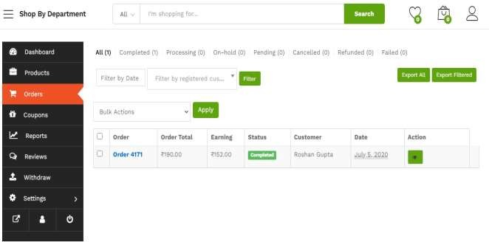
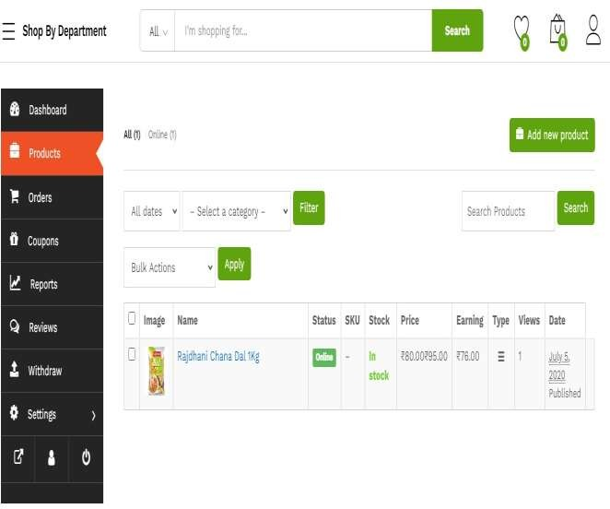
Orders Received Section.
Products Management Section.

Slide 10
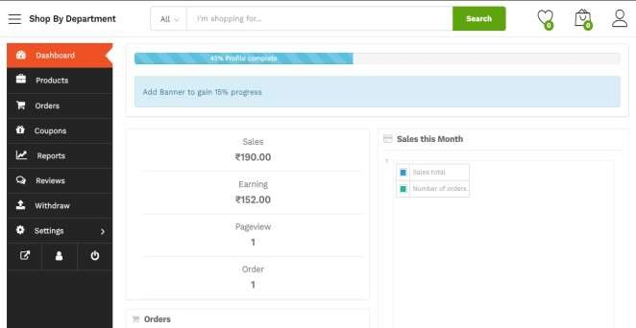
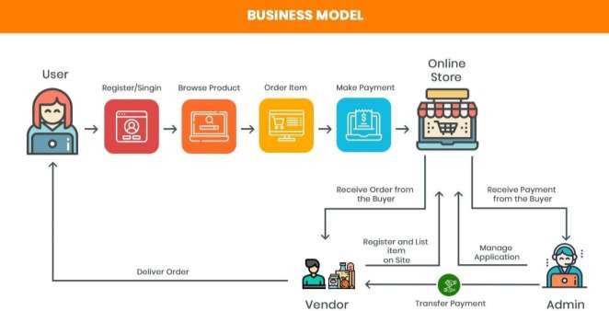
Automatic Generated Sales Reports.
Our Simple but unique business Model is here:
REFER THIS FOR MORE DETAILS :
https://www.youtube.com/watch?v=G5Go2MjW8MU&feature=youtu.be

