Slide 1
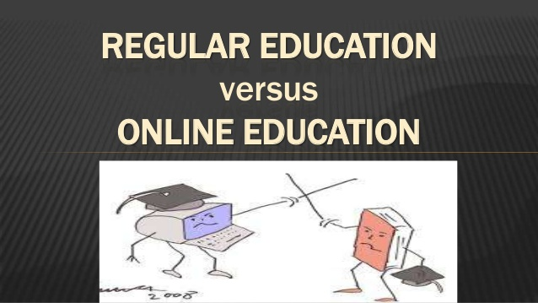

Slide 2


Slide 3



WHAT’S REGULAR TEACHING??
WHAT’S ONLINE TEACHING??

Slide 4
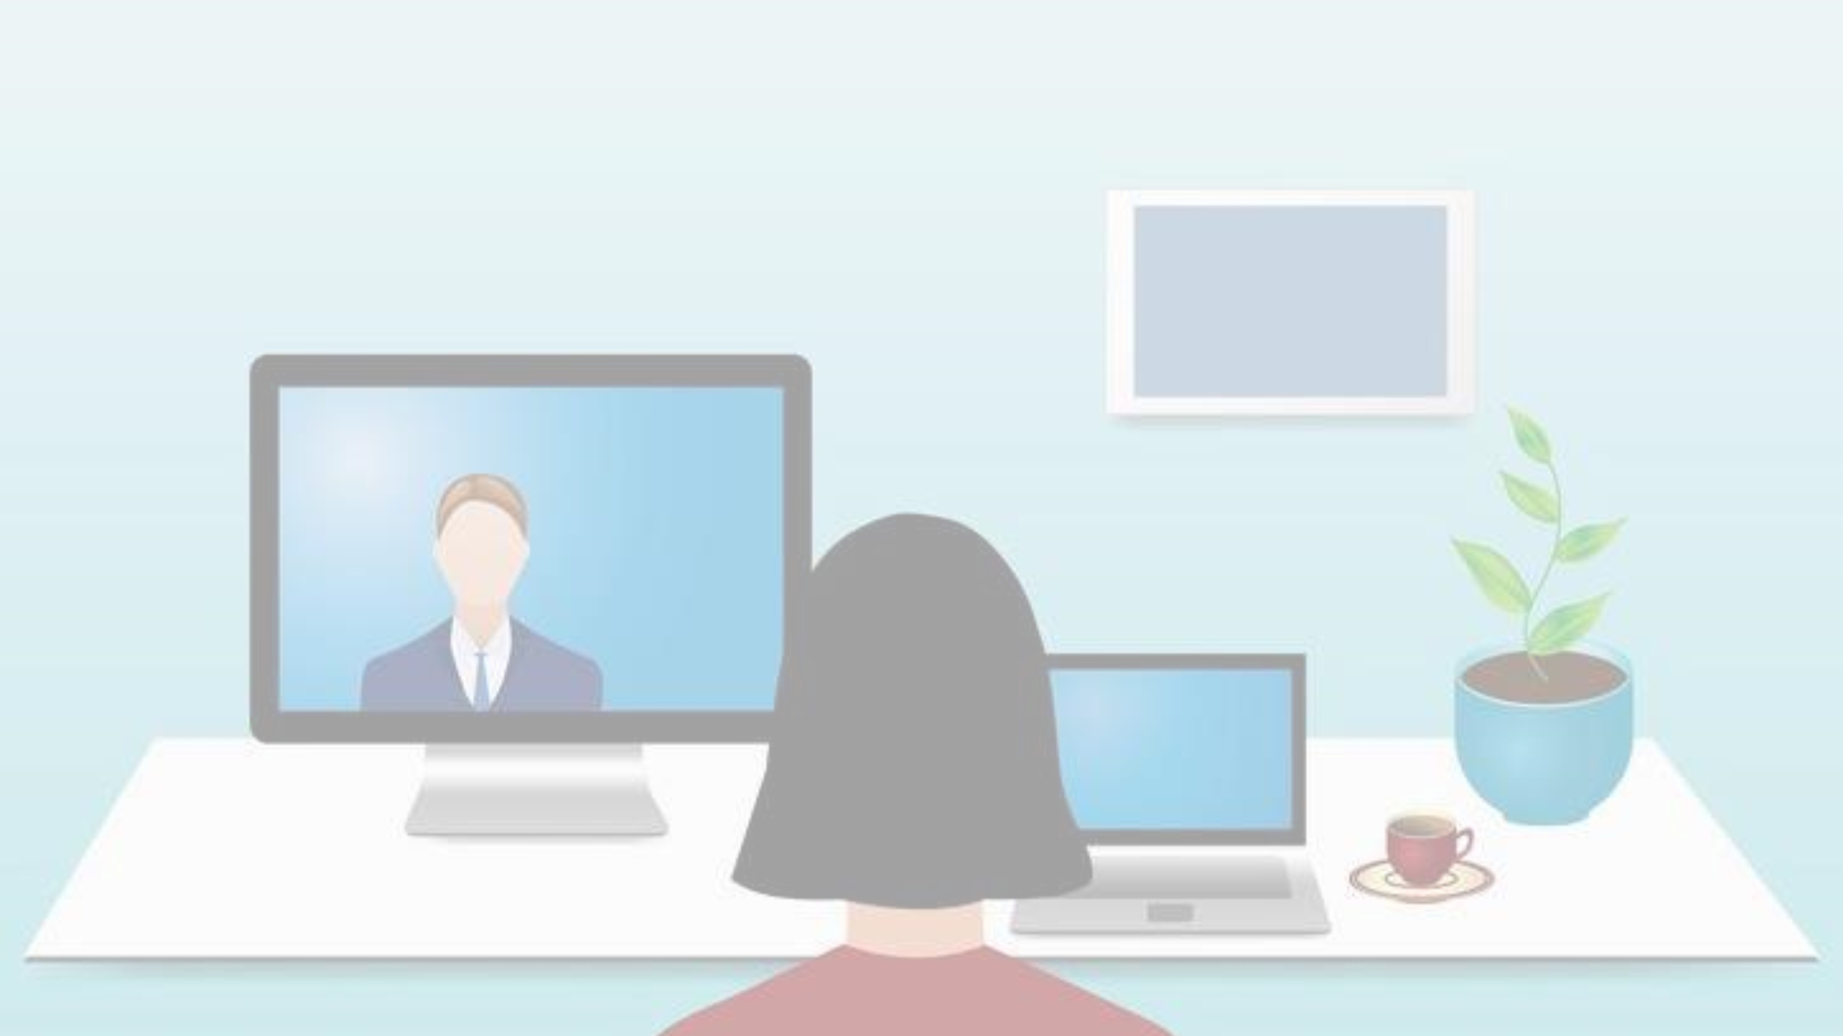

It INCREASES
ACCESS TO
EDUCATION
•
to
everyone.
•
IF DEVELOPED PROPERLY, ONLINE CLASSES
may increase efficiency and course
productivity.
•
Online Learning may decrease costs for
institutions and students alike.

Slide 5


•
STUDENTS FELT THE SENSE OF
•
TEACHERS COMMUNICATED
COMPETITIVENESS AND USED
THE KNOWLEDGE WITH
TO APPLY MORE EFFORTS AS A
STUDENTS AND ENFORCED
WHOLE.
STANDARDS OF BEHAVIOUR
•
STUDENTS UTILISED THEIR
TIME MORE EFFICIENTLY BY
CLARIFYING THEIR DOUBTS
COMFORTABLY.

Slide 6
LETS COMPARE!
TRADITIONAL TEACHING
ONLINE TEACHING
DEMONSTRATIONS
COLLABORATION
EXPLANATION
COST EFFECTIVE I.E CHEAPER
LESS TIME CONSUMING
SELF PACED LEARNING ALLOWANCE

Slide 7
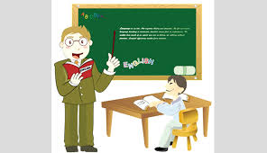

NEGATIVES
NEGATIVE GROUPS
SPOON FEEDING
FAVORITISM
SELF DISCIPLINE
PLAGIARISM
ISOLATION

Slide 8


Social view on online teaching
Why Online Education Needs to Get Social ?
..**xeewdewededde
Its a fact that in todays world if you are effective on social media then you stand a good chance of being effective in online teaching

Slide 9
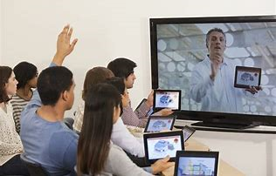
How do these two activities go together?
-PRESENCE
The people who seem to get the most out of social media are those who dedicate themselves to being present on their platform of choice
-COMMUNITY
The most important step is to state the development of a learning community up-front in the course objectives, and then to design the assignments and interactions in a way that fosters that community

Slide 10
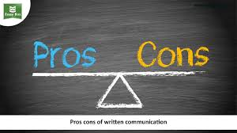
Pros and cons seen by the society in online teaching
Pros
1. Job availability & flexible hours
2.It's convenient!
3.The simplicity
Cons
Social interaction
Student/instructor interaction
motivation

Slide 11
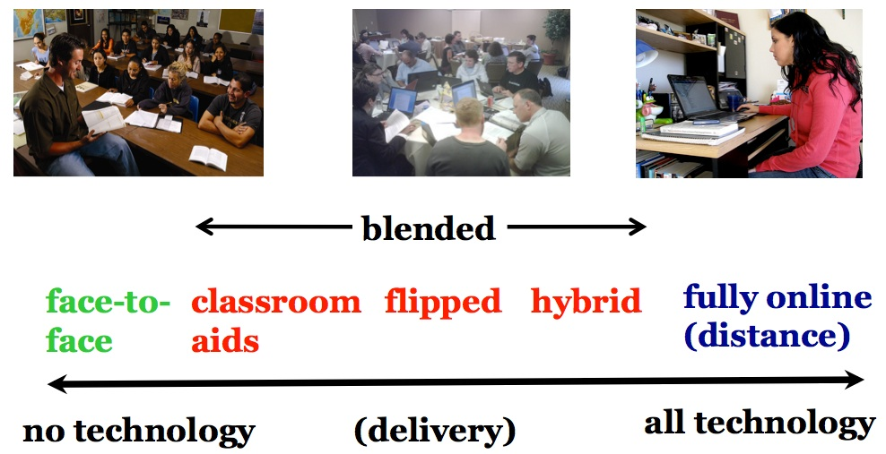
CONSEQUENCES
INTERACTION GAP BETWEEN MENTOR AND STUDENT.
GAIN OF IMPROPER KNOWLEDGE AND INCOMPLETE CONCEPTS.
THE WAY OF SOCIALIZATION AND SHARING OF THOUGHTS HAS YIELD ROBUST NEGATIVE ESTIMATES.
This Photo by Unknown Author is licensed under CC BY-SA-NC

Slide 12
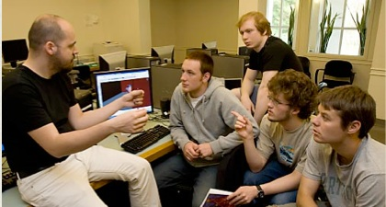
CONCLUSION
A PROPER BALANCE MUST BE MAINTAINED BETWEEEN ONLINE TEACHING AND TRADITIONAL WAY OF TEACHING.
UTILIZATION OF ONLINE TEACHING AND ITS BENEFITS IS MANDATORY.
THE PUBLIC MUST BE MADE AWARE OF THE TECHNOLOGY OF ONLINE EDUCATION AND HOW CAN IT LEAD TO EXEMPLIFY OUR EDUCATION MODE.
SCHOOLS AND INSTITUTIONS MUST MAKE USE OF ONLINE TEACHINNG AS A MODE TO TEACH THE STUDENTS IN A MORE INTERACTIVE WAY.
THE INTERACTION BETWEEN MENTOR AND STUDENT MUST BE MADE MORE SECURE AND LIVELY BY USING ONLINE EDUCATION TO IMPROWISE THE TEACHING.

Slide 13

THANK YOU

