Slide 1
Techie Talk: Performance and Optimization Panel

Slide 2

Panel of Experts!
Sarah Jelinek, Title, Company
Mitch Milam, Head Coach, xRM Coaches
Matt Wittemann, Chief Customer Officer, ClickDimensions

Slide 3
Sarah Jelinek Title, Company
Power user with Microsoft SharePoint®2010, Microsoft Office®2010, Microsoft Dynamics GP 2010, Microsoft FRX®, Microsoft Forecaster 7.0, Management Reporter and Encore Project software
Deployed PowerPivot software in SharePoint 2010 to give staff access to data
About xxx
35 employees - Located in xxxx
Non-profit professional association with External Facing website and intranet in SharePoint 2010
Slide for each person
To do self introductions

Slide 4

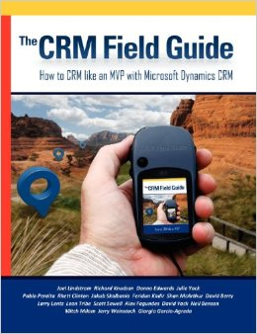
Mitch Milam Head Coach, xRM Coaches
Seven-time MVP for Dynamics CRM
Has worked with Dynamics CRM since 2005 (CRM 3.0)
Currently focuses on Dynamics CRM:
Architecture
Development
Developer and administrator training

Slide 5
Matt Wittemann Chief Customer Officer, ClickDimensions
Oversee technical support, training and operations at ClickDimensions – the top-rated and most-rated ISV solution on the Dynamics Marketplace
8-time recipient of the Microsoft Most Valuable Professional (MVP) award
Author of ‘The Microsoft Dynamics CRM 2011 Administration Bible’ (Wiley, 2011)

Slide 6
Session Objectives
Interactive!
Share experiences on CRM performance and optimizaton
Discuss do’s, don’ts and best approaches
Answer YOUR questions

Slide 7
Conversation Starters
Where should I start looking when performance is bad?
What are some of the top tips you can offer?
Do you know what the AsyncOperationBase table is?
Did you load a lot of data and have it slow down?
Notes:
Top tips:
1 – Enable HTTP compression in IIS
2 - TempDB table larger

Slide 8
Thank You For Attending!
Name | Company | Email
Sarah Jelinek
Mitch Milam
Matt Wittemann | ClickDimensions | matt@clickdimensions.com @MattNC

