Slide 1

XrmToolbox: The tools you need to get the job done
DYNAMICS 365

Slide 2

Mitch Milam
mitch@xrmcoaches.com
@mitchmilam
linkedin.com/in/mitchmilam
youtube.com/xRMCoaches

Slide 3
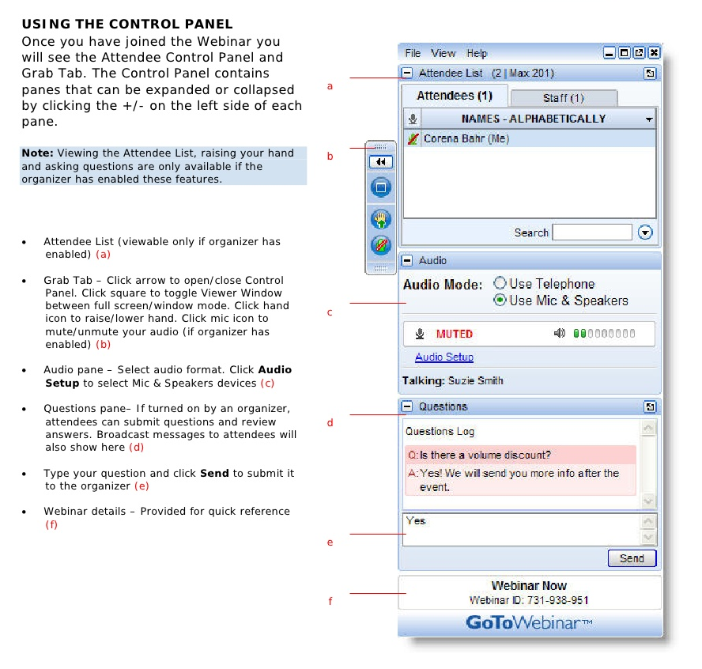
Webinar Housekeeping

Slide 4
Agenda
When
Where
Why
Technology
Tools

Slide 5

Announcements

Slide 6
Announcements
SnapShot! for Dynamics CRM and Dynamics 365
Will ship on Monday, August 7th
Version 4.5
Lots of new features
The ultimate documentation tool for Dynamics CRM and Dynamics 365

Slide 7
Announcements
New Online Course Offerings
Dynamics 365 JavaScript Development
Dynamics 365 Plug-In Development
Dynamics 365 Maintenance and Troubleshooting
Go-Live on Monday, August 21st
Go-Live on Monday, August 28th
Go-Live on Monday, September 4th

Slide 8

Tanguy TOUZARD
@TanguyTOUZARD
mscrmtools.blogspot.com
xrmtoolbox.com
ww2.xrmtoolbox.com (beta)

Slide 9
Installation and Setup

Slide 10
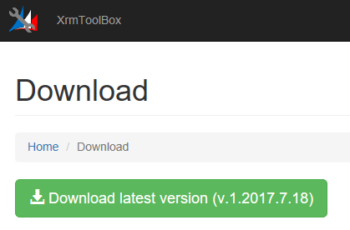
Step 1: Download and Install

Slide 11
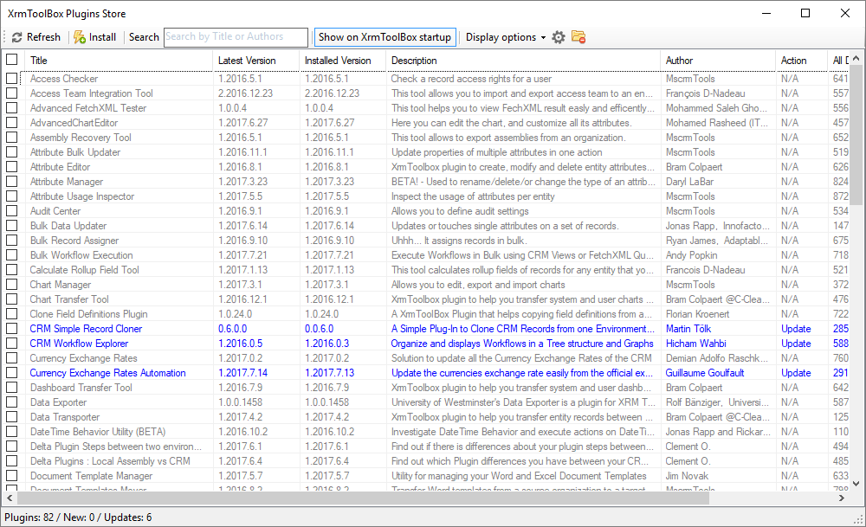
Step 2: Select Plugins

Slide 12
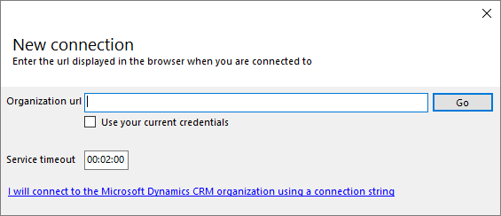
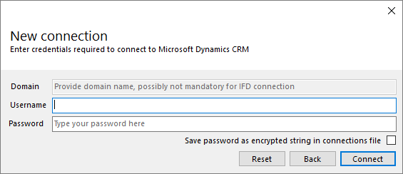
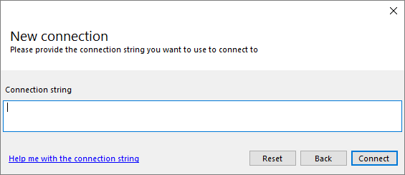
Step 3: Connect to Dynamics

Slide 13
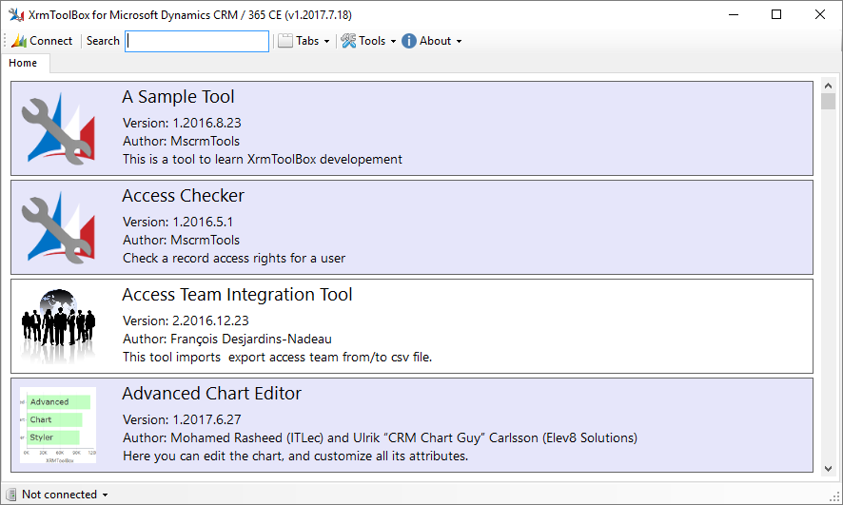
Step 4: Get to Work

Slide 14
What is XrmToolbox?

Slide 15
XrmToolbox Overview
XrmToolbox is a tool for Dynamics CRM/365 administrators and developers
Built from the ground-up to be extensible
Ships with 30+ plugins
The Dynamics community has contributed another 50
Current plugin count is 82 (2017.08.03)

Slide 16
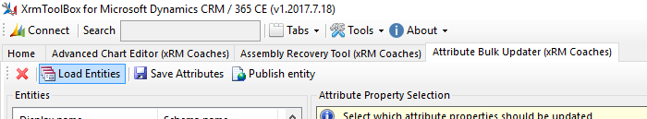
User Interface
Singular user interface
Each plugin you open receives its own tab
Each tab has a toolbar offering specific functionality

Slide 17
Plugins
Are uploaded by the developer to Nuget
Made available via the Plugin Store
Which loads automatically upon startup
You are notified of updates automatically on startup
For both XrmToolbox and the Plugins

Slide 18
Questions?

Slide 19
Thank You

