Slide 1

Notes:
Beating Dynamic Pricing

Slide 2
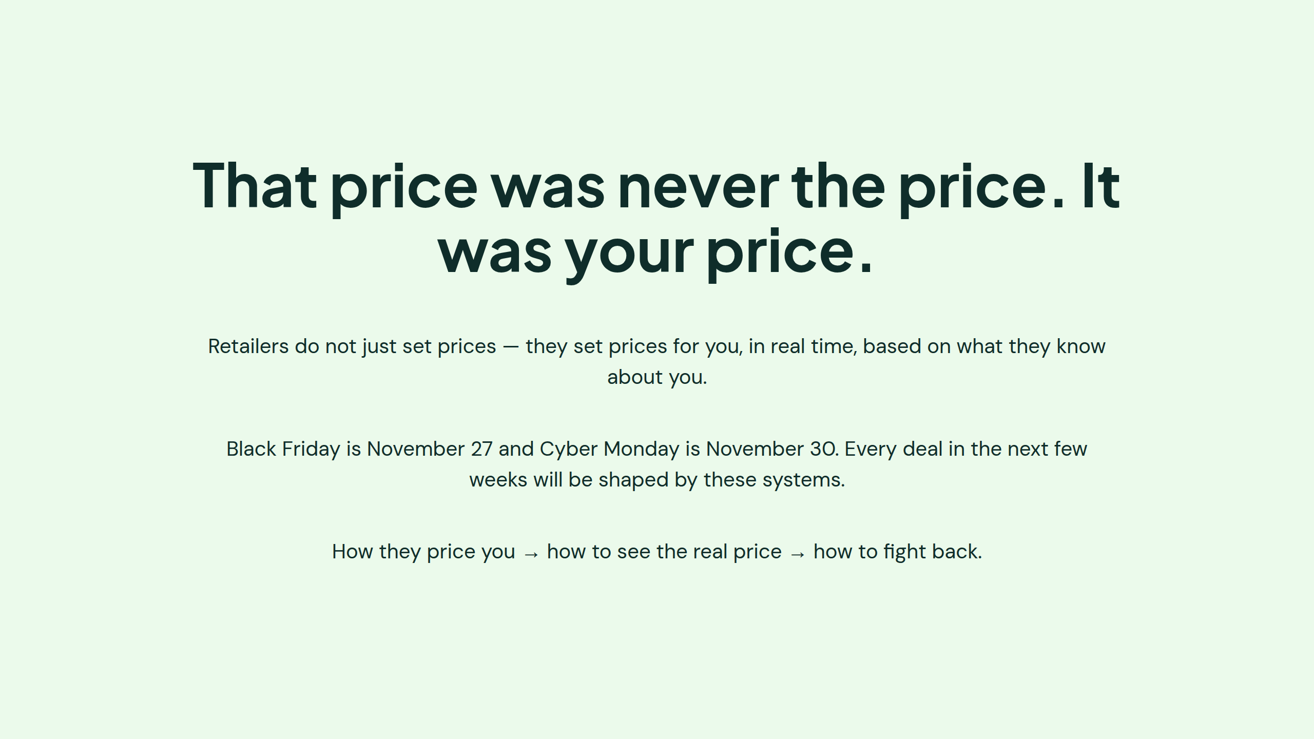
Notes:
That price was never the price. It was your price.

Slide 3
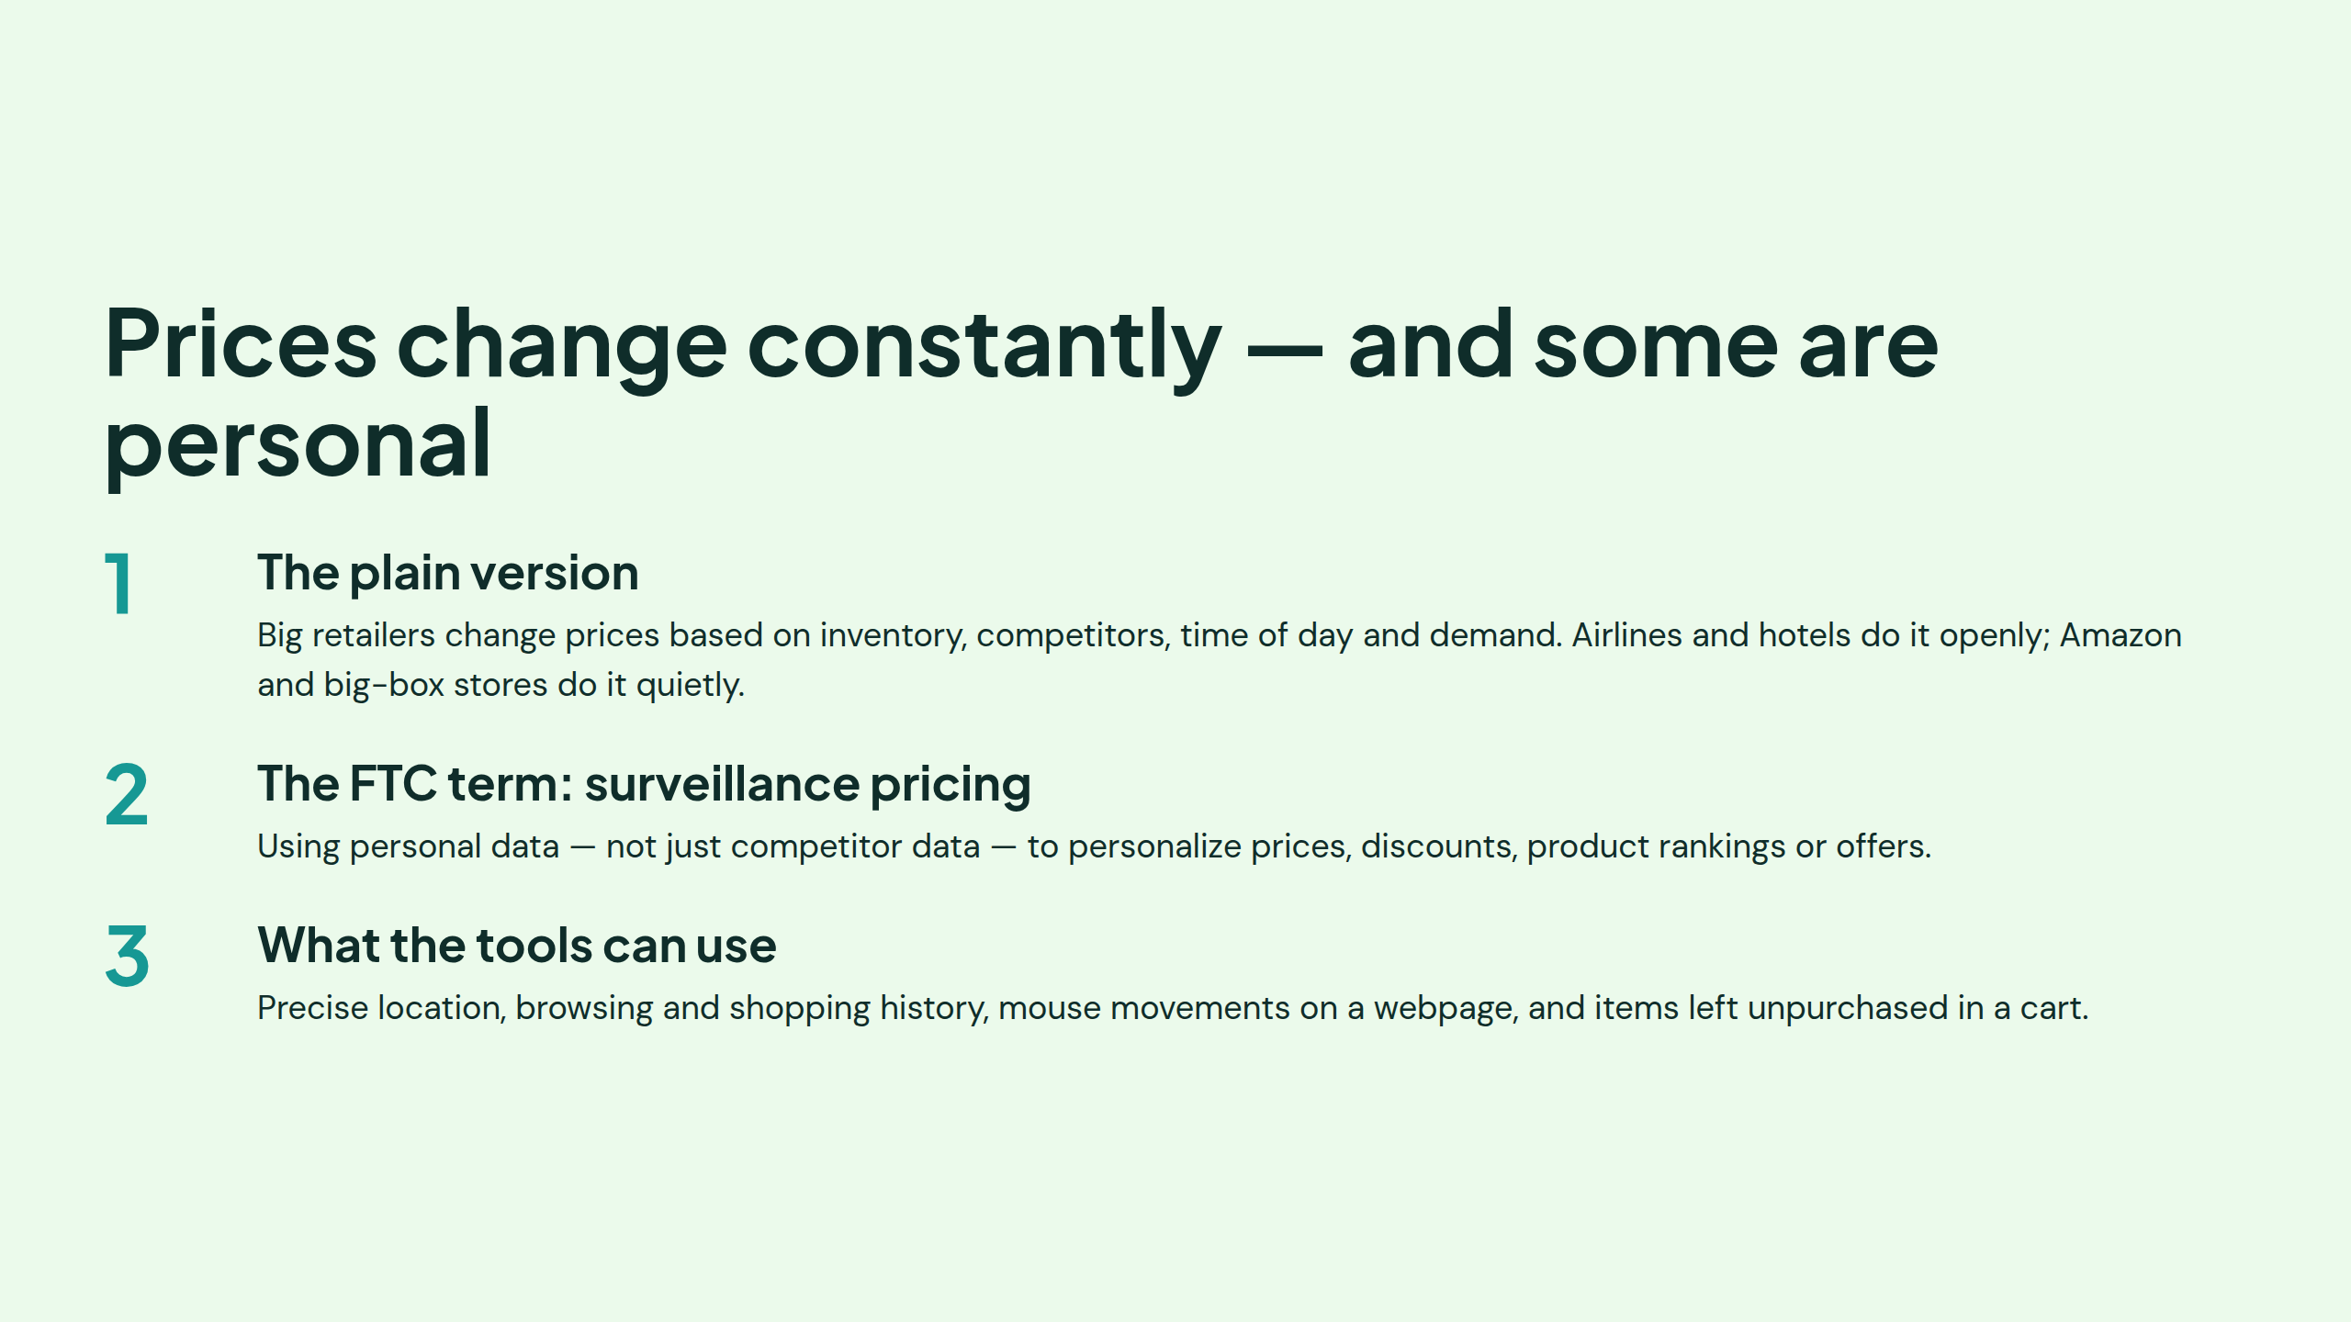
Notes:
Prices change constantly — and some are personal

Slide 4
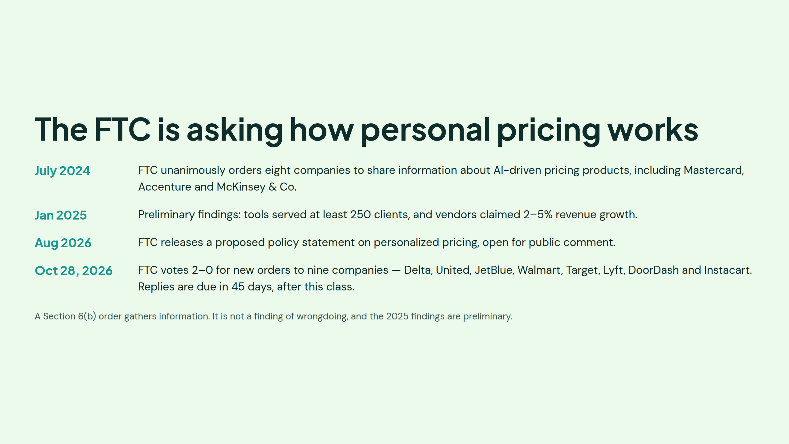
Notes:
The FTC case file (grounded facts to cite):
- July 2024: FTC unanimously used Section 6(b) authority to order **eight companies** to hand over information about AI-driven pricing products (firms included Mastercard, Accenture, PROS, Bloomreach, Revionics, McKinsey & Co.)
- January 2025: FTC staff released **preliminary findings** — reviewed documents from six of those intermediaries.
- What the data showed: tools can use **precise location, browsing/shopping history, mouse movements on a webpage, and items left unpurchased in a cart** to tailor prices, promotions, and product placement.
The hypothetical example the FTC published: a shopper profiled as a **new parent shown higher-priced baby thermometers** at the top of search results.
August 2026: FTC released a **proposed policy statement on personalized pricing** with a request for public comments
October 28, 2026: FTC voted 2-0 to issue new Section 6(b) orders to **nine large companies** — Delta, United, JetBlue, Walmart, Target, Lyft, DoorDash, Instacart — seeking details on how they use personal data to set individualized prices and worker pay. Delta and JetBlue say they don't set individual prices from personal data.
References:
https://www.ftc.gov/news-events/features/surveillance-pricing
https://www.ftc.gov/system/files?file=ftc_gov/pdf/sp6b-issue-spotlight.pdf
https://www.ftc.gov/system/files/ftc_gov/pdf/p246202_surveillancepricing6bstudy_researchsummaries_redacted.pdf
https://www.theguardian.com/us-news/2026/oct/29/delta-uber-ftc-pricing

Slide 5
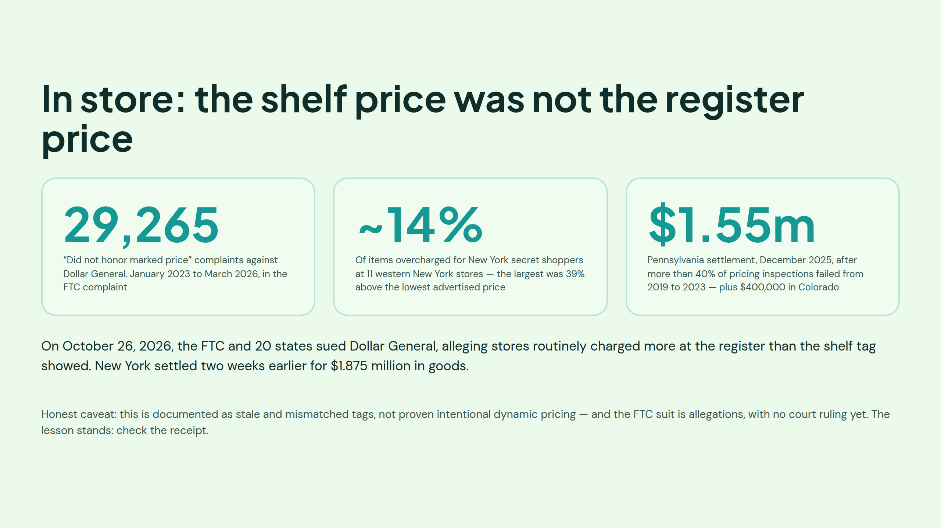
Notes:
- Dollar General received tens of thousands of complaints from consumers across the country who say the company did not honor the advertised price, demonstrating widespread consumer harm and confirming that customers nationwide have been charged more than the advertised price.
References:
https://www.ftc.gov/news-events/news/press-releases/2026/10/ftc-state-partners-sue-dollar-general-charging-consumers-more-advertised-many-products

Slide 6
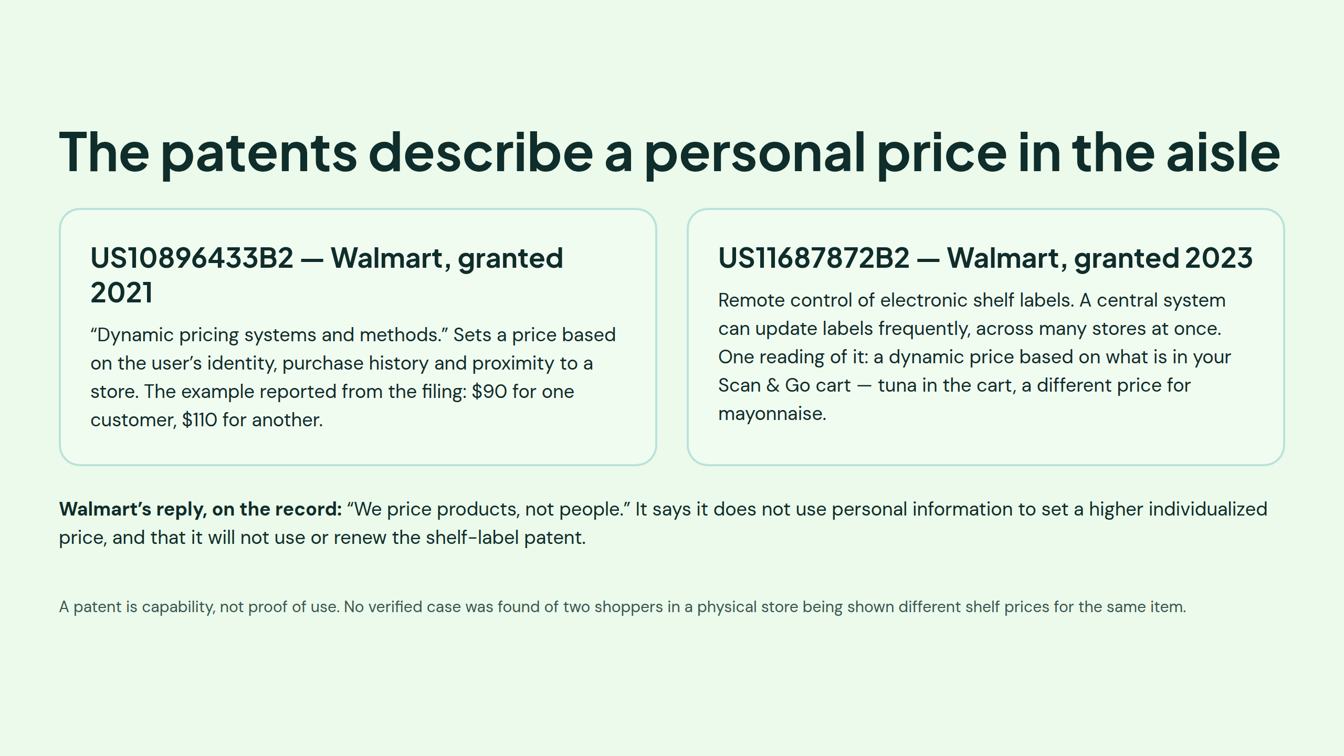
Notes:
References:
Dynamic pricing systems and methods [patent]
https://patents.google.com/patent/US10896433
System and method for remote controlling of electronic shelf labels [patent]
https://patents.google.com/patent/US11687872B2

Slide 7
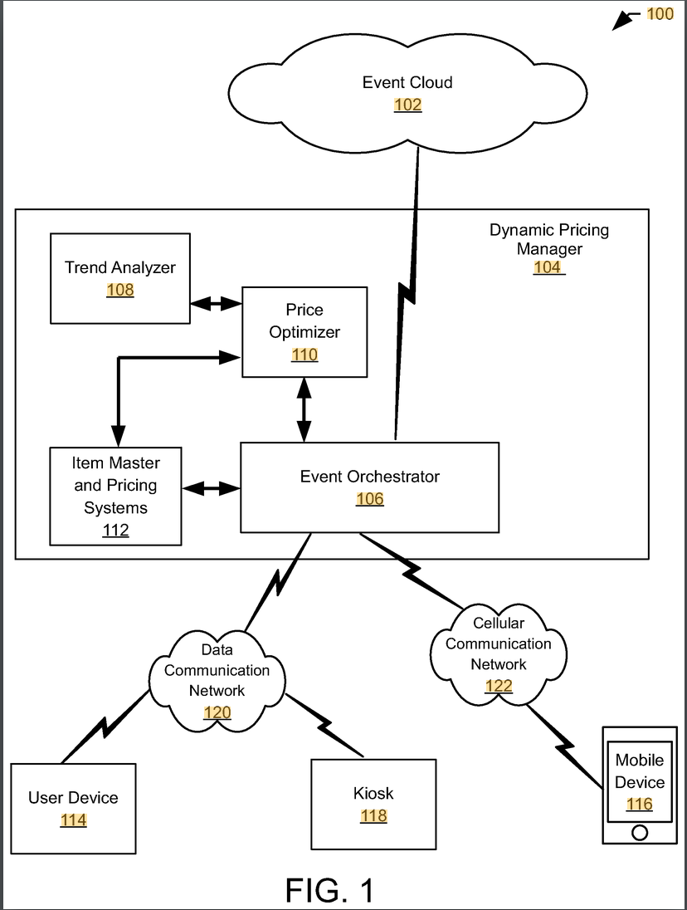
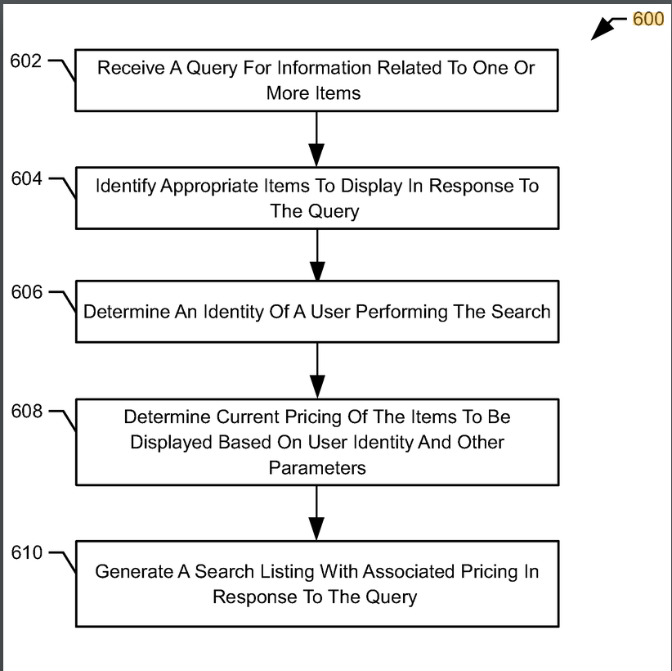
Notes:
Reference:
https://patents.google.com/patent/US10896433

Slide 8
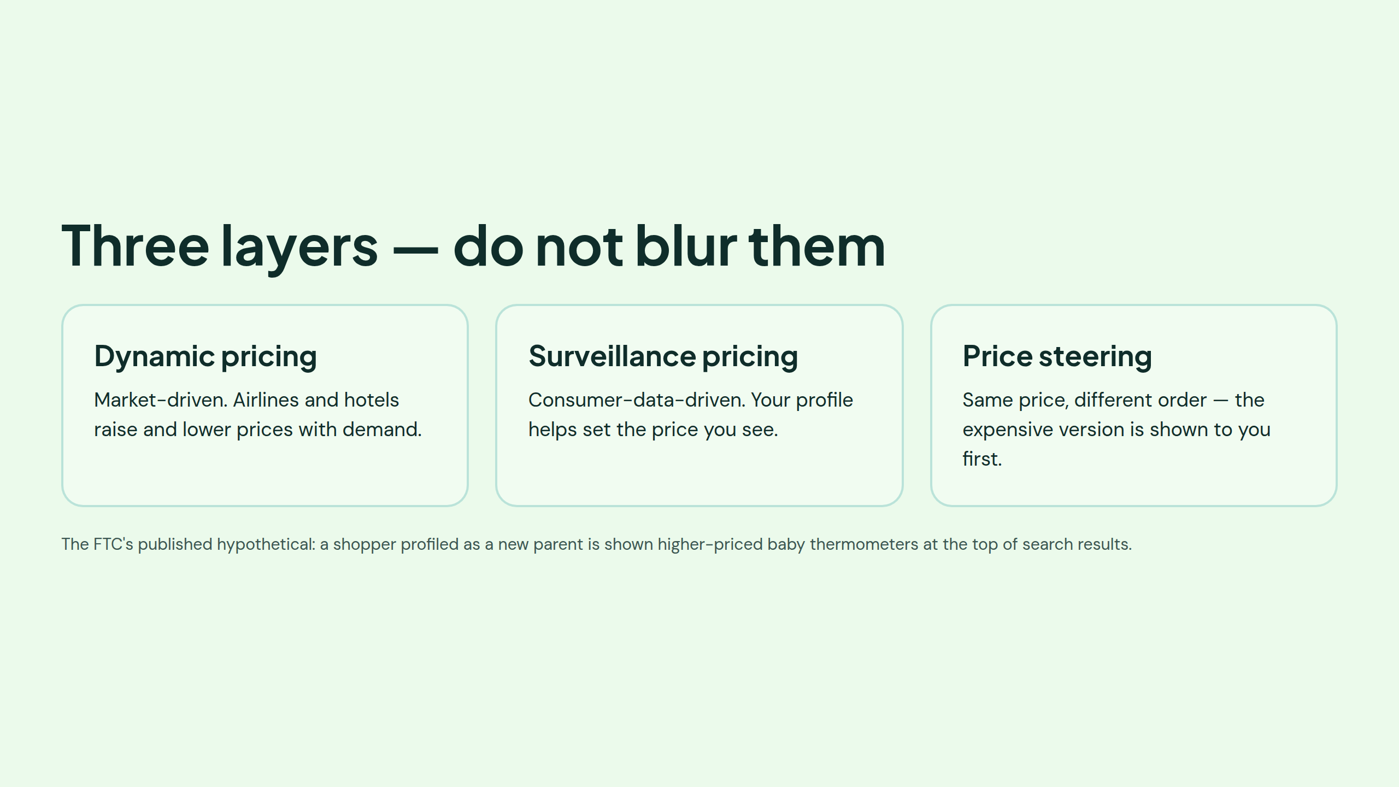

Slide 9
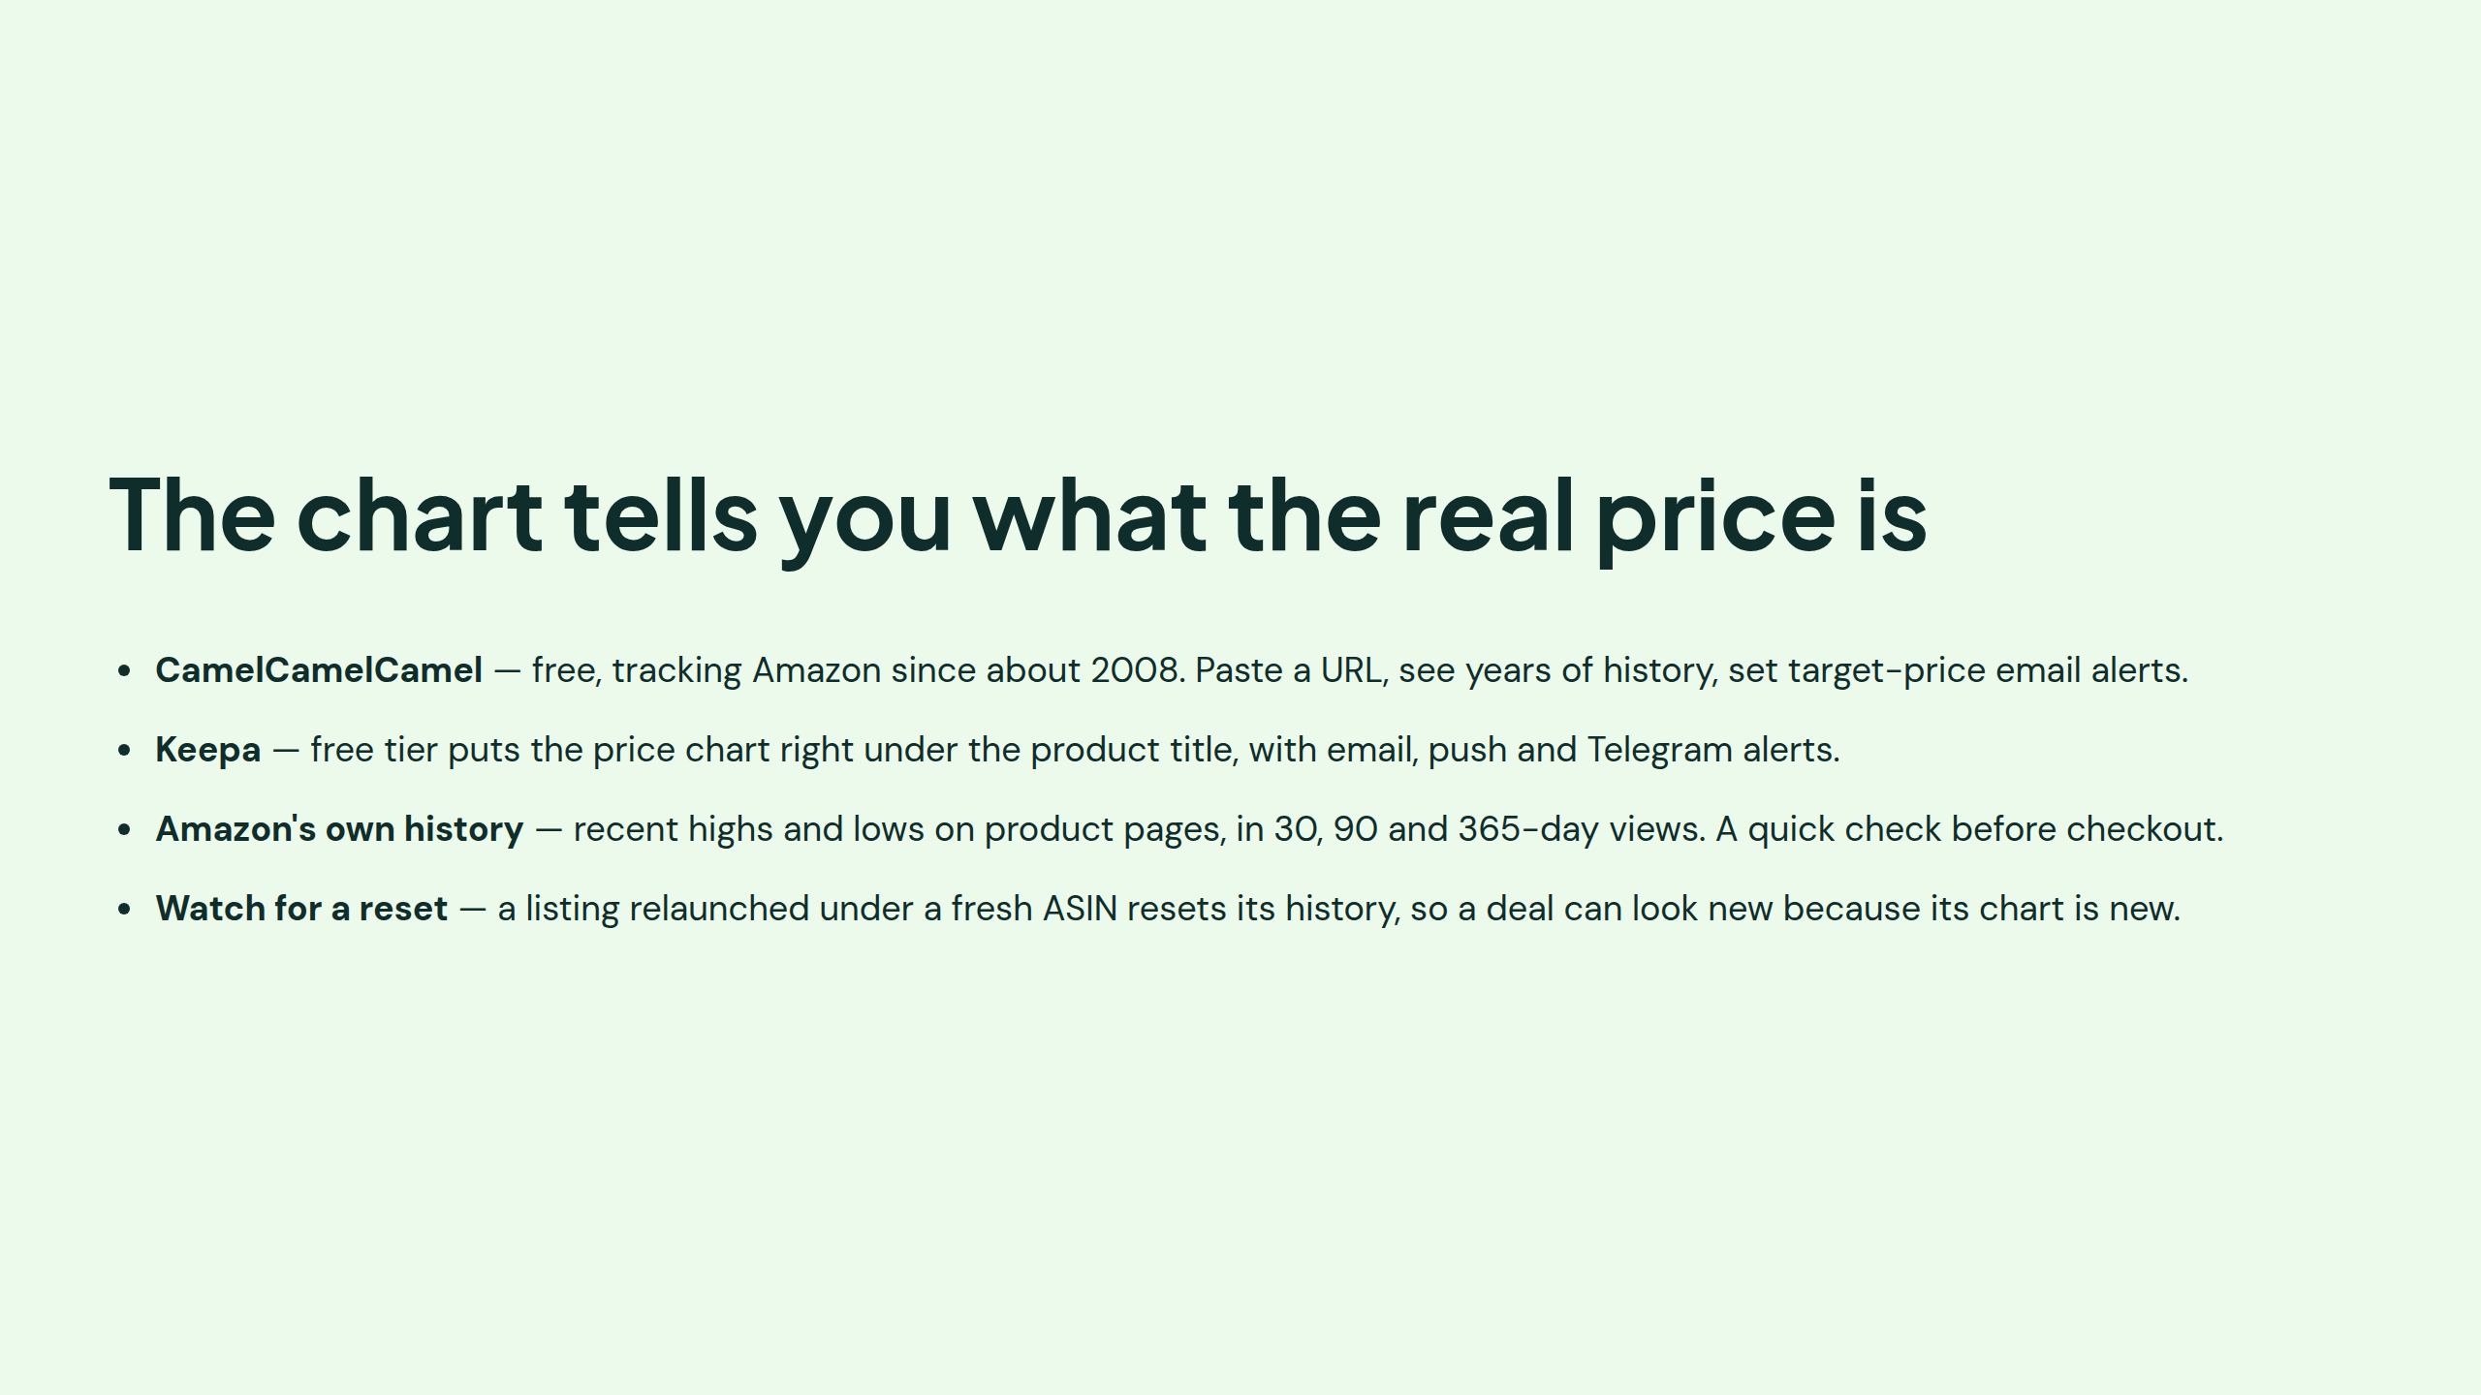
Notes:
https://camelcamelcamel.com/
https://keepa.com/

Slide 10
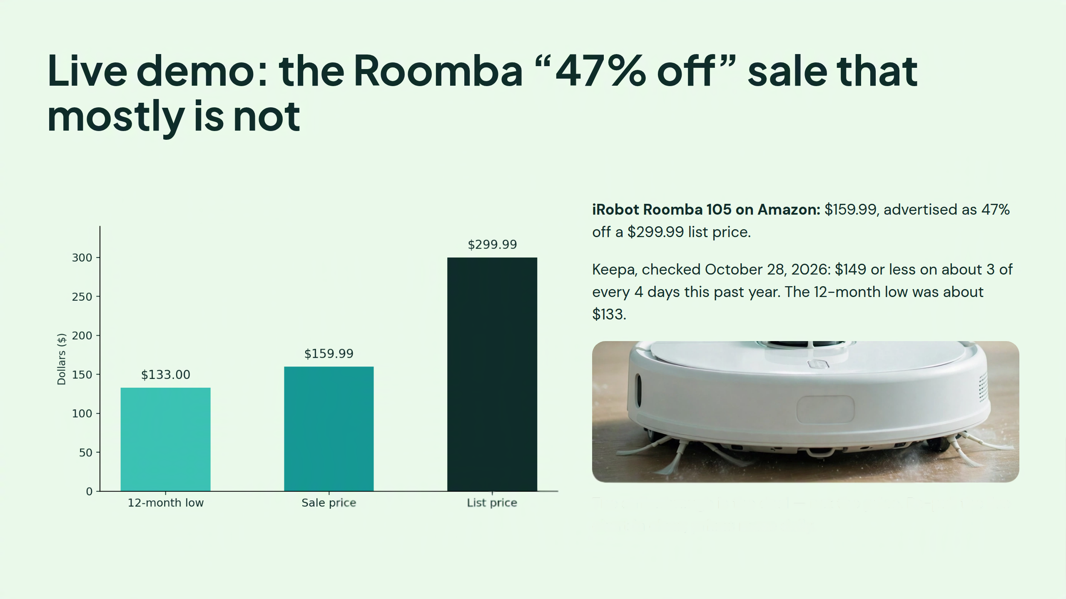

Slide 11
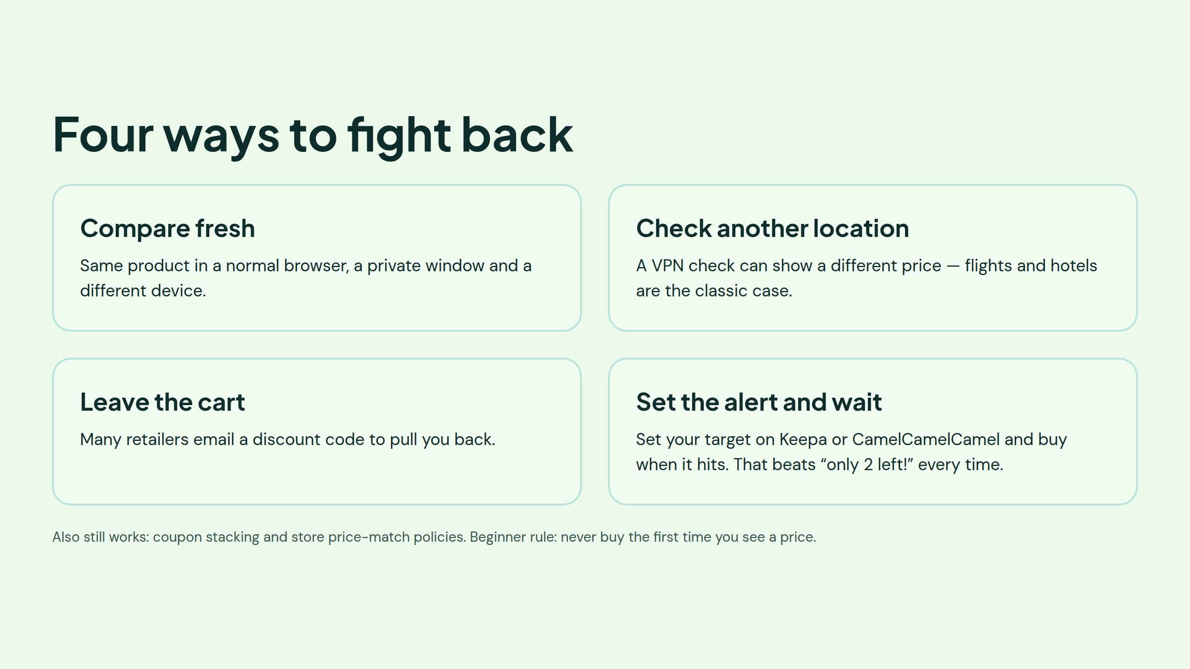

Slide 12
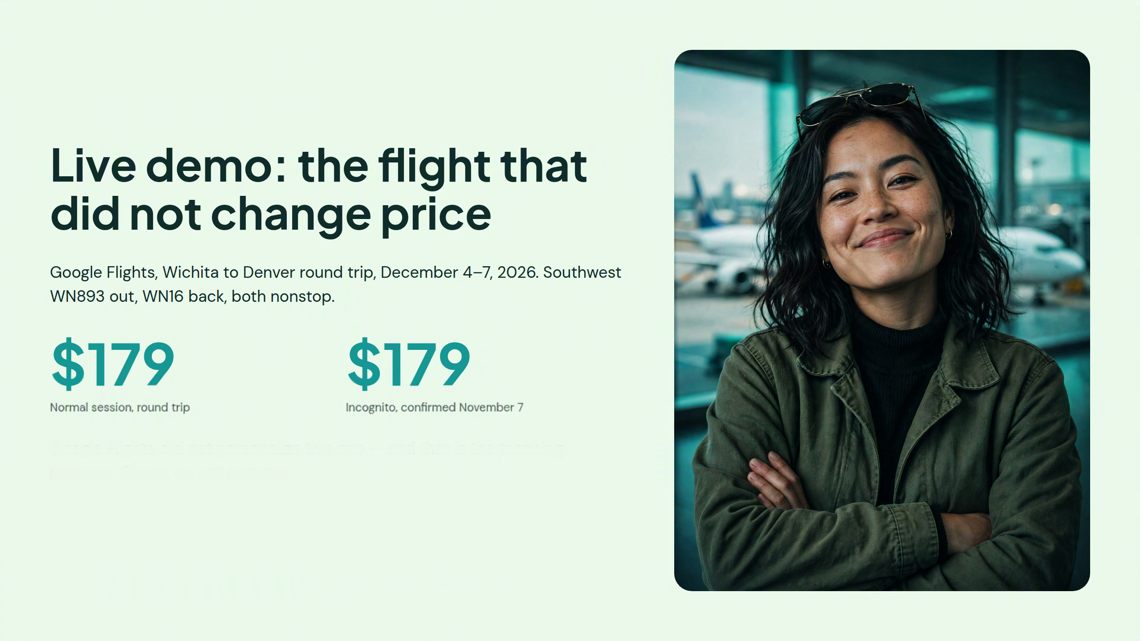

Slide 13
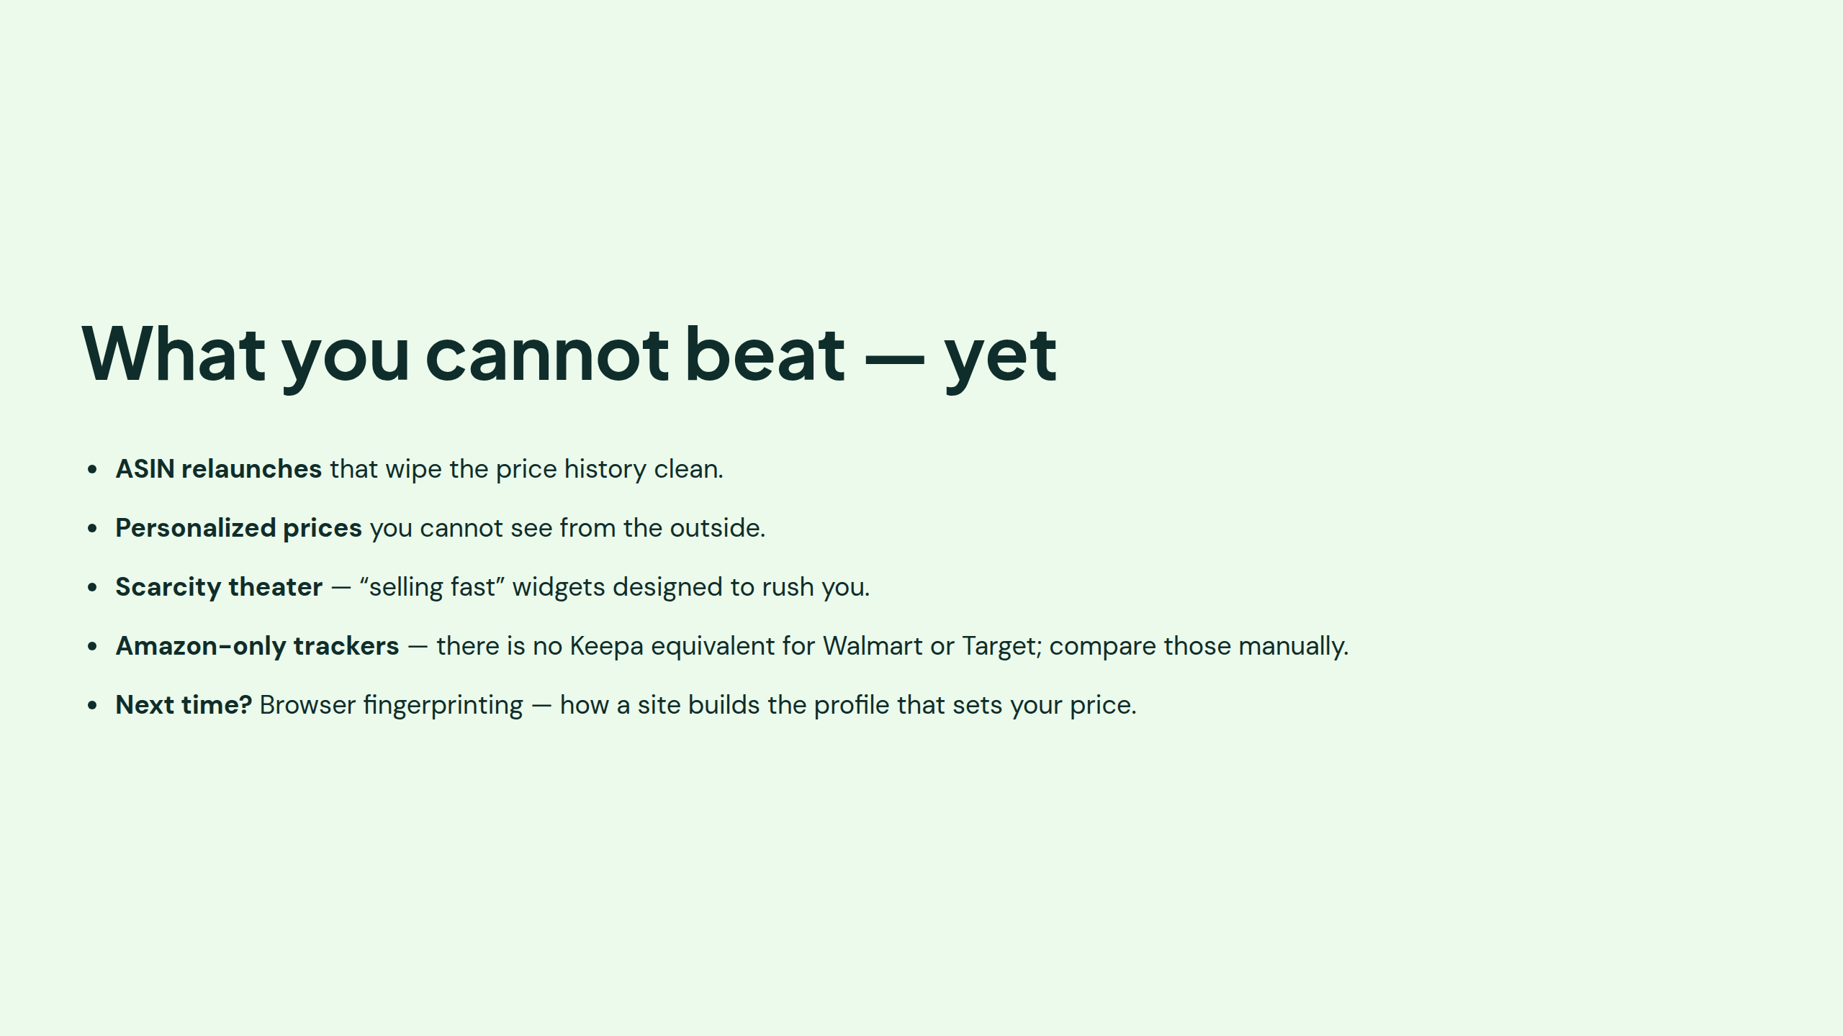

Slide 14


