Slide 1
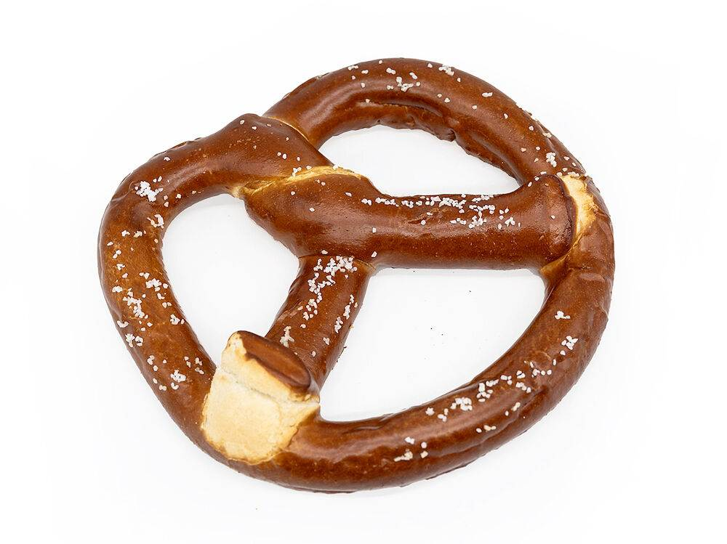
What Fuels Science?
The Food Words In Science

Slide 2
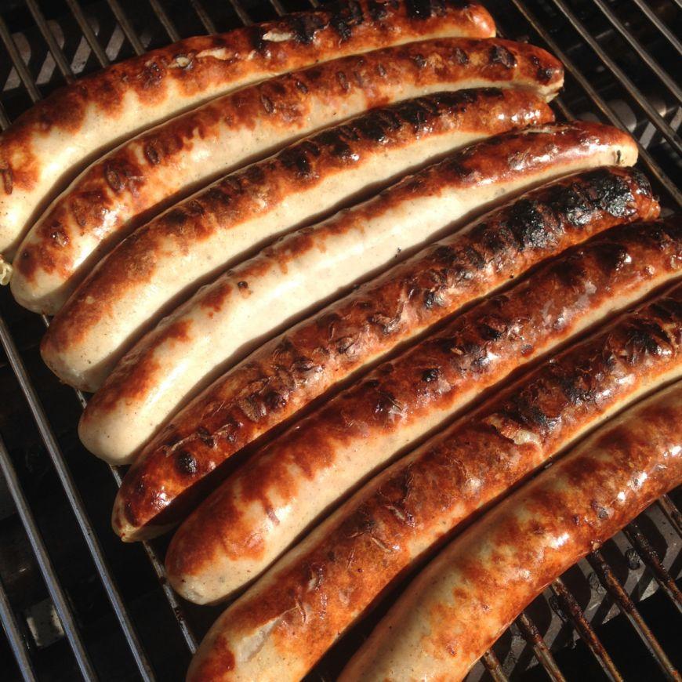
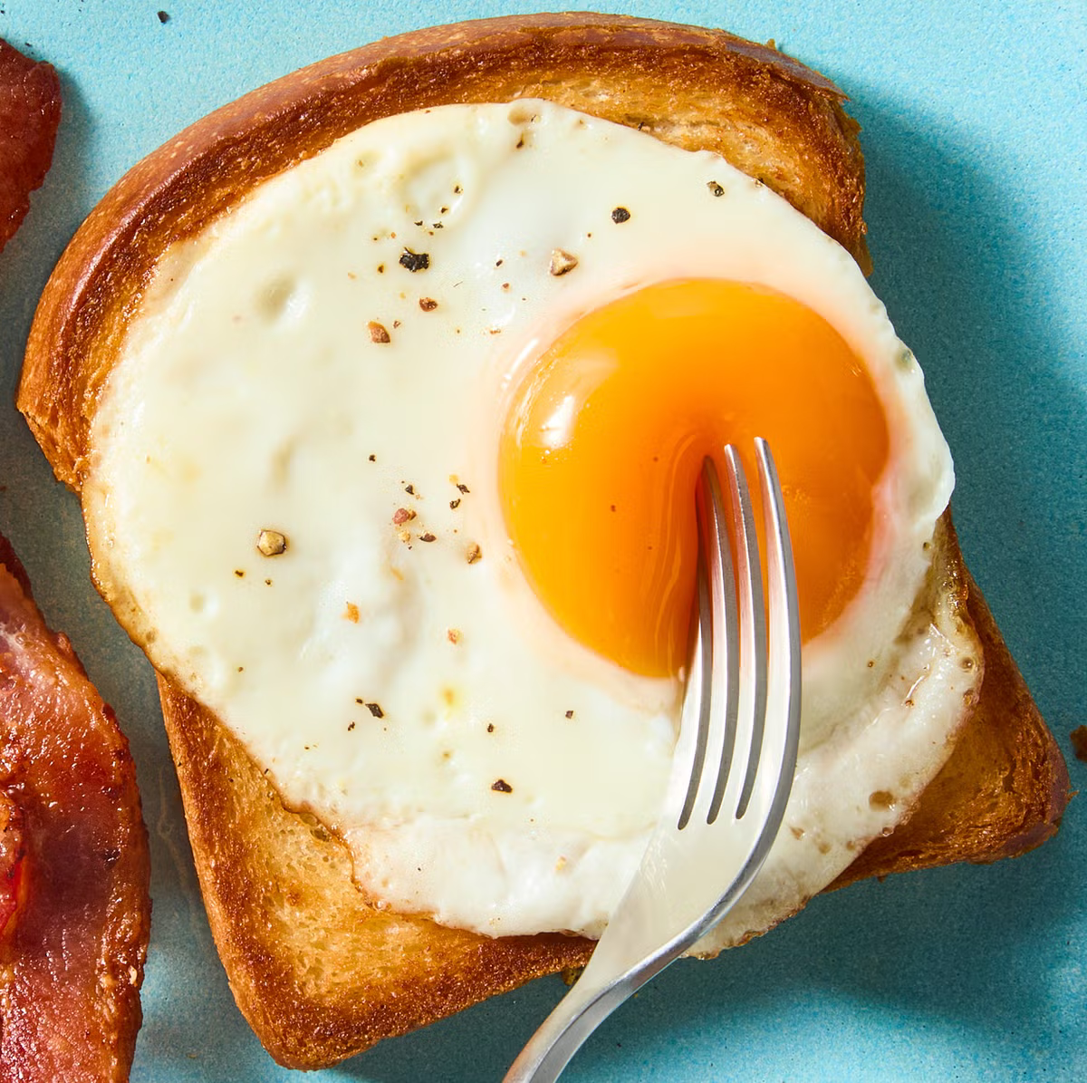
Why?
I get hungry
I like food
Accidental writing
Need api practice

Slide 3
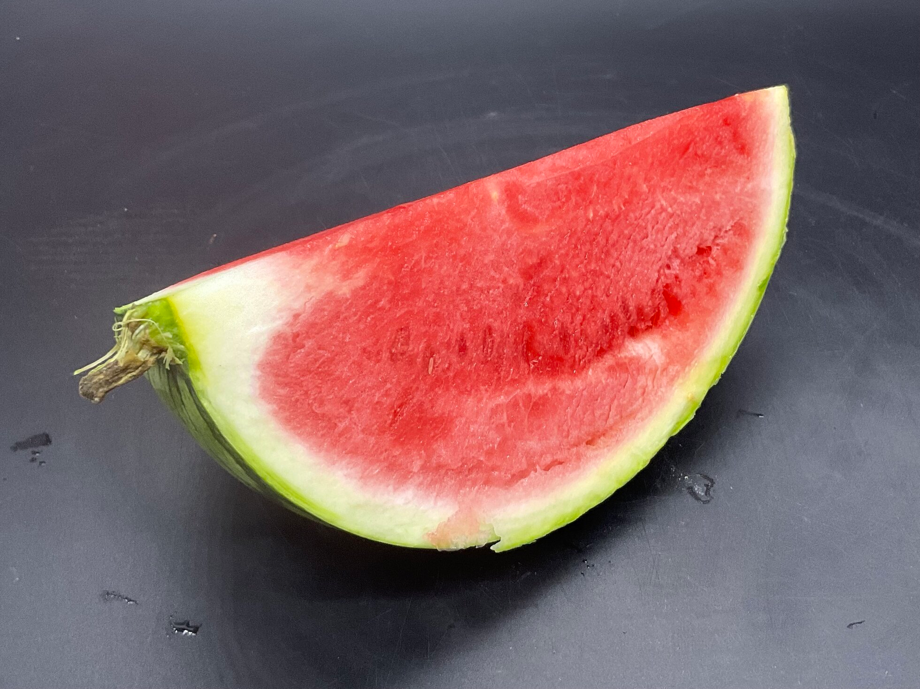
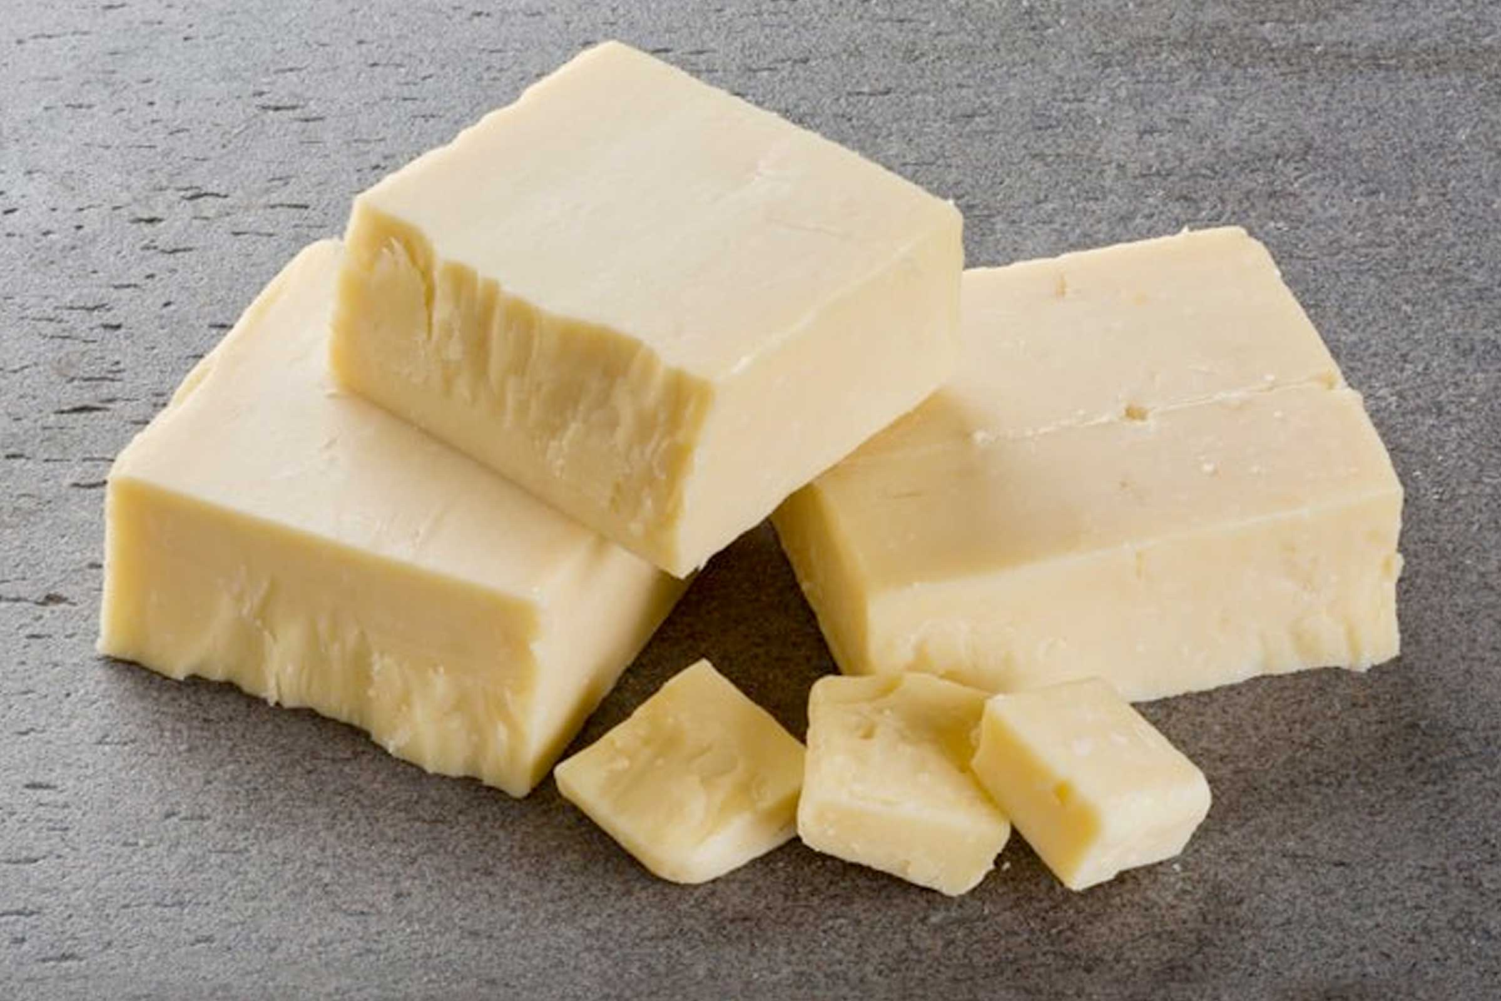
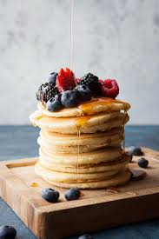
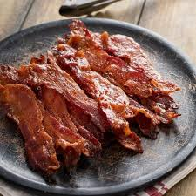
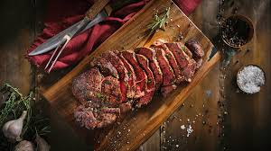
How I Did It And How It Made Me Cry And Hungry

Slide 4
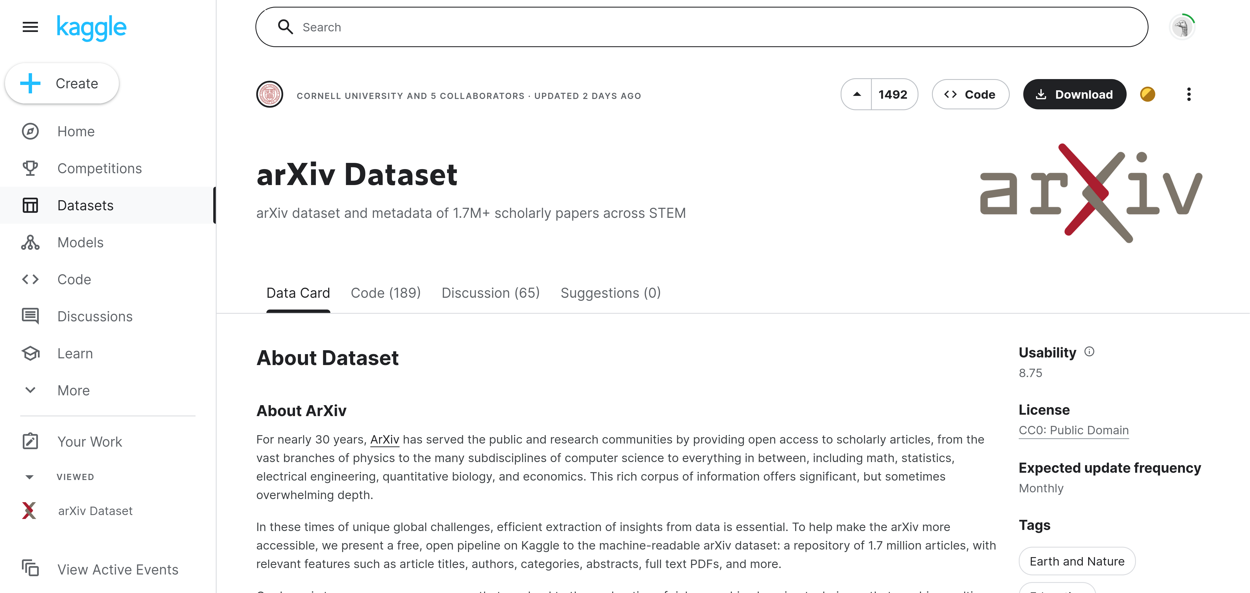

Slide 5
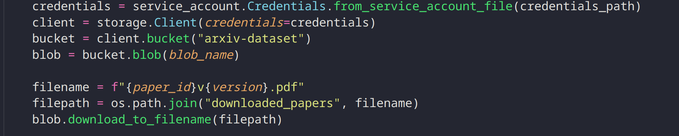
Google Bucket
<2 MILLION PAPERS
<1.1TB

Slide 6
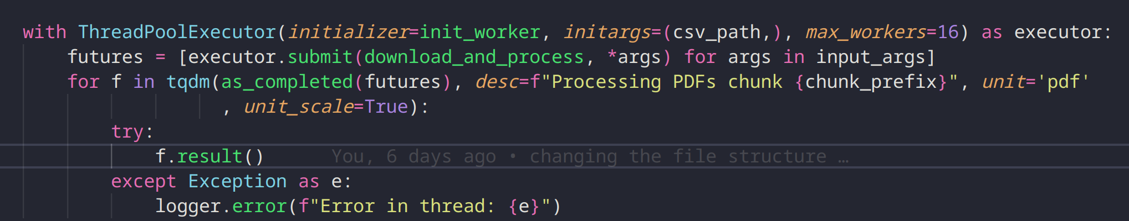
We can handle this

Slide 7
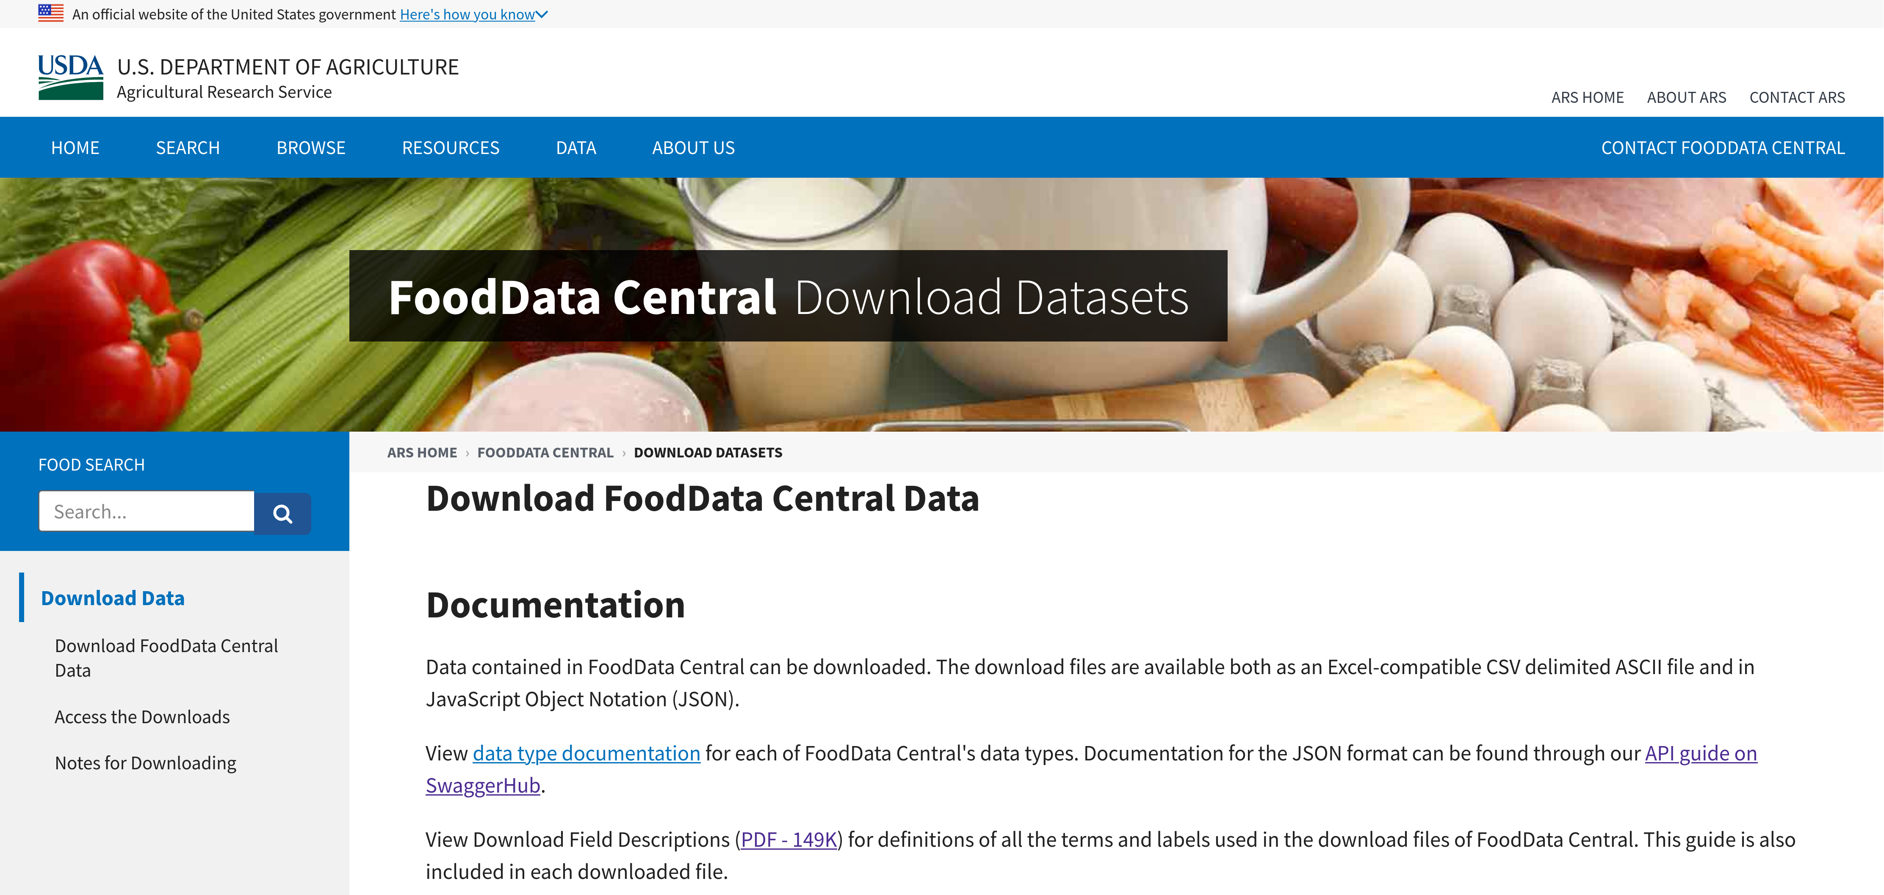
The Food Refrence

Slide 8
Everything Is Going Well
Until 2020 attacked
8-12 PDF/s

Slide 9
The Too many warning
Slowed down to 1pdf/s
Due to some way these are made
Cleaned the pdfs and it ended up to 3 per second
But this is a lot of pdfs to not work I don’t like adobe

Slide 10
Now
With 2.35 million papers analysed
With the code running for over 2 weeks

Slide 11
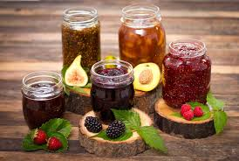
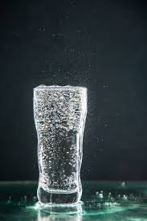
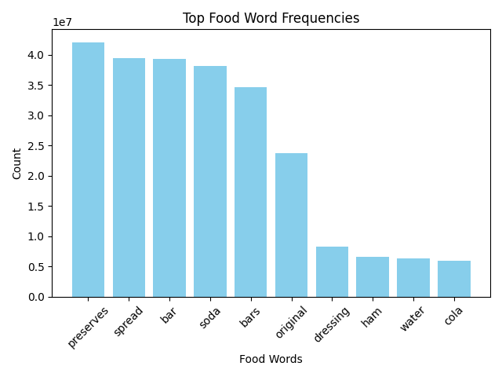
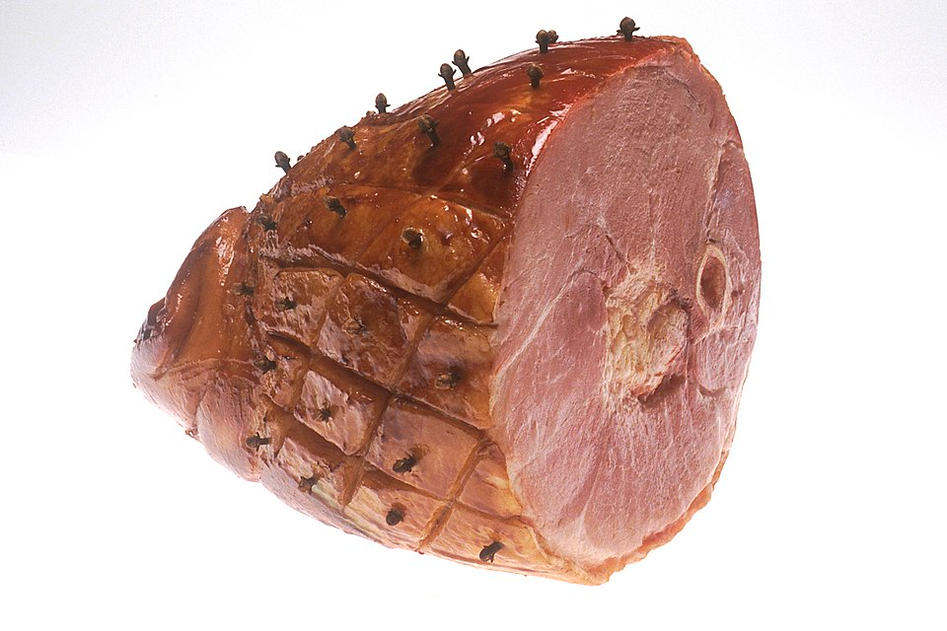
Top 10 Words

Slide 12
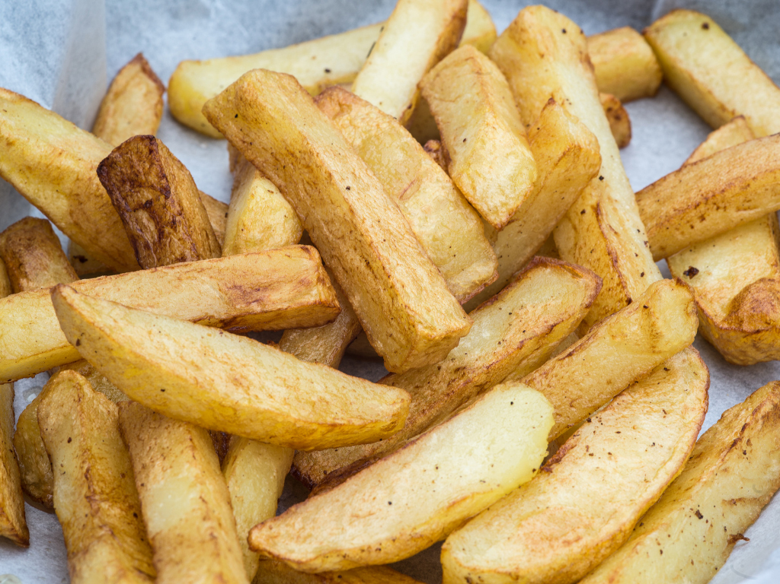
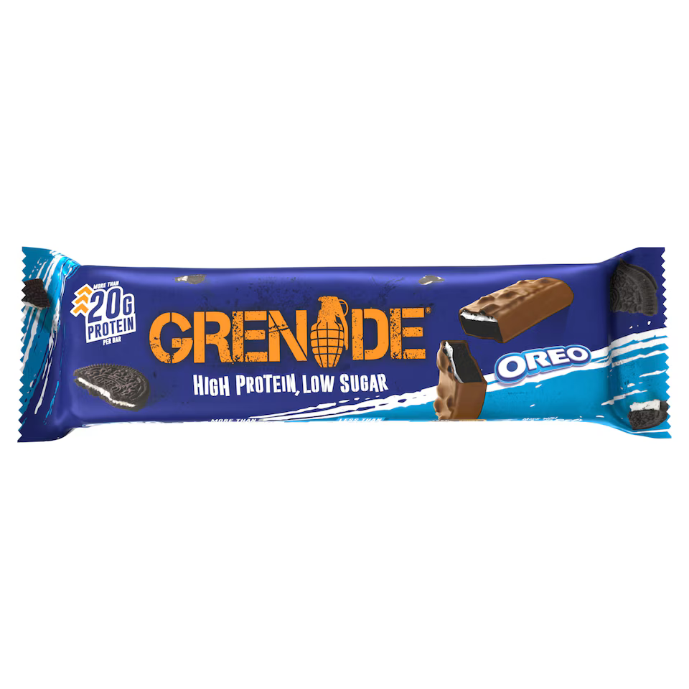
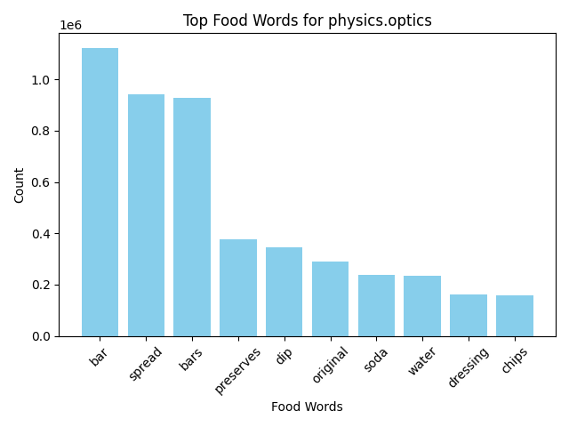
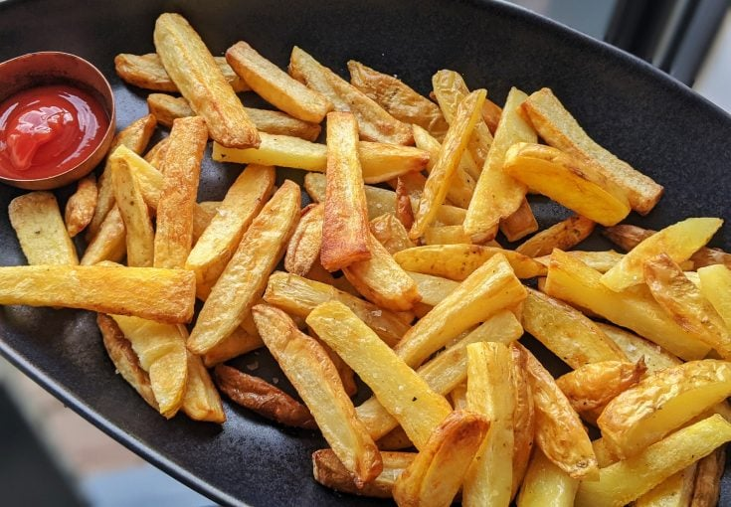
For optics?

Slide 13
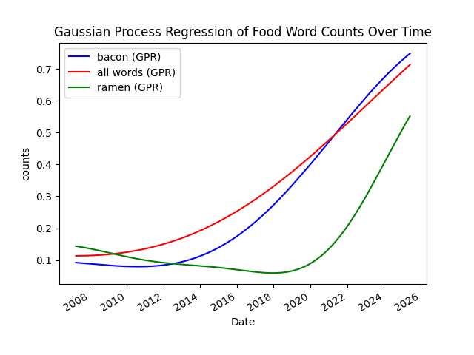
How food words are mentioned over time?

Slide 14
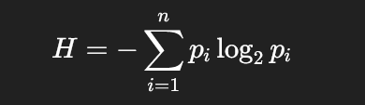

Shannon entropy
This generates a number of bits

Slide 15

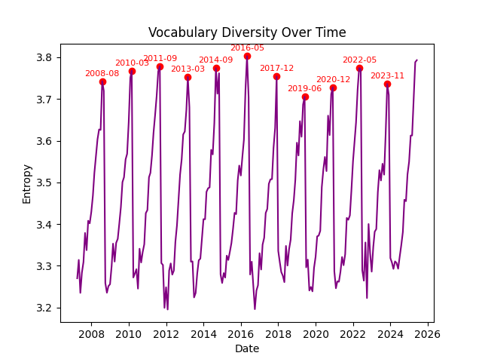



Slide 16
Conclusions
We Say a lot of food related words
They are mostly confined to 16 words
The bacon and ramen revolutions are well formed
We must fight for PDFs to get more readable

Slide 17
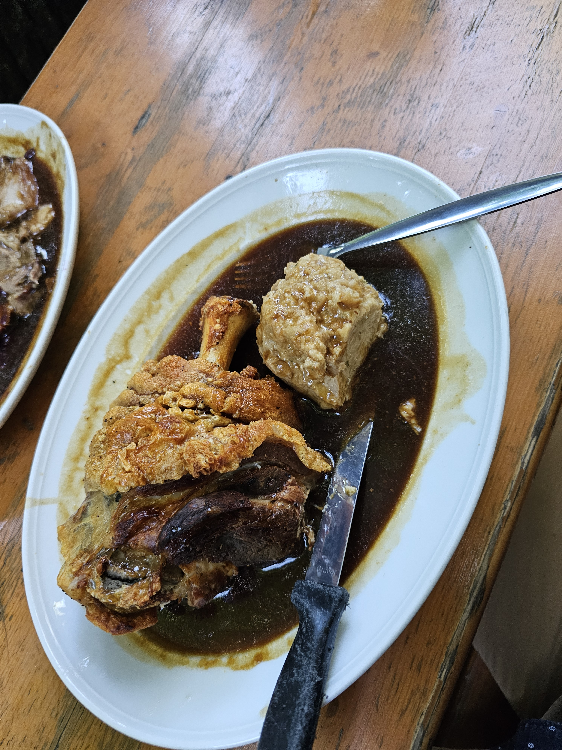

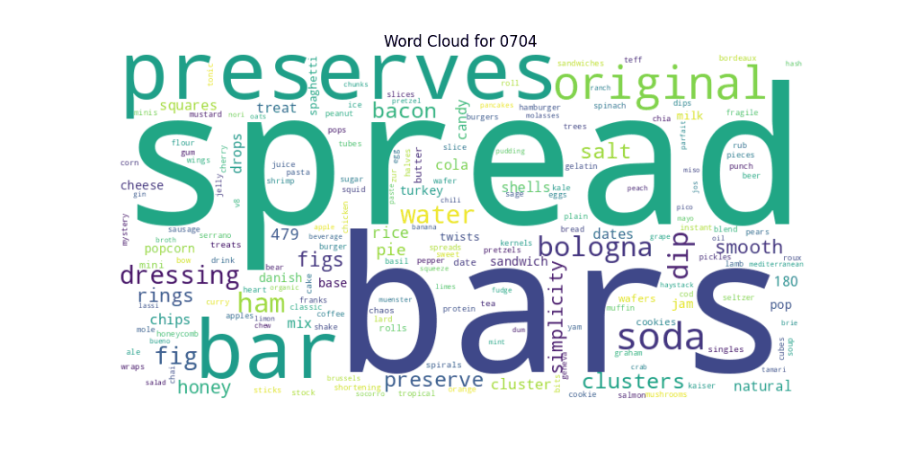
Thank You For Listening
Thank you Arxiv for being chill with data

