Slide 1
Book Store
Mitchell Hess
Kevin Gautier
Bertha Assan Sackey
Abhinay Peeta
Durga Samrith Uppala

Slide 2
Introduction

Slide 3
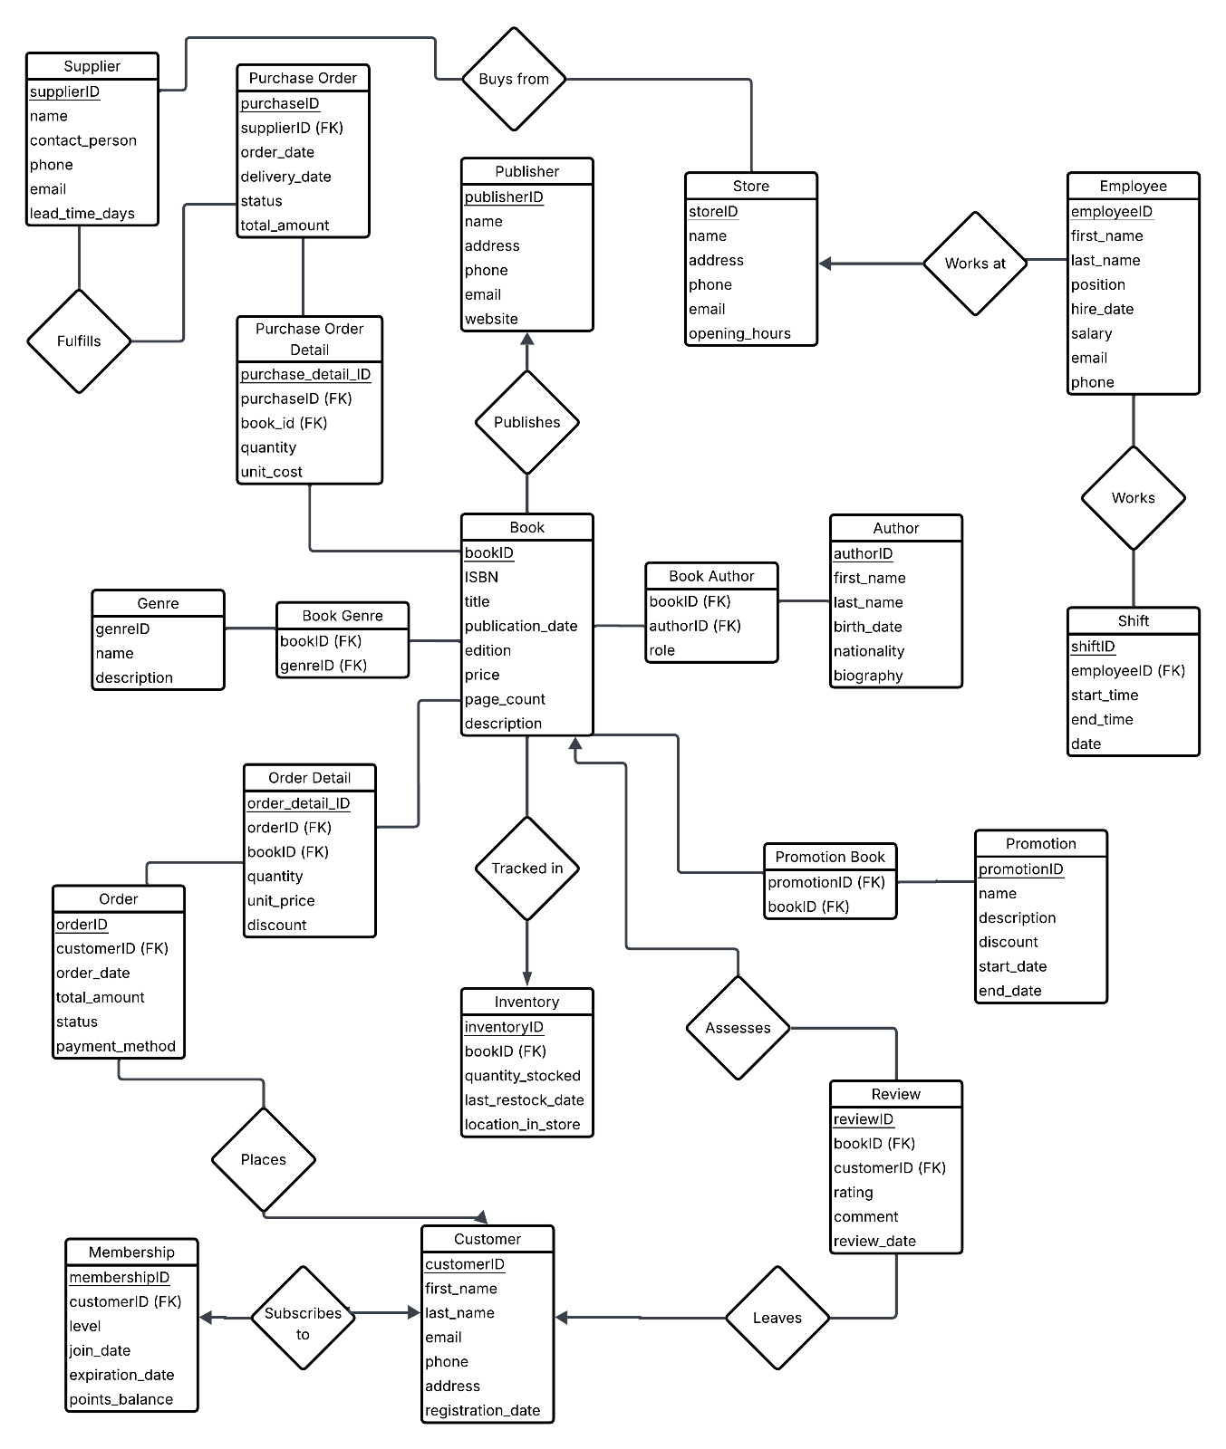
ER Diagram

Slide 4




System Details
DBMS: MySql
Programming Language: Python
GUI: Tkinter
Version Control/Remote Repository: GitHub

Slide 5
Demo

Slide 6
Thank You

