Slide 1

GloBox Food and Drink Banner A/B Test
Analysis and Report
By
Mitchell McCallum

Slide 2
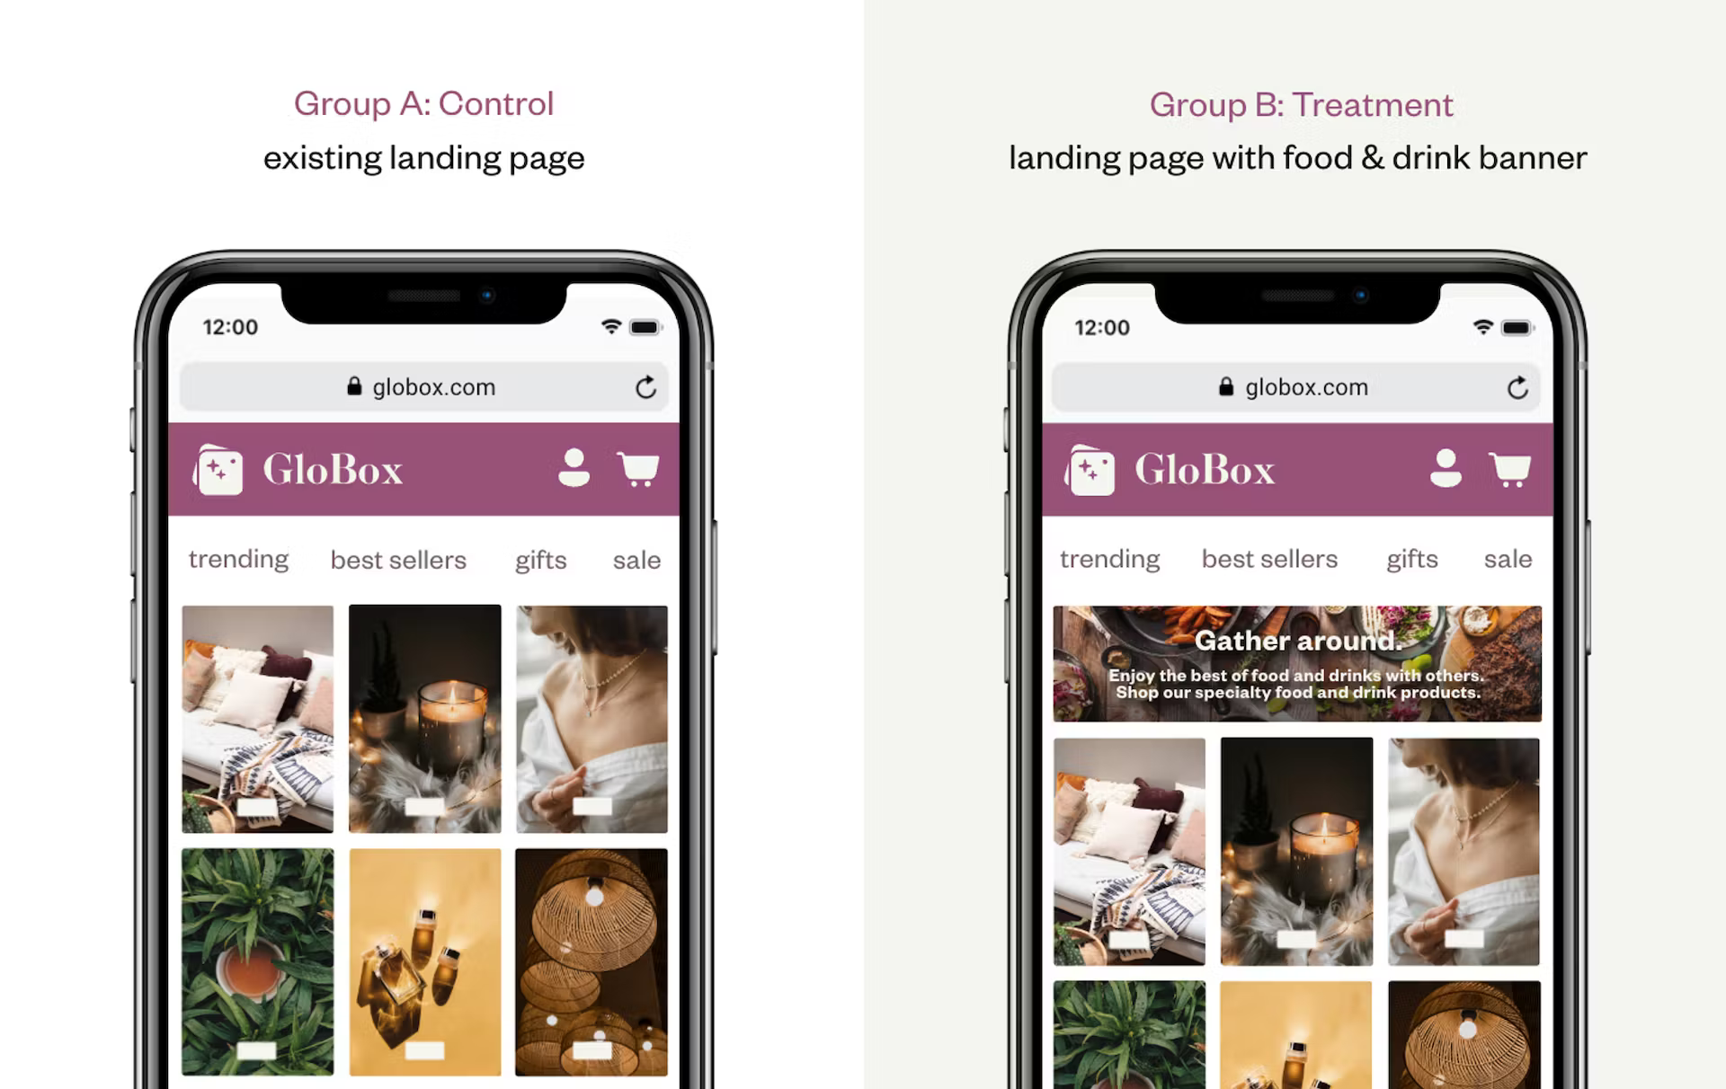
Introduction
A/B test conducted to assess a proposed new banner for Globox’s website
Banner introduces users to Globox’s food and drink offering for purchase when clicked on.
Notes:
The A/B test was conducted to evaluate the impact of a new food and drink banner on user behavior on the GloBox mobile website.
GloBox's food and drink offerings have grown tremendously in the last few months. The new banner was introduced to bring awareness to this product category with the aim of increasing revenue.
The new banner was expected to enhance user engagement and encourage more purchases by highlighting the variety of food and drink offerings available.

Slide 3
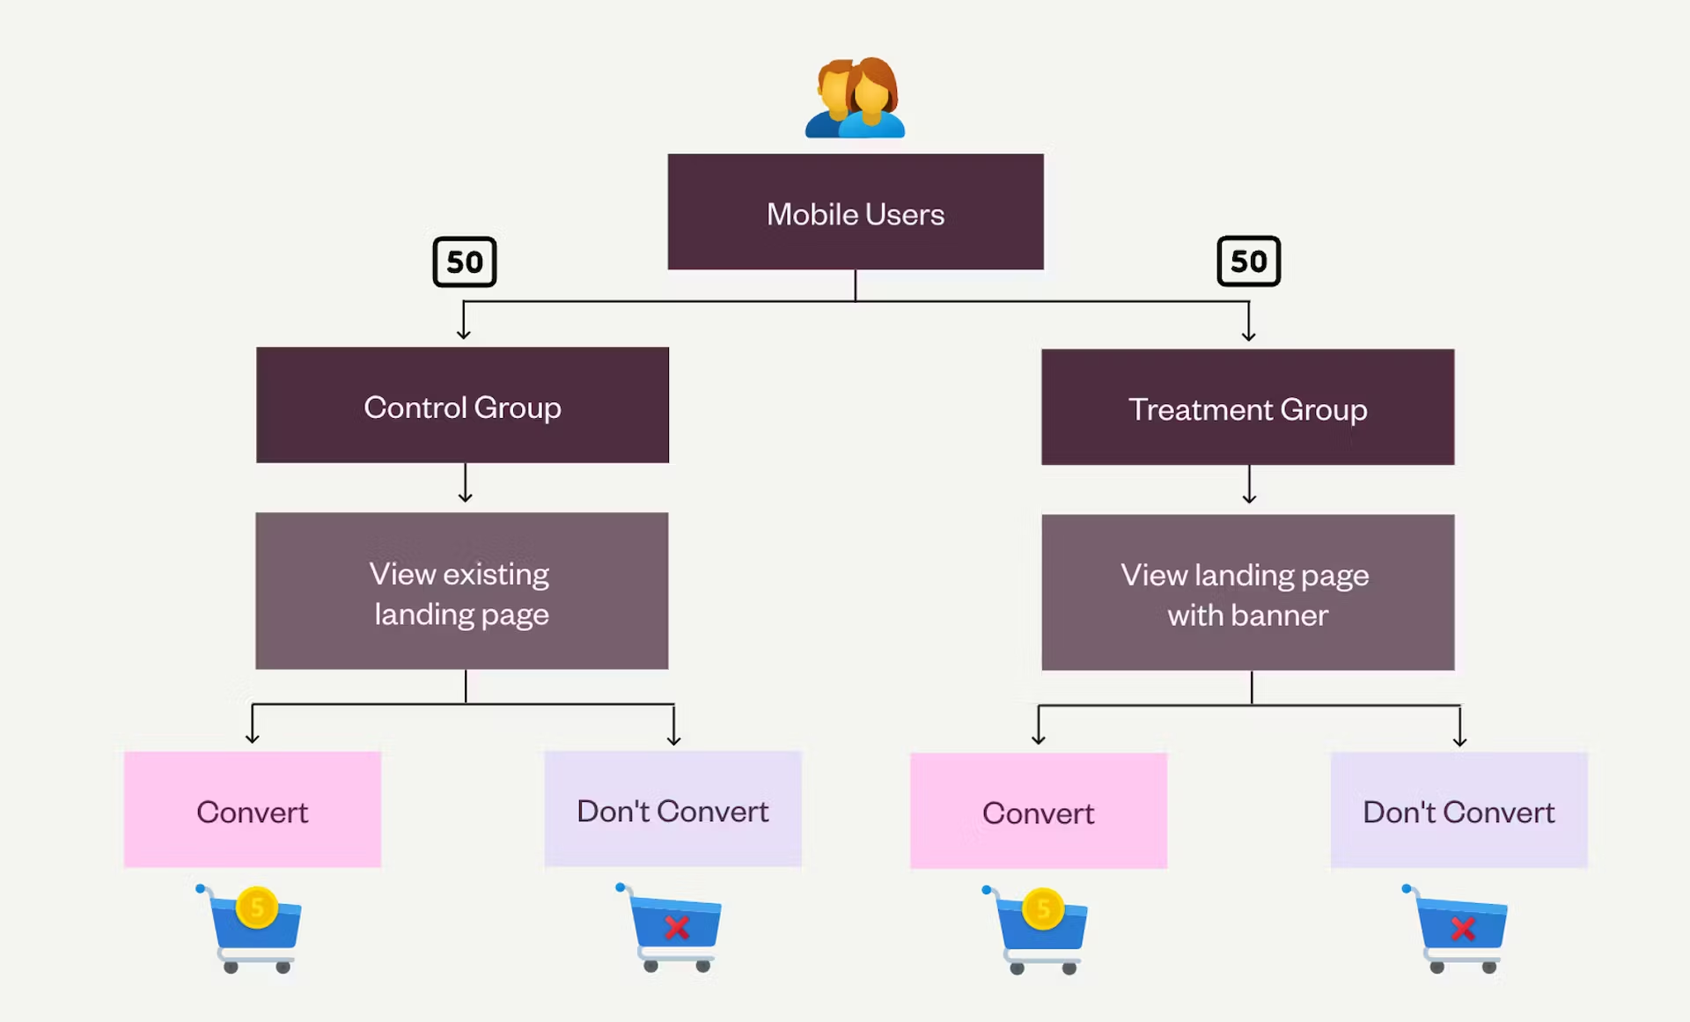
Test Design and Key Metrics
Random Users assignment to Banner or No Banner groups.
Primary Metrics of assessment was the conversion rates for users in Banner and No-Banner Groups.
Study conducted between January 26th to Fevbruary 6th last year.
Notes:
Test Design: Users visiting the site during the test period were randomly assigned to the control or test group. The control group saw the original site and the test group saw the food and drink banner.
Test Duration: The test was conducted over a period of 12 days, from January 26 to February 6.
Primary Metrics: The primary metrics of interest for the test were the conversion rate and the average amount spent per user amongst those converted. The conversion rate was defined as the proportion of users who made a purchase during their visit or subsequent visits to the site. The average amount spent was calculated as the total amount spent divided by the number of users with activity.
Data Collected: The dataset used for the analysis includes data on approximately 49,000 users who visited the site during the test period. The data collected was the group they were assigned to, whether they made a purchase or not, the amount they spent, and other user characteristics such as gender, device, and country of residence.

Slide 4
Conclusions and Recommendations
The A/B test showed a statistically significant difference in conversions.
Test group had an 18.87% increase in terms of conversion rate.
Despite the positive impact on user behaviour, overall ravenue impact was minimal.
Recommendation is to NOT implement the new banner and conduct further testing along with different approaches to ensure conversions retain their value.
Notes:
The A/B test showed a statistically significant difference in conversion rate between the control and test group, suggesting that the new banner had a positive impact on user behavior.
The test group outperformed the control group by approximately 18.87% in terms of conversion rate.
Despite the positive impact on user behaviour the overall revenue Globox collected was minimal, an increase of 184 out of a sample of 24600 and average spending amongst those users in fact decreased average spent from $81.01 to $68.43 with only a 1.5% increase to total spending
Considering the web domain resources Globox would need to spend to attain a meager increase in total revenue I would recommend to NOT implement the proposed banner for the site.

Slide 5
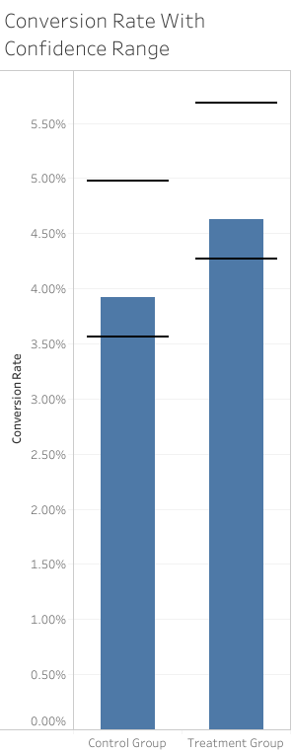
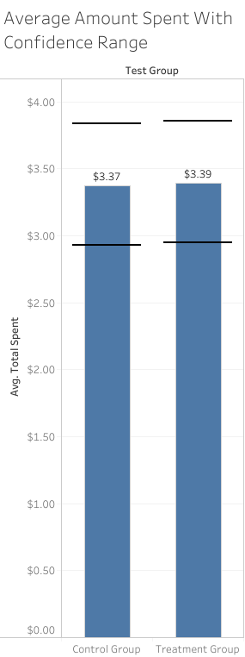
Data Overview and User Characteristics
Total Users:
There were 48,943 total users in the A/B test with 24,343 in the Control group and 24,600 in the Test group.
Conversion Rates:
The Control group had a conversion rate of 3.923% while the Test group had a conversion rate of 4.630%. There was an overall increase of 12.47%. Statistically we were able to prove that the banner will consistently generate more purchases than the original site design.
Average spent:
The Control Group had an overall average spend of $3.37 for the control group, $3.39 for the treatment group. This includes average spent among the entire population factoring the conversion rate. Statistically we were not able to prove that the average spend would always be greater for the Treatment Group.
Notes:
Total Users:
There were 48,943 total users in the A/B test with 24,343 in the Control group and 24,600 in the Test group.
Conversion Rates:
The Control group had a conversion rate of 3.923% while the Test group had a conversion rate of 4.630%. There was an overall increase of 12.47%. Statistically we were able to prove that the banner will consistently generate more purchases than the original site design.
Average spent:
The Control Group had an overall average spend of $3.37 for the control group, $3.39 for the treatment group. This includes average spent among the entire population factoring the conversion rate. Statistically we were not able to prove that the average spend would always be greater for the Treatment Group.

Slide 6
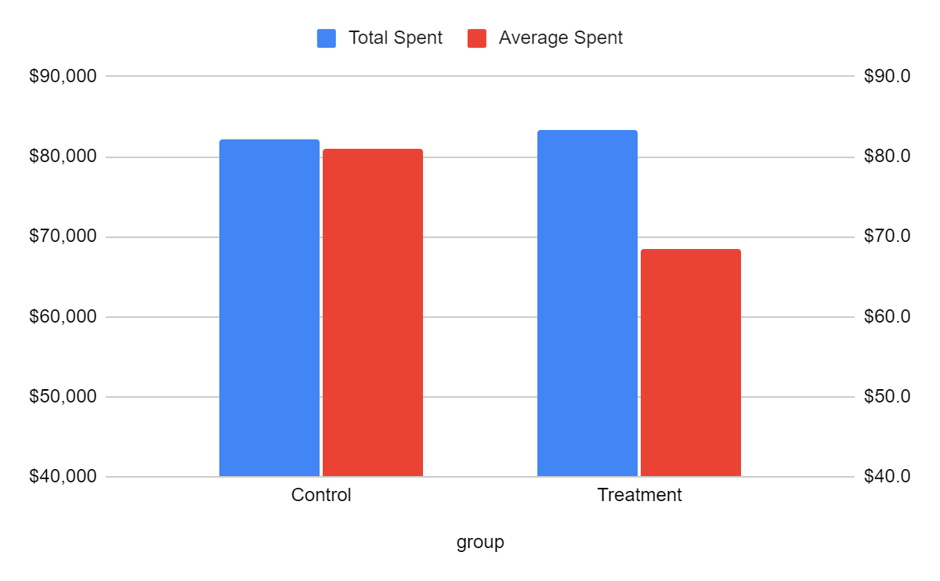
Financial Overview
Total Spent:
Only a 1.54% or $1,269.43 increase for the treatment group.
Average Spent:
Average loss of $12.54 or 15.53% per customer
Notes:
Total Spent:
Here we see a cross comparison of the total revenue and average spent among customers. Despite the previous demonstration of a greater engagement rate, this had lower impact on overall revenue. Thus total revenue has only increased by only 1.54% or $1,269.43 .
Average Spent:
The aforementioned minimal impact on total revenue is explainable by the much lower average spend amongst customers in the treatment group we see an average loss in the spending of $12.54. This leads to an average loss of 15.53% per customer

Slide 7
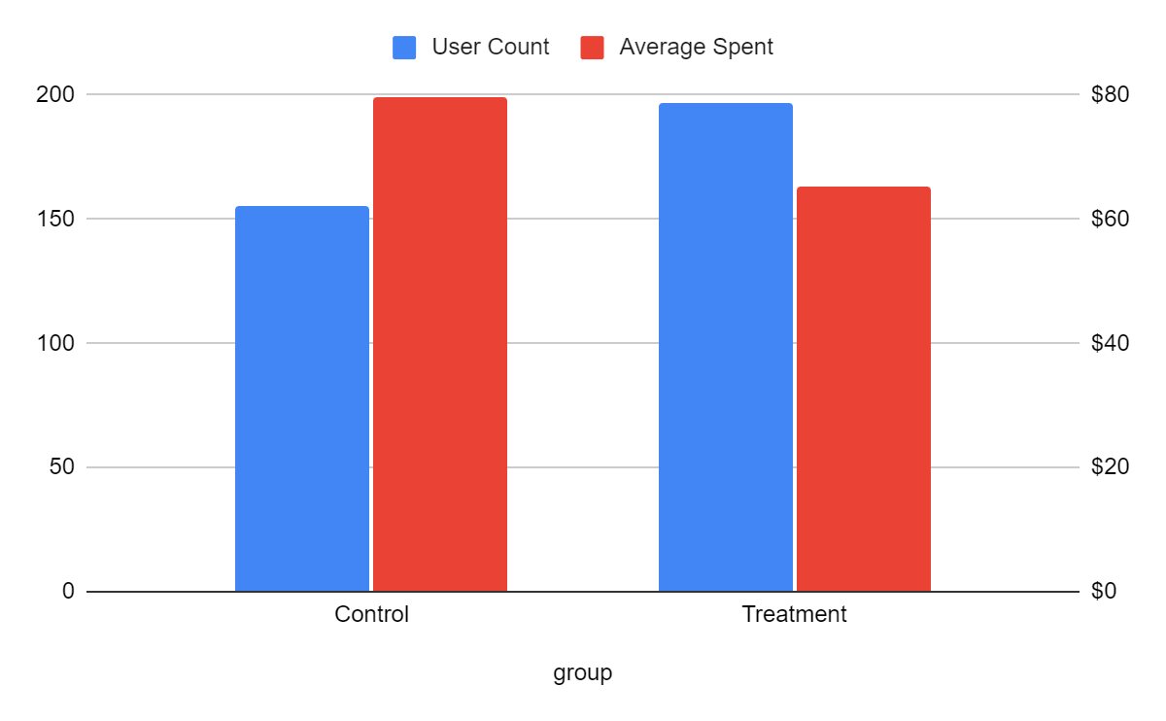
Uninvested User analysis
Average
spent
User count
Average Spent and user count with Null gender, device or country values shows an increase of 30% for the user count with lower average spent.
Notes:
Average Spent and user count with Null gender, device or country values shows an increase of 30% for the user count with lower average spent.
We have attributed the results where users have left NULL for their personal details have having a degree of disinterest in the brand. As you can see the user count
was higher in the treatment group. Along with a lower average spent. This is an aspect that merits further scrutiny but evidence that the quality of customer is lower among the treatment group.

Slide 8
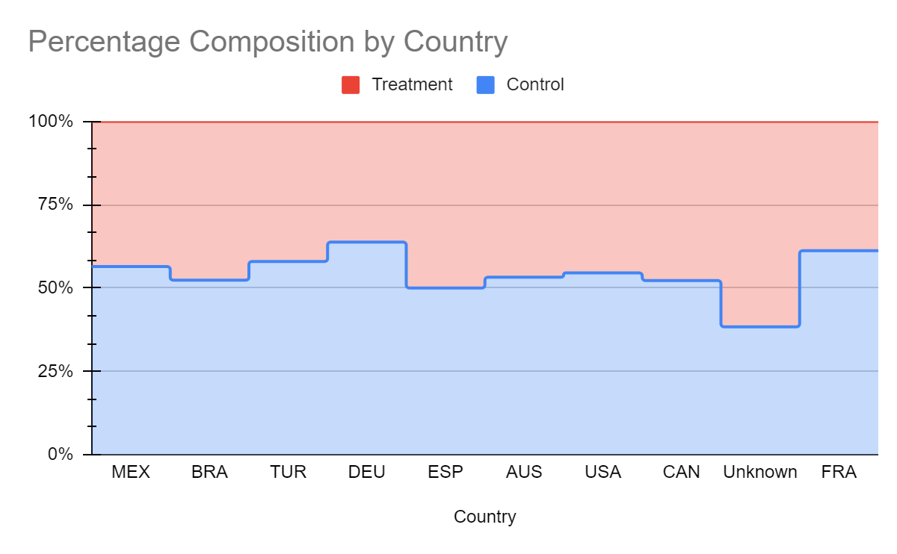
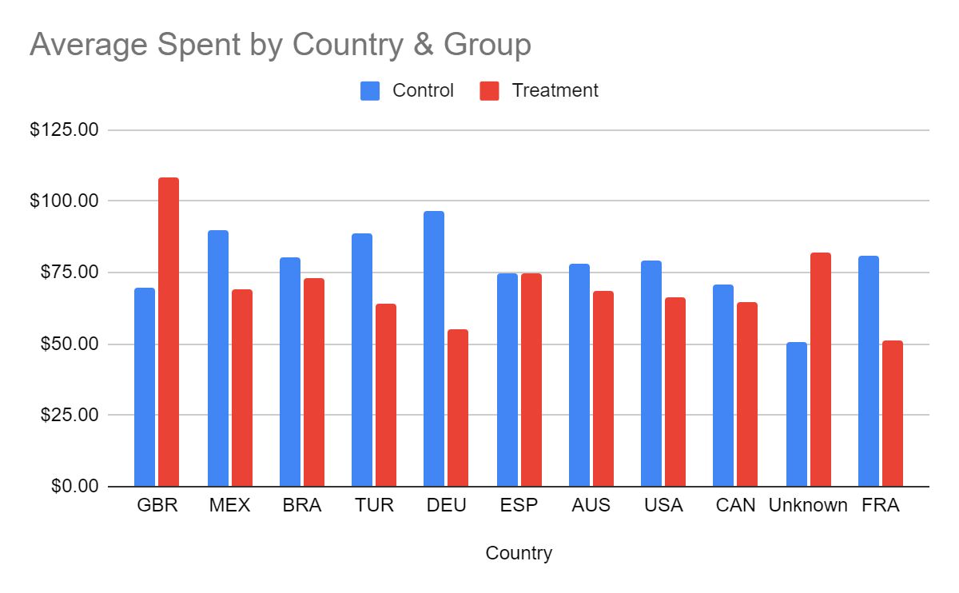
Country Analysis
UK a notable outlier where both conversions and average spent among customers was high
Overall trend is lower average spent and higher conversion rates across countries.
USA had a %13.3 higher conversion rate and a %16.72 lower average spend amongst customers
Notes:
Some Key Insights from the country asnalysis
Highlight: The UK emerges as a standout, with both conversion rates and customer spending outpacing other nations.
Trend Analysis: A general shift towards higher conversion rates paired with a decrease in average spending is observed across countries.
USA: Demonstrates a significant improvement in engagement, with the test group's conversion rate rising by 13.3% compared to the control group, though average spending has decreased by 16.72%.Brazil: Shows notable growth in conversion rates by 18.1% for the test group, reflecting effective targeting or campaign strategies.
Our data-driven approach continues to refine customer engagement strategies, optimizing conversion while balancing expenditure.
Further detailed analysis is required for the UK market to understand the drivers behind the exceptional performance.

Slide 9
Future Work
Selective implementation of the banner
Design Improvements
Product Analysis
Expand Testing
Notes:
Selective implementation of the banner: Consider implementing the banner for a select group of users such as those with an IP address in the UK as test results indicate positive results for both conversion and average spent.
Design Improvements: Test other design or user experience elements to improve conversion. This could include changes to the layout, color scheme, or other elements of the site.
Product Analysis: Explore what products are commonly purchased together. This could improve our suggested add-on algorithm and potentially increase the average spend per user.
Expand Testing: Continue the A/B test but expand the test populations to approximately 121,000 based on the ideal sample size analysis. This will provide more robust results and increase the confidence in the findings.

Slide 10

Questions & Discussion

