Slide 1
International Supply Chain Volatility
Visual story — two charts per slide
Notes:
Dataset: 1,196,238 rows × 56. International subset: 1,013,509 rows.

Slide 2
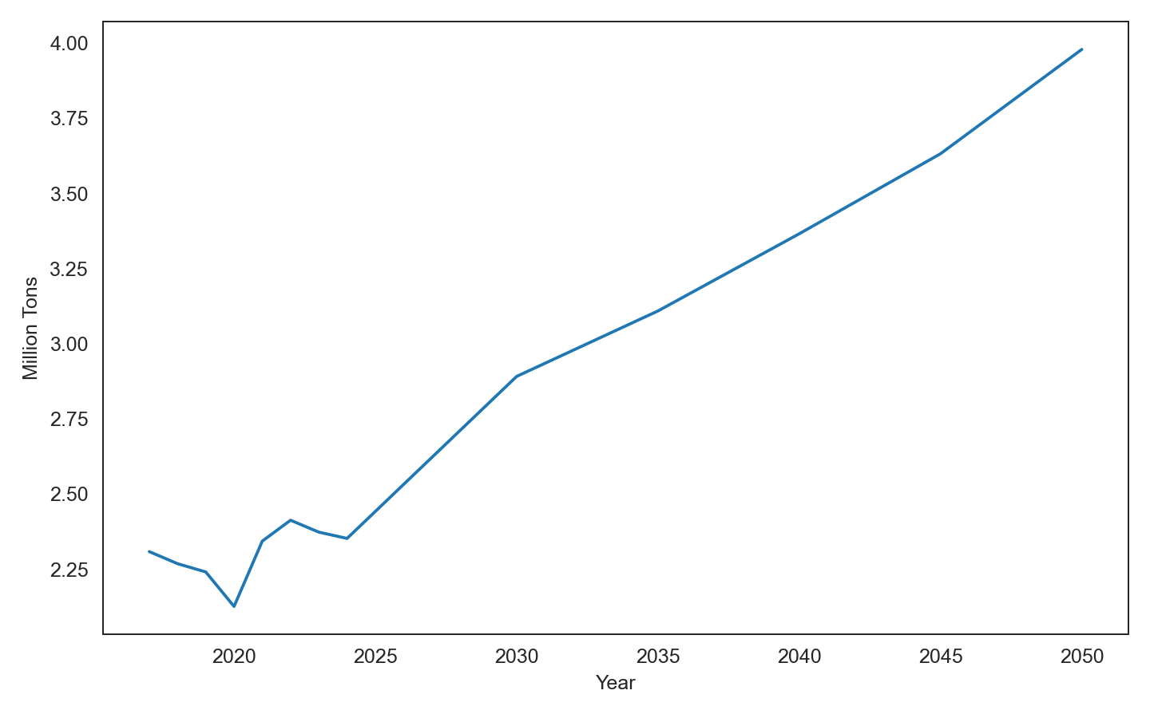
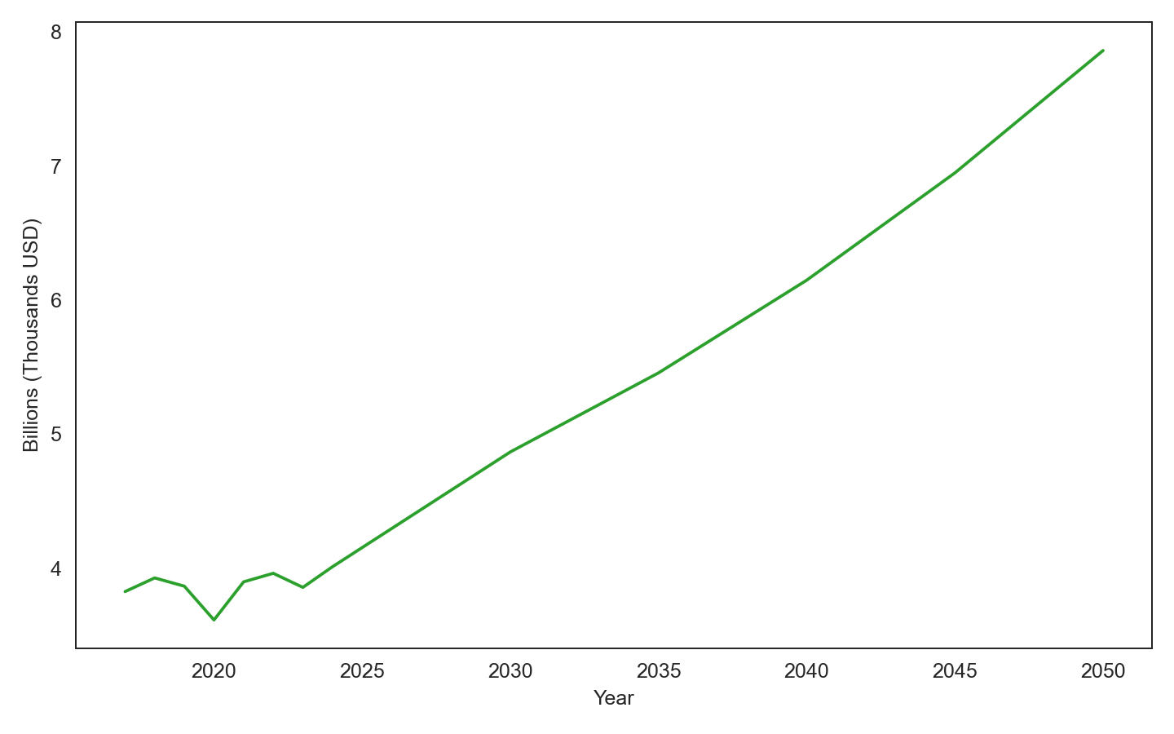
Notes:
Slide 1 (Title): Set the stage — international freight volatility and where it concentrates.

Slide 3
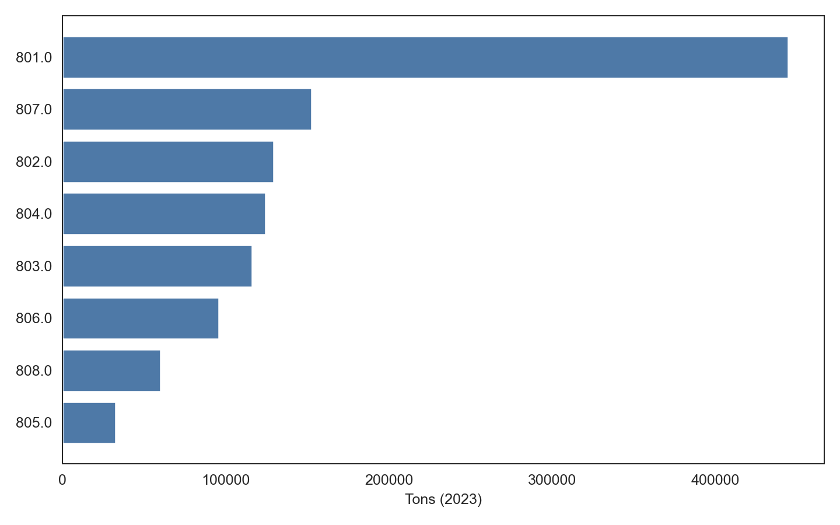
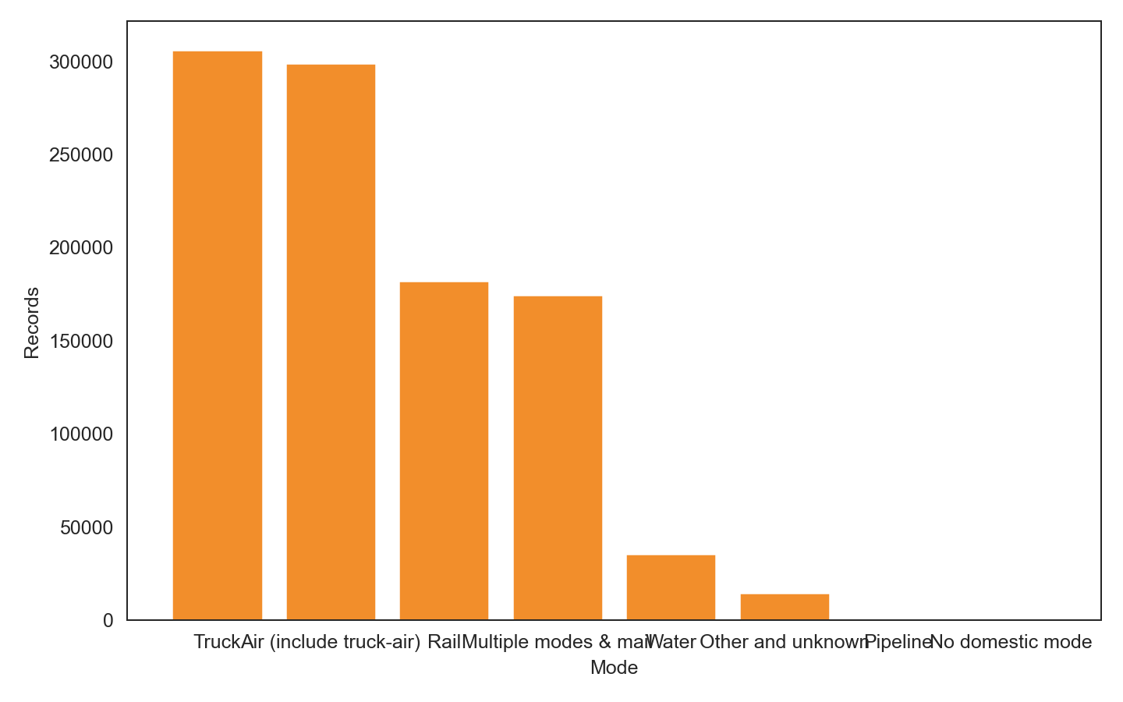
Notes:
Slide 2 (Trends): Tons grow from 2.3M to 4.0M; value from 3.8B to 7.9B (thousands USD). Highlight inflection years.

Slide 4
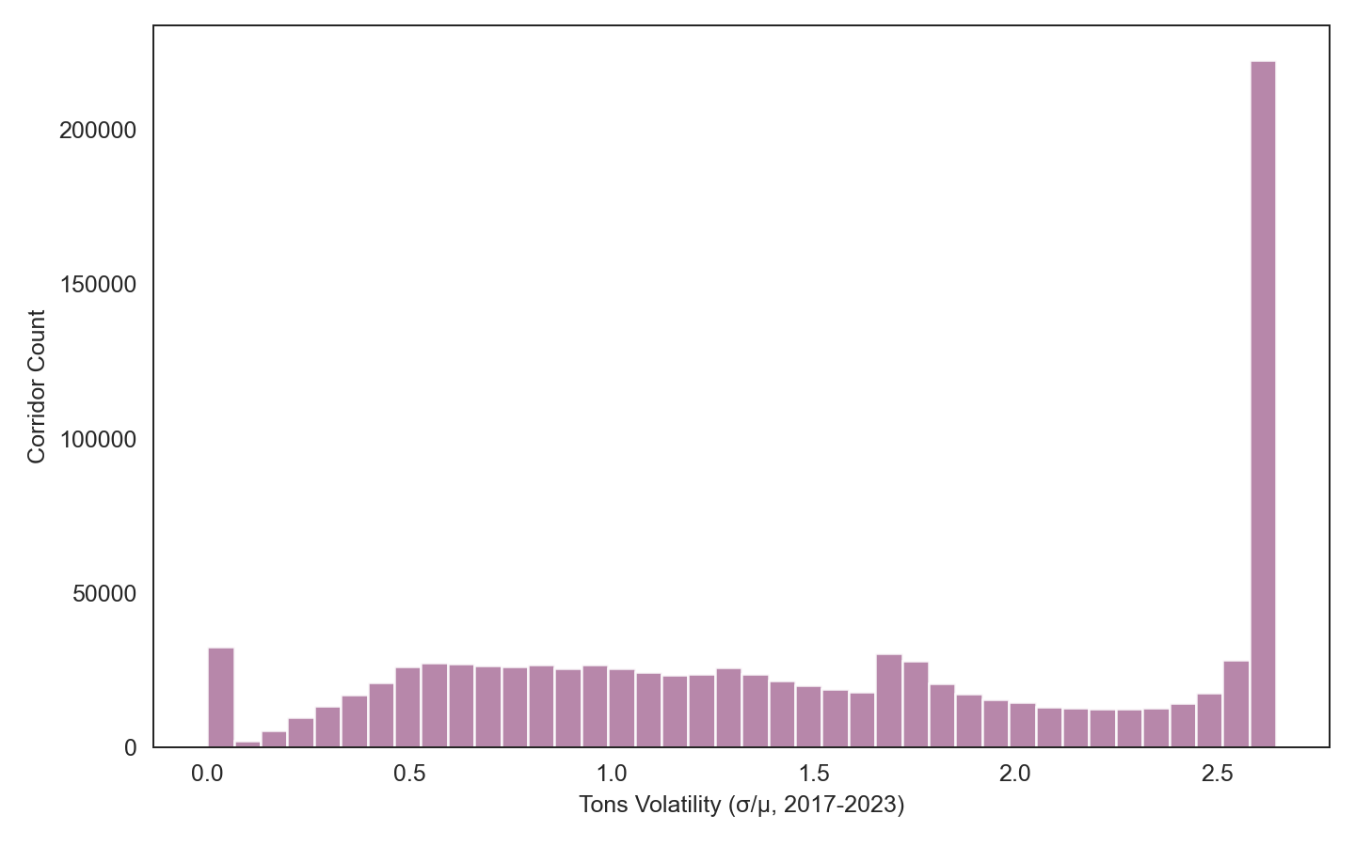
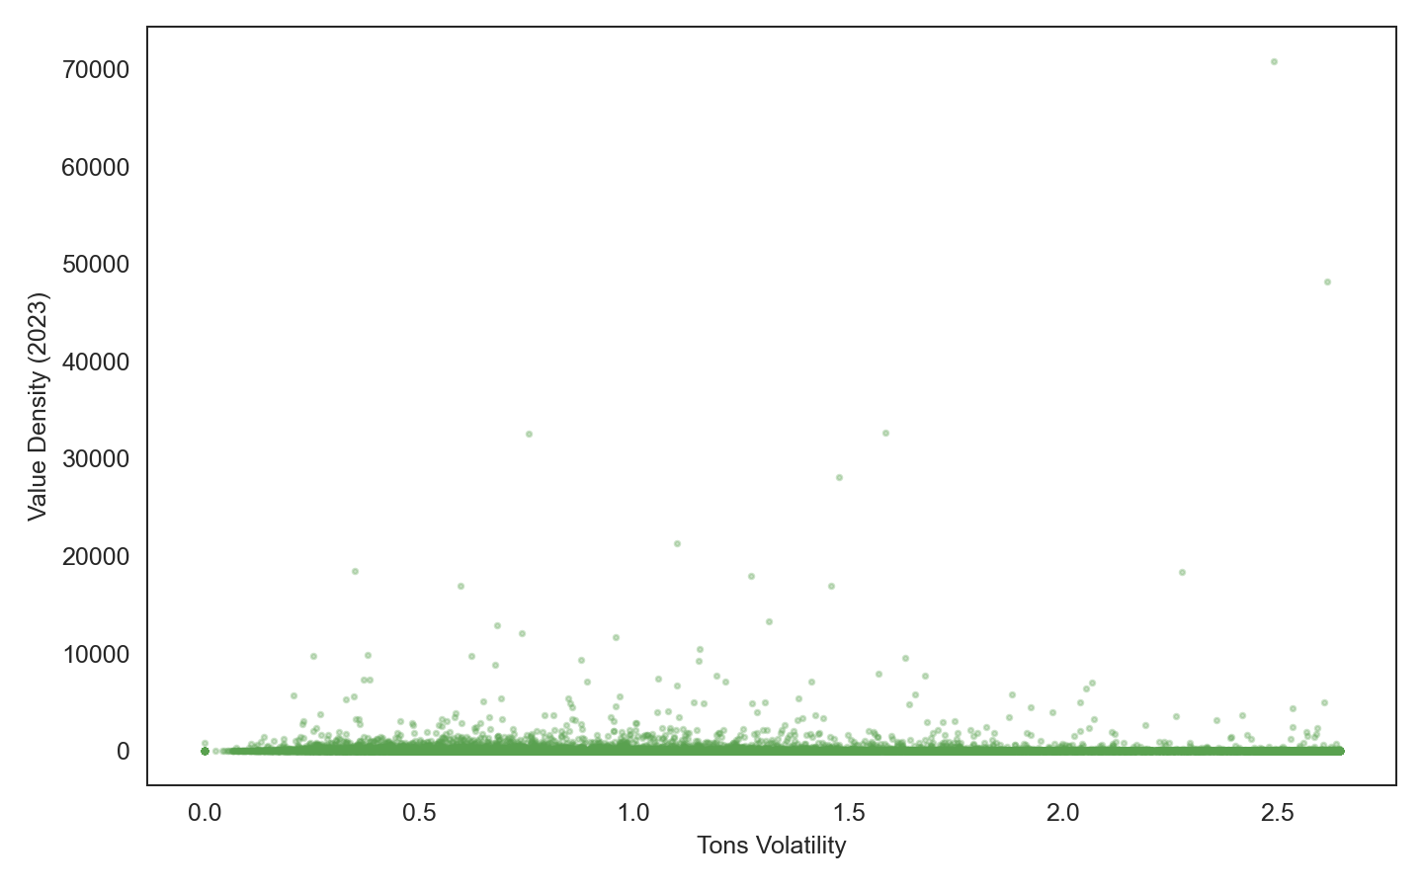
Notes:
Slide 3 (Where risk concentrates): 801.0 leads 2023 tons. Discuss portfolio balance across top regions.

