Slide 1
Supply Chain Volatility – International Story
FAF5.7 – Insights, Risks, and Resilience

Slide 2
Executive Summary
Dataset size: 1,196,238 rows × 56 columns; completeness ≈ 95.9%.
International subset size: 1,013,509 records.
Mix: Imports 512,780, Exports 500,729 (trade_type).
Average resilience score: 50.0 (0-100).

Slide 3
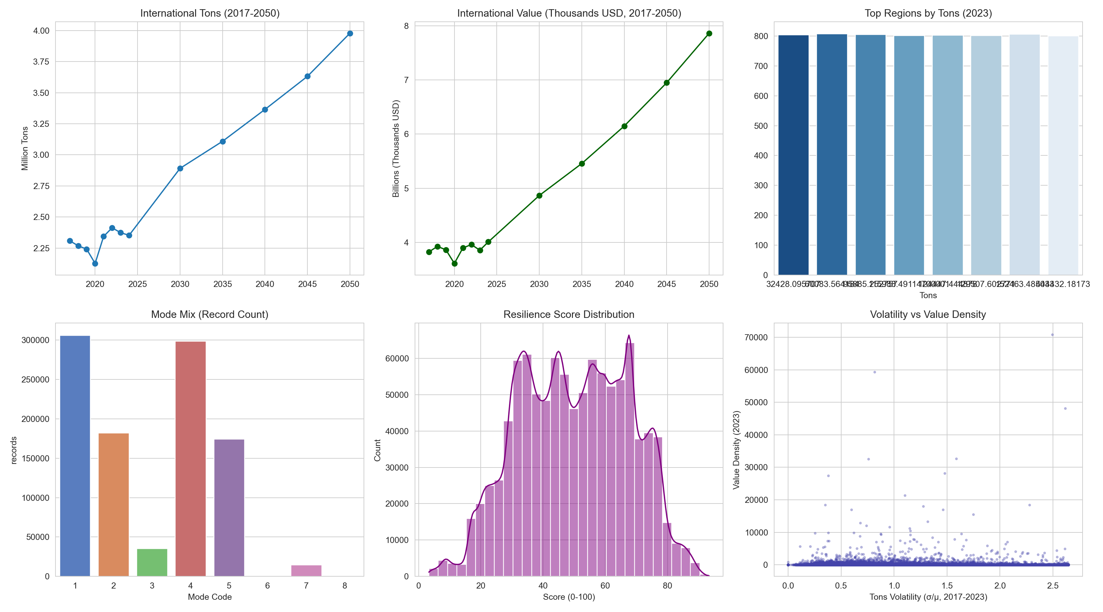
International Risk & Resilience Dashboard

Slide 4
Actions & Recommendations
Prioritize lanes with high volatility and low resilience for mitigation.
Diversify corridors where concentration (HHI) is elevated.
Increase mode optionality where feasible; reduce dependence on single modes.
Focus on regions contributing the largest volatility-weighted tonnage.
Track resilience scores quarterly as volumes and values evolve.

