Slide 1
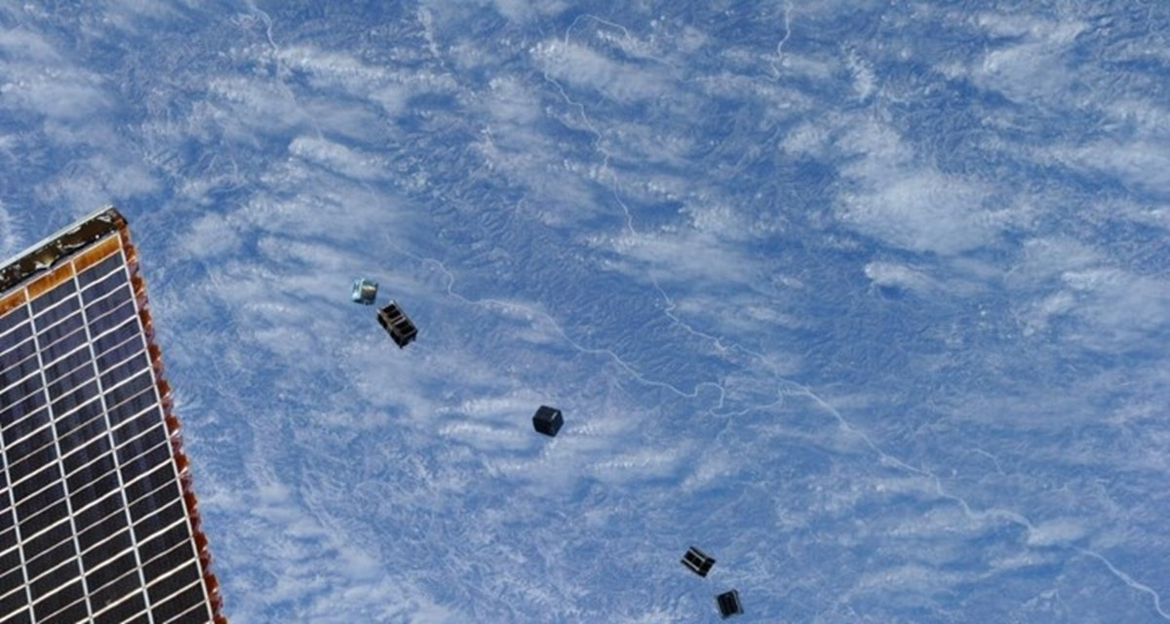
Satellite State Estimation
April 18th, 2024
Professor Axelrad
Laura Davies
Mitchell Krouss

Slide 2
Agenda
Background Information
Methods/Results
Conclusion/Next Steps

Slide 3
Background Information

Slide 4
Goal
Space situational awareness (SSA) – “is the knowledge, characterization, and practice of tracking space objects and their operational environments.” https://aerospace.org/ssi-space-situational-awareness
Important for predicting conjunction between object and for enabling collision avoidance maneuvers.
U.S government is responsible for keeping an accurate map of all space traffic which can be distributed commercially.
Done using sensors and data processing techniques to estimate the number of objects and their orbits.

Slide 5
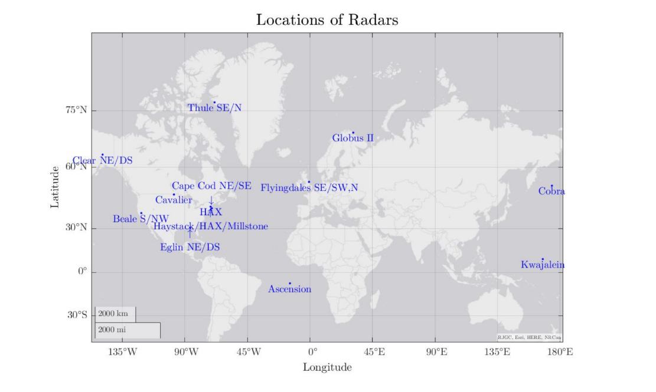
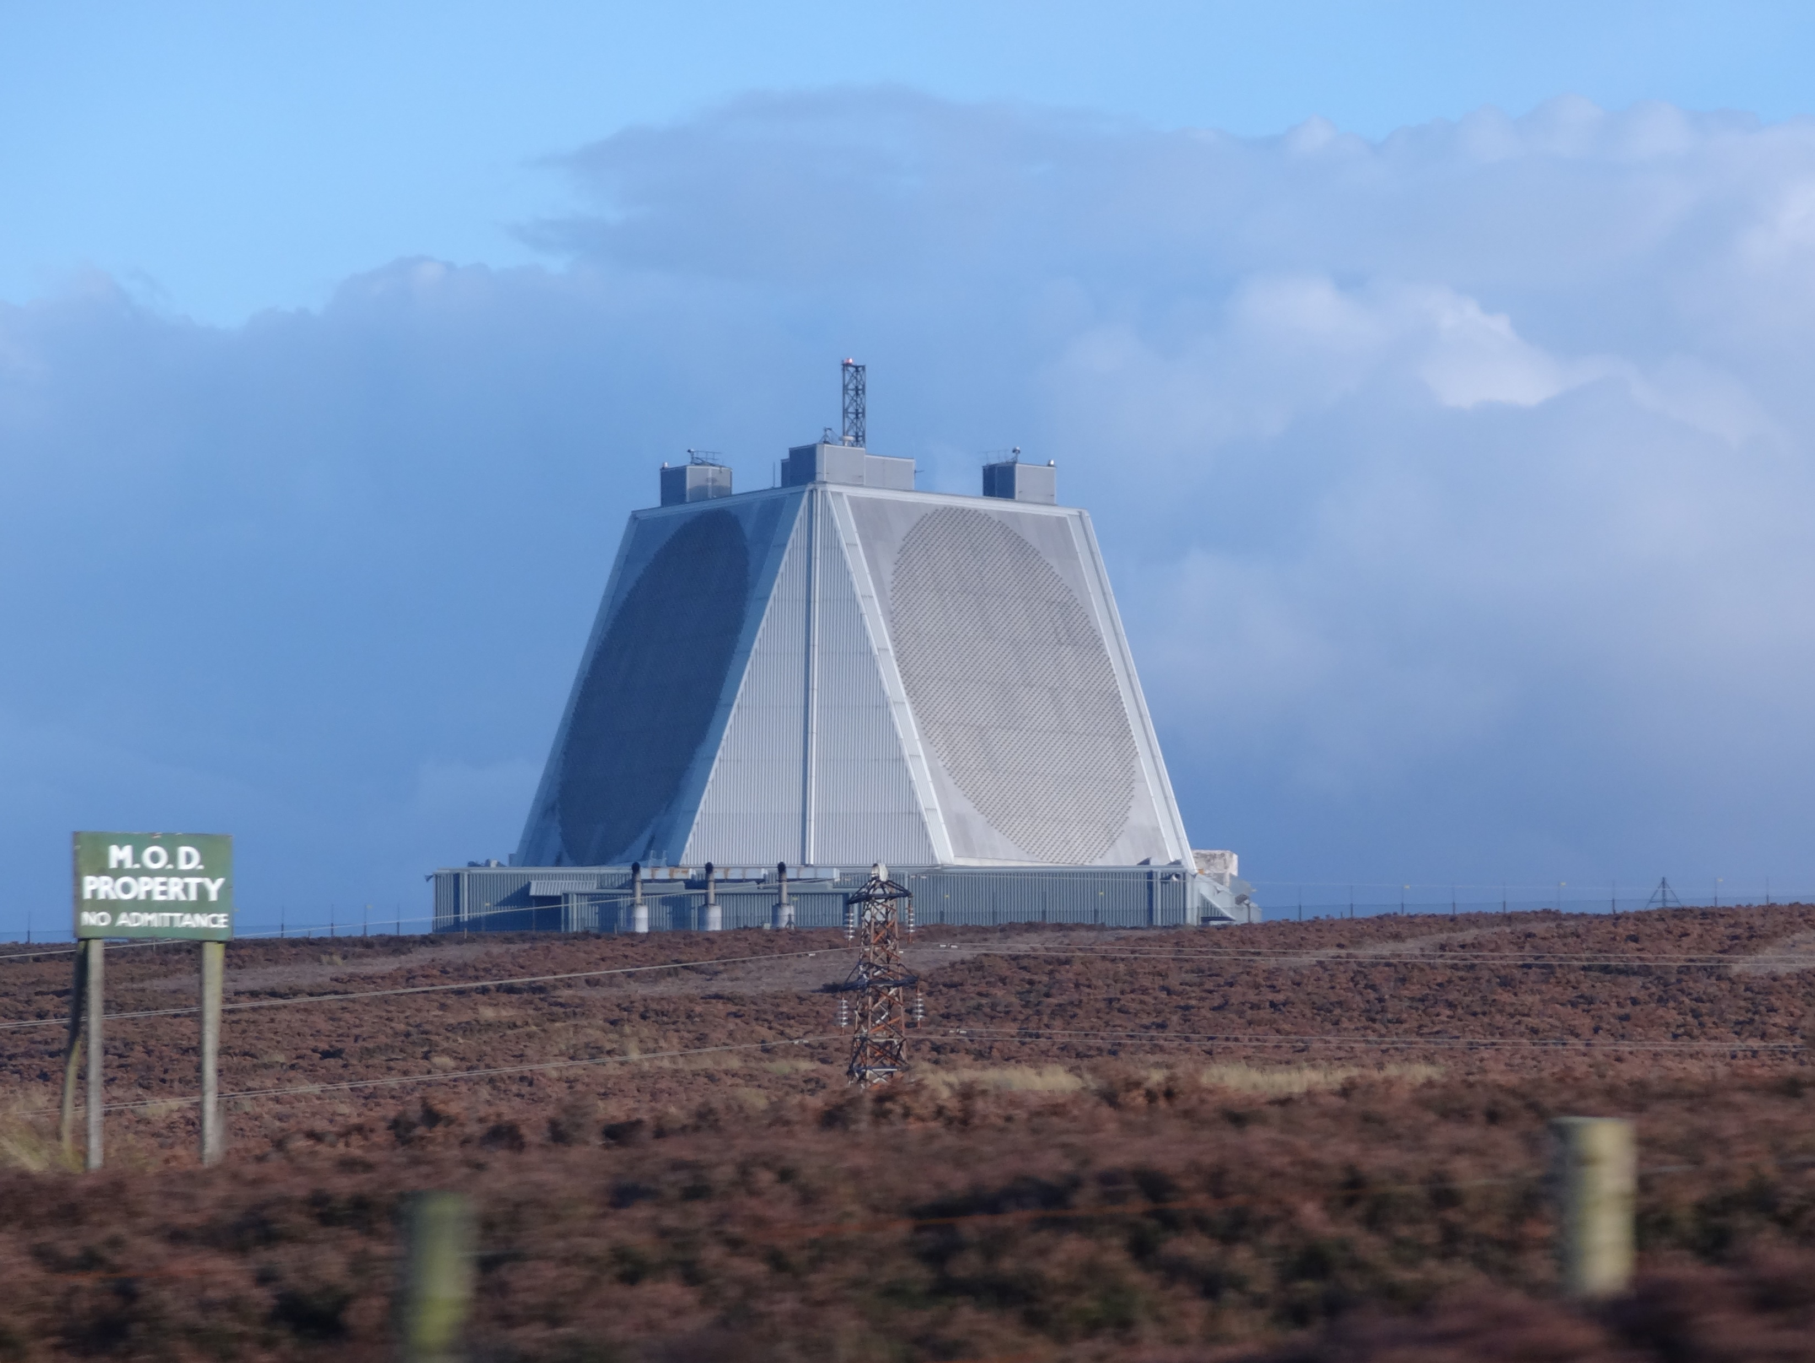
Data
The USAF has provided radar observations of the Transport-1 deployment
Radar observations provides:
Range
Range Rate
Azimuth
Elevation
Noisy measurements
https://en.wikipedia.org/wiki/RAF_Fylingdales#/media/File:RAF_Fylingdales_Radar.jpeg
P. Axelrad, L. Davies, 2023, Large-Scale Satellite Deployment Tracking

Slide 6
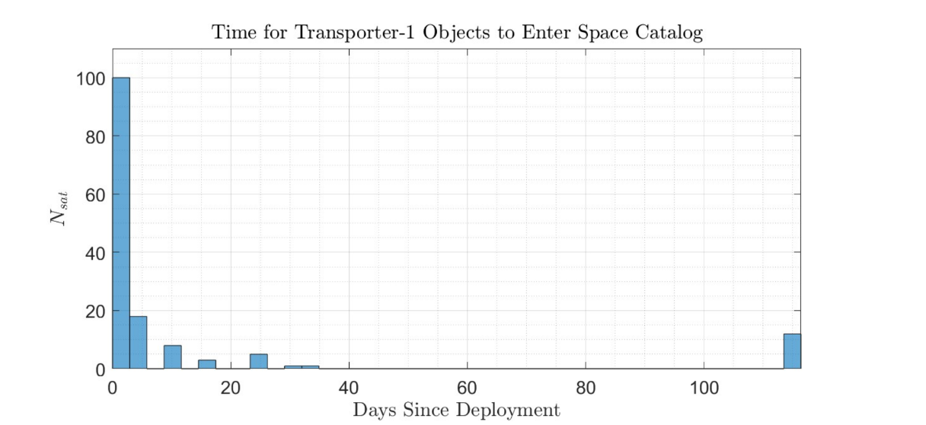
Data
Deployed 143 satellites, 139 are currently tracked by CSpOC (Combined Space Operation Center)
Satellites are in LEO, with an altitude of 500km
P. Axelrad, L. Davies, 2023, Large-Scale Satellite Deployment Tracking

Slide 7
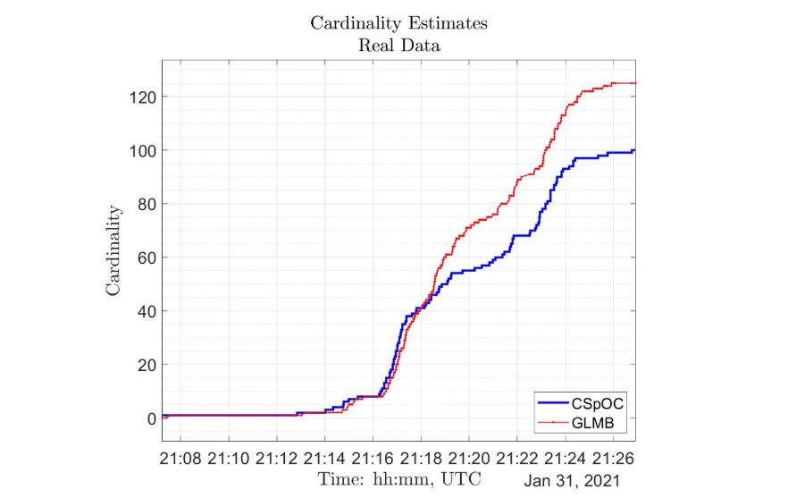
Previous Work
Laura and Professor Axelrad implemented a Generalized Labeled Multi-Bernoulli (GLMB) Filter for Resident Space Object (RSO) tracking
This filter uses finite set statistics and extended Kalman filters to do data association and state estimation
They saw the algorithm estimated more RSOs than were present
Difficult to stitch together satellites measurements to existing tracks after long periods of propagation
I focused on the state estimation piece of this problem
P. Axelrad, L. Davies, 2023, Large-Scale Satellite Deployment Tracking

Slide 8
My Contribution
Filtered data over Flyingdales
Filtered data over Globus
Data from Flyingdales propagated to Globus
The goal of my project is to make the propagated match the filtered data, so the algorithm will make them one object.
This can be achieved with better position and velocity estimation at the end of Flyingdales.
P. Axelrad, L. Davies, 2023, Large-Scale Satellite Deployment Tracking

Slide 9
Methods/Results

Slide 10
Extended Kalman Filter
A Kalman filter is a state estimation tool which optimally updates our sates according to the measurement uncertainty and the process noise.
The measurement uncertainty is driven by how noisy the data is (sensor characteristics) and the process noise accounts for the dynamics which we are not modeling.
Our state space is Earth Centered Inertial (ECI) position and velocity.
EKFs are used for state estimation of nonlinear systems
Our measurement model is nonlinear (going from range, range rate, az, el, to our state space)
Our dynamics model is nonlinear, J2 orbit propagation
The covariance propagation and update uses Jacobians from the dynamics and measurement models.
I inherited the dynamics, measurement models, and Jacobians which were all used in the Kalman equations

Slide 11
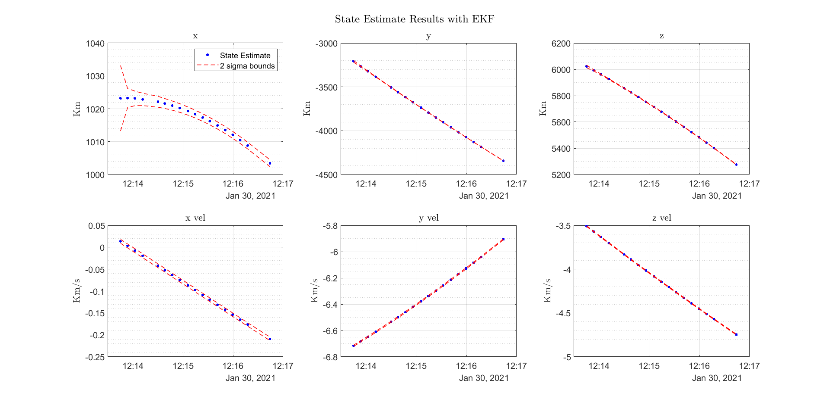
Extended Kalman Filter
3-minute pass over Flyingdales.
Satellite has ~500 km altitude
Mostly moving in the y and z direction.
Covariance get smaller as we get more measurements.
One satellite passing over the Fylingdales radar station

Slide 12
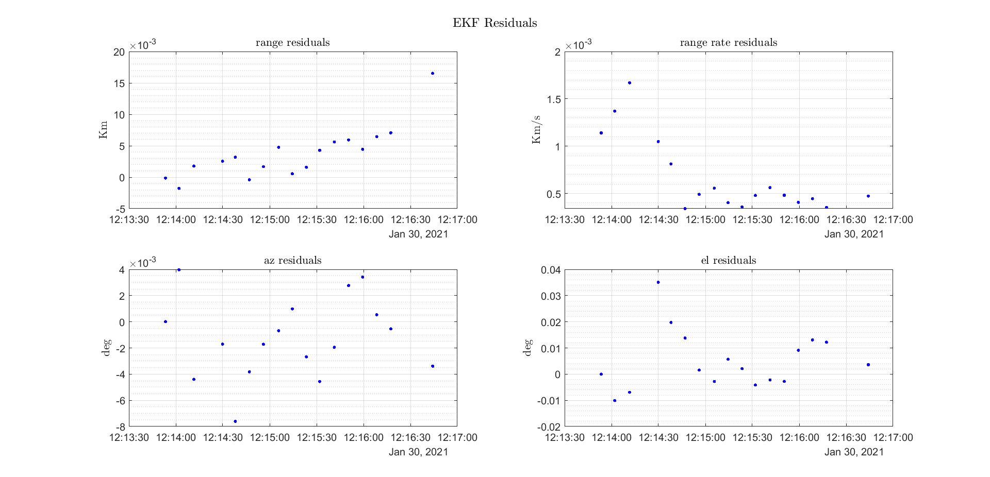
Extended Kalman Filter
We expected:
Sigma_range = 10 meters
Sigma_range_rate = 1 meter/second
Sigma_az = 0.005 degrees
Sigma_el = 0.005 degrees
Magnitude is a little higher than what we would expect from filter residuals
Given the trend in the filter residuals, it looks we are not properly modeling the system
Rang, range rate are not mean 0.
This good be an indication of poor state estimation

Slide 13
Lambert’s Method
Used to find the initial velocity to start the EKF
Method for determining the orbit given from two position vectors and the delta time between the two.
Uses a two-body propagator and does not consider higher perturbation terms (J2, J3, J4, …)

Slide 14
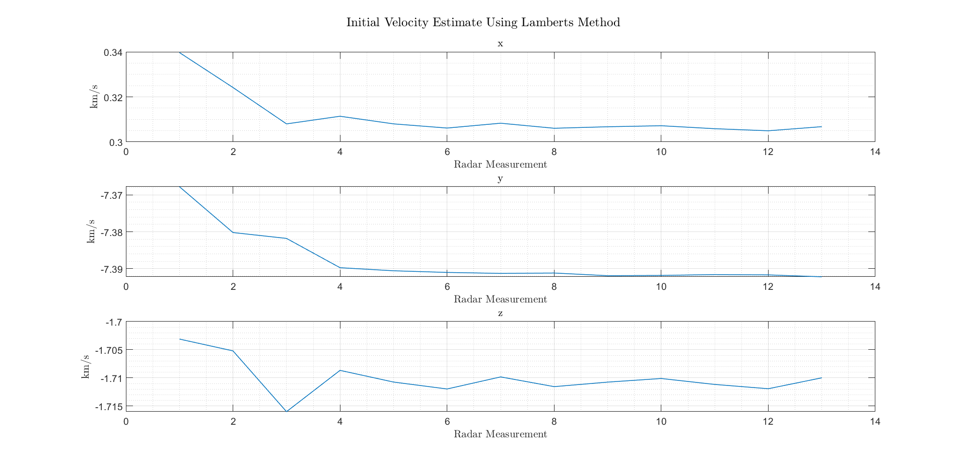
Lambert’s Method
Initial velocity for the first radar point is different depending on the second radar point used in the pass
Using first two points yields different initial velocity compared to using other points further a part in the arc
Consistent with many satellites

Slide 15
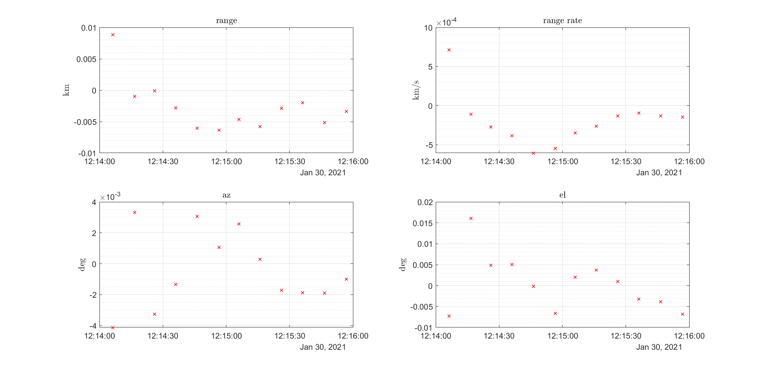
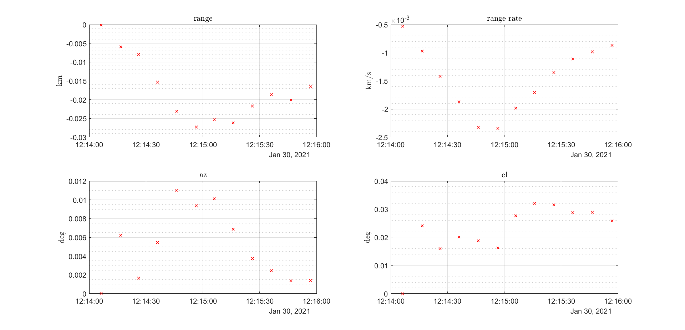
Lambert’s Method
Using first and Last points
Using first Two Points
Mean 0
Magnitude is much lower
Not mean 0
Magnitude it higher

Slide 16
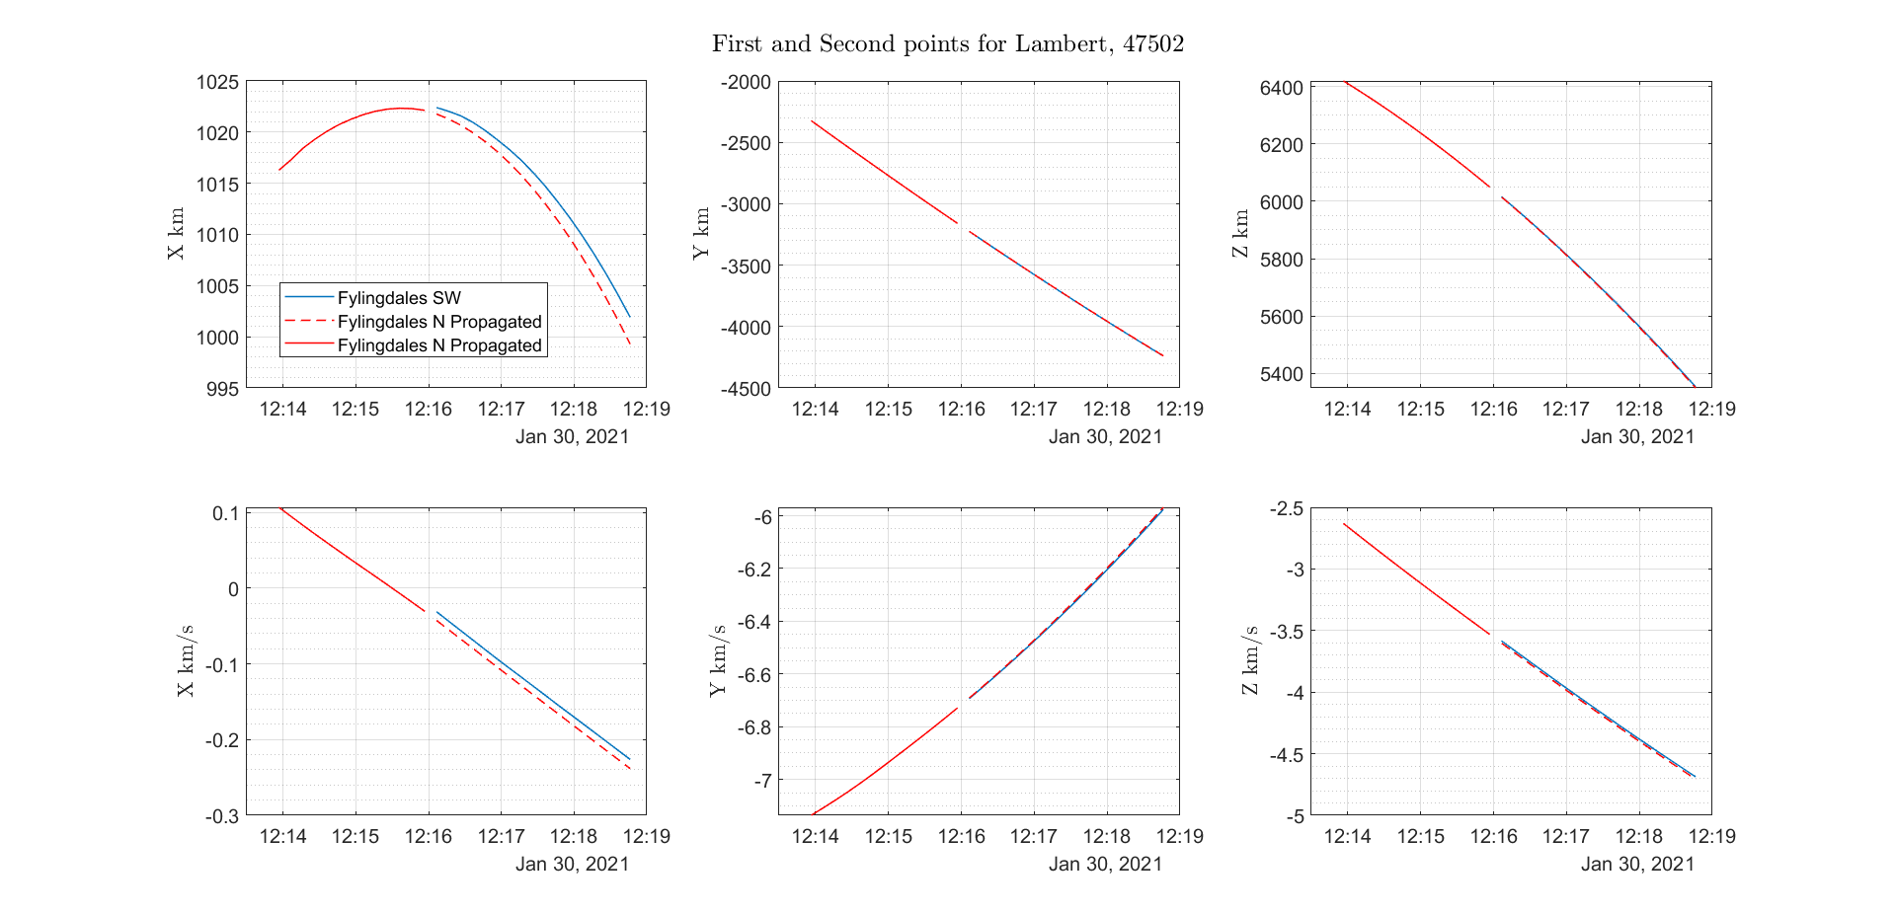
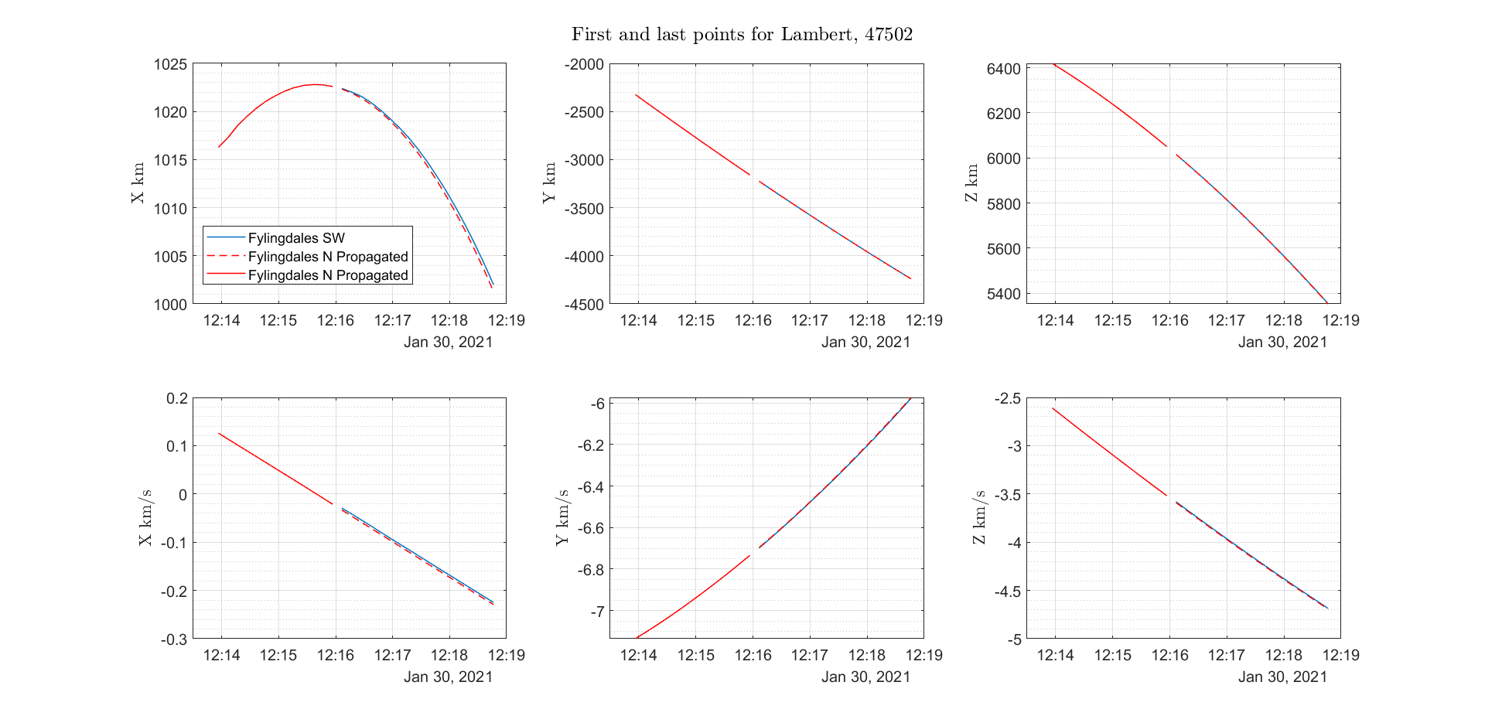
Lambert’s Method
State Propagated with first and second point for Lambert
State Propagated first and last point for Lambert

Slide 17
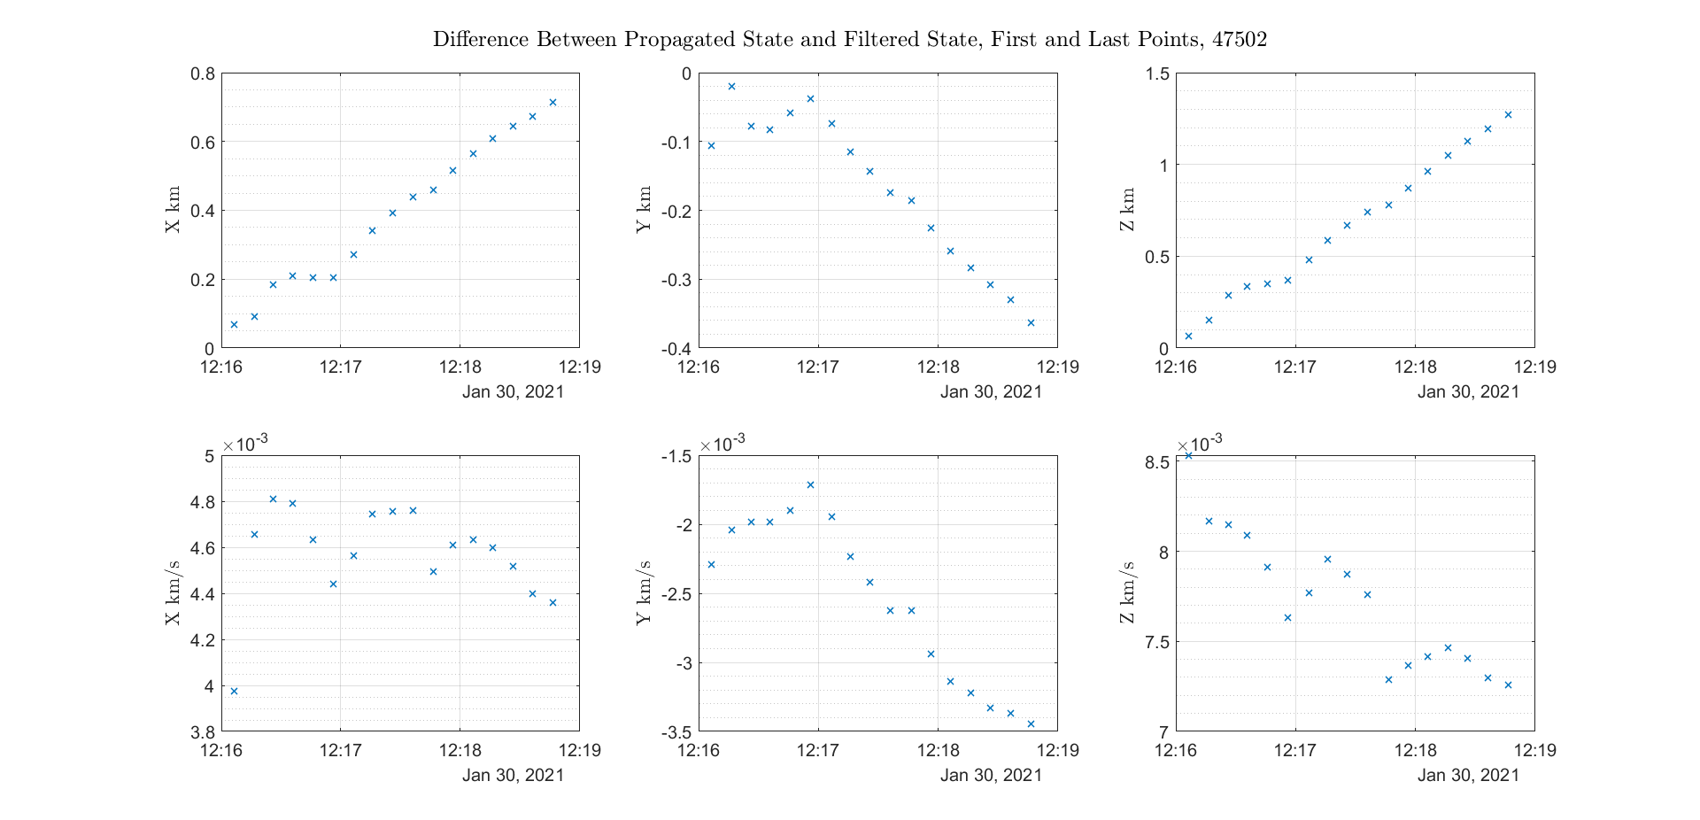
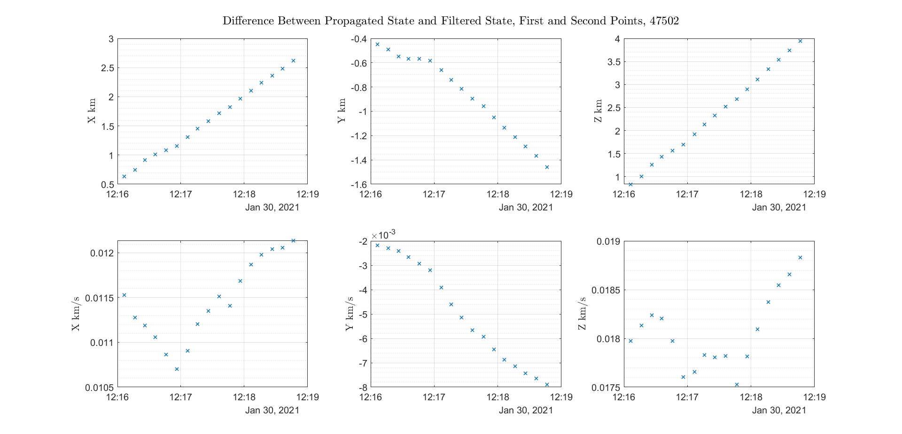
Lambert’s Method
Initial position error is much lower.
Propagation gets worse over time

Slide 18
Longer Propagation
Around 15 minuets of propagation are much more common
Passing over different radar station
Results for 16.5 minuets of propagation
Satellite | Delta X (km) | Delta Y (km) | Delta Z (km) | Delta Vx (km/s) | Delta Vy (km/s) | Delta Vz (km/s)
47465 | -14 | -0.687 | 92.5 | -1.85e-3 | -103.e-3 | 2.2e-3
47493 | -13.4 | -3.5 | 87.7 | -2.5e-3 | -110e-3 | 23e-3
47452 | 10.1 | -57.2 | -35 | 120e-3 | -13.e-3 | 66e-3
Looked like different objects to the algorithm

Slide 19
Longer Propagation
Double checking radar station locations seems to help a lot
Satellite | Delta X (km) | Delta Y (km) | Delta Z (km) | Delta Vx (km/s) | Delta Vy (km/s) | Delta Vz (km/s)
47465 | 9.8 | -3.8 | 4.8 | 5.4e-3 | -8.9e-3 | 1.2e-3
47493 | 2.685 | 1.147 | -1.21 | -1.35e-3 | -3.7e-3 | -3.35e-3
47452 | 2.14 | 7.35 | -4.83 | -15e-3 | -13e-3 | 11e-3
Huge Improvement from 80-90 km difference

Slide 20
Conclusions/Next steps
Velocity is difficult to estimate in one radar pass and is the driving factor for orbit propagation not agreeing with the next radar.
Using points further a part in time can help with velocity estimation.
Consider using Az rate and El rate for better velocity estimation.
Update radar map

Slide 21
Backups

Slide 22
Batch Filter
Uses least squares to solve for the initial state
Recursively ran batch filter until we got a good initial state estimation
Used that initial state and propagated for the radar pass to compare the propagated sate to the radar measurements
Tested on simulated data

Slide 23
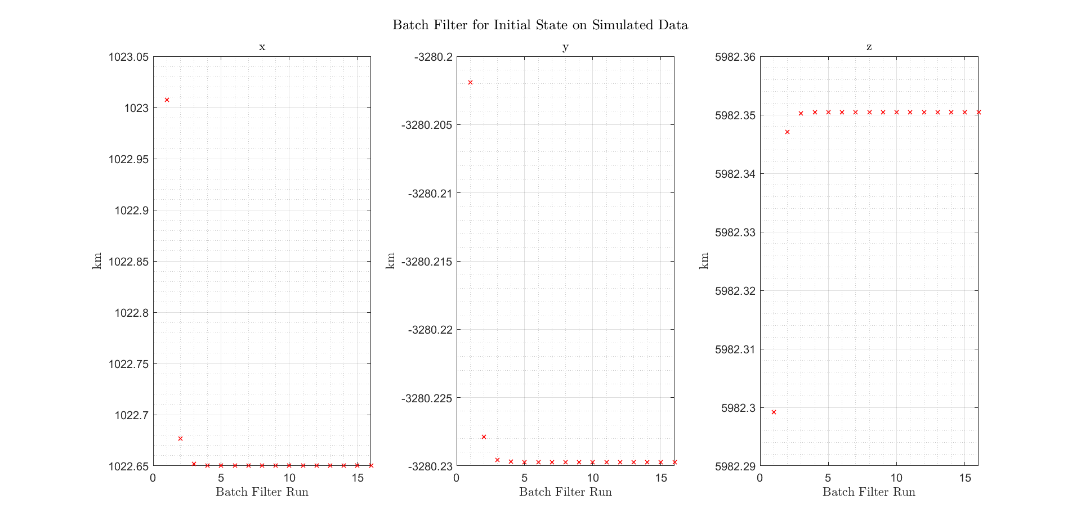
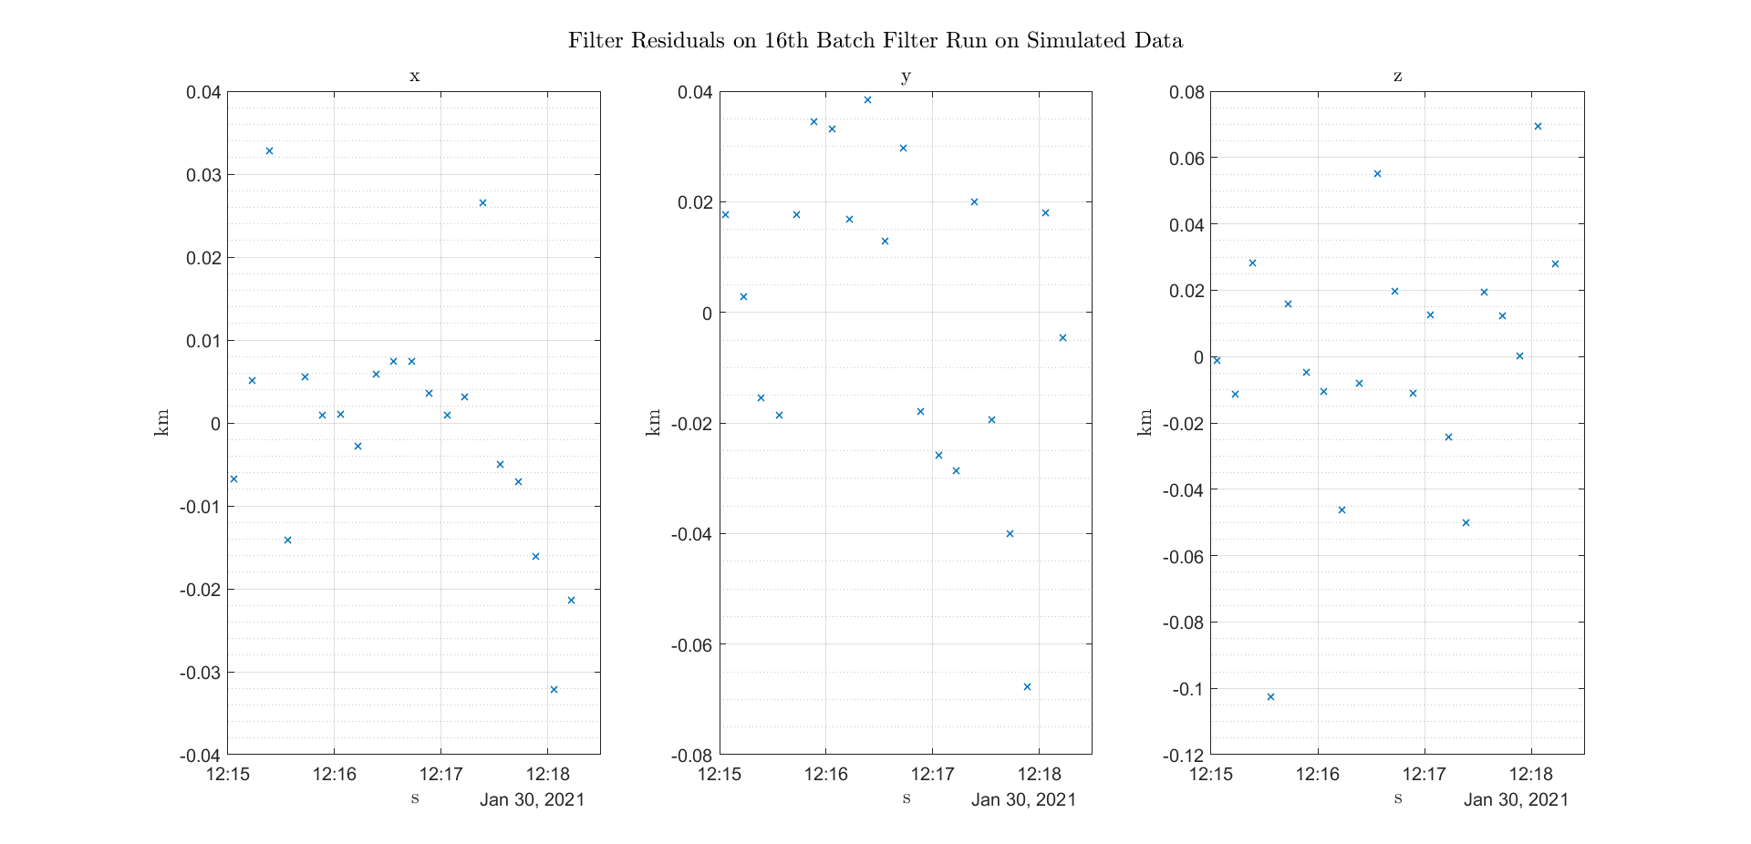
Batch Filter
Results on Simulated data

Slide 24
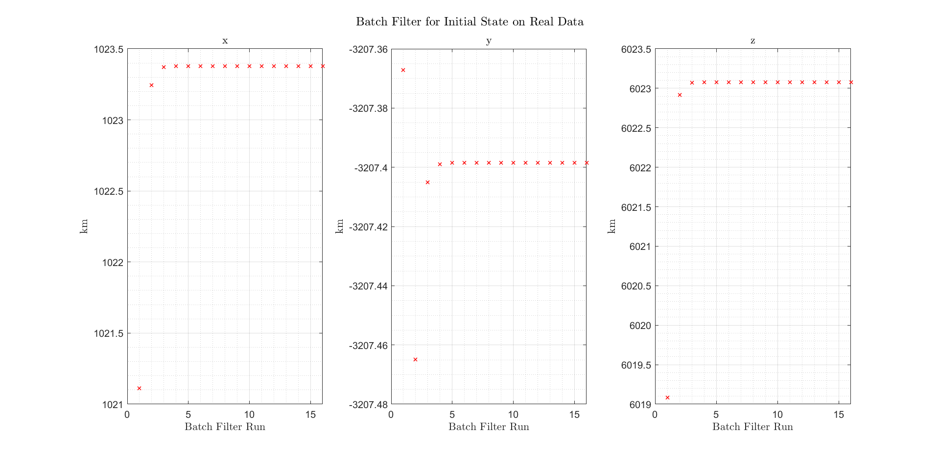
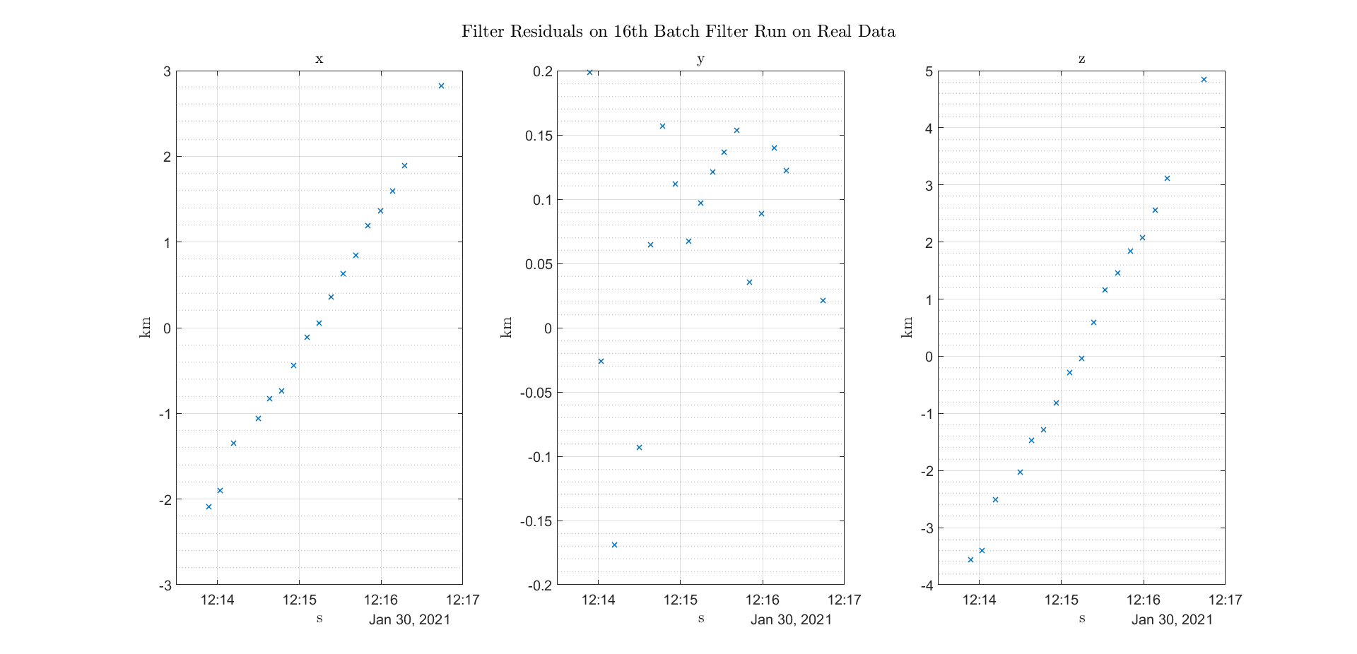
Batch Filter
Results on Real data

