Slide 1
Redesign Project 2016 US Election Map
Mitchell Breeden
STAT-515-009

Slide 2
Intro
The United States uses the electoral college
Differs from the popular vote
270 of 538 are required to win

Slide 3
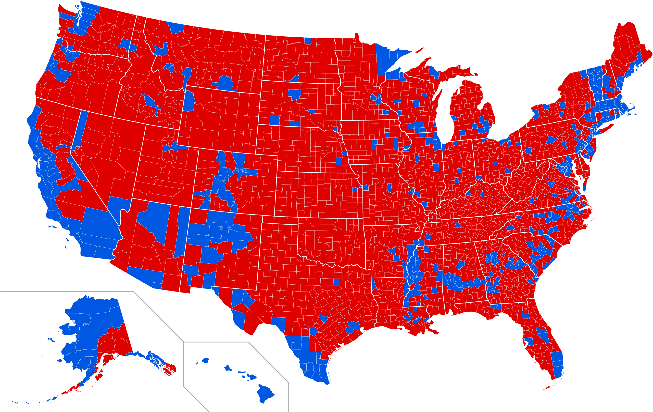
Original
The map above shows results by county, but this can be misleading
Source: Ali Zifan via Wikimedia Commons
Referenced: https://news.yale.edu/2021/04/21/swing-vote-trumped-turnout-2016-election

Slide 4
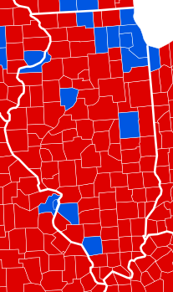
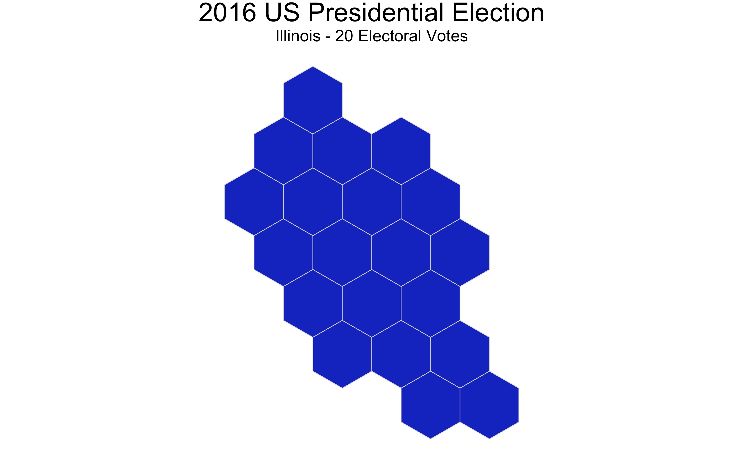
Comparison
Original
Redesign
Original is misleading
Population centers caused Illinois to go blue

Slide 5
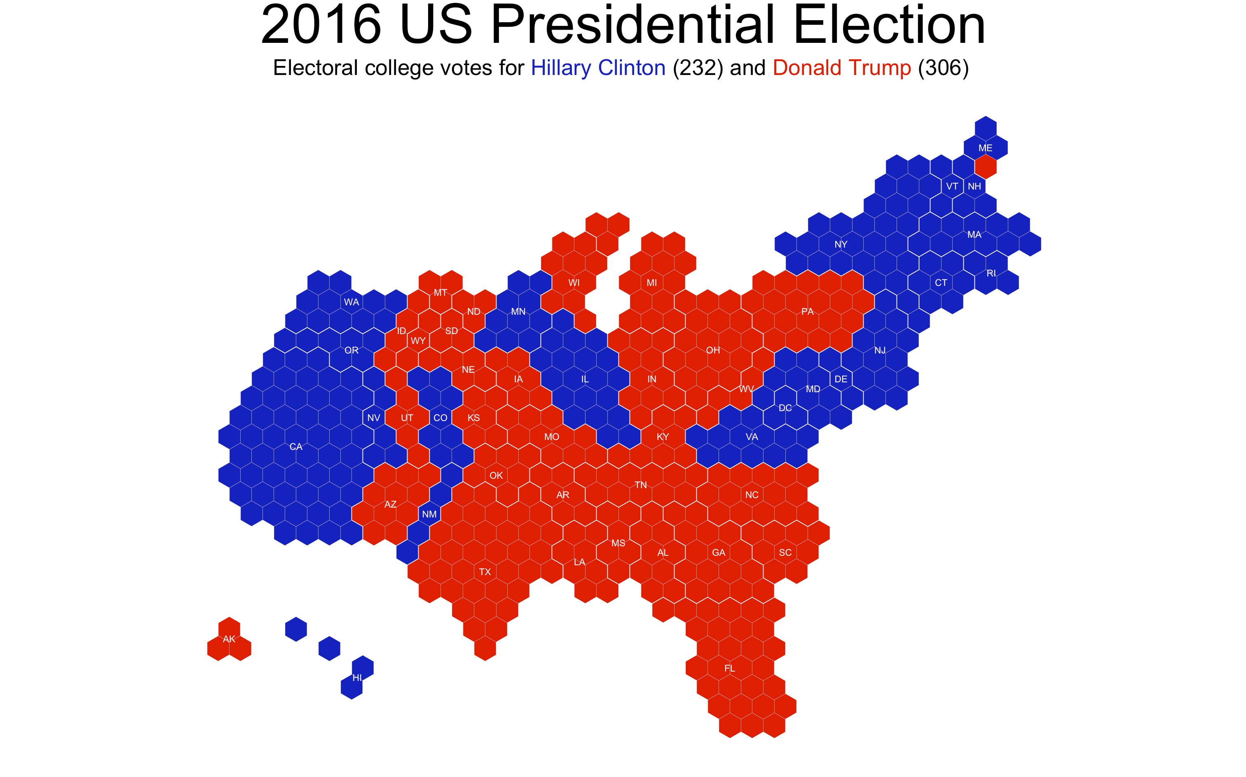
Redesign
The number of hexagons displayed above equals the number of each state’s electoral votes
Software
RStudio
tilegramsR
ggplot2

Slide 6
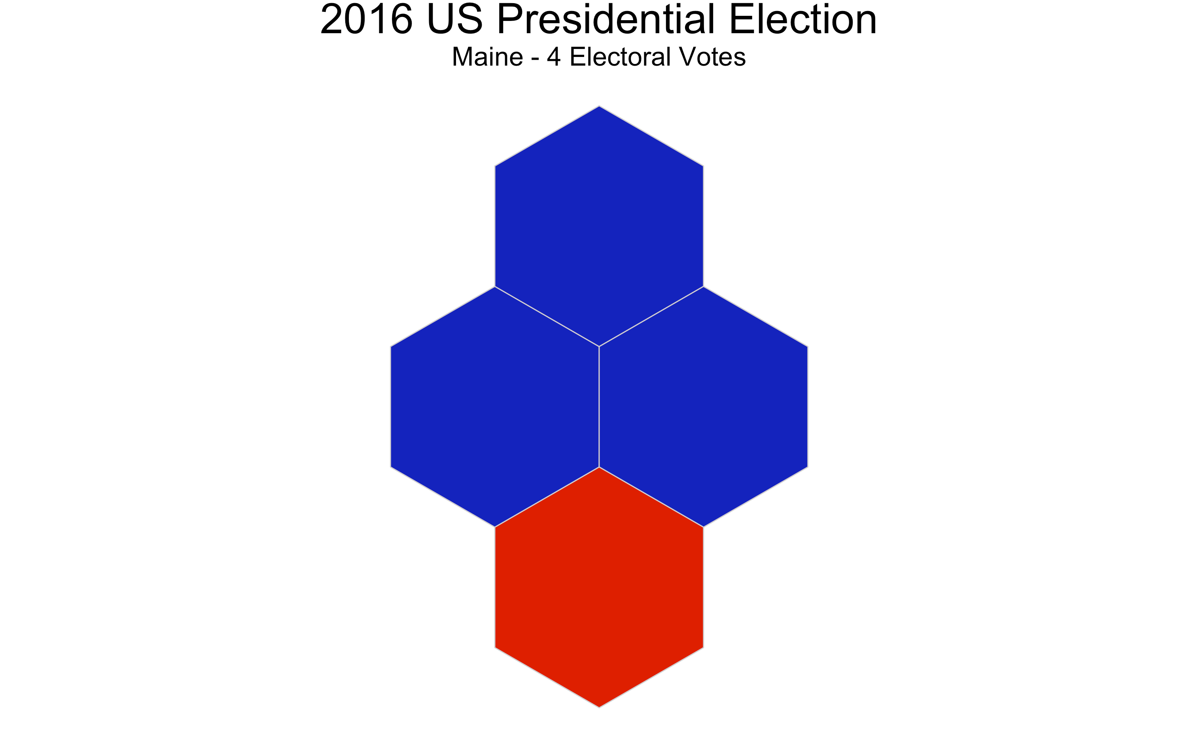
Special Efforts
Function to see individual states
Shows state name and electoral votes

Slide 7
Conclusion
Electoral votes vs counties
My redesign helps to visualize the macro level while the original focuses on the micro level
Next Steps
Tooltips
Color by percent of vote

