Slide 1
Parkinson's Disease
Prediction
OR-568-002
Fraol Abebe, Mitch Breeden, John Gullette, Jason Pinto, Ryan Wadsworth

Slide 2
What is Parkinson’s
Parkinson's disease is a neurodegenerative disorder that affects the central nervous system.
Characterized by the gradual loss of dopamine-producing cells in a region of the brain called the substantia nigra, leading to the impairment of motor functions.
An estimated 60,000 Americans are diagnosed with Parkinson's disease each year.
Parkinson's disease is most commonly diagnosed in people over the age of 60, but it can also affect younger people.
The annual direct and indirect costs of Parkinson's disease in the United States are estimated to be $52 billion.
Notes:
Ryan slide 1
4% of people worldwide are diagnosed before the age of 50.
costs associated with medical treatment, lost productivity, and caregiving expenses according to a study published in Journal of Parkinson's Disease

Slide 3
Project Description
The goal of this study is to develop a predictive model for Parkinson's Disease Progression by analyzing protein abundance data.
The data collected is a large dataset consisting of protein and peptide abundance values from cerebrospinal fluid (CSF) samples of hundreds of Parkinson's disease patients.

Slide 4
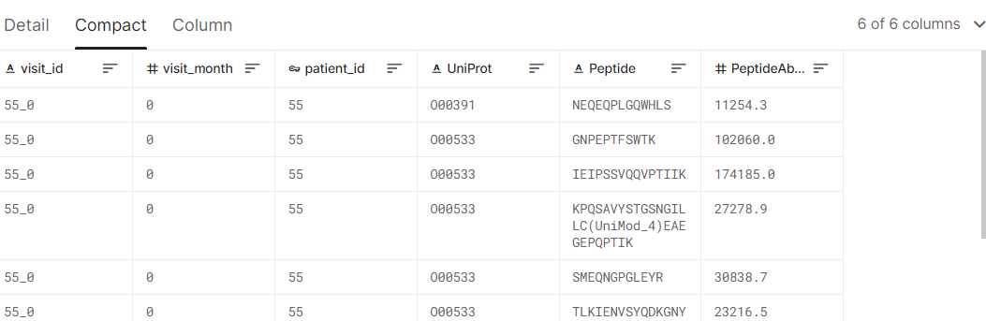
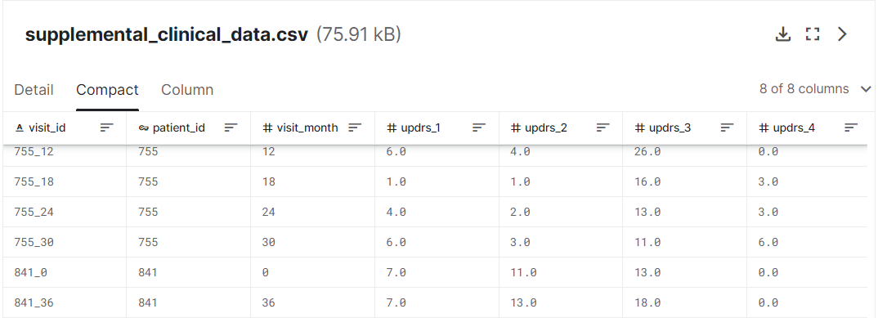
Data Sources
The data was retrieved from Kaggle: https://www.kaggle.com/competitions/amp-parkinsons-disease-progression-prediction

Slide 5
Summary of the Predictors and Response
Predictors:
patient_id: An ID code for the patient.
visit_month: The month of the visit, relative to the first visit by the patient.
UniProt : The UniProt ID code for the associated protein
Peptide : The sequence of amino acids included in the peptide
PeptideAbundance: The frequency of the amino acid in the sample.
Clinical_state_on_medication: Whether or not the patient was taking medication
NPX: normalized measure of protein expression frequency in a sample
Response:
updrs_[1-4]: rating score of the patient's symptoms for a particular category (N) of the Unified Parkinson's Disease Rating Scale.

Slide 6
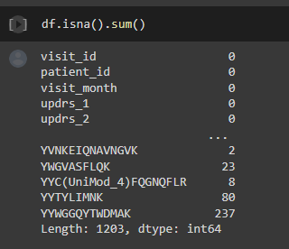
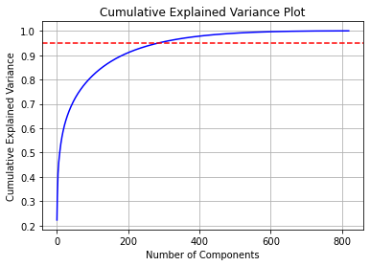
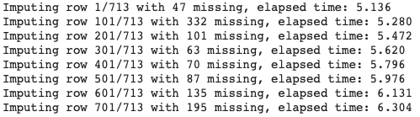
Data Pre-processing and Transformation
Merged protein, peptide, and clinical datasets before preprocessing
Aggregated protein and peptide data by visit_id and calculated the mean value for each protein and peptide in that visit
Scaled the predictors data using StandardScaler from the sklearn.preprocessing library
Checked for missing values and used KNN imputation method from the fancyimpute library with k=3 to fill in the missing values
Applied PCA to reduce data dimensionality and choose important features, our data contained over 1200 features
Reduced the data to 400 features after PCA

Slide 7
Summary of the Final Cleaned-Up Dataset Used for
Modeling
X_train shape: (499, 1196)
X_test shape: (214, 1196)
y_train shape: (499, )
y_test shape: (214, )
Y2, y3, y4 also used
X_train_pca shape: (499, 400)
X_test_pca shape: (214, 400)

Slide 8
Initial Modeling Methods
These models were created before we used PCA on the dataset.
Used all proteins and peptides as predictors with a 70/30 random train/test split.
Created a separate model for each response variable.
We wanted to use models that allowed us to examine feature importance as one of the goals of the grant is understanding the relationship between these proteins and peptides and the progression of Parkinson’s disease.

Slide 9
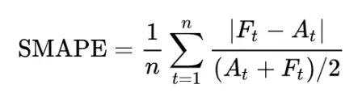
SMAPE
This Kaggle competition uses SMAPE, or symmetric mean absolute percentage error, as the scoring metric.
Generally used to measure accuracy in time series models.
Currently in the competition, the teams on the top of the leaderboard are achieving mid to high 50s for their models.

Slide 10
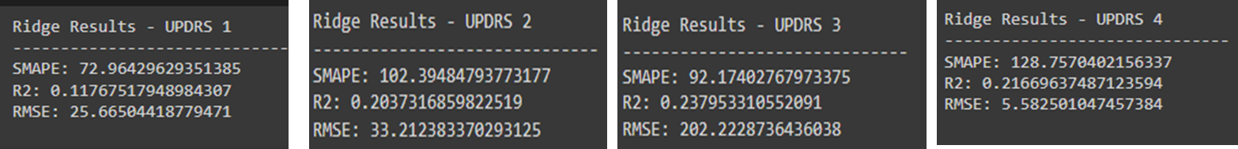
Ridge Regression
Adds penalties to insignificant predictors which serves as feature selection.
Our model has about 1,200 predictors
Hyperparameters tuned using GridSearchCV with alpha values of 0.1, 0.5, 1, 5, 10, and 100
We evaluated the model performance using SMAPE, R2, and RMSE
Output of the Model

Slide 11
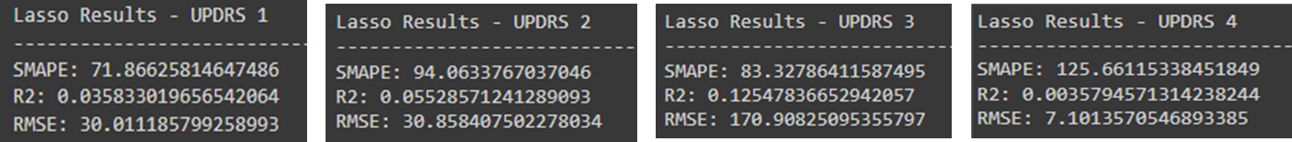
LASSO
Minimizes the sum of the absolute values of the model coefficients
The model is trained using GridSearchCV to find the best hyperparameters that result in the lowest error
The hyperparameters are tuned with alpha values of 0.1, 0.5, 1, 5, 10, and 100.
10-fold cross-validation is used during the training process to avoid overfitting and improve generalization performance
Output of the Model

Slide 12
Random Forest Regression
Ensemble method that selects subsets of training data and predictors to create multiple trees.
Uses the average prediction of the combined trees.
The maximum size of the tree serves as feature selection which is ideal because we have more predictors than samples.
RF gives us the ability to interpret which predictors are most important.
We used 1000 trees, 2 minimum samples per leaf, and 5 minimum samples per split.

Slide 13
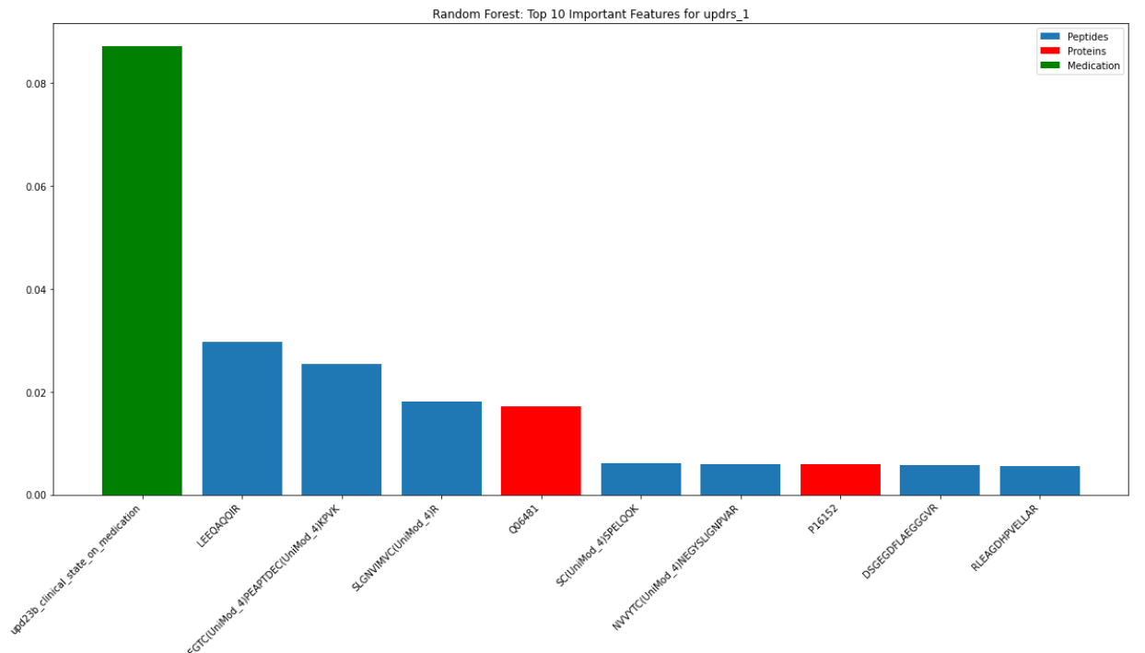
Random Forest Regression - Important Features
The most important predictor shown here is an indicator variable for if the patient is on Parkinson’s medication.
The blue bars are amino acids and red bars are proteins.

Slide 14
Extra Trees Regression
Similar to random forest regression but selects random split points and uses additional trees.
This model performed the best of all the models tested, outperforming random forest.
This could be do to overfitting on the random forest model or the increased diversity gained from splitting on random variables combined with a higher number of trees.
We used 1000 trees, 2 minimum samples per leaf, and 5 minimum samples per split.

Slide 15
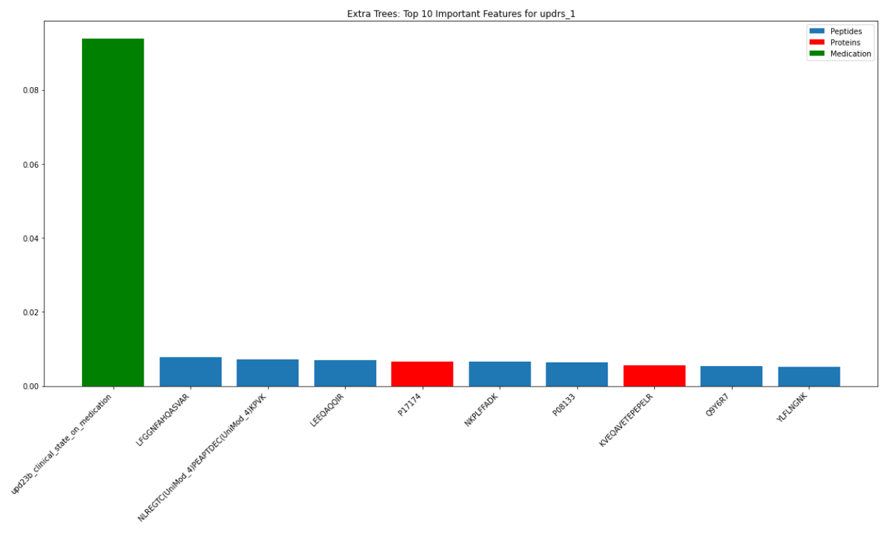
Extra Trees Regression - Important Features
Although we achieved better model performance from extra trees regression, the feature importance is more uniform.

Slide 16
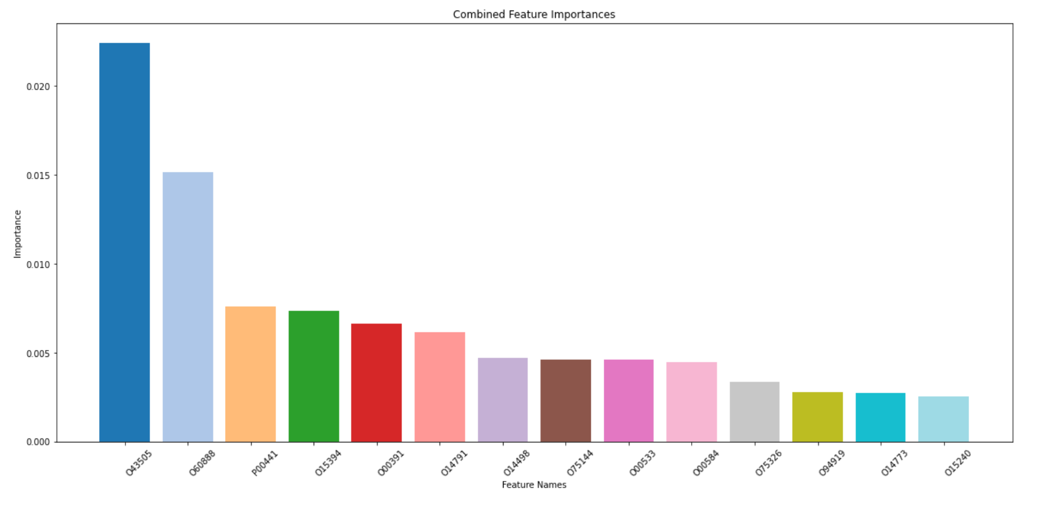
Feature Importances
The most important predictor for all response variables was if the patient was medicated for Parkinson’s.
* Not shown on the right because of scale.

Slide 17
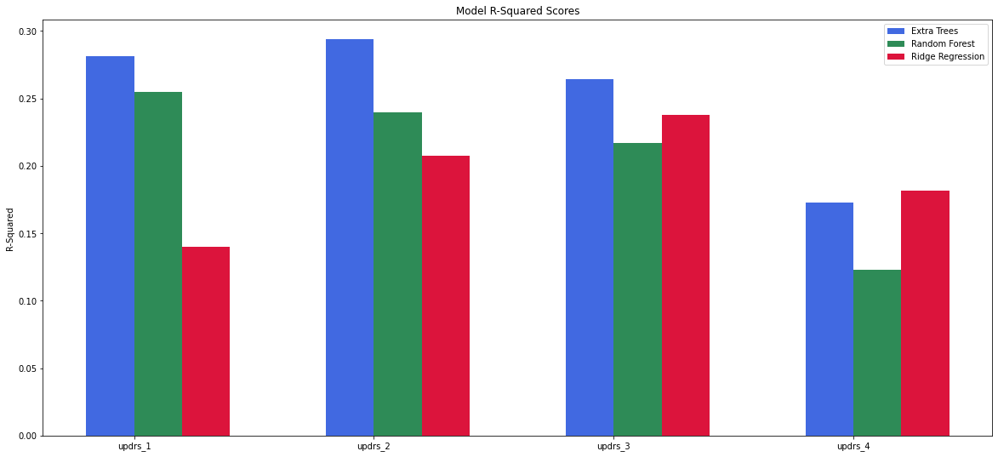

Slide 18
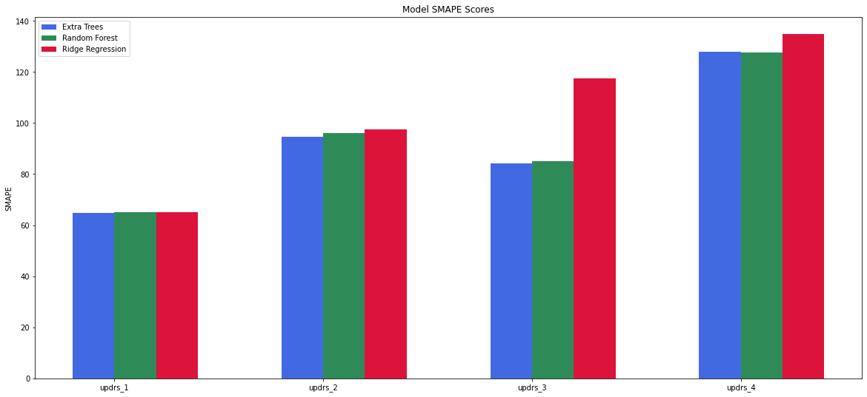

Slide 19
Time Split and PCA Approach
The UPDRS values were listed by month per patient, therefore we also built models attempting to predict each patient’s progression month to month
We split the train and test data based upon time. The first 80% of each patient’s visits was in the training set and the last 20% of the patient’s visits were used for the test set
Dimensionality Reduction was performed using PCA - reducing the number of predictors to 500.
New predictors were added including the month number since the patient was first studied and the first visit UPDRS values

Slide 20
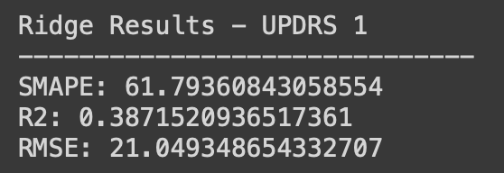
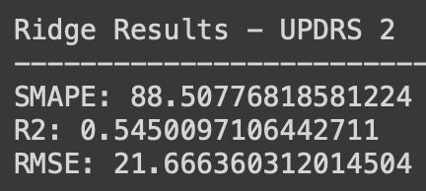
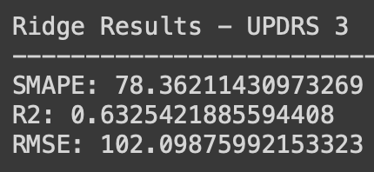
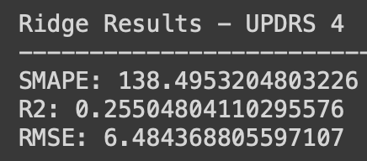
Best Time Split Model
Ridge Regression was the highest performing Time Split Model
Still, the predictive performance was not very strong

Slide 21
Time Split Model v.s Just Peptides and Proteins Model
Overall, the best model accounting for the timing of patient visits (Ridge Regression) outperformed the best model trained on only Proteins and Peptides (Extra Trees Regression)
The only statistic the Proteins and Peptides alone model outperformed the Time Split model was the SMAPE of UPDRS-4.
Notes:
Symmetric mean absolute percentage error

Slide 22
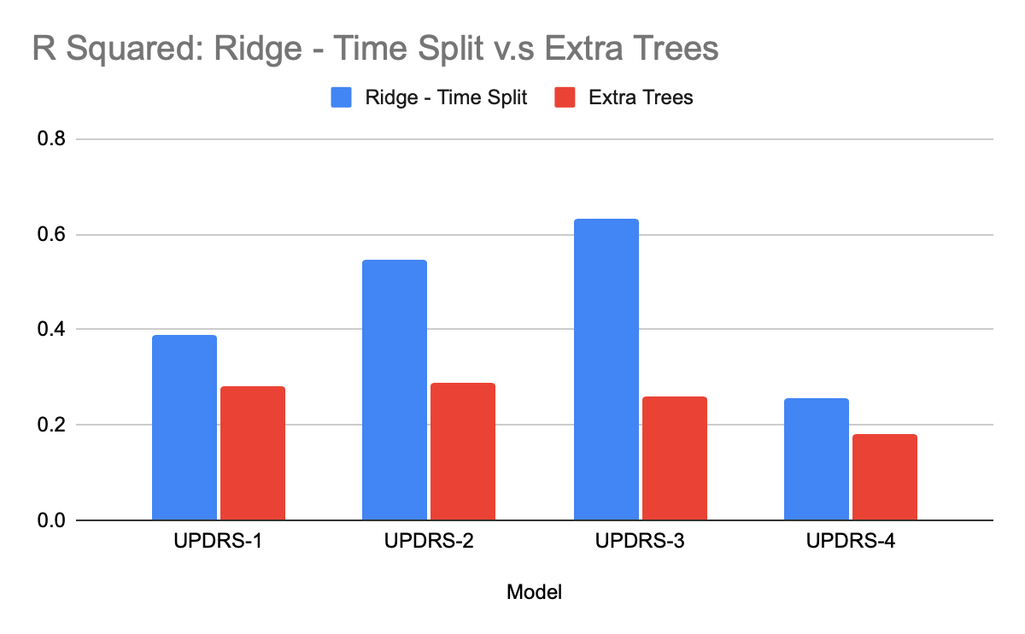

Slide 23
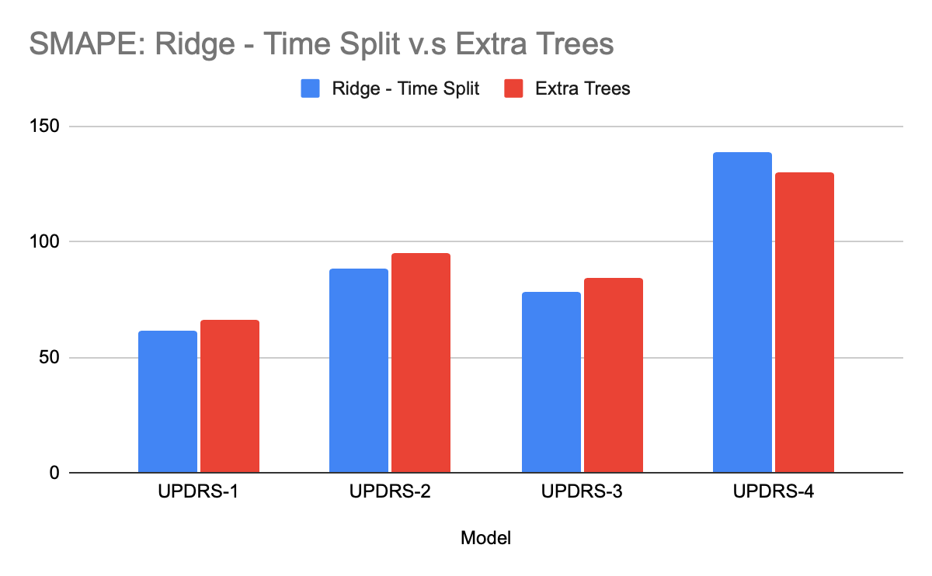

Slide 24
Conclusion
The abundance of proteins and peptides contained in cerebrospinal fluid are not perfect predictors of the progression of Parkinson’s disease, but there is enough relevant variance to give some indication.
We hope that in the future this type of predictive analysis can help treat/catch Parkinson’s disease in order to better treat it.

