Slide 1
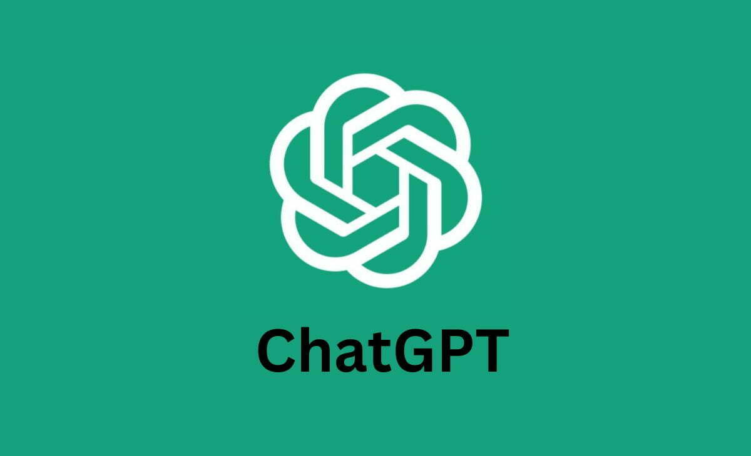
ChatGPT Sentiment Analysis
Team 1: Brian Monter, Eliza Punnoose, Mitch Breeden, Rock Chan
Professor: Maryam Heidari
AIT 526-002: Natural Language Processing
George Mason University
Summer 2023

Slide 2
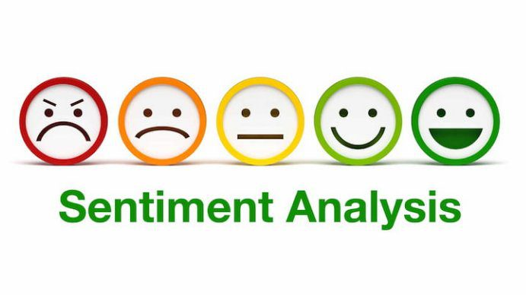
Contents
Abstract
Introduction
Related Work
Objectives
Dataset
The System
Results
Conclusion
References
Questions

Slide 3
Abstract
Throughout the paper we will consider various questions, the two main being;
What approach is best for determining sentiment for a tweet?
What is the initial sentiment surrounding ChatGPT on twitter based on the tweets in the specified range?
The two approaches that were used to determine sentiment were the Pattern approach and the Vader approach.
Based on the beginning days of ChatGPT’s popularity, the initial sentiment shows it is useful, helpful, and here to stay!

Slide 4
Introduction
What is ChatGPT?
How is ChatGPT viewed in the public eye?
What is Sentiment Analysis?
How can we use Sentiment Analysis on tweets related to ChatGPT?

Slide 5

Related Work
Studies on tweets about ChatGPT
“What Can ChatGPT Do?” Analyzing Early Reactions to the Innovative AI Chatbot on Twitter - Viriya Taecharungroj 2023
Latent Dirichlet Allocation
Twitter Sentiment Analysis for ChatGPT - ANIL 2023
Sentiment Analysis

Slide 6

Objectives
Identify opinions
Sort these opinions into relevant categories
Identify the negative and neutral opinions
Determine the best sentiment analysis approach

Slide 7
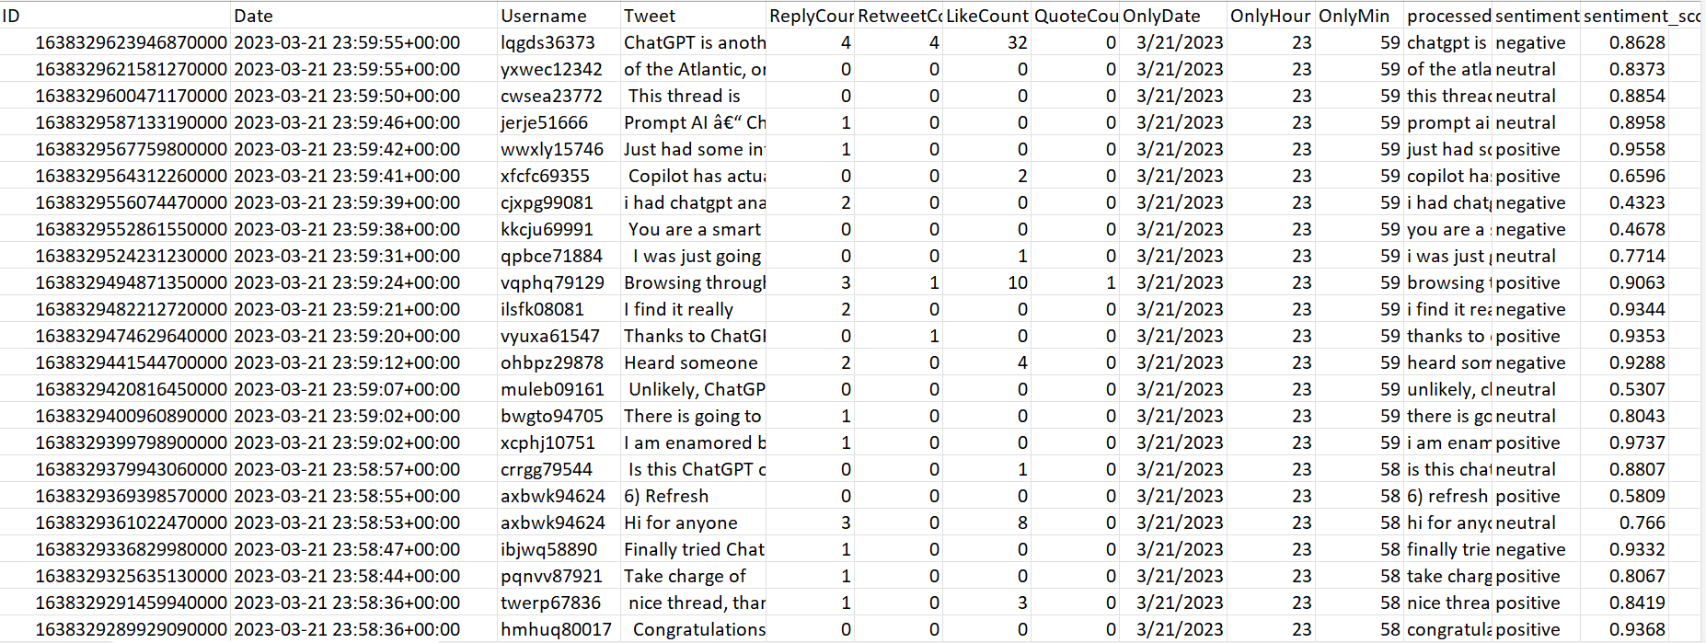
Dataset
About 100,000 Tweets in English
All contain the word ChatGPT
Range: March 18th, 2023 to March 21st, 2023
Variables:
ID: unique tweet id
Date: date the tweet was sent
Username: username of the person who tweeted (masked for this data and non-real ids are generated)
Tweet: content of the tweet (tags and links deleted)
ReplyCount: number of replies to tweets
RetweetCount: number of retweets to tweets
LikeCount: number of likes to tweets
QuotesCount: number of quotes to tweets

Slide 8
The System
Packages: Pandas, NLTK, Numpy, Emoji, Textblob, Wordcloud, Preprocessor, and Matplotlib
Transformer-based Sentiment Analysis Model
Processed and cleaned the data - created columns and removed emoji’s
Preprocessed tweets into a cleaner version
Lowercase conversion
Punctuation removal
Handling of dots and spaces
Removal of words starting with certain characters
Hashtag processing
Character repetition reduction
Stop word removal

Slide 9
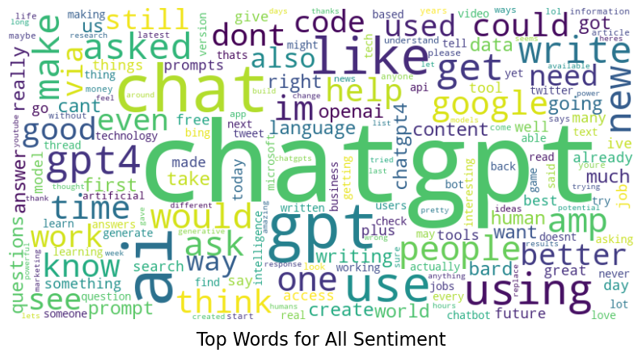
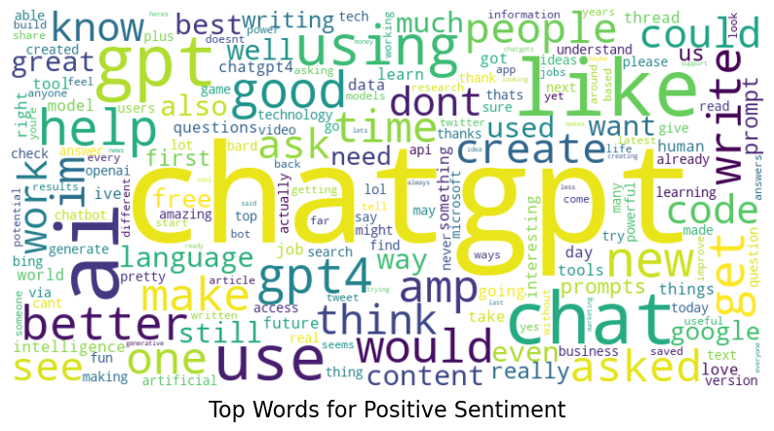
Results - Word Cloud
Top Words for All and Positive Sentiment
Words that stand out:
Like
Help
Better
Good
Use
All of these words indicate that the user is having more of a positive experience compared to a negative one and using ChatGPT for useful tasks such as writing or coding help.

Slide 10
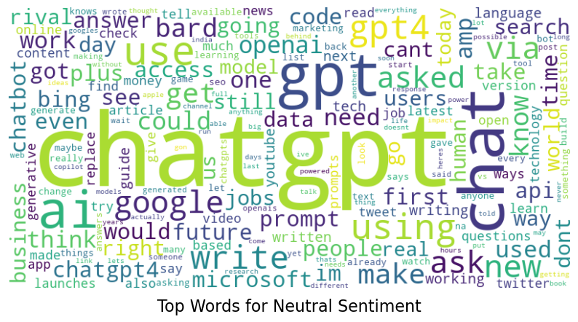
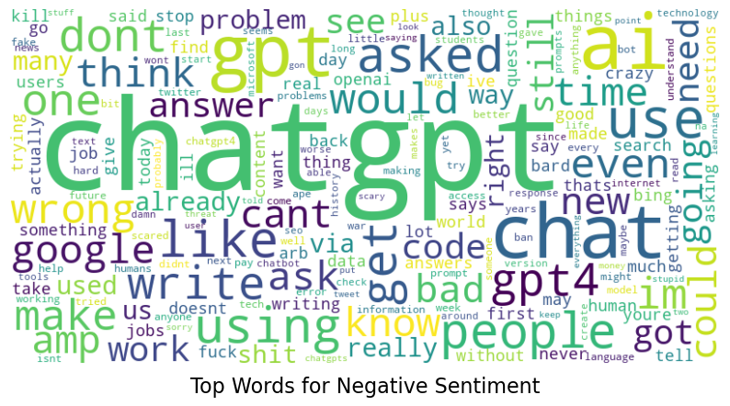
Results - Word Cloud
Top words for Neutral and Negative Sentiment
Words that stand out:
Chat
Asked
Bad
People
Think
Write
These words indicate that the user had a neutral or negative experience when asking ChatGPT to perform certain tasks such as writing.

Slide 11
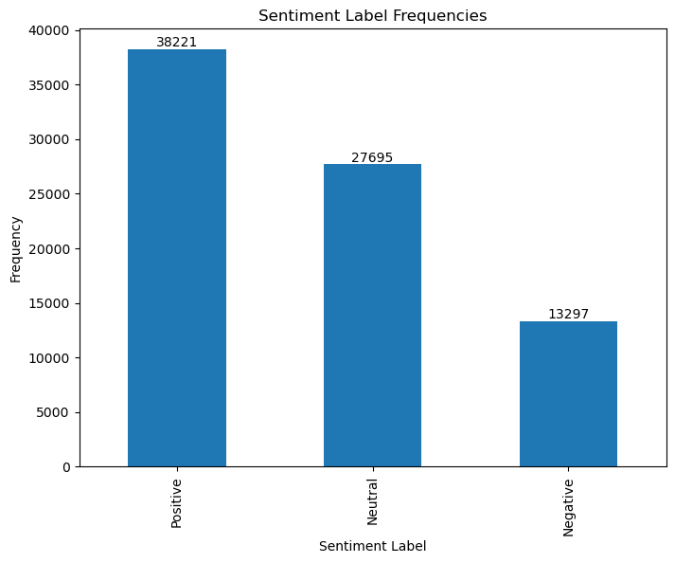
Results - Sentiment Label Frequencies
Column plot that shows the frequency of each sentiment label in the data.
Users tend to have a more positive or neutral experience with ChatGPT.

Slide 12
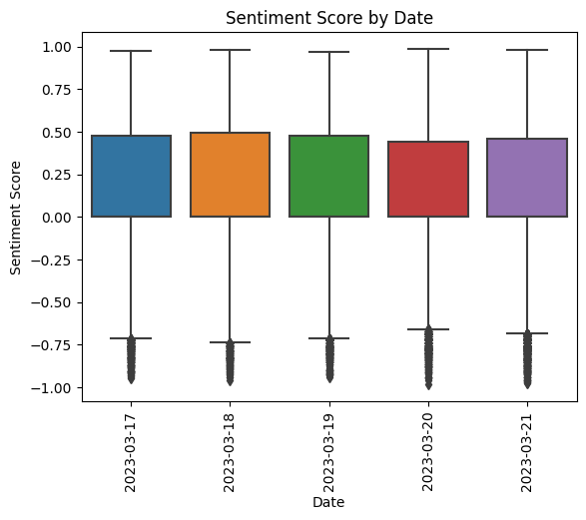
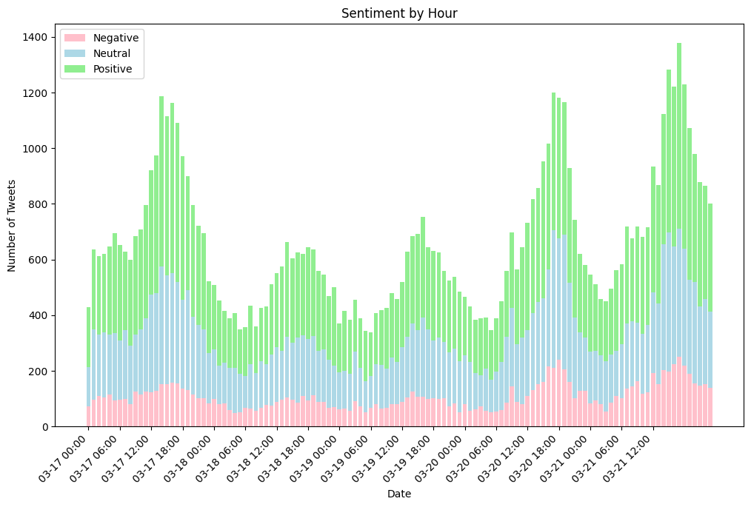
Results - Sentiment by Date and Hour
Boxplot for Sentiment score is scaled from -1 to 1.
The 50% mean is 0 to 0.5. The range of sentiment score is from 1 to -0.75.
Less people twitter on March 18 and 19 which is Saturday and Sunday.
More people twitter at 12:00pm each day.

Slide 13
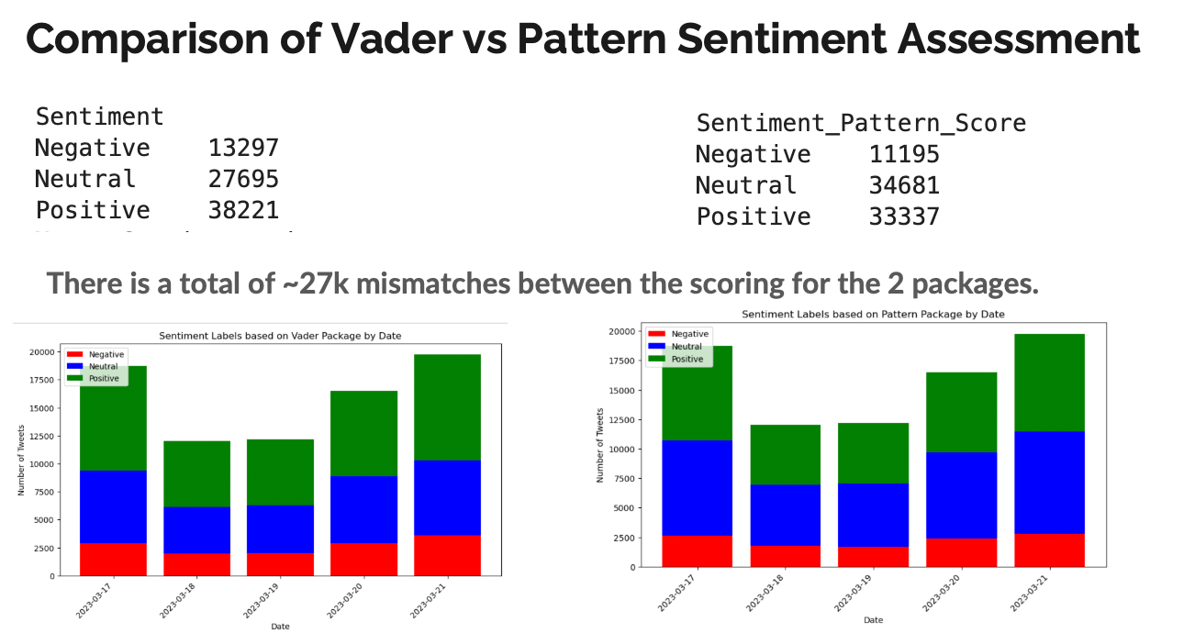

Slide 14
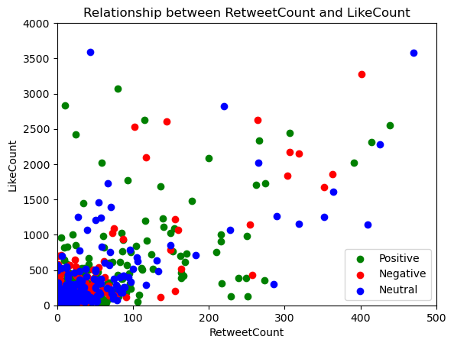
Results
No clear pattern.
Most liked and most retweeted tweets were identified as neutral tweets.
Tend to be more green (positive) tweets that were liked/retweeted compared to negative tweets.

Slide 15
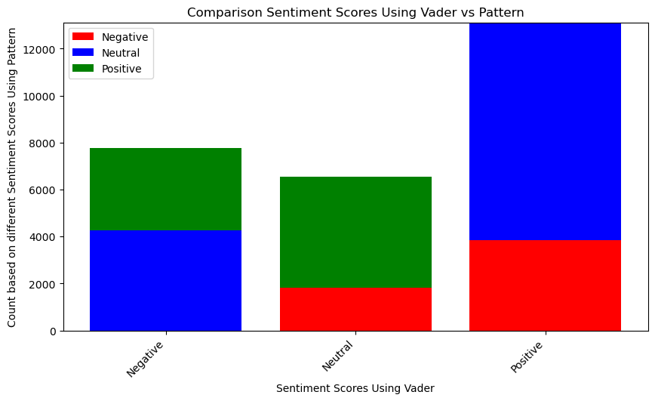
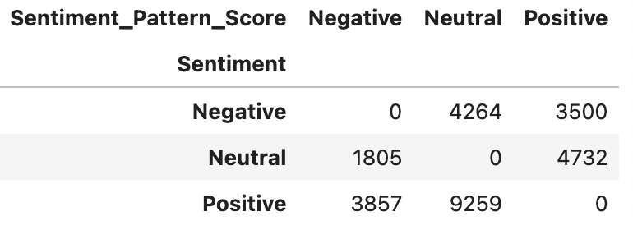
Results - Vader vs Pattern
Pattern Approach - Text data mining tool that has a text-processing component.
Vader Approach - Approach specifically attuned to social media text.

Slide 16

Conclusion
Pattern vs. Vader - Between different approaches, identifying sentiment is different.
Pattern seemed to identify sentiment in a better way - manually going through examples.
The initial sentiment to ChatGPT was positive or neutral for the most part during the time frame from March 18th, 2023 to March 21st, 2023

Slide 17
Picture References
ChatGPT Has Accelerated the Flywheel (tsvcap.com)
How to Create and Deploy a Simple Sentiment Analysis App via API - KDnuggets
About Twitter | Our logo, brand guidelines, and Tweet tools
The Dangers of Having an Opinion in the 21st Century | Geeks (vocal.media)
Sentiment Analysis | Sentiment Analysis Tools | Express Analytics

Slide 18
References
Taecharungroj, V. (2023, February 16). “What Can ChatGPT Do?” Analyzing Early Reactions to the Innovative AI Chatbot on Twitter. Big Data and Cognitive Computing; MDPI. https://doi.org/10.3390/bdcc7010035
ANIL. (2023, March 25). Twitter Sentiment Analysis for ChatGPT. Kaggle. https://www.kaggle.com/code/sanlian/twitter-sentiment-analysis-for-chatgpt
Blei, D. M., Ng, A. Y., & Jordan, M. I. (2003, January). Latent dirichlet allocation - Journal of Machine Learning Research. Latent Dirichlet Allocation. https://jmlr.org/papers/volume3/blei03a/blei03a.pdf
GeeksforGeeks. (2023, April 6). What is sentiment analysis?. GeeksforGeeks. https://www.geeksforgeeks.org/what-is-sentiment-analysis/
Sahagian, G. (2021, April 13). What NLP Library you should use for your sentimental analysis project. Medium. https://medium.com/geekculture/what-nlp-library-you-should-use-for-your-sentimental-analysis-project-bef6b357a6db

Slide 19
Any Questions?

