Slide 1
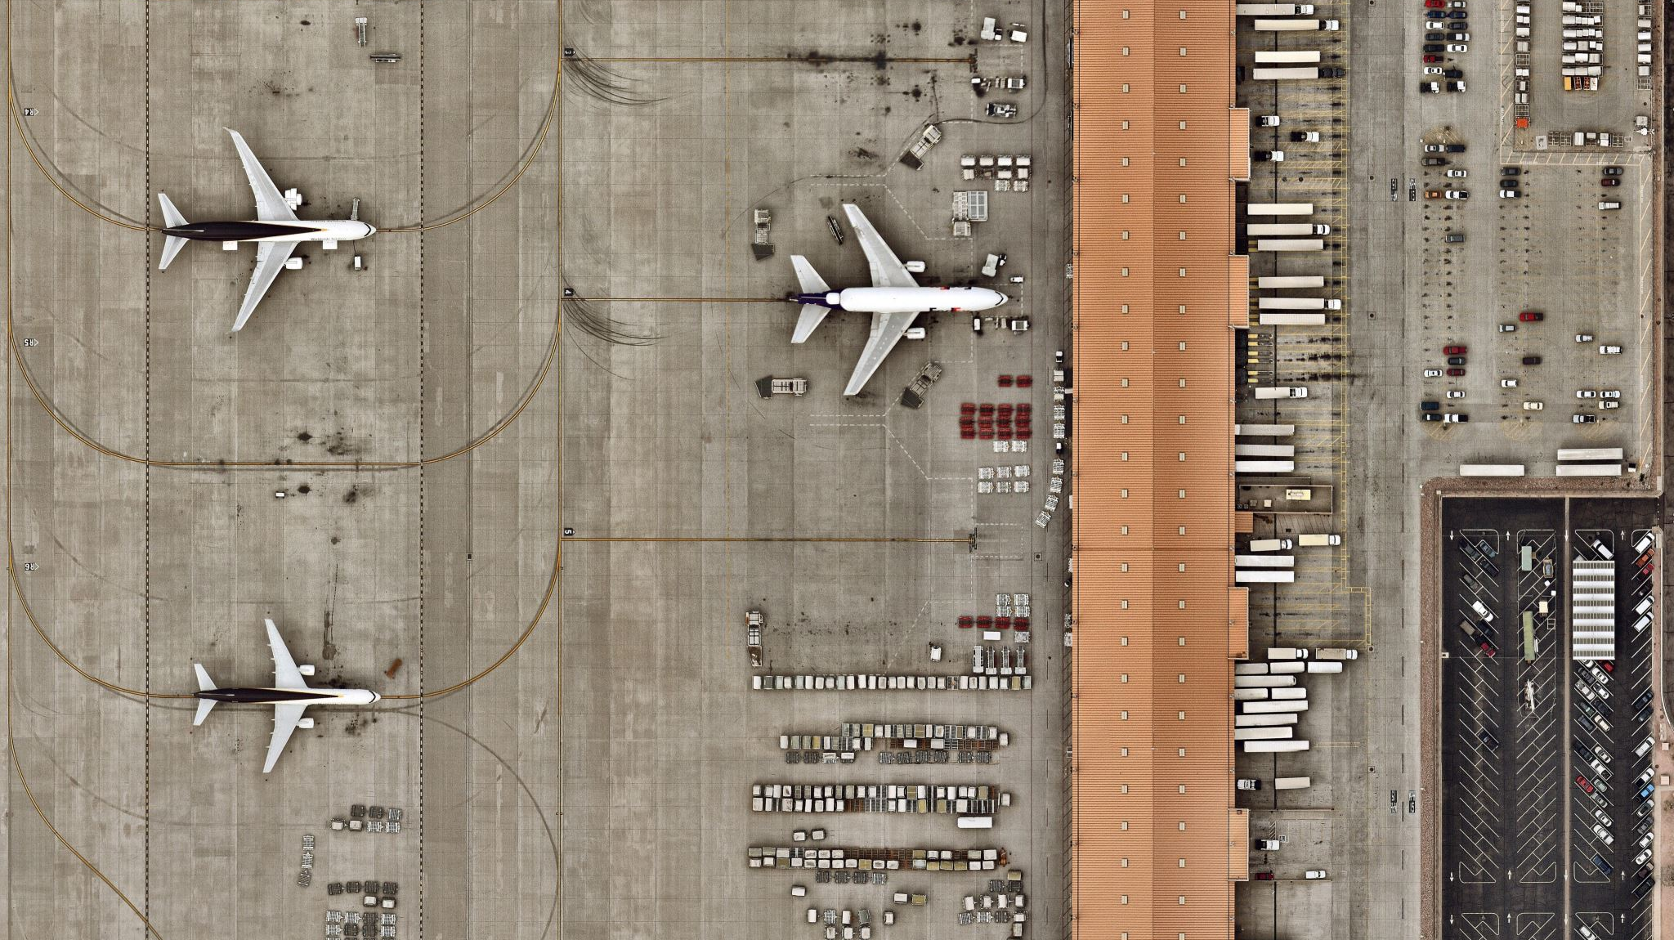
Flight Delays Final Project
Mitchell Breeden
STAT-515-009

Slide 2
Intro
Flight data utilized was recorded in January 2015 - Kaggle
# of Flights: 458,311
# of Those Delayed: 176,627 (38.54%)
FAA requires delays on tarmac to be less than 3 hours
Longer delays and passengers must be afforded the opportunity to deplane

Slide 3
Cleaning
Merge origin/destination airports and airlines
Optimize columns for readability
Assign delayed thresholds
< 1 Hour
1-2 Hours
2-3 Hours
> 3 Hours

Slide 4
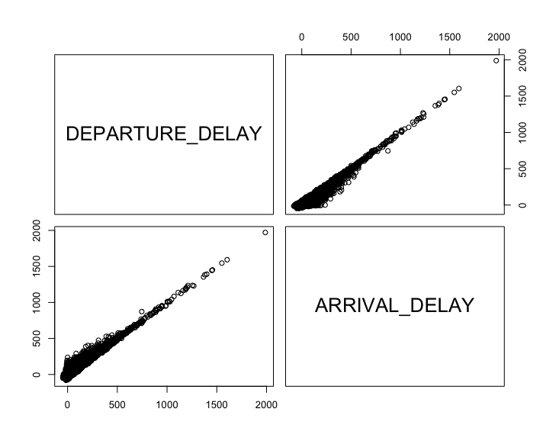
Correlation
DEPARTURE_DELAY ARRIVAL_DELAY
DEPARTURE_DELAY 1.000000 0.938116
ARRIVAL_DELAY 0.938116 1.000000

Slide 5
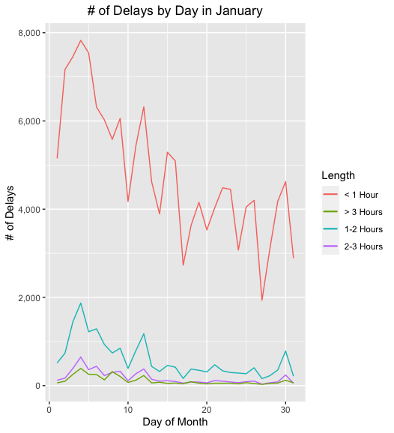
Date
Spike in beginning of January
Most variance in ‘< 1 Hour’

Slide 6
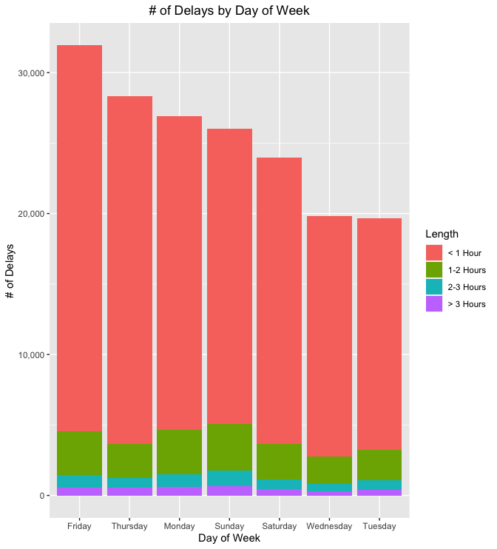
Day of Week
Most Delays
Friday
Least Delays
Tuesday

Slide 7
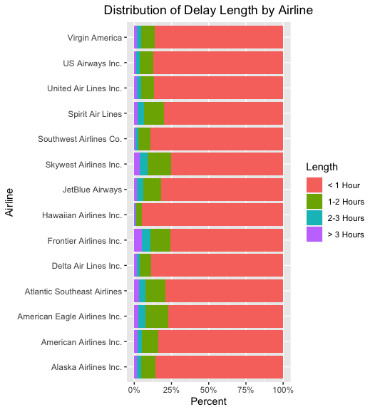
Airline
Airlines have different number of flights
Frontier Airlines Inc. has the most ‘> 3 hours’ delays

Slide 8
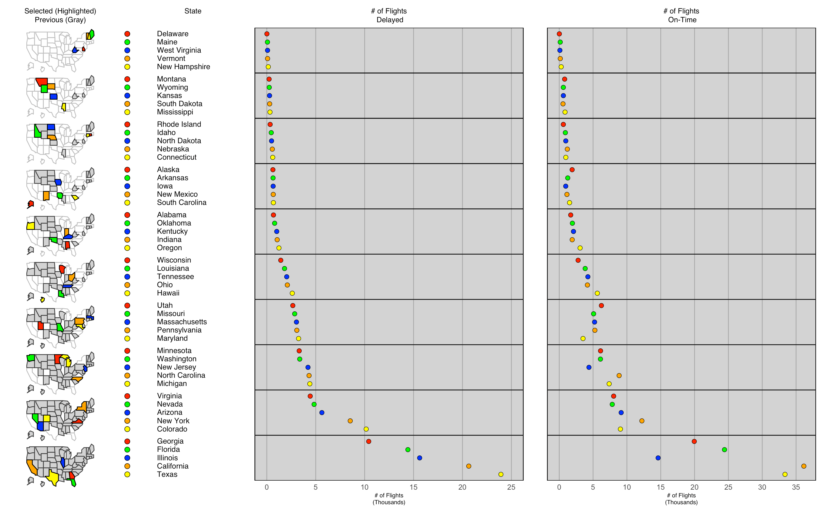
Map
Most Delays
Texas, California, Illinois, Florida, Georgia
Least Delays
Delaware, Maine, West Virginia, Vermont, New Hampshire

Slide 9
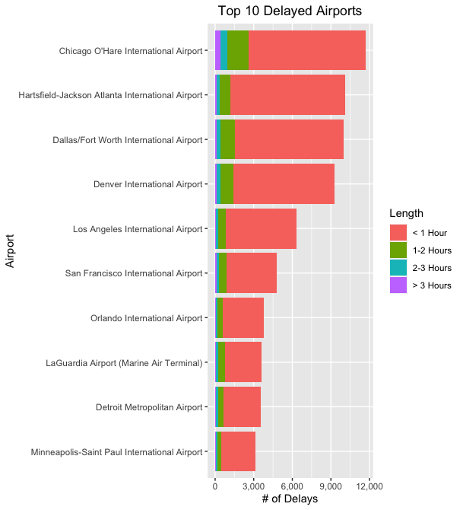
Airport
Most Delays
Chicago O’Hare International Airport
Least Delays
Minneapolis-Saint Paul International

Slide 10
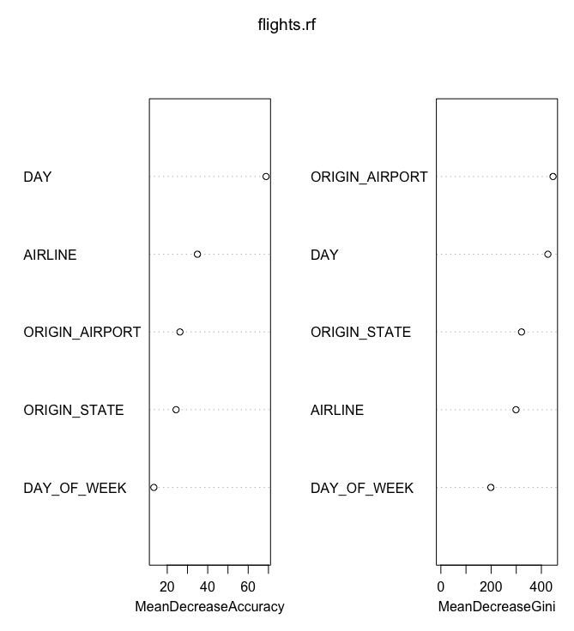
Variable Importance
Most Important Features
DAY, AIRLINE, ORIGIN_AIRPORT, ORIGIN_STATE
Least Important Features
DAY_OF_WEEK

Slide 11
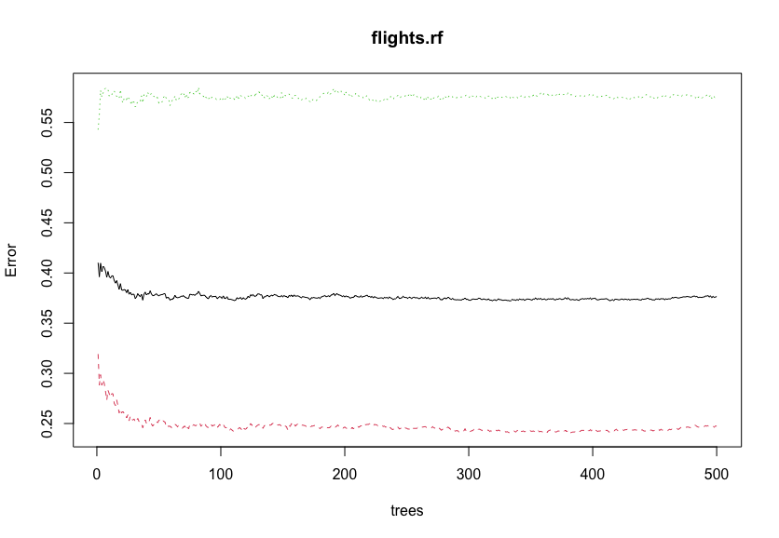
Random Forest
Call:
randomForest(formula = is_DELAYED ~ ., data = train, importance = TRUE, proximity = TRUE)
Type of random forest: classification
Number of trees: 500
No. of variables tried at each split: 2
OOB estimate of error rate: 33.61%
Confusion matrix:
0 1 class.error
0 3873 355 0.08396405
1 1996 770 0.72161967

Slide 12
Conclusion
Determining factors helped build random forest model
More robust computing power would help improve model
This data can help travelers make informed decisions about their next flight

