Slide 1
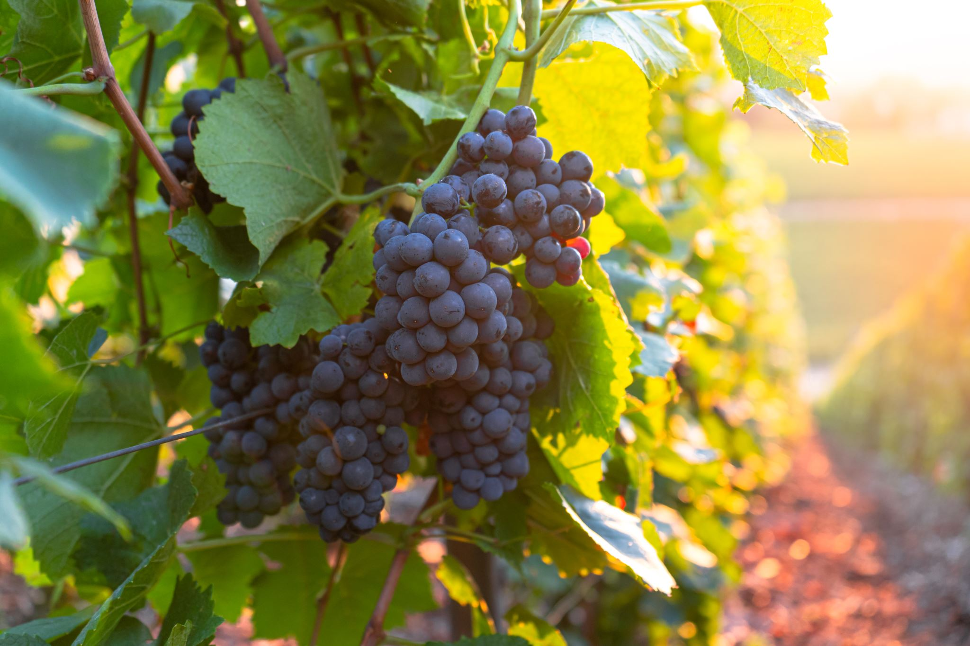
Predicting Wine Quality Using KNN and ANN
Project Team #1
AIT 736-003
Summer 2023
Notes:
An
Welcome to the Project Team #1 presentation. This is for class AIT 736 taking place the Summer of 2023. This project is Predicting Wine Quality Using K Nearest Neighbor (KNN) and Artificial Neural Networks (ANN) techniques.

Slide 2
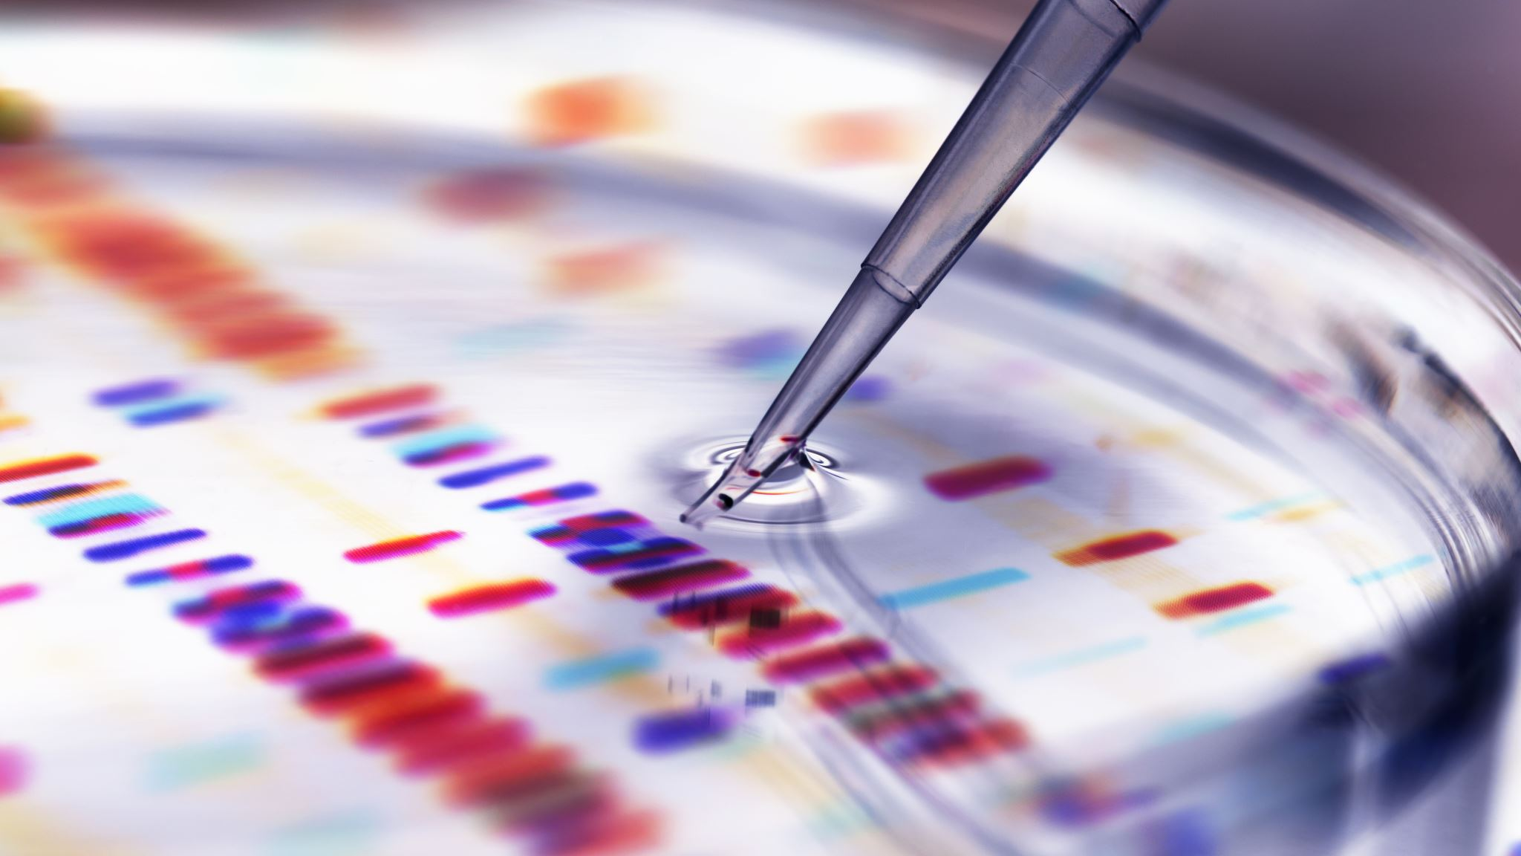
Overview
Introduction
Background
Research/Investigation
Development
KNN Classification
ANN using Tensorflow
Summary/Further Recommendations
Notes:
An
In this presentation we will start with an introduction of the team and then a background of the topic discussed, Wine Quality. We will present existing research regarding wine quality and discussed the dataset used for the modeling techniques. The two techniques utilized are KNN Classification and ANN using Tensorflow. In each of those techniques, we will go into detail of the methods and algorithms used as well as the accuracy results of those models. Lastly, we will wrap up with a summary and recommendations for further studies.

Slide 3
Team Member Introductions
Mitch Breeden
An Major
Dedelolia Olungwe
Gregory Tress
Notes:
An

Slide 4

Background
United States is the largest consumer of wine at a rate of 4.3 billion bottles per year (Alcohol.org, 2023)
Wine is produced all over the world and exists in many cultures
What is considered good wine?
Notes:
An
Wine has been consumed all over the world. It exists in many countries and cultures and is produced all over the world and continues to be a profitable industry. In 2020 global wine distribution earned over 350 billion dollars in revenue despite decreased sales due to the pandemic. United States if the largest consumer of wine at a rate of 4.3 billion bottles per year.
Currently the most expensive bottle of wine on the market was sold at $558,000. It was a 1945 Domaine de la Romanee-Conti.
But what is considered good wine?
Wine ratings were thought to originally be developed by University of California-Davis based on clarity, flavor and stability. In the 1980’s, wine critic Robert Parker enhanced the wine rating and created a 100-point system.
Many wine critics and experts often consider several factors such as complexity, balance, typicity, intensity and finish. Although, these are factors in determining quality wine, it continues to be subjective to the critic’s preferences.
This project will explore the aspects of quality wine using the physiochemical qualities and develop two models to predict wine quality.

Slide 5
Proposed Project Plan
K Nearest Neighbors (KNN) Classification model
Artificial Neural Networks (ANN) model using Tensorflow
Utilized existing Wine Quality Dataset through UCI Machine Learning Repository website
Quality Variable: sensory data range from 0 to 10
Output Variable
Quality scores of 8 or greater are considered as excellent wine quality for the purposes of this project
Notes:
An
The two techniques presented in this project are the K Nearest Neighbors Classification (KNN) model and the Artificial Neural Networks (ANN) model using Tensorflow.
We will discuss further in details the features within the dataset as well as the methods and algorithms used in each of the models developed.
Using an existing dataset on wine quality available through the UCI Machine Learning Repository, we will develop two models with the features available within the dataset that includes a quality variable which will be used as the output variable for training the models. The range of the quality variable is from 0 to 10 with 10 being the highest quality.
For the purposes of this study, output variables with a quality score of 8 or above will be considered excellent quality wine.
The goal of this project is to develop model tehcniques using existing historical wine quality data to create a standard tool for determining quality wine. The tool is intended to be used by wine producers, wine critics and consumers to create an industry standard, thus pushing all those invested in the industry to push harder for better quality wine.

Slide 6
Existing Research
Cortez, P., Cerdeira, A.L., Almeida, F., Matos, T., & Reis, J. (2009). Modeling wine preferences by data mining from physicochemical properties. Decis. Support Syst., 47, 547-553.
Utilized multiple regression, neural network (NN) and support vector machines (SVM) to build models in order to provide a solution for an objective Wine certification process for wine producers and consumers.
Notes:
An
The dataset used within this project originated from a data mining study using physiochemical properties by Paulo Cortez, Antonio Cerderia, Fernando Almeida, Telmo Matos and Jose Reis. Their study attempted to predict human wine taste preferences using three regression techniques, multiple regression, neural networks and support vector machine. Results indicated that between the three techniques, SVM provided the best performance with overall accuracy of 62.4% for red and 64.6 white in predicting quality wine. This was due to the SVM algorithm guaranteeing optimum fit.

Slide 7
Additional Studies
Nebot, À., Mugica, F., & Escobet, A. (2015). Modeling Wine Preferences from Physicochemical Properties using Fuzzy Techniques. International Conference on Simulation and Modeling Methodologies, Technologies and Applications.
Vargas-Vera, M., Salles, C., Parot, J., & Letelier, S. (2017). A E-Business Case of Study: Modelling the Quality of the Wine using its Physicochemical and Qualitative Properties. Int. J. Knowl. Soc. Res., 8, 1-20.
Er, Y., & Atasoy, A. (2016). The Classification of White Wine and Red Wine According to Their Physicochemical Qualities. International Journal of Intelligent Systems and Applications in Engineering, 4, 23-26.
Notes:
An
Other studies developed other techniques using the same dataset to predict wine quality. Some of these additional studies and techniques include Fuzzy Inductive Reasoning Technique by Angela Nebot et al.
Maria Vargas-Vera et al. utilized clustering and classification algorithms.
In 2016, a study by Yesim Er and Ayten Atasoy utilized binary classification using the random forest techniques, KNN and Support Vector Machines.

Slide 8
Development: UCI Wine Quality Dataset
Consists of both red and white wine samples.
11 Features
Fixed Acidity
Volatile Acidity
Citric Acid
Residual Sugar
Chlorides
Free sulfur dioxide
Total sulfur dioxide
Density
pH
Sulphates
Alcohol
Notes:
Dedelolia
The dataset is a sample of 4,898 red wines and 1599 white wines from Vinho Verde. This is a small region in Northern Portugal known for its super value wines of white, red and rose.
Vinho Verde translated is “green wine” meaning young wine are lighter wines and popular as a summer choice.
The dataset contains 11 physiochemical wine properties as well as a quality property.
The input in this study are the physiochemical attributes of wine that play a role in determining its quality, flavor and sensory experience. These include ….
The output is the quality feature which determines the overall quality of wine in our training models. It has a scale or score from 0-10.

Slide 9

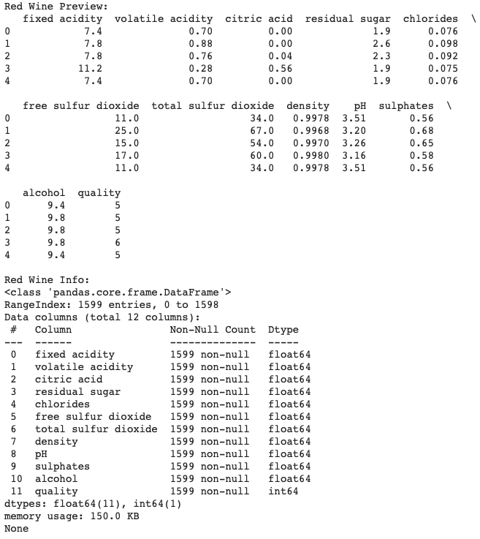
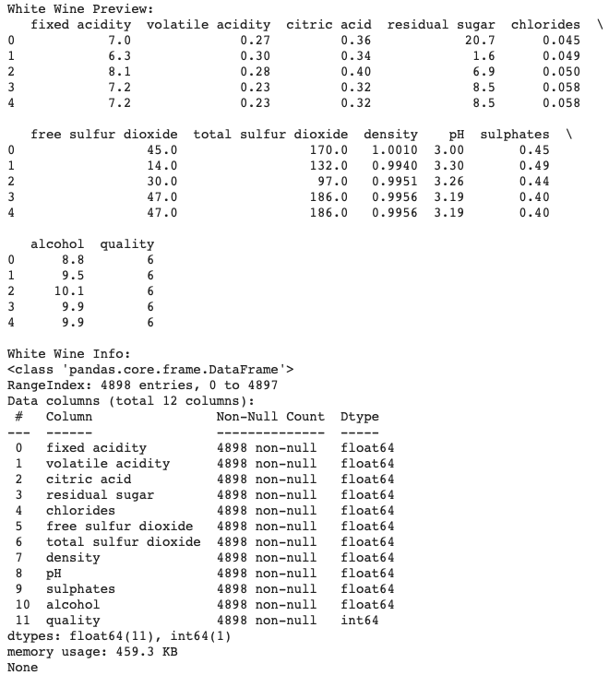
Development : Data Quality Assessment
Two csv files (red and white samples)
No missing entries
Due to the distribution of values within the dataset, normalization may be useful for the analysis using Yeo-Johnson power transformation.
Notes:
Dedelolia
During the development phase, we conducted a thorough data quality assessment involving two CSV files containing red and white wine samples – had no missing entries
As we delved deeper, we recognized the significance of addressing the distribution of values within the dataset. To enhance the accuracy of our analysis, we employed the Yeo-Johnson power transformation. This normalization technique adapts well to various distribution shapes, ultimately enabling us to extract more meaningful insights from the data.

Slide 10
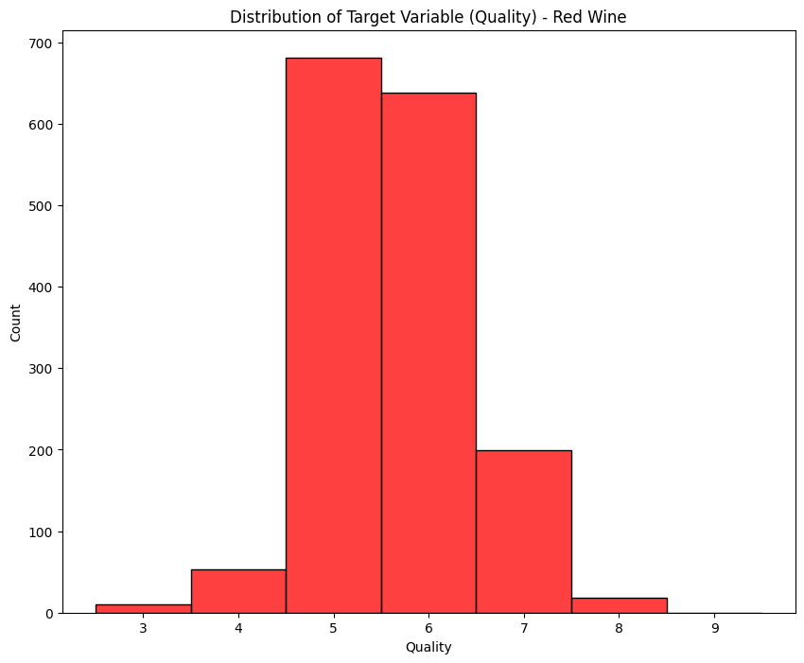
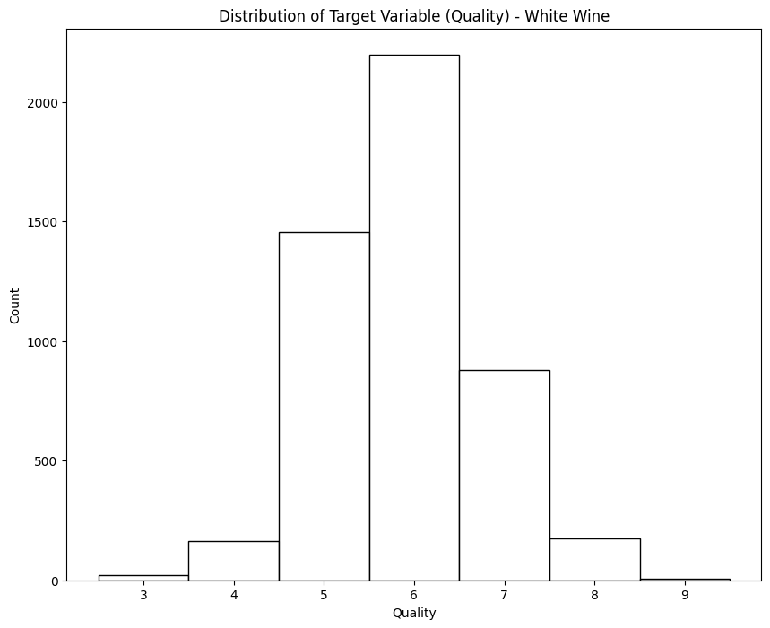
Quality Distribution of Dataset
Notes:
Dedelolia
The quality of the wine scores for both the red and white wines range from 0 to 10.
0 having the least quality
10 having the highest quality.
The distribution of the quality variables appear to follow a Gaussian pattern with many within the “average range”

Slide 11
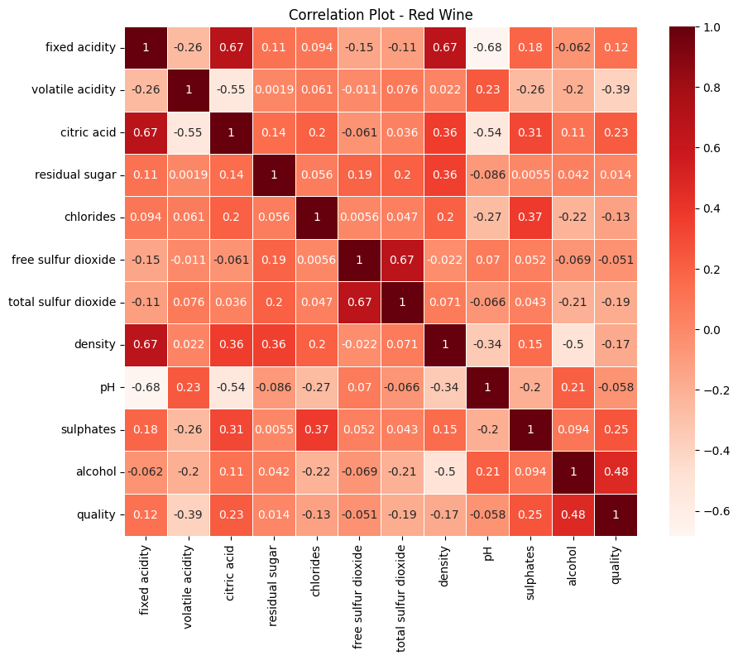
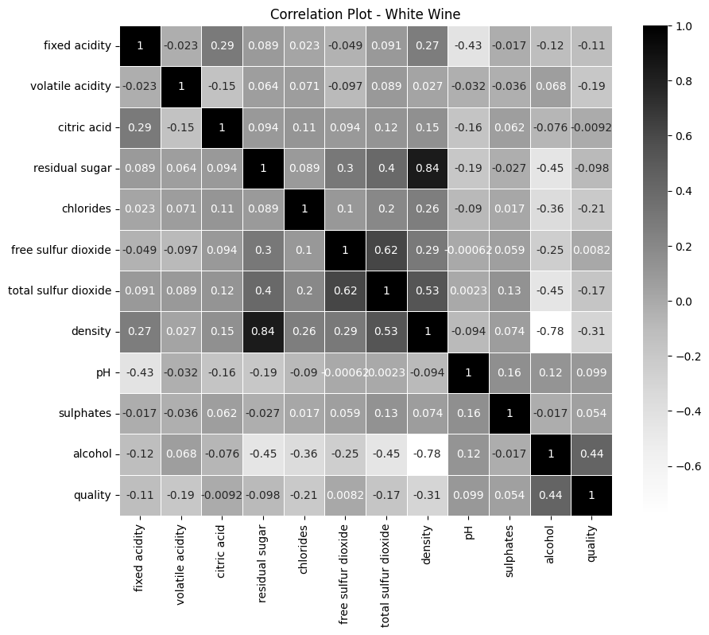
Correlation Plot of Dataset
Notes:
Dedelolia
-1 indicates a perfectly negative linear correlation between two variables
0 indicates no linear correlation between two variables
1 indicates a perfectly positive linear correlation between two variables
Variables closest to 1:
Correlation coefficients whose magnitude are between 0.7 and 0.9 indicate variables which can be considered highly correlated.
Variables which a high correlation besides the value one were
Although there were a range of values , we would like to point out the highest positive and negative linear correlation values for red and white wines.

Slide 12
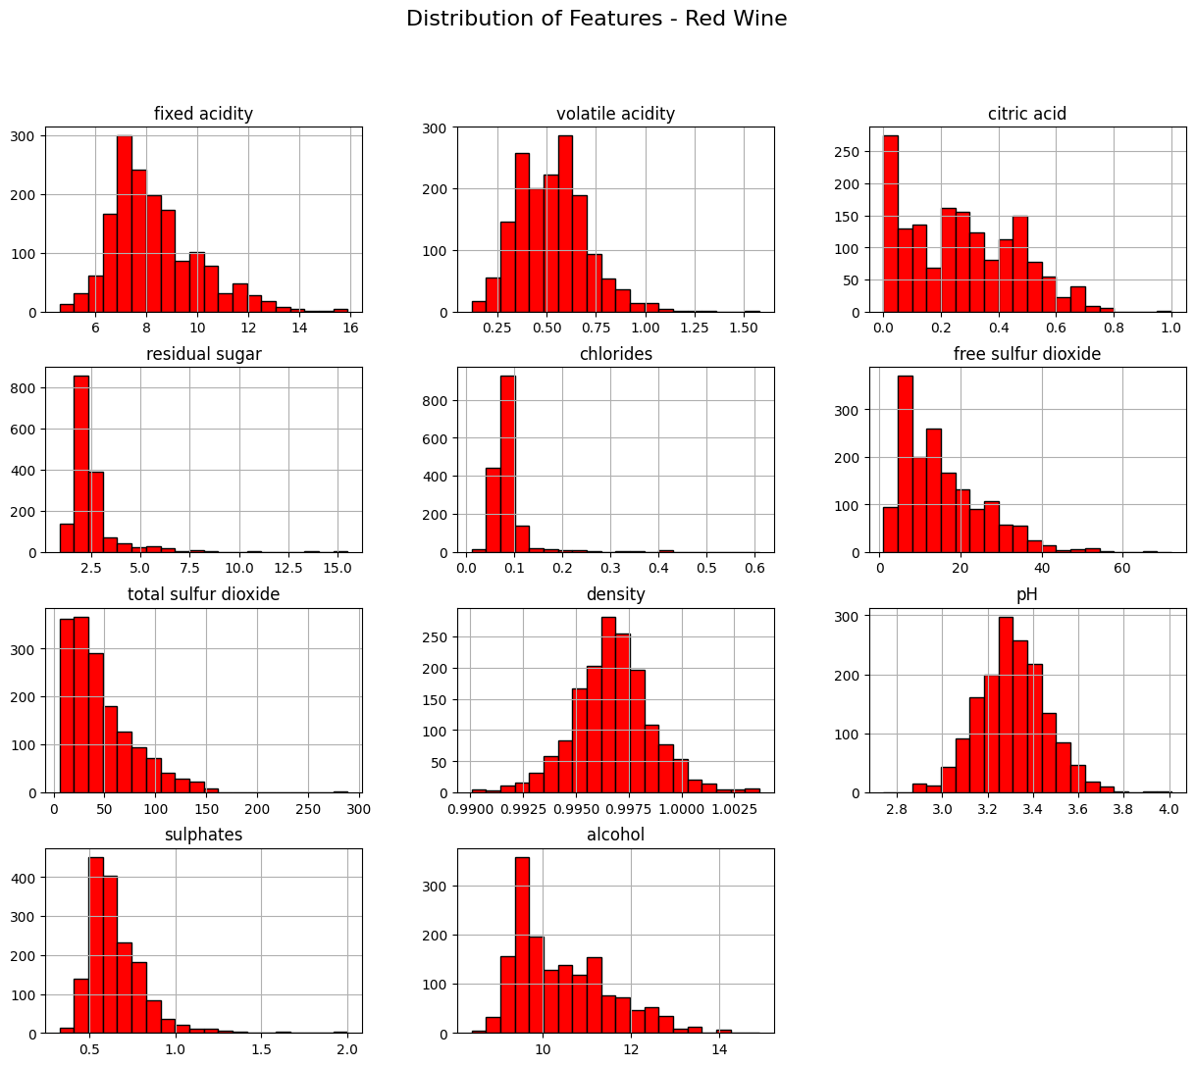
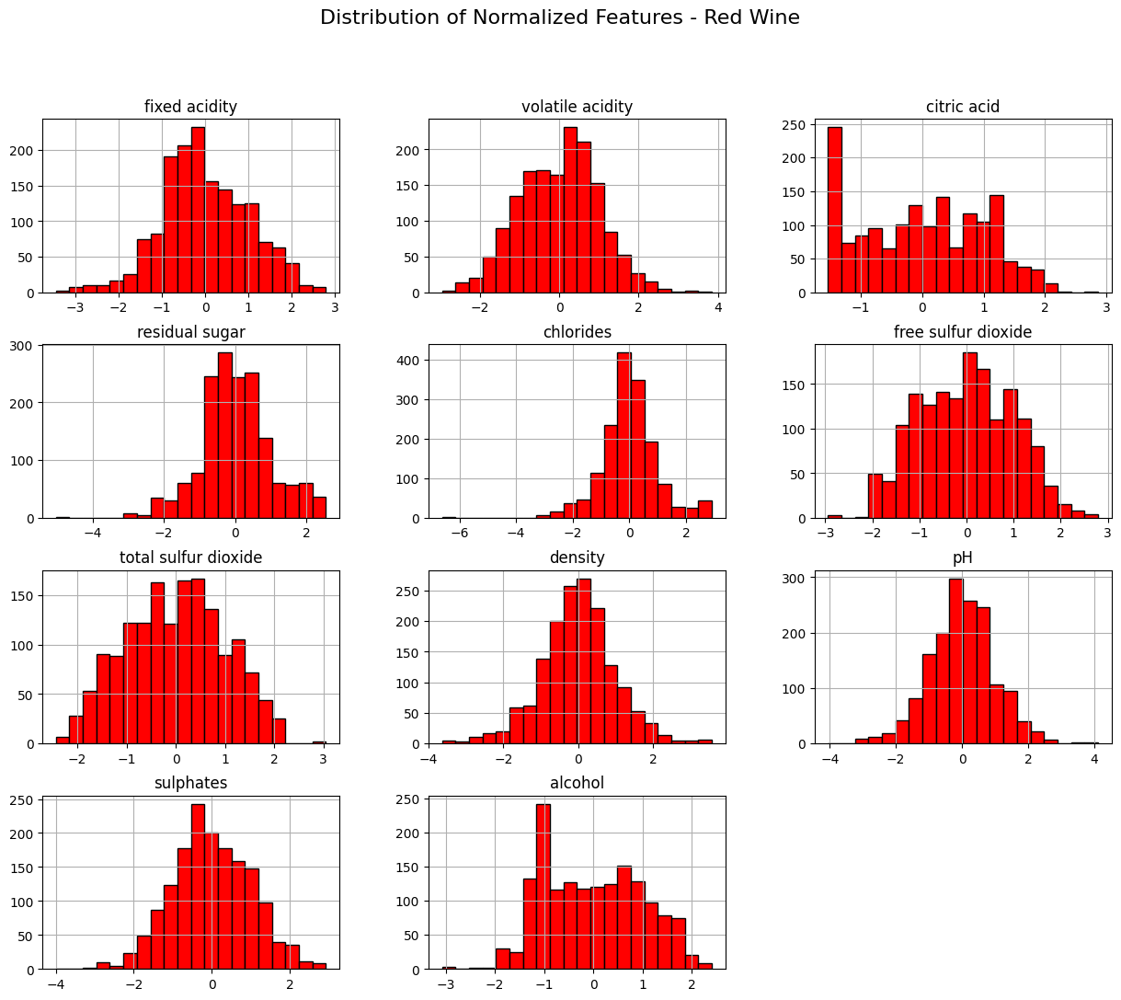
Distribution of Red Wine Features/Normalized
Notes:
Dedelolia
Distribution of features
the result of normalizing data creates a dataset more suitable for analysis and modeling, as it removes discrepancies in scale and ensures fair comparisons between different features. By doing so, we can see that each plot offers valuable insights into the characteristics that contribute to the quality of red wine.

Slide 13
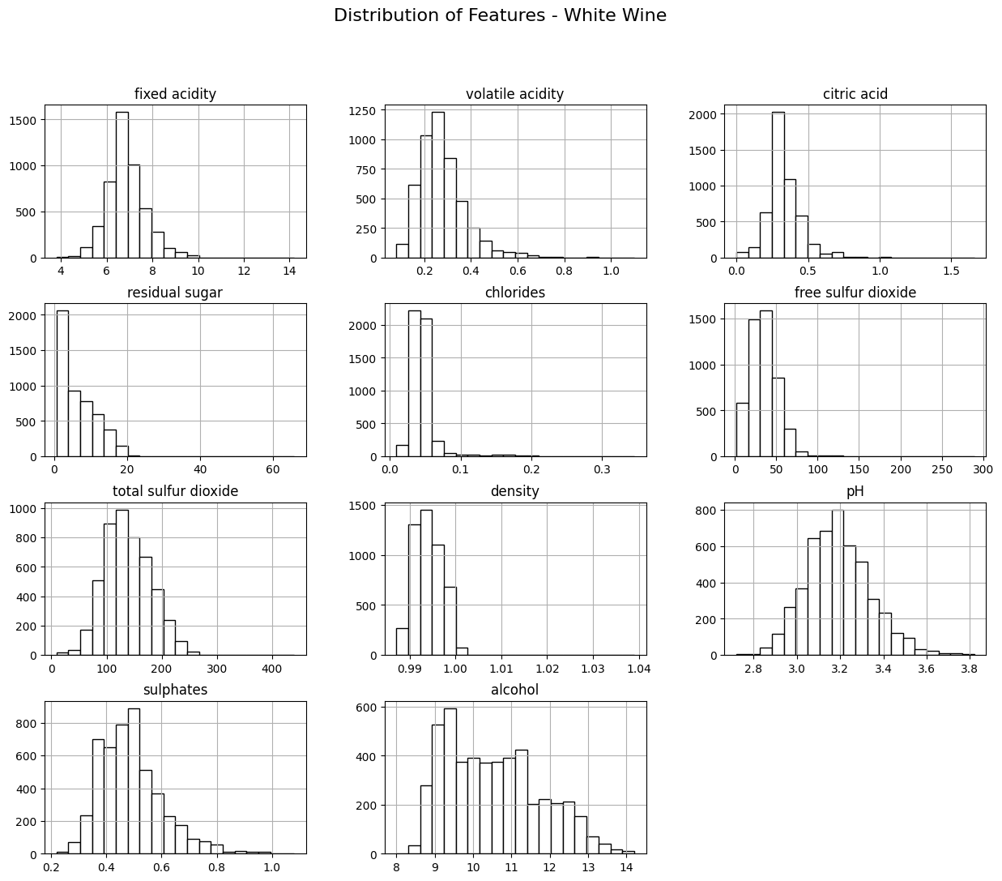
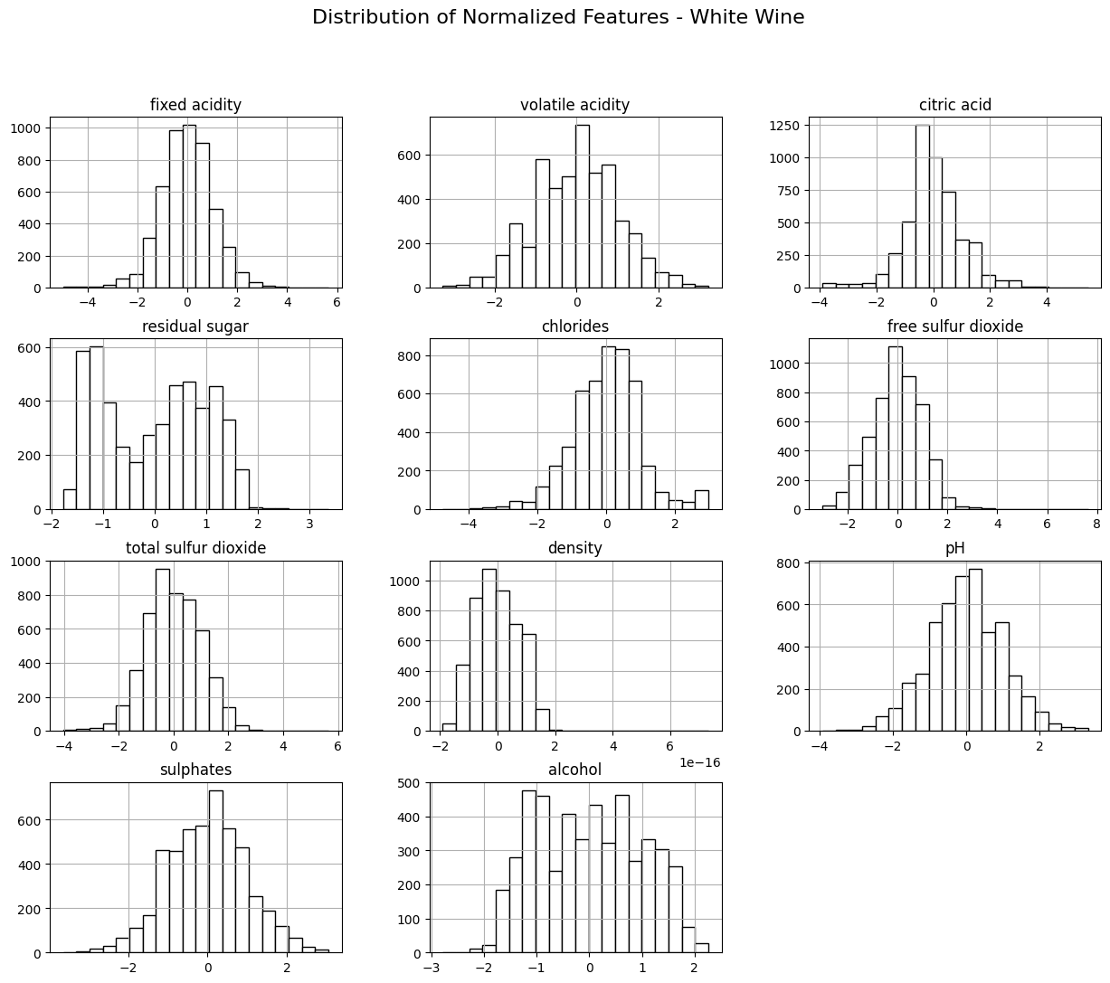
Distribution of White Wine Features/Normalized
Notes:
Dedelolia
Distribution of features
Like red wine, the datset for white wine was also normalized.
This insightful representation allows us to observe how the various attributes are spread across the dataset.

Slide 14
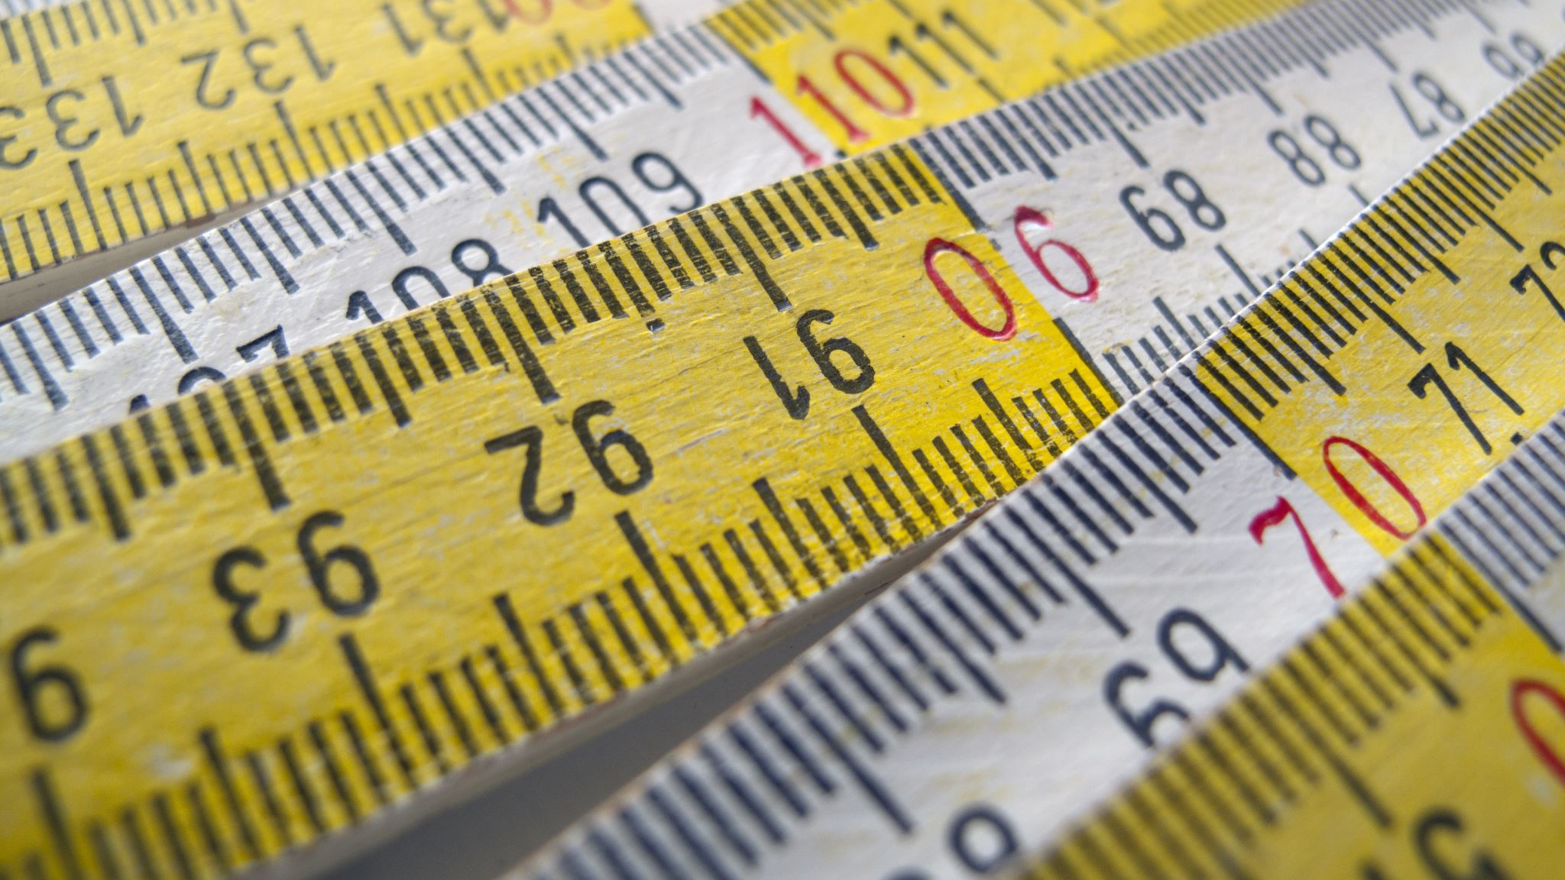
KNN Classification
Notes:
Mitch
The first model that we wanted to use to classify the wine qualities was K-nearest neighbors.

Slide 15
Methods
Train-Test Split
80/20
Hyperparameter Tuning with Grid Search
N_neighbors: [1, 3, 5, 7, 9, 11, 13, 15]
Weights: Uniform, Distance
Metric: Euclidean, Manhattan, Minkowski, Chebyshev
Notes:
Mitch
We started by splitting the data into an 80/20 train-test split for both the red and white wine datasets. After doing this, we created a hyperparameter grid containing 1,3,5,7,9,11,13, and 15 neighbors, for weights, we chose uniform (in which each of the k-nearest neighbors has an equal contribution in the prediction) and distance (where the influence of each neighbor on the prediction is proportional to its distance from the new instance). For metrics we chose Euclidean (which calculates the straight-line distance between two points in Euclidean space), Manhattan (which measures the distance between two points as the sum of the absolute differences between their coordinates), Minkowski (a generalized form that includes both Euclidean and Manhattan distances as special cases) and Chebyshev (which calculates the maximum absolute difference between the coordinates of two points).

Slide 16
Algorithm
K-Nearest Neighbors
'KNeighborsClassifier' class from 'sklearn.neighbors'
Hyperparameters
Fitted 5 folds for each of 64 candidates, totaling 320 fits
N_neighbors: 15
Weight: Distance
Metric: Euclidean (Red Wine), Manhattan (White Wine)
Accuracy
'accuracy_score' from 'sklearn.metrics'
Notes:
Mitch
To run the algorithm, we utilized the KneighborsClassifier class from SKLearn. We then completed a grid search with our hyper parameters which consisted of 5 folds for each of 64 candidates and resulted in 320 fits. From that, we were able to determine that the optimal number of neighbors was 15, the optimal weight was distance and the optimal metrics were Euclidean for Red Wine and Manhattan for White wine. We then re-ran the algorithm with those parameters and obtained accuracy scores though SKLearn as well.

Slide 17
KNN Results
Red Wine Accuracy: 65.94%
White Wine Accuracy: 67.76%
Notes:
Mitch
We were able to obtain accuracy scores of 65.94% for Red Wine and 67.76% for white wine. Next, we wanted to see if we could gather more insights using an artificial neural network with TensorFlow.

Slide 18
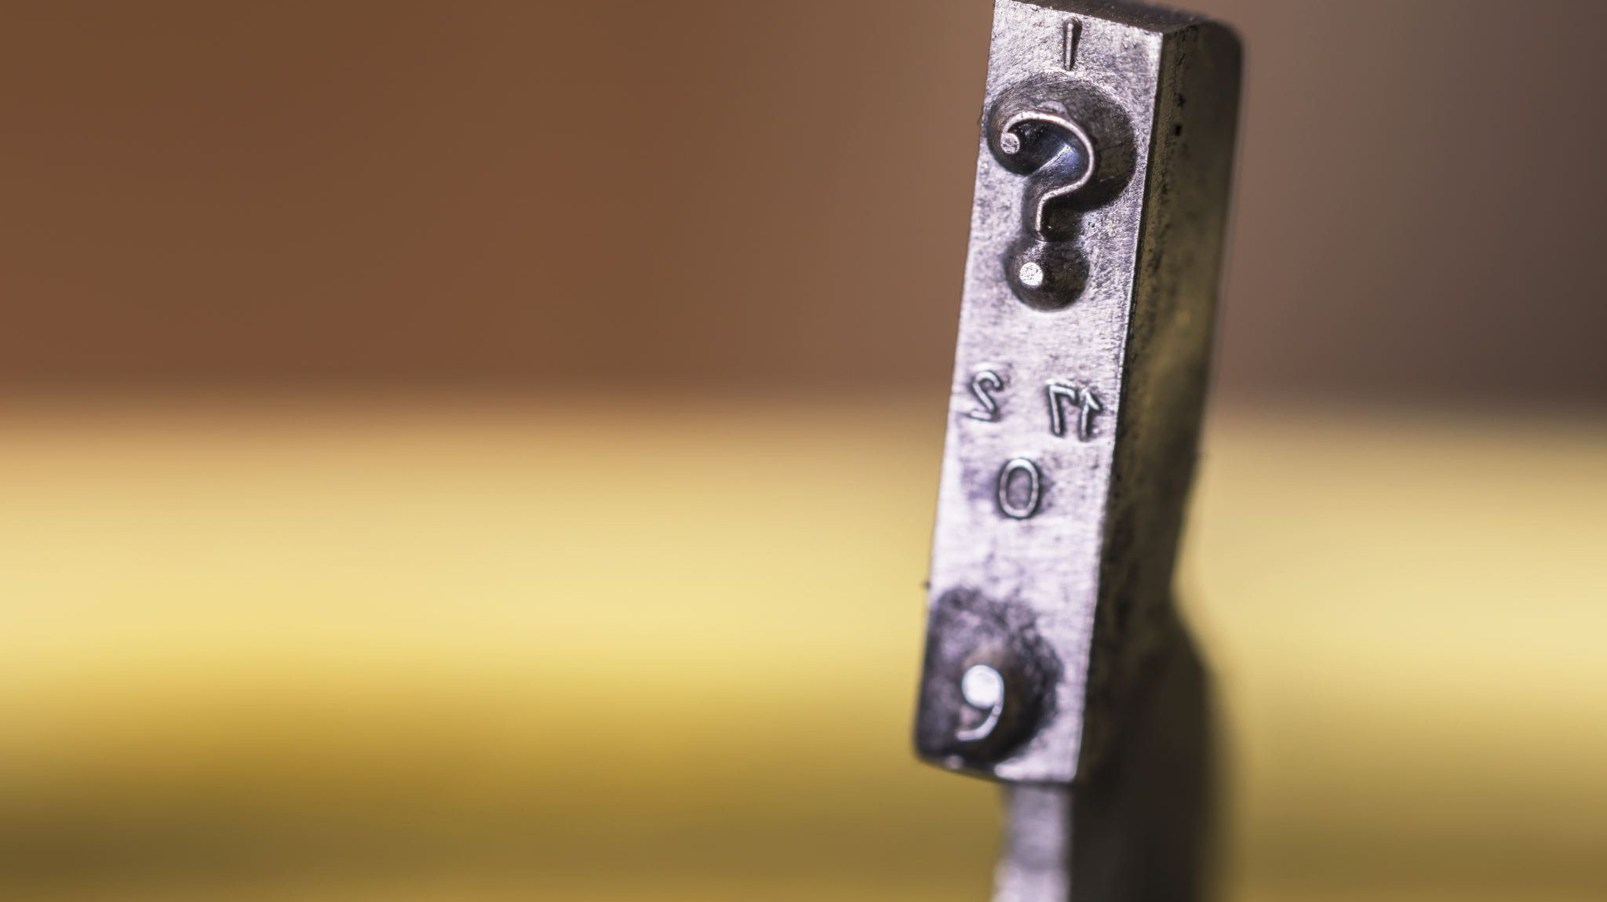
ANN using TensorFlow
Notes:
Greg

Slide 19
Methods
Implementation
Tensorflow for Python
Keras sequential model
TensorBoard to visualize results
Google Colab execution environment
Approaches
Regression: predict real number output, close to label
Classification: predict whole number output (label)
Binary classification: predict if quality exceeds a threshold
Notes:
Greg

Slide 20
Regression
Goal: predict a real number output, as close as possible to the label (which is a whole number)
Loss function: measured by Mean Squared Error (MSE). This computes the mean of squares of errors between labels and predictions.
Notes:
Greg

Slide 21
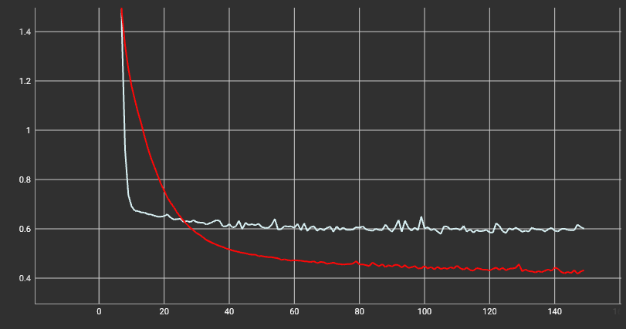
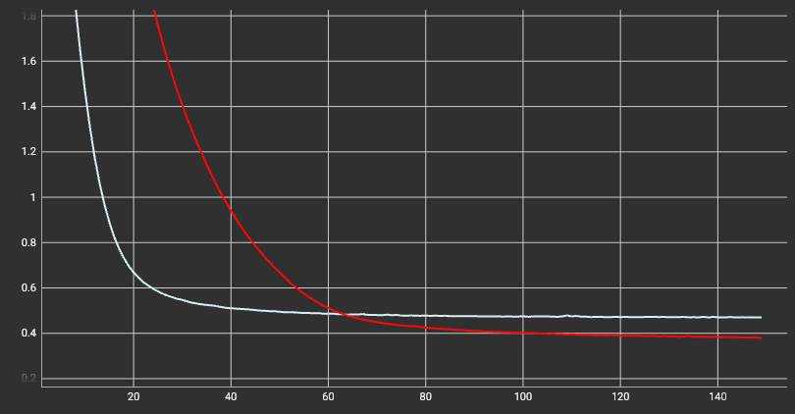
Normalization
Red and white dataset comparison of non-normalized vs normalized regression loss
Normalized attributes show smoother curve and better accuracy; but slower learning early on
Non-normalized attributes
Normalized attributes
Notes:
Greg
Further analysis will be done with normalized attributes. Z-score shown (mean 0 deviation 1)

Slide 22
Regression
Build the model
Sequential model with Dense layers (connected to all inputs)
Single layer with number of neurons equal to number of attributes
Activation function ReLU (Rectified Linear Unit): outputs zero or positive value
model = tf.keras.Sequential([
layers.Dense(11, activation="relu"),
layers.Dense(1)
])
Notes:
Greg

Slide 23
Regression
Compile the model
Loss function is MSE; optimizer is Adam (stochastic gradient descent)
Fit the model
Provide features and labels
Specify number of epochs and other options (verbose mode displays loss per epoch)
model.compile(loss = tf.keras.losses.MeanSquaredError(),
optimizer = tf.keras.optimizers.Adam())
model.fit(features, labels,
epochs=150, verbose=0)
Notes:
Greg
Similar pattern for compile/fit regardless of layer structure
Adam learning rate defaults to 0.001

Slide 24
Regression
Cross-dataset evaluation
Is the model general enough to fit the other dataset? (Red vs White)
Expectation: results will be close (low loss), but not as good, across datasets
Result: the model does NOT apply to the other data set
Why does this matter?
Want to determine if chemical properties have general implications about the quality, regardless of the specific type of wine
Loss (MSE) | White model | Red model
White dataset | 0.4807 | 0.8823
Red dataset | 0.8407 | 0.3729
Notes:
Greg

Slide 25
Regression
Performance considerations
Time to train model increases approximately linearly with size of dataset, and number of epochs.
Not much improvement in accuracy after ~150 epochs, so we will not analyze accuracy after that point
Size of Dataset (white/red factor) | Train 100 epochs, 1 layer | Train 200 epochs, 1 layer | 2x epochs time factor
White dataset (4898) (w/r: 3.06 x) | 30.5 s (w/r: 3.2 x) | 53.6 s (w/r: 2.9 x) | 1.76 x
Red dataset (1599) | 9.5 s | 18.3 s | 1.93 x
Notes:
Greg
Add more layers: might allow the model to extract and recombine higher-order features embedded in the data.

Slide 26
Regression
Should we change the layers?
What if we add a second layer to increase accuracy:
model = tf.keras.Sequential([
layers.Dense(11, activation="relu"),
layers.Dense(6, activation="relu"),
layers.Dense(1)
])
Loss (MSE) | White model, 1 layer | Red model, 1 layer | White model, 2 layers | Red model, 2 layers
White dataset | 0.4807 | 0.8823 | 0.4771 | 0.7871
Red dataset | 0.8407 | 0.3729 | 0.8051 | 0.3717
Result: <1% improvement within dataset
Notes:
Greg
Add more layers: might allow the model to extract and recombine higher-order features embedded in the data.

Slide 27
Regression
Should we change the layers?
Adding more or larger layers results in some improvement in accuracy
Time performance is not linear with number of neurons (time increase is small)
Layers: 11 → 99 → 33 → 1
White: 0.3668, Red: 0.2628
Layers: 11 → 99 → 99 → 33 → 1
White: 0.2976, Red: 0.2126
Layers: 11 → 99 → 99 → 99 → 33 → 1
White: 0.2337, Red: 0.1058
Notes:
Greg
Examples with 100 epochs

Slide 28
Classification
Preparation: Normalize labels
Red quality labels 3 to 8; White quality labels 3 to 9
Subtract 3 from all labels to obtain a range from 0 to 5, or 0 to 6 respectively
Result: 6 possible labels for red and 7 possible labels for white
Notes:
Greg
In theory could have additional labels from 0 to 10, but we are only concerned with actual labels used in these datasets

Slide 29
Classification
Build the model
Sequential model with Dense layers (connected to all inputs)
Classification using output layer containing number of neurons matching number of possible labels. But, we will build both red and white models with 7 nodes to help with comparison.
Softmax activation compares probability for each output class
model = tf.keras.Sequential([
layers.Dense(11, activation="relu"),
layers.Dense(7, activation="softmax")
])
Notes:
Greg
In theory could have additional labels from 0 to 10, but we are only concerned with actual labels used in these datasets

Slide 30
Classification
Compile the model
Loss function is SparseCategoricalCrossentropy: useful with integer labels
Save accuracy metric
Fit the model
model.compile(loss=tf.keras.losses.SparseCategoricalCrossentropy(),
optimizer=tf.keras.optimizers.Adam(),
metrics=['accuracy'])
model.fit(features, labels,
epochs=100, verbose=0)
Notes:
Greg

Slide 31
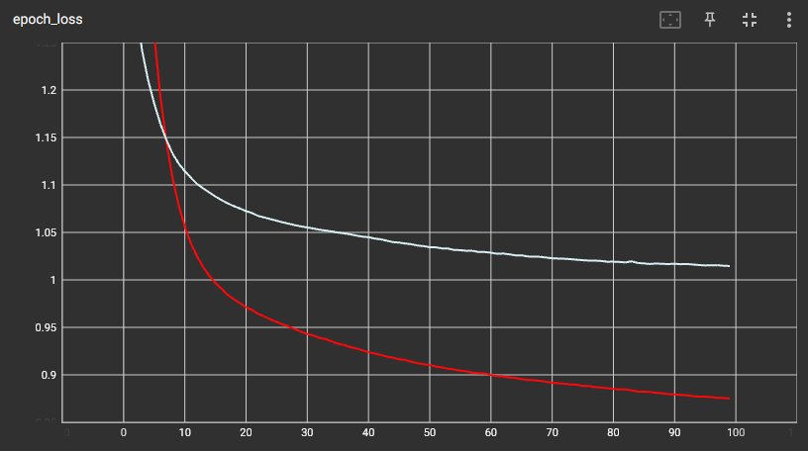
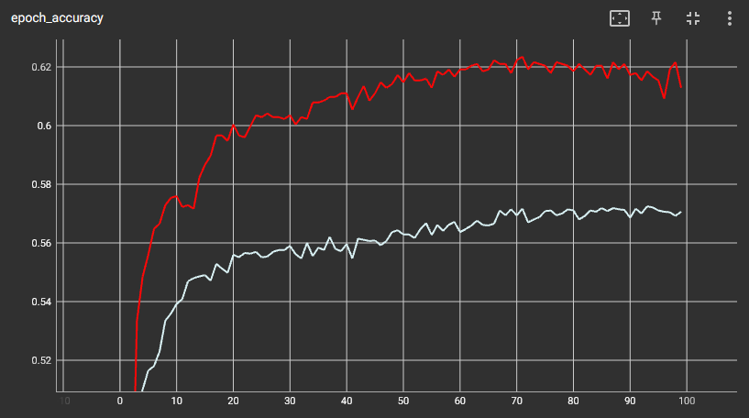
Classification
Accuracy with 1 layer, 100 epochs
Red: Reaching about 62% and then flattening
Notes:
Greg

Slide 32
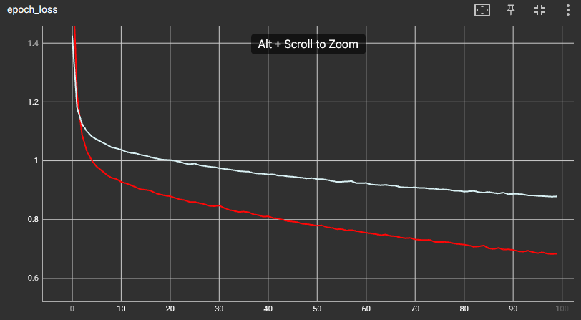
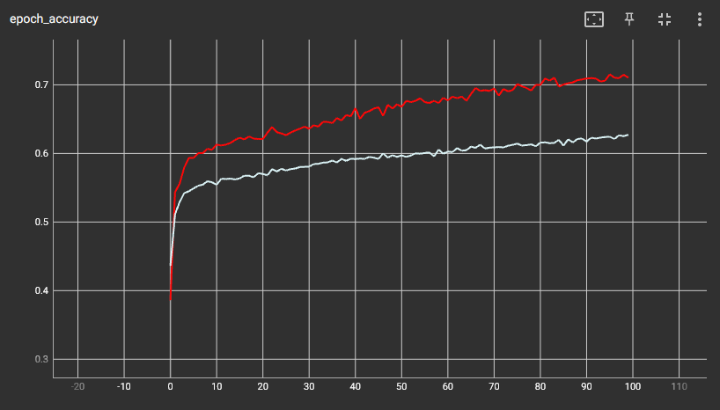
Classification
Improvement with layers
11 → 99 → 7 : Red over 70%, more linear trajectory, still room for improvement
Notes:
Greg

Slide 33
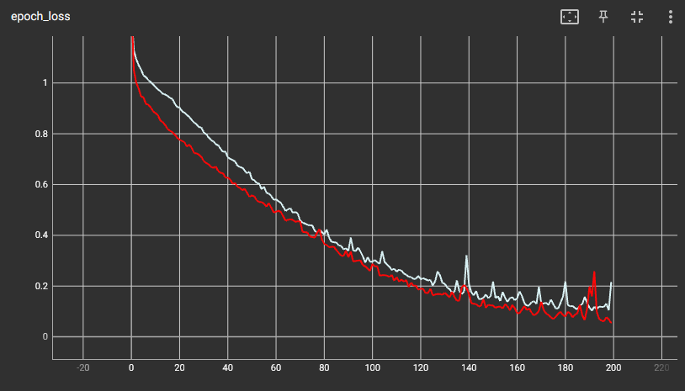
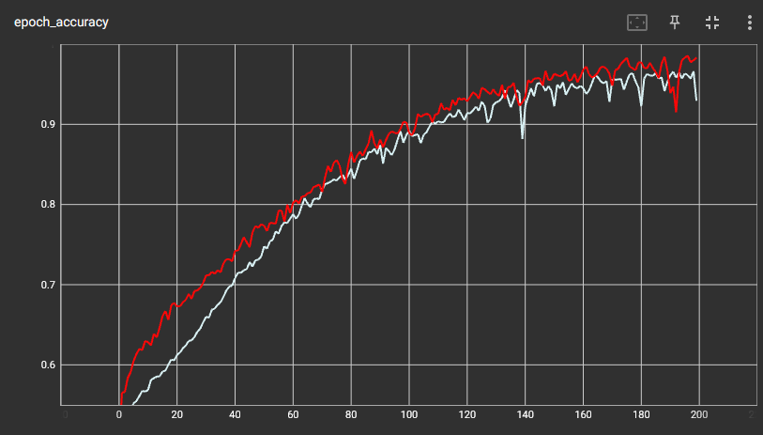
Classification
Increase epochs to 200, and further increase layers
11 → 99 (x 3) → 7 : Red up to 98%, White up to 96%
Notes:
Greg

Slide 34
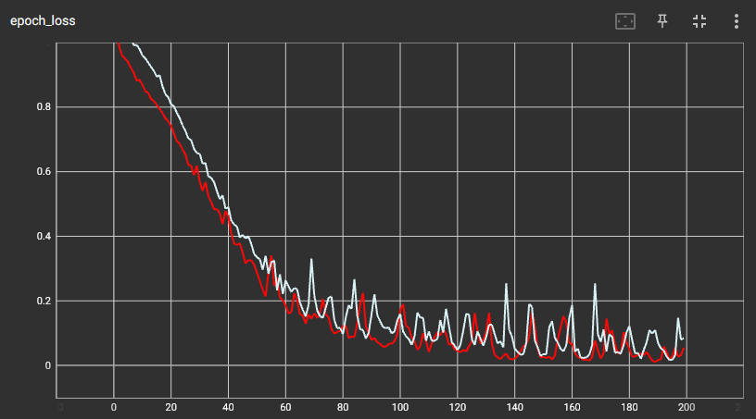
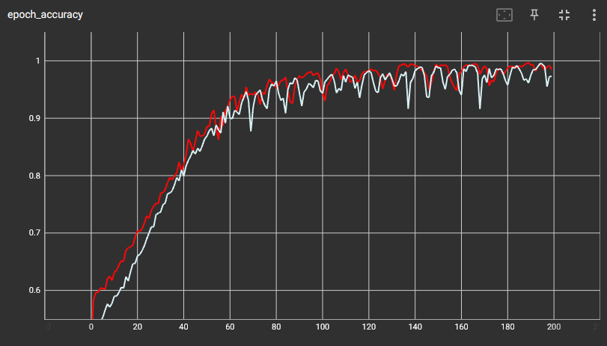
Classification
Increase epochs to 200, and further increase layers
11 → 99 (x 5) → 7 : Red and White each achieve >99% accuracy after ~150 epochs
Notes:
Greg
Some jagged behavior in the graph where the accuracy drops 3 or 4 %, then corrects itself after a few more epochs. May be a factor of learning rate

Slide 35
Classification
Cross-dataset evaluation
Is the model general enough to fit the other dataset? (Red vs White)
Conclusion: No; accuracy is low (but this does not reveal information about the labels)
Accuracy | White model | Red model
White dataset | 0.9808 | 0.4140
Red dataset | 0.4146 | 0.9994
Notes:
Greg
General trend may be present, but not matching the exact labels in the other dataset

Slide 36
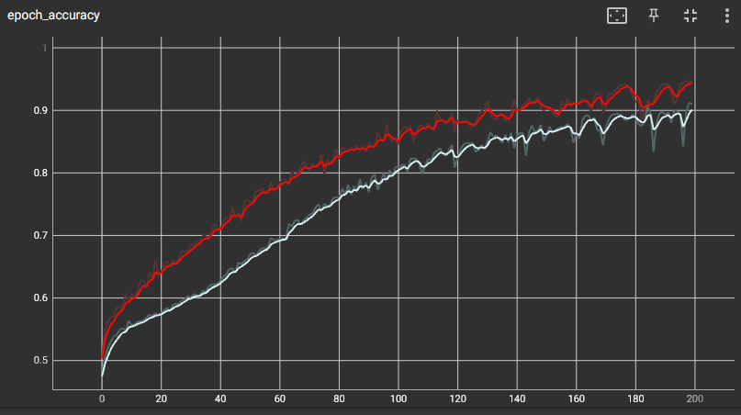
Simplifying the model
Previous example (11 → 99 (x 5) → 7) x 200 epochs = ~60s to execute (red + white)
Can we eliminate some attributes and still obtain high classification accuracy?
Features with lowest correlation to quality: residual sugar, free sulfur dioxide, pH, fixed acidity, total sulfur dioxide
Training with fewer attributes: no time savings; lower accuracy
Red 94%, White 90%
Slower learning
Conclusion: do not remove features
Notes:
Greg

Slide 37
Binary classification
What if we only care about “excellent” wine, “good” wine, etc?
White: 3.7% of examples w/ quality 8 or greater; 21.6% are 7 or greater
Red: 1.1% of examples w/ quality 8 or greater; 13.6% are 7 or greater
Transform labels from integer to 0 ( < threshold) or 1 ( >= threshold)
Output layer now has 1 neuron with sigmoid activation
model = tf.keras.Sequential([
layers.Dense(11, activation="relu"),
layers.Dense(1, activation=“sigmoid")
])
Notes:
Greg
We may not be very concerned with predicting 3v4 or 4v5; but we do want to know if something meets our criteria for high quality

Slide 38
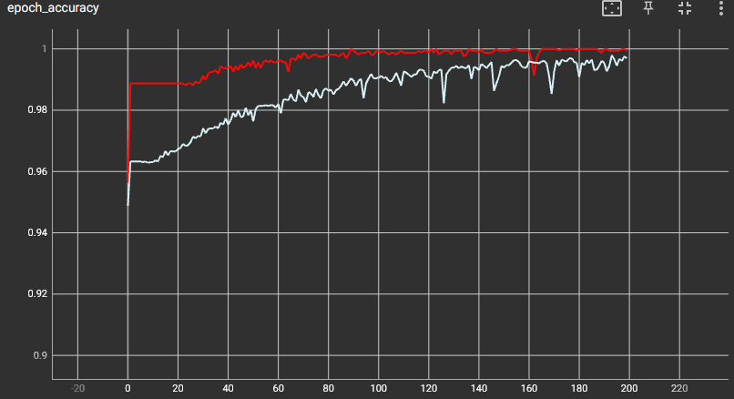
Binary classification
Classify “excellent” wine: quality 8 or greater
Layers: 11 → 99 → 99 → 1; 200 epochs
Good accuracy cross-dataset
Accuracy | White model | Red model
White dataset | 0.9959 | 0.9500
Red dataset | 0.9656 | 0.9981
Notes:
Greg

Slide 39
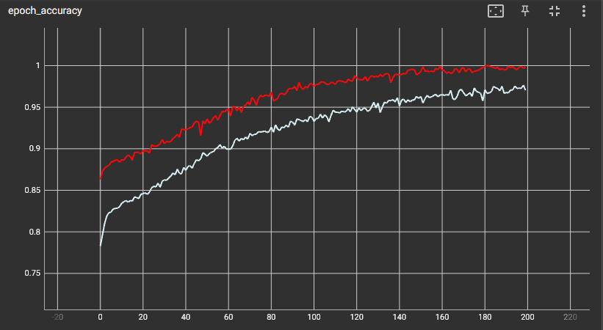
Binary classification
Classify “good” wine: quality 7 or greater
Layers: 11 → 99 → 99 → 1; 200 epochs
Lower overall accuracy vs “excellent”
Accuracy | White model | Red model
White dataset | 0.9588 | 0.7607
Red dataset | 0.7730 | 0.9987
Notes:
Greg

Slide 40
ANN Results
Consistently predict “excellent” quality with over 99% accuracy
Accurate classification requires multiple layers and a large number of neurons
Such as 11 → 99 (x 5) → 7 with 200 epochs
Models are not generally applicable across different types of wine
Suggests other taste factors, not present in attributes collected/measured
Normalization of inputs is recommended for best accuracy
Notes:
Greg
Taste may be subjective
Accuracy can be tuned further but will take longer to execute and may require multiple executions of training based on random state

Slide 41
Summary
Defining good wine
KNN model
Attained accuracy of red and white whine
Explored optimal hyperparameters
TensorFlow Neural Network
Regression
Adding more/larger features improves accuracy
Binary Classification
Consistently predicted “excellent” quality
Notes:
Dedelolia
While the accuracy is moderate, it suggests that the model has learned to capture certain patterns related to wine quality in the red and white wine datasets.
Using the KNN model:
We were able to obtain accuracy scores of 65.94% for Red Wine and 67.76% for white wine. Next, we wanted to see if we could gather more insights using an artificial neural network with TensorFlow.
Using Tensor Flow
Consistently predict “excellent” quality with over 99% accuracy
Adding more or larger layers results in some improvement in accuracy
…
This study serves as a foundational step towards understanding wine quality assessment through machine learning, highlighting the potential for continued advancements in wine classification…

Slide 42
Further Recommendations
Obtain additional datasets to further extend the training model to include different regions of wines.
Consider developing models for individual types of wines such as Merlots, Chardonnays, Pinot Noir, Syrah and Rieslings as each wine type has unique features.
Consider how to make the sensory property more objective.
Notes:
An
As noted previously regarding the dataset, it includes only a set of red and white wines within a single region in Northern Portugal. As we know, there are wines produced throughout the world. It would be beneficial to increase the model to include wines from all over the world.
Additionally, it would important to consider the different types of wines that exist. Some common types of wines include cabernet, syrah, zinfandels, Rieslings, and chardonnay. As the processes of making the wines are different, so are the characteristics and quality. For example, cabernets are known as long lived aged wines with notes of smokey and savory flavors , whereas a syrah is also a full bodied red but known for fruity and spicy notes.

Slide 43
Thank you
Questions?

Slide 44
References
Alcohol.org. (2023, 01 17). Worldwide Production & Consumption Rates of Beer and Wine. Retrieved from American Addiction Centers Alcohol.org: https://alcohol.org/guides/beer-wine-production-consumption-worldwide/
Cooking, S. o. (n.d.). Wine. Retrieved from Science of Cooking: https://www.scienceofcooking.com/food-and-wine/history-of-wine.html
Cortez, P., Cerdeira, A., Almeida, F., Matos, T., & Reis, J. (2009). Wine Quality. Retrieved from UCI Machine Learning Repository: https://doi.org/10.24432/C56S3T.
Fedesoriano. (n.d.). Spanish Wine Quality Dataset. Retrieved from Kaggle: https://www.kaggle.com/datasets/fedesoriano/spanish-wine-quality-dataset
Hagan, M. (2020, 10 13). Wine History: Exploring Wine's History and Origins. Retrieved from Usual Wines: https://usualwines.com/blogs/knowledge-base/history-of-wine
Kimball, S. (2023). Top 5 Most Expensive Bottles of Wine Ever Sold. Retrieved from Crush Wine XP: https://crushwinexp.com/top-5-expensive-bottles-wine-ever-sold/
Kingma, D. P. (2014). Adam: A Method for Stochastic Optimization. Retrieved from https://arxiv.org/abs/1412.6980
Puckette, M. (n.d.). A Pragmatic Approach to Using Wine Ratings. Retrieved from Wine Folly: https://winefolly.com/tips/wine-ratings-explained/
Rustagi, D. (n.d.). Normalize A Column In Pandas. Retrieved from https://www.geeksforgeeks.org/normalize-a-column-in-pandas/
The CEO Magazine. (2022, 07 01). The World's Most Expensive Wines Are a Testimony of Survival. Retrieved from CEO Magazine: https://www.theceomagazine.com/lifestyle/food-beverage/most-expensive-wines/
Wallace, K. (n.d.). Wine Ratings 101. Retrieved from Wine School: https://www.vinology.com/wine-ratings-101/

