Slide 1
Melting Point Prediction for Organic Molecules
Mitchell Clove
1

Slide 2
Problem & Motivation
Organic Molecules have many applications, including drugs, munitions, fuels, batteries, etc. [1]
Performance of the molecule depends on temperature, i.e. a compound may act differently as a liquid vs solid
There are tens of thousands of organic compounds, so a model that is reliable for predicting melting points is useful
The goal of my project was to predict a discrete value, the melting point, based on molecular descriptors.
The dataset included the SMILES molecular descriptor, and 424 groups
id,SMILES,Tm,Group 1,…
2175,FC1=C(F)C(F)(F)C1(F)F,213.15,…
2

Slide 3
Methodology
I tried several methods:
Gradient Boosted Trees – YDF
Simple Neural Network - TensorFlow
Linear Regression - TensorFlow
Graph Neural Network – PyTorch
My theory was that the graph neural network would outperform the others, due to the sparseness of the data. (2662 rows vs 424 descriptors.) I thought the neural network would be second because of the complexity of the data, which would be too hard to represent in other formats.
3

Slide 4
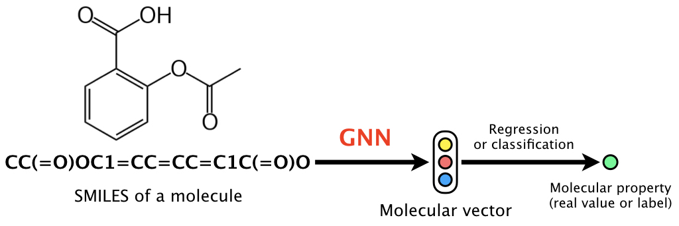
More Info on Graph Neural Network
I used a GNN implementation that transforms SMILES molecular descriptors into graph format. [3]
I ignored the group descriptors when training the GNN
Graphic from GitHub repository of Graph neural network (GNN) for molecular property prediction (SMILES format), the repository I used
4

Slide 5
Experiments
I used two datasets, the Kaggle dataset with SMILES and 424 groups, and the Jean-Claude Bradley Open Melting Point Dataset[4], which is a common open-source dataset that lists SMILES descriptors of molecules and their melting points. I used the second dataset after poor performance in the GNN using only the Kaggle dataset.
5

Slide 6
Evaluation
Model | MAE | Notes
Baseline | 266.982 | Average over 10 different runs, random value in range of training data
Linear Regression | 51.522647857666016 | Normalized Data, 1000 epochs, lr=0.1 (more epochs had no noticeable improvement)
Gradient Boosted Trees | 56.54150070764068
Simple Neural Network | 93.06829476007056 | Batch normalization, 3 fully connected layers, dropout, 100 epochs (More epochs led to overfitting)
Graph NN | 143.90505979310973 | Performed better on only the Kaggle dataset, compared to 154.0285636715423 with external dataset
6

Slide 7
Comparisons
Linear Regression surprisingly performed the best
My hypothesis for the graph data performing poorly is because the structure of the molecule may be less important to melting point than the groups that were included in the Kaggle dataset.
Unfortunately, the Kaggle dataset doesn’t describe what the groups are, so I couldn’t use an external dataset with more molecules
7

Slide 8
Conclusion/Future work
Graph NN wasn’t the silver bullet I had hoped
Simple techniques are often better and obviously less computationally expensive
The paper I presented on [2] implemented something called a Knowledge Infused Molecular Graph, which combined molecular descriptors as well as the SMILES description. The researchers found that their implementation outperformed a GNN and simple regression techniques on their own.
8

Slide 9
References
[1] ScienceDirect. (n.d.). Energetics. In ScienceDirect Topics. Retrieved 2025, from https://www.sciencedirect.com/topics/chemistry/energetics#definition
[2] Qing Ma, Zhenqi Zhang, Wei Yang, Wei Li, Jia Ju, Guijuan Fan,
Strategies for constructing melt-castable energetic materials: A critical review,
Energetic Materials Frontiers
[3]
masashitsubaki, “GitHub - masashitsubaki/molecularGNN_smiles: The code of a graph neural network (GNN) for molecules, which is based on learning representations of r-radius subgraphs (i.e., fingerprints) in molecules.,” GitHub, 2025. https://github.com/masashitsubaki/molecularGNN_smiles?tab=readme-ov-file
[4]
Awguhst, “Melting Point Dataset: SMILES & Tm,” Kaggle.com, 2025. https://www.kaggle.com/datasets/awguhst/melting-point-dataset (accessed Dec. 04, 2025).
9

