Slide 1

Exploratory Analysis and Visualization Adidas Sales
08th February 2023

Slide 2
Project Overview
Review of Data Topic
Description of Data
Data Question
Synopsis of Data Exploration
Synopsis of Data Analysis
Analysis Tools

Slide 3
Review of Data Topic

Slide 4
Overview of Data Topic
The obtained data focuses on the US Adidas sales for 2020/21 and explores sales based on following categorical data;
US states (50 States)
US regions (05 regions)
Retailers (06 retailers)
Product Categories (06 categories)
Sales Channels (03 channels)

Slide 5
Selection Criteria of Data
The basis for data selection are as follows;
2 years historical sales data
Covers all regions and states
Extensive categorical data
Extensive numerical data
Machine learning & visualization

Slide 6
Description of Data

Slide 7
Data Tables
The analysis focuses on 2 key input data tables;
Adidas Sales Data
US Census Data
This Data is further broken down to following output relational tables;
Sales
Products
Regions
Retailers
States

Slide 8
Adidas Sales Data
Column | Data Type | Statistical Type
Retailer | Object (String) | Categorical - Nominal
Retailer ID | Object (String) | Categorical - Nominal
Invoice Date | Date | Numerical - Interval
Region | Object (String) | Categorical - Nominal
State | Object (String) | Categorical - Nominal
Product | Object (String) | Categorical - Nominal
Price Per Unit | Integer | Numerical - Continuous
Units Sold | Integer | Numerical - Continuous
Total Sales | Integer | Numerical - Continuous
Operating Profit | Integer | Numerical - Continuous
Operating Margin | Floating Decimal | Numerical - Continuous
Sales Method | Object (String) | Categorical - Nominal

Slide 9
US Census Data
Column | Data Type | Statistical Type
State ID | Object (String) | Categorical - Nominal
State | Object (String) | Categorical - Nominal
Total Population | Integer | Numerical - Continuous
Male Population | Integer | Numerical - Continuous
Female Population | Integer | Numerical - Continuous
Male Median Age | Floating Decimal | Numerical - Continuous
Female Median Age | Floating Decimal | Numerical - Continuous
Median Age | Floating Decimal | Numerical - Continuous
Sex Ratio | Floating Decimal | Numerical - Continuous
Earning Population | Integer | Numerical - Continuous
Median Income | Integer | Numerical - Continuous

Slide 10
Synopsis - Data Exploration

Slide 11
Data Exploration through ETL
Pandas library was utilized to conduct the following data exploration to clean data for analysis;
Clean Overall Sales Data (Drop null values, recreate columns with calculations, and IDs)
Conduct ETL to breakdown sales sheet to main table and look up tables for RDB
Preprocess data for tableau visualizations
Preprocess data for machine learning algorithms

Slide 12
Data Questions & Analysis

Slide 13
Machine Learning
This Analysis utilizes machine learning within the Scikit-learn library to assess the following outputs;
Cluster Analysis using K-means and PCA to determine population clusters in terms of total population, median income and median age on US Census Data
Supervised machine learning using multiple ML algorithms to predict operating margin based on input classifications
Multiple Linear Regression using Random Forest Regressor to predict future sales and operating profit per state based on population data and historic sales data

Slide 14
Relational Data Base
ETL through Pandas was conducted to clean and breakdown the sales data table into the following main tables and lookup tables;
Sales
Products
Regions
Retailers
States (US Census Data)
The above RDB is used to draw insight on sales in relation to retailers, products, regions and consumer demographics

Slide 15
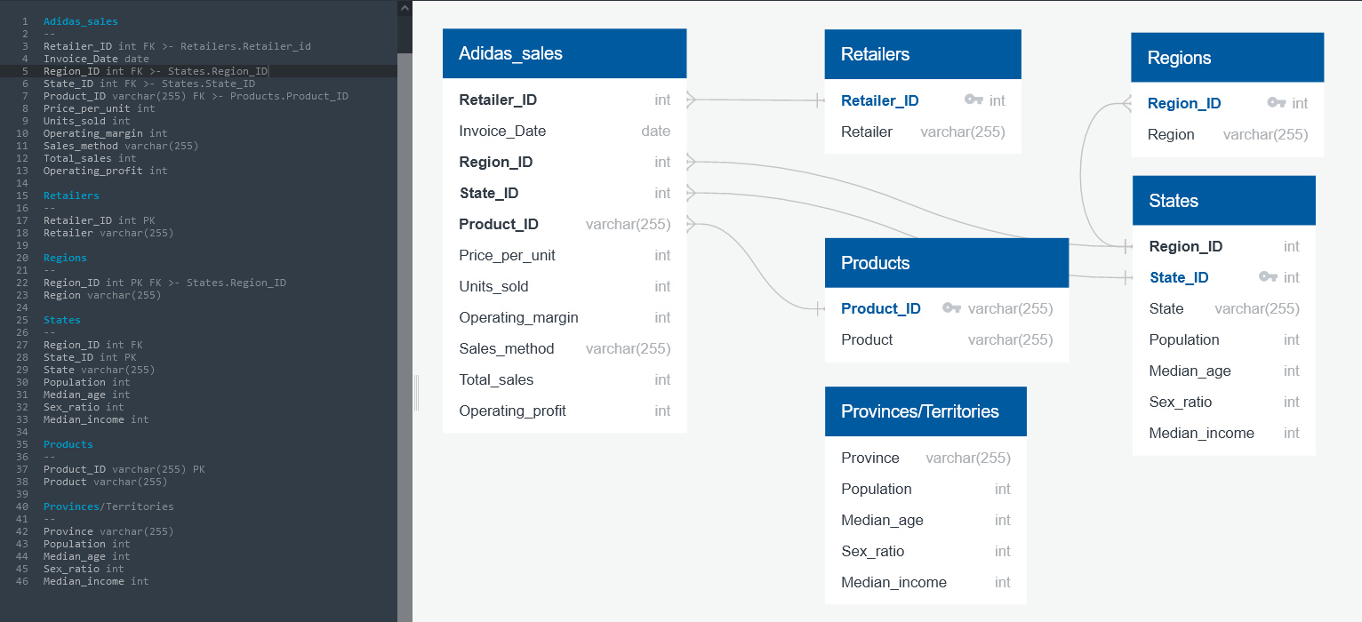
Relational Data Base

Slide 16
Tableau Dashboards
The data story will be complete through an overview of the following factors through Tableau visualizations;
Overview of US demographics
Performance of Retailers
Performance of Products
Performance of Sales Methods
Relationship between consumer groups and sales performance

Slide 17
Analysis Tools

Slide 18
Analysis Tools
The technologies used in building this data pipeline are as follows;
Data Type | Statistical Type
Python - Jupyter Notebook | Data Cleaning and ETL procedures
AWS + Postgres | Relational Databases and database administration
Python - Jupyter Notebook | Machine Learning Algorithms
Tableau | Data Visualizations and Dashboards

Slide 19
Thank You

