Slide 1

Exploratory Analysis and Data Visualization Adidas Sales
08th February 2023

Slide 2
Project Overview
Data Topic
Data Description
Data Question
Data Exploration
Data Analysis
Analysis Tools
Analytical Output
Recommendations

Slide 3
Review of Data Topic

Slide 4
Data Topic
The US Adidas data explores sales and financial information based on following categorical data;
US states (50 States)
US regions (05 regions)
Retailers (06 retailers)
Product Categories (06 categories)
Sales Channels (03 channels)

Slide 5
Selection Criteria of Data
The basis for data selection;
2 years historical data
Comprehensive geographical coverage - US
Extensive categorical data
Extensive numerical data
Machine learning & visualization

Slide 6
Description of Data

Slide 7
Data Tables
Two key input data tables;
Adidas Sales Data – 2020/21
US Census Data - 2020
Above data simplified to following output relational databases;
Sales
Products
Regions
Retailers
States – US Census Summaries

Slide 8
Adidas Sales Data
Column | Data Type
Retailer | Object (String)
Retailer ID | Object (String)
Invoice Date | Date
Region | Object (String)
State | Object (String)
Product | Object (String)
Price Per Unit | Integer
Units Sold | Integer
Total Sales | Integer
Operating Profit | Integer
Operating Margin | Floating Decimal
Sales Method | Object (String)

Slide 9
US Census Data
Column | Data Type
State ID | Object (String)
State | Object (String)
Total Population | Integer
Male Population | Integer
Female Population | Integer
Male Median Age | Floating Decimal
Female Median Age | Floating Decimal
Median Age | Floating Decimal
Sex Ratio | Floating Decimal
Earning Population | Integer
Median Income | Integer

Slide 10
Analysis Tools

Slide 11
Analysis Tools
Technologies used to build data pipeline;
Data Type | Statistical Type
Python - Jupyter Notebook - Pandas | Data preprocessing through ETL procedures
AWS + Postgres | Relational Databases and database administration
Python - Jupyter Notebook – SK Learn | Machine Learning Algorithms
Tableau | Data Visualizations and Dashboards

Slide 12
Data Exploration

Slide 13
Data Exploration through ETL
Pandas library was utilized for data exploration;
Clean Data (Drop null values, recreate columns with calculations, and IDs)
ETL to breakdown datasheet to main table and lookup tables for RDB
Preprocess data for tableau visualizations
Preprocess data for machine learning algorithms

Slide 14
Data Questions & Outcomes

Slide 15
Relational Data Base
Breakdown of sales and census data into the following relational database;
Sales
Products
Regions
Retailers
States (US Census Data)
Outcome → draw insight of sales in relation to retailers, products, regions and consumer demographics

Slide 16
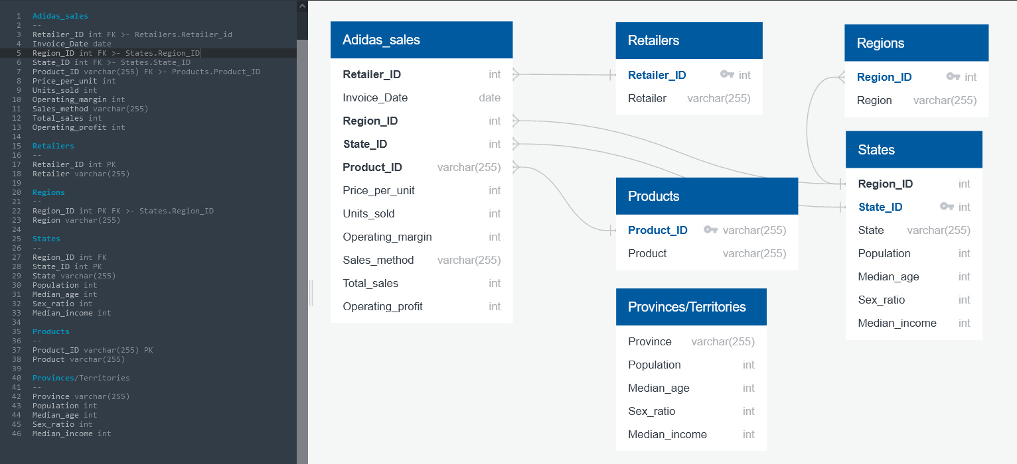
Relational Data Base

Slide 17
Tableau Dashboards
Data visualization dashboards to gauge the following consumer and sales insights;
Overview of US demographics
Performance of Retailers
Performance of Products
Performance of Sales Methods
Relationship between consumer groups and sales performance

Slide 18
Overview – US Demographics

Slide 19
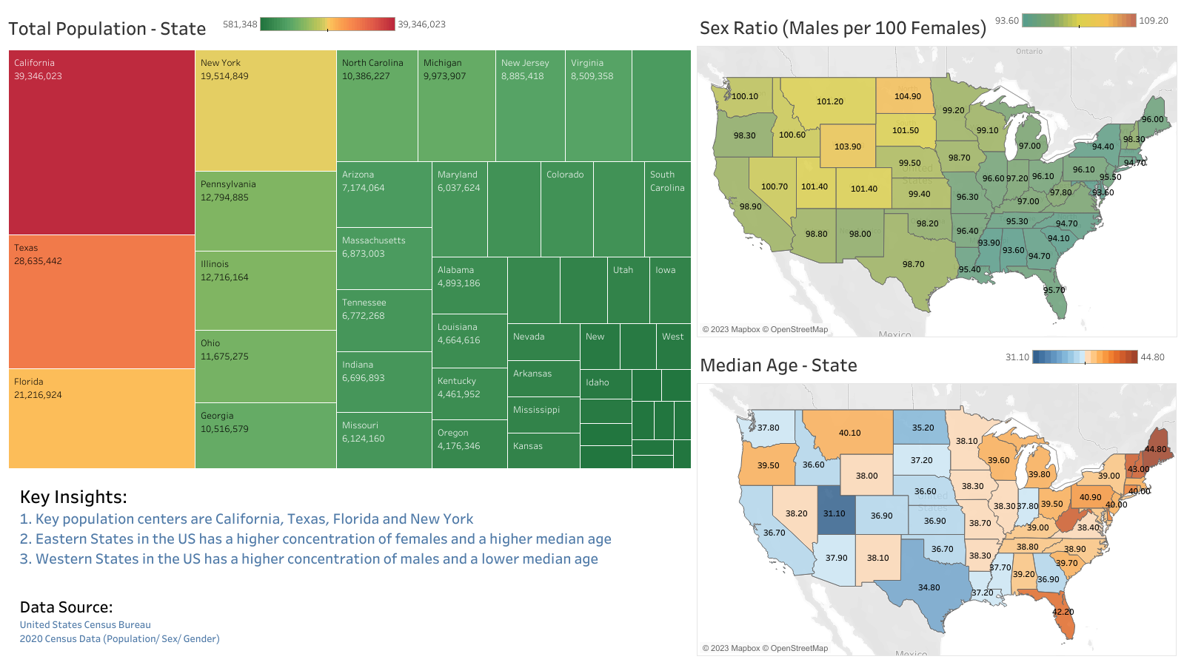

Slide 20
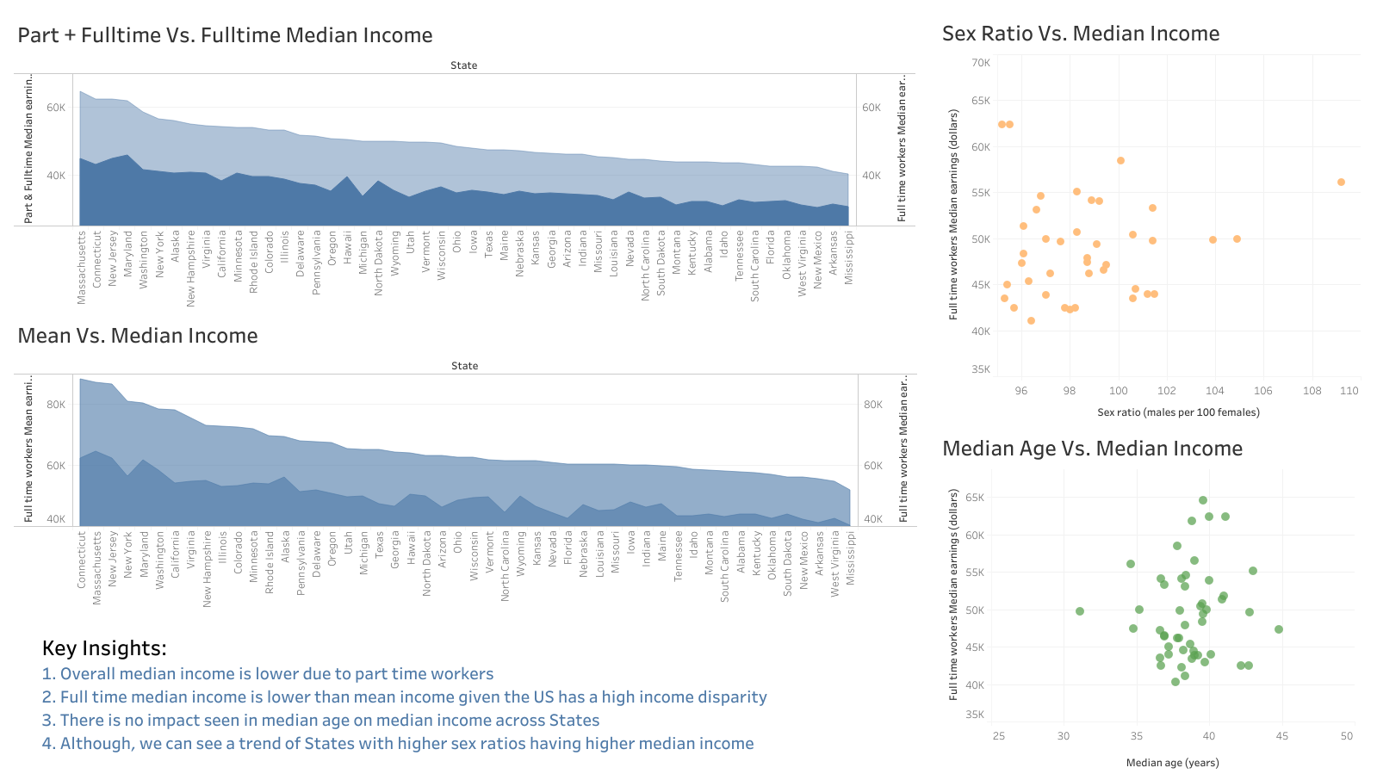

Slide 21
Sales Dashboard

Slide 22
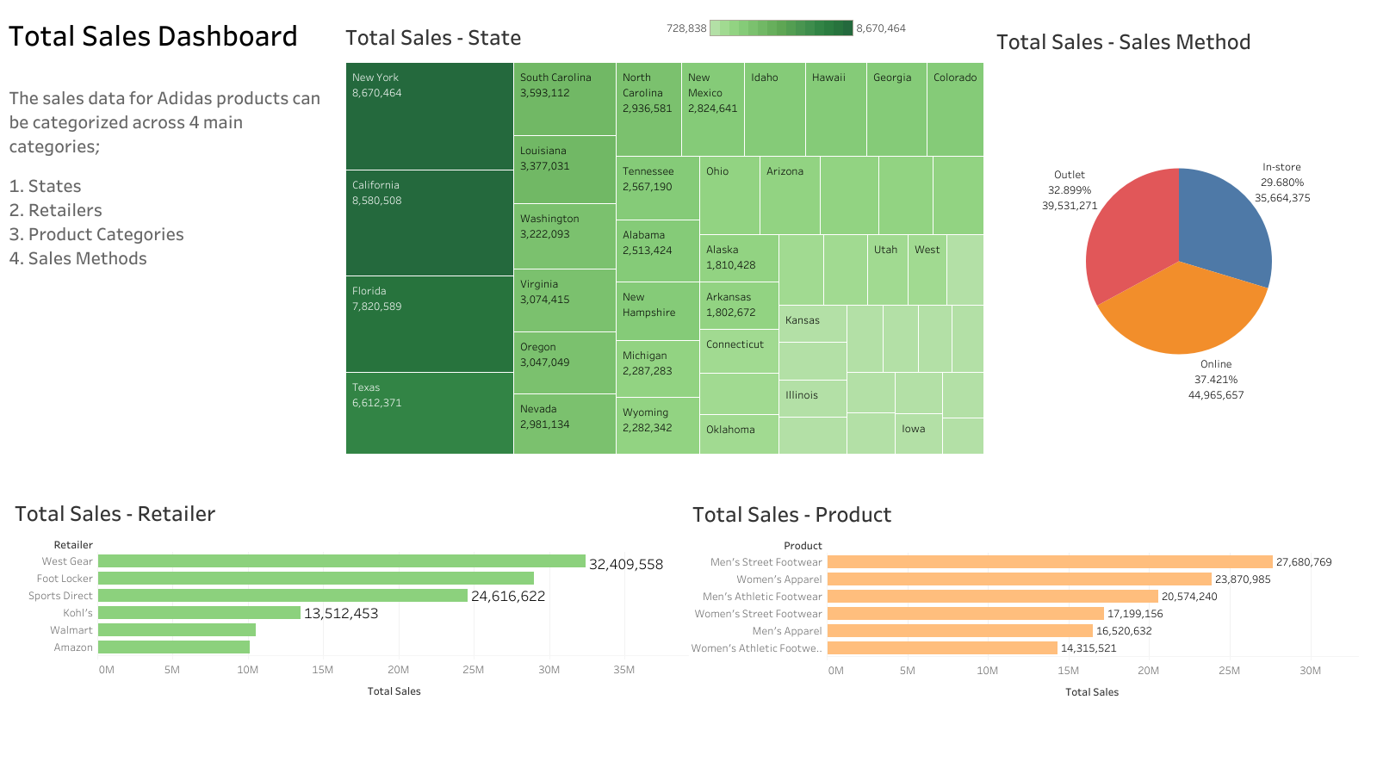

Slide 23
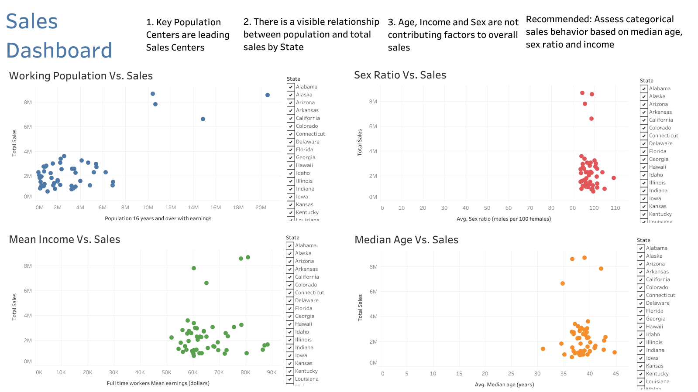

Slide 24
Machine Learning
This Analysis utilizes machine learning within the Scikit-learn library with the following techniques;
Unsupervised Machine Learning Clustering
Predictive Multiple Linear Regression Models
Binary Classification Supervised Machine Learning

Slide 25
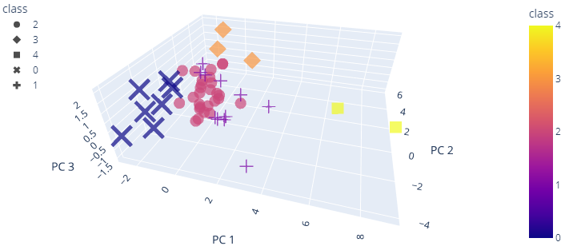
Unsupervised Machine Learning Clustering
Cluster Analysis using K-means and PCA to determine demographic clusters in terms of total population, median income and median age on US Census Data
Key Insights:
States can be separated into five distinct groups based on demographic and economic data
This can be used to further optimize administrative organization based on region population size and sales

Slide 26
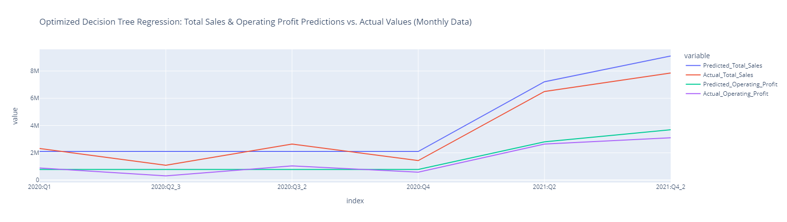
Predictive Multiple Linear Regression Models
Multiple Linear Regression using multiple algorithms to predict future sales and operating profit based on demographic and economic data
Key Insights:
Root Mean Squared Error (RMSE): ~618,379, corresponding directly to dollar amount
Future monthly sales upwards of 8 million sales and 4 million operating profit
Further demographic data can drastically increase accuracy

Slide 27
Binary Classification Supervised Machine Learning
Classification Report
 | Precision | Recall | F1-Score
Negative Prediction | 0.98 | 0.99 | 0.98
Positive Prediction | 1.00 | 1.00 | 1.00
Accuracy |  |  | 1.00
Confusion Matrix
 | Predicted Negative | Predicted Positive
Actual Negative | 393 | 2
Actual Positive | 10 | 2007
Supervised machine learning using multiple machine learning algorithms to predict operating margin based on input features
Key Insights:
Predictions based on median operating margin of 35% or greater
SMOTEENN model offers a highly accurate predictive model

Slide 28
Recommendations – Future Analysis

Slide 29
Future Analysis
The following are additional exploratory analysis that can be considered as an extension to current analysis;
Determine how sex ratio of a State impacts sales across the product categories
Determine how median age of State population impact sales based on sales method/ channel
Determine median income has an impact on the average price of units across the product categories
Determine if sex ratio has an impact on the average price of units across the product categories

Slide 30
Alternative Approaches

Slide 31
Alternative Approaches
Neural Networks to forecast sales of Canadian provinces using US sales, US demographic and Canadian demographic data
Access to additional sales data (5-6 years) to utilize multiple linear regression and predict future sales across country/ states/ product categories, etc.
Develop individual product dashboards if specific SKU based information was present across product categories

Slide 32
Thank You

