Slide 1
RF Signal SNR Estimation & Modulation Classification
Mitchell Rudy
11 March 2024

Slide 2
Overview
Dataset, Splitting, Measures of Success
Signal-to-Noise Ratio (SNR) Estimator
Modulation Classifier
Reinforcement Learning (RL) against Modulation Classifier

Slide 3
1. Dataset – RADIO ML 2018.01A
Over 2 million synthetic RF signals’ IQ data
24 modulation schemes
SNR range: -20 to 30 dB (steps of 2 dB)
1024 samples per signal
https://www.deepsig.ai/datasets/ (hdf5 format)
Kaggle (numpy format)
“Over the Air Deep Learning Based Radio Signal Classification”
Paper available at ARXIV or IEEE
Built neural network classifying the different modulation type

Slide 4
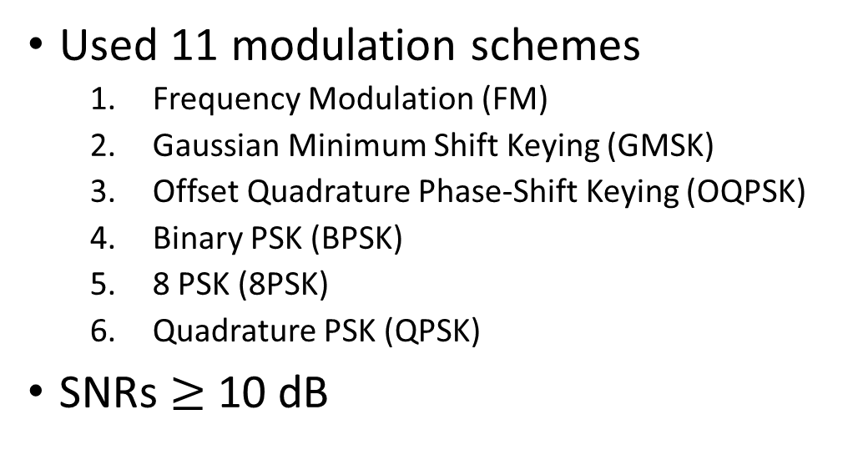
1.a. Data Downscaling & Splitting
Used 11 modulation schemes
Frequency Modulation (FM)
Gaussian Minimum Shift Keying (GMSK)
Offset Quadrature Phase-Shift Keying (OQPSK)
Binary PSK (BPSK)
8 PSK (8PSK)
Quadrature PSK (QPSK)
SNRs $≥$ 10 dB
4 Amplitude Shift Keying (4ASK)
Amplitude Modulation-Double-Sideband-Suppressed Carrier (AM-DSB-SC)
AM-Single-sideband-SC (AM-SSB-SC)
On-Off Keying (OOK)
16 Quadrature AM (16QAM)
495,616 signals remaining after downscaling
Equally split for parts 1, 2, and 3. (~165K)
90/10 split for training/testing subsets (~148.5K / ~16.5K)
Split by mod. schemes
25% of training set split for validation (~37K)
Seed = 1

Slide 5
1.b. Measures of Success
SNR Estimation
Mean square error
Baseline of ~ 0.055 dB² [REF]
Page analyzes BPSK, QPSK, 8PSK, 16PSK with Constellation Diagrams
Modulation Classification
Accuracy
Baseline of ~100% (based on paper)
Reinforcement Learning
Accuracy against Mod. Classifier
Lacked formal baseline, desired better than 9% (random guess)

Slide 6
2. SNR Estimator
Applied simplified WAVENET model
8xConv1D layers with constant filters (32) & kernel size (2),
Dilation rate doubles (1, 2, 4, … , 128)
3xConv1D layers followed by 1xMaxPooling1D Layer
Conv1D filters 64, 128, 256; kernel size 2; stride 2
MaxPooling1D pool size 128, stride 128
Flatten into 4 sets of Dense (256) & Dropout (0.25) layers
Output Dense layer with 1 neuron
Batch Normalization layers appeared to degrade performance
Training Parameters
Epochs: 200
Batch Size: 128
Learning Rate (LR): 0.001
Early Stopping: Patience 50
Reduce LR on Plateau: Patience 10, Factor 0.75

Slide 7
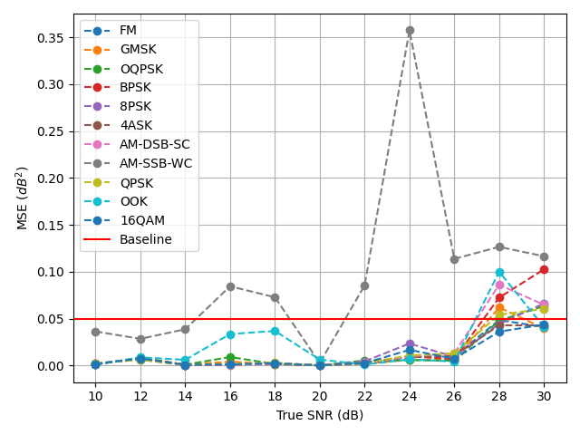
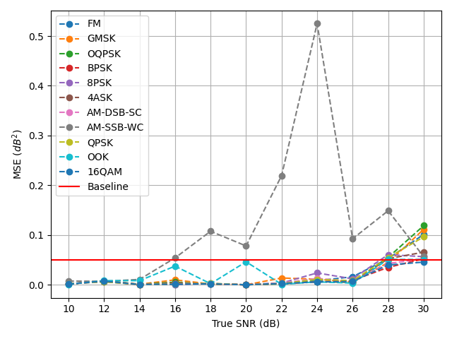
2.a. SNR Estimator Performance
Compared Mean Squared Error (MSE) to sub-0.055 baseline [REF]
Validation: Overall MSE = 0.0222
Test: Overall MSE = 0.0247

Slide 8
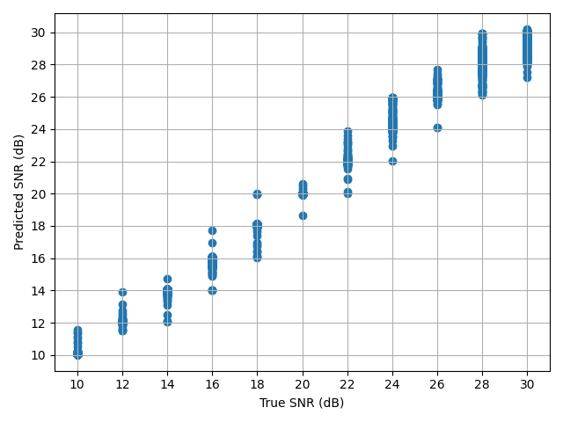
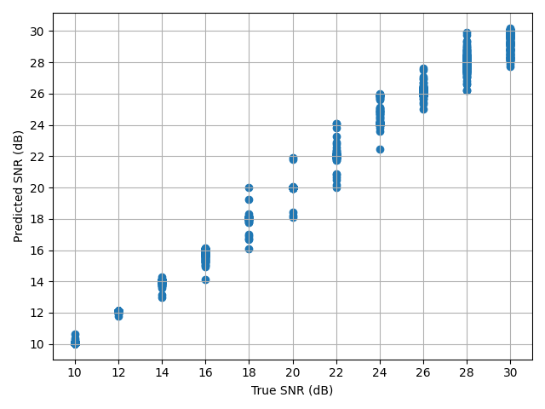
2.a. SNR Estimator Performance
Possible explanations: model prefers predicting within training support; logarithmic trends at higher SNRs.
Validation:
Test:

Slide 9
3. Modulation Classifier (MC)
Arrived at similar architecture to paper’s
Conv1D & MaxPooling1D layers to shrink (1024, 2) → (8, 64)
Flatten into Dense (512 neurons) & Dropout (50%) layers
Output dense layer with 11 neurons
Training Parameters
Epochs: 100
Batch Size: 128
Learning Rate (LR): 0.001
Early Stopping: Patience 15
Reduce LR on Plateau: Patience 10, Factor 0.75

Slide 10
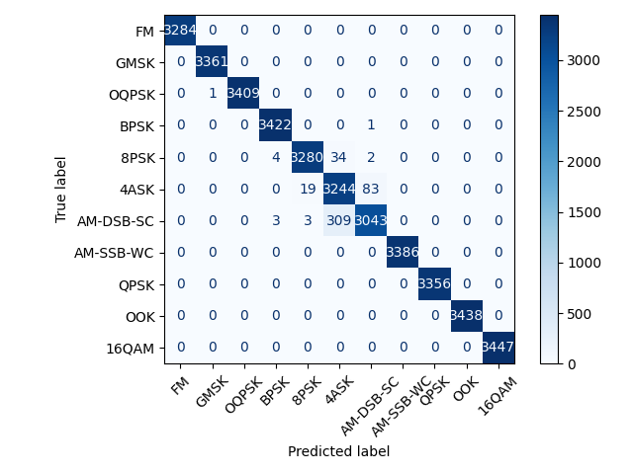

3.a. MC Performance
Validation: Accuracy = 0.99
Test: Accuracy = 0.99

Slide 11

4. RL against Modulation Classifier
Created environment using modulation classifier
Input set of RF data
Agent predicted value from 0 to 10
Feedback based on mod. classifier’s prediction
Rewarded -2 (incorrect value), +1 (correct value)
Still working out the kinks (memory management)
Very slow method of supervised learning
Wanted an environment to evaluate the time to model a system’s behavior
Out-Of-Memory

Slide 12
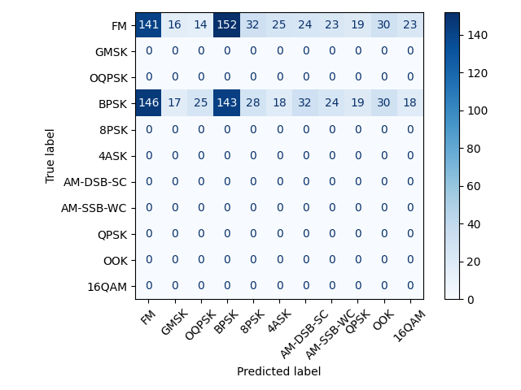
4.a. RL Binary Classification Test Case
Classify FM and BPSK signals
Training: ~2000 examples each / 50 iter.
Final Iter.: Count: 3999; Accuracy: 0.34
Evaluation: Use ~500 examples of each
Count: 999; Accuracy: 0.28;
True Label = Mod. Classifier Prediction
Predicted Label = Agent’s Action
Agent started to learn what actions should be taken, but still needs to learn when to take each.
Evaluation Set Confusion Matrix

Slide 13
5. Conclusion
SNR Estimation using IQ data can perform similarly to Image-Based Neural Networks
Need to improve RL environment, reward structure, policy parameters before applying to research work.

Slide 14
Questions?

Slide 15
BACKUP
MitchellRudy/EENG645_FinalProject: EENG645_FinalProject (github.com)

Slide 16
2. SNR Estimator Architecture
(BatchSize, 1024, 2) (BatchSize, 1024 , 32)
(BatchSize, 512, 64) (BatchSize, 256, 128)
(BatchSize, 128, 256)
(BatchSize,1,256) (BatchSize, 256) (BatchSize, 1)
Conv1D
32 Filters, Kernel Size 2, “Causal” padding, Dilation Rates = [1, 2, 4, 8, 16, 32, 64, 128]
8x
Conv1D
64 Filters, Kernel Size 2, Stride length 2, “Valid” padding
Conv1D
128 Filters, Kernel Size 2, Stride length 2, “Valid” padding
Conv1D
256 Filters, Kernel Size 2, Stride length 2, “Valid” padding
MaxPooling1D
128 Pool Size, Stride length 128, “Valid” padding
Flatten
4x
Dense (256 Neurons, ‘relu’ activation)
Dropout (25%)
Dense (1 Neuron, ‘linear’ activation)

Slide 17
3. Modulation Classifier Architecture
Conv1D
64 filters, kernel size 1, ‘valid’ padding, ‘relu’ activation
MaxPooling1D
pool size 2, stride 2, ‘valid’ padding
(BatchSize, 1024, 2) (BatchSize, 8, 64) (BatchSize, 512) (BatchSize, 11)
7x
Flatten
4x
Dense (512 Neurons, ‘relu’ activation)
Dropout (50%)
Dense (11 Neurons, ‘softmax’ activation)

