Slide 1
Recommendation Systems Business Report
MIT Applied AI and Data Science Program
Mitchell Streeter
1/20/26
Notes:
‹#›

Slide 2
Item-Item Collaborative Filtering of Large-Scale Music Recommendation
Key Takeaways:
Build a scalable music recommendation system
Use implicit listening behavior (play counts)
Balance accuracy, discovery, and scalability
Final solution: item–item collaborative filtering
Notes:
‹#›

Slide 3
Problem & Objective
Millions of songs → Attention scarcity
Songs continuing = Feedback
Goal: Scalable personalization from behavior
Notes:
‹#›

Slide 4
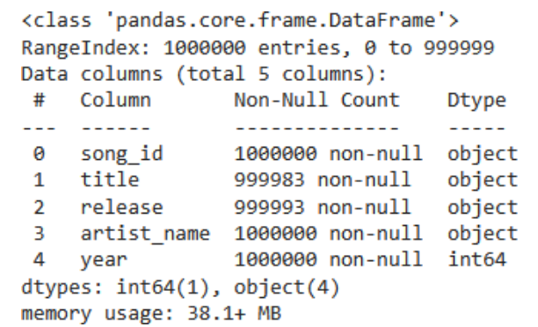
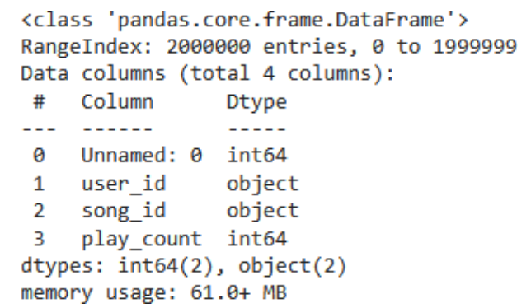
Data Overview
Large scale song metadata and minimal user-item interaction data form the foundation of the recommendation problem
“song_data” structure
“count_data” structure
Notes:
‹#›

Slide 5
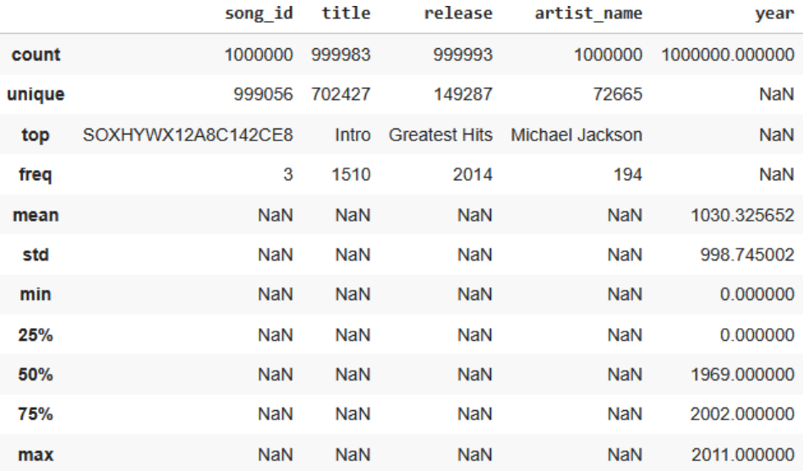
Song Metadata Distribution
Song metadata spans multiple decades with occasional missing values, necessitating only minor sanitization rather than aggressive filtering
Summary statistics of “song_data.csv” (pre-sanitization)
Notes:
‹#›

Slide 6
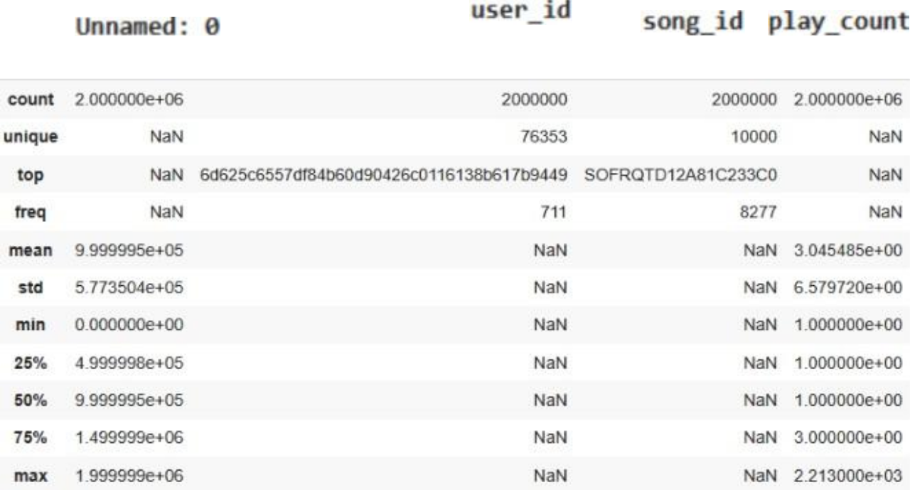
User Listening Behavior
Play counts reveal a deep right-skew, demonstrating a pattern of repeated listening to a small subset of songs
This warrants collaborative filtering
Summary statistics of “count_data.csv” (pre-sanitization)
Notes:
‹#›

Slide 7
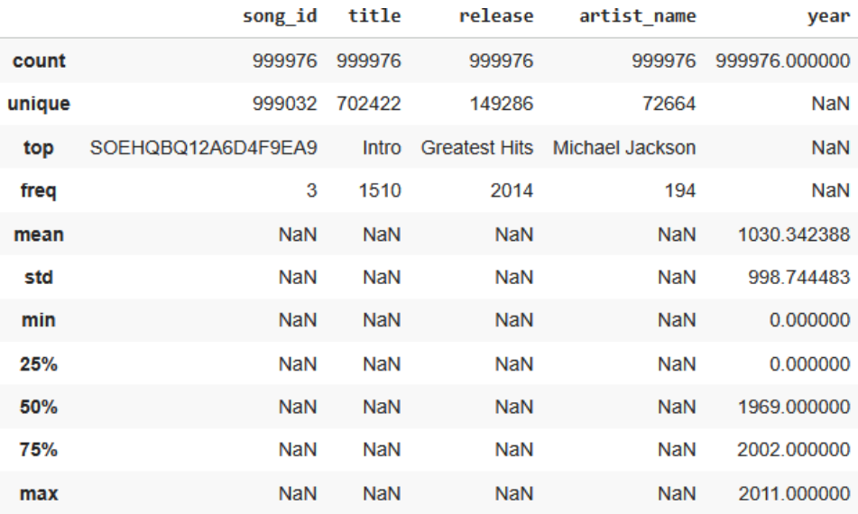
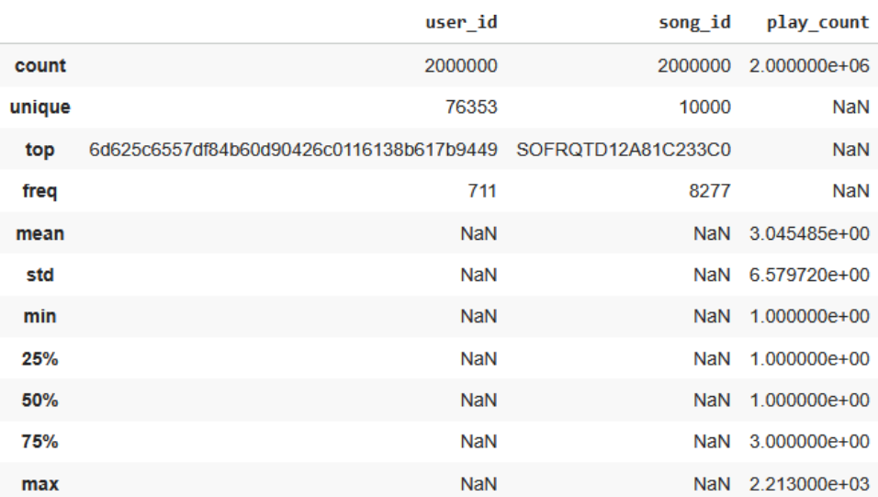
Cleaned Data for Modeling
Filtering and deduplication yields a stable, tractable user-item interaction matrix
This is optimal for recommendation modeling
Top: Sanitized song data
Bottom: Sanitized interaction data
Notes:
‹#›

Slide 8
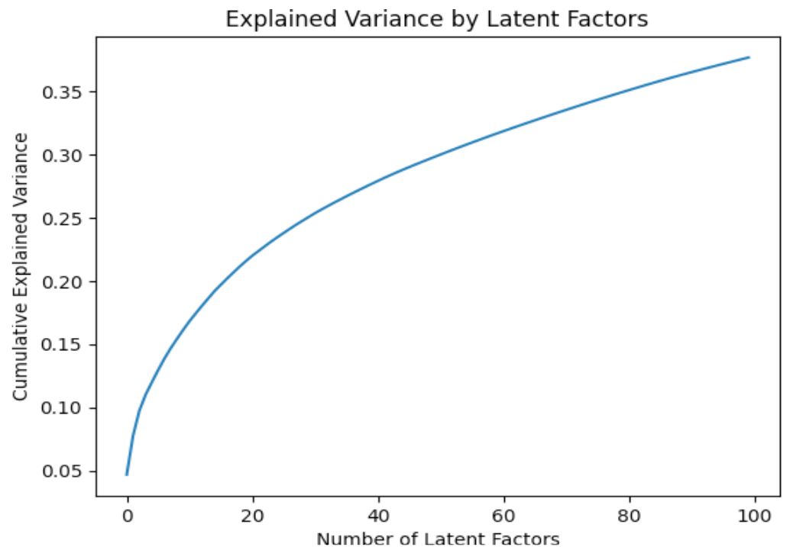
Latent Preference Structure
Structure of Latent Preferences
A moderate number of latent factors capture most of the variance in listening behavior
This reflects overlapping musical preferences
Notes:
‹#›

Slide 9
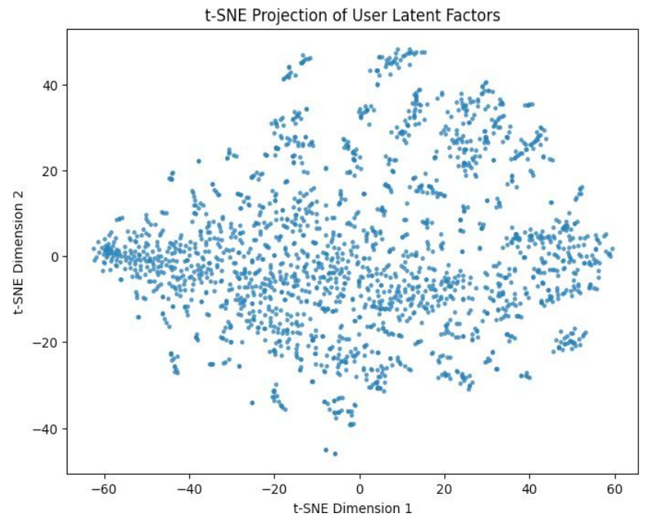
User Preference Similarity
Users cluster locally in latent space in “neighborhoods”
This indicates shared listening patterns, without rigid preference segmenting
T-SNE graph of latent user factors
Notes:
‹#›

Slide 10
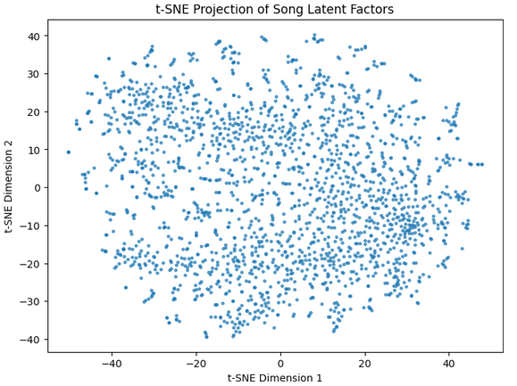
Song Audience Overlap
Songs with similar audiences appear closer in latent space
This enables effective item-item similarity computing
Notes:
‹#›

Slide 11
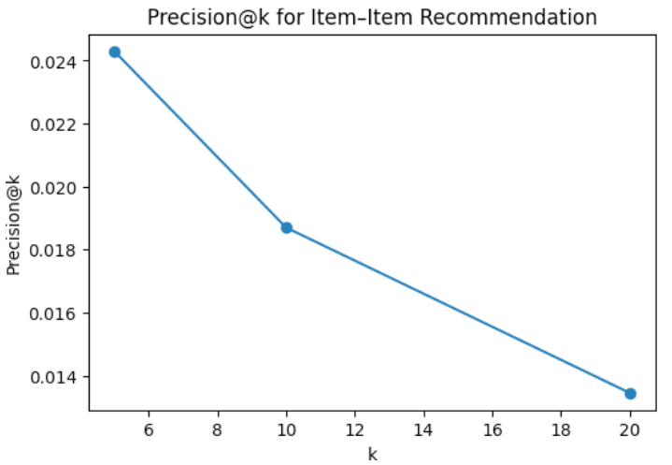
Accuracy of Recommendations
Precision@k for item-item music recommendation systems: Precision decreases as number of recommendations increases
Notes:
‹#›

Slide 12
Model Performance Comparison (Precision@k)
Model | Precision@5 | Precision@10 | Precision@20
Popularity | 0.0212 | 0.0151 | .0125
User-User CF | 0.0255 | 0.0193 | .0144
Item-Item CF | 0.0243 | 0.0187 | .0135
Collaborative filtering methods > Popularity-based methods
Item-item methods showed the greatest consistency (displayed in bold)
Precision@k comparisons
across recommendation models
Notes:
‹#›

Slide 13
Model Tuning and Validation
GridsearchCV selects an SVD configuration with 100 latent factors, strong regularization, achieving RMSE ~ 1.31
GridSearchCV results for matrix factorization and model tuning. 1.31 RMSE with 100 latent factors indicates resilient framework; .1 reg_all/”SurpriseSVD” is appropriate for sparse feedback
Notes:
‹#›

Slide 14
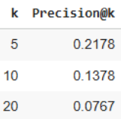
Tuned Model Precision
Tuned SVD model focuses relevant recommendations in the top section of the ranking list
Precision@k Results of TUNED SVD recommendation model
Notes:
‹#›

Slide 15
Business Recommendations
Mainstream tracks → Engagement
Genre-adjacency → Library expansion
Long-tail → Listener retention
Notes:
‹#›

Slide 16
Final Recommendation & Steps
Deploy item-item collaborative filtering
Compute similarities offline
Popular tracks used as a default for new users
Notes:
‹#›

