Slide 1


GPipe: Efficient Training of Giant Neural Networks using Pipeline Parallelism
Yanping Huang, Youlong Cheng, Ankur Bapna
NeurIPS’ 2019
Reporter: Mingcan Xiang
Sem. 14, 2020

Slide 2
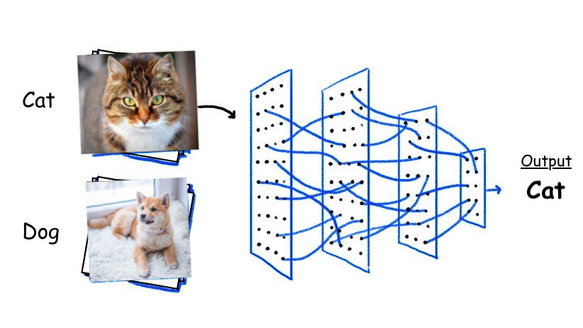
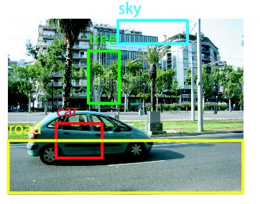
DNN is everywhere
Image Classification
Accurate on ImageNet
Image Object Detection
Larger and deeper model always outperform their simple and shallow counterparts!
Natural Language Processing
Notes:
As we all known, Deep neural network has seen great progress over the last decade, and achieved great successes in many areas, partially thanks to the development of methods that facilitated scaling effective capacity of neural networks.
This trend has been most visible for image classification, as demonstrated by the accuracy improvements on ImageNet with the increase in model capacity.
A similar phenomenon can also be observed in natural language processing (NLP) where Larger and deeper model always outperform their simple and shallow counterparts!
Almost every researcher uses neural network in their current work, causing the fancy trend. This give us the illusion that we were outdated if we don’t use neural network. So DNN is everywhere

Slide 3
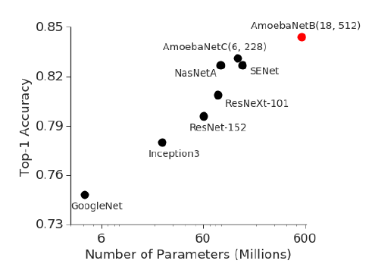
DNN is everywhere
Larger and deeper model always outperform their simple and shallow counterparts!
Figure 1 shows strong correlation between top-1 accuracy on ImageNet 2012 validation dataset and model size for representative state-of-the-art image classification models in recent years. There has been a 36 x increase in the model capacity. Red dot depicts 84.4% top-1 accuracy for the 550M parameter AmoebaNet model.

Slide 4

Existing problem
We can not always hold the large Neural Networks on a single GPU.
In many cases, increasing model capacity beyond the memory limit of a single accelerator (e.g. GPU or CPU) has required developing special algorithms or infrastructure.
There are some traditional ways to allocate large model over multiple-GPUs
Data parallelism
Model parallelism
However, these traditional ways still suffer from executing efficiency and memory capacity.
So, the author proposes GPipe, using pipeline parallelism to solve these deficiencies.
Notes:
Now that Larger and deeper neural network always perform better than their simple and shallow counterparts,
We should always choose the better one ? No way.

Slide 5
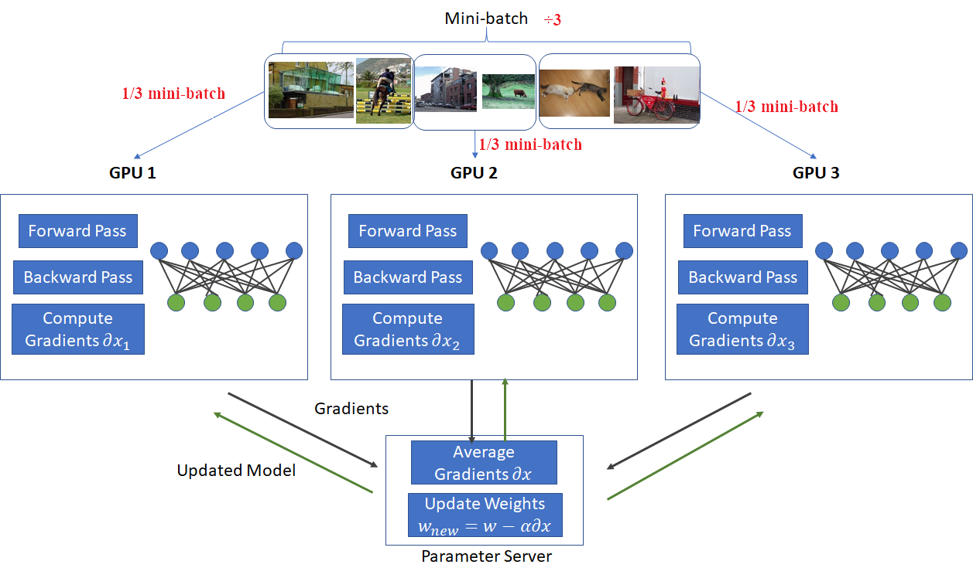
Data parallelism
The model on different GPU is the same
Highlight:
All the parameters
Every GPU holds a replicated whole model
Inputs are evenly partitioned across workers
Inputs are trained on its own partition
Periodically synchronize weights with other GPUs, using either collective communication primitives (e.g. all_reduce) or parameter servers to update model parameters.
Notes:
Before going to pipeline parallelism, I want to give you some intuition about the data parallelism and model parallelism. Because pipeline parallelism somehow bases on both of these.
In this graph, we use parameter server.

Slide 6
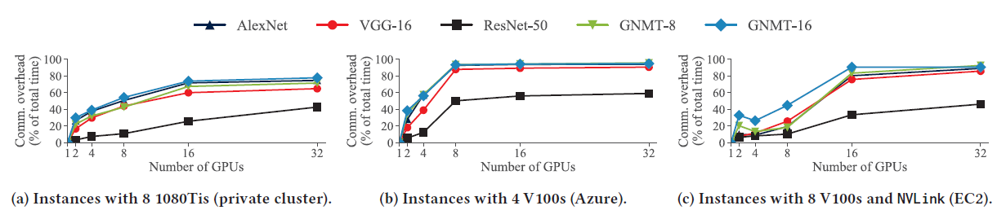
Data parallelism
Deficiency:
Communication overhead of data-parallel training using different multi-GPU server instances and models
As the number of data-parallel workers increases, communication overheads increase for all models
When the number is closed to 32, communication overhead take the most part.
Notes:
This picture quantitatively shows the fraction of training time spent in communication stalls with data parallelism for different classes of DNNs using three types of servers.
So, it seems won’t work well, when we want to use lots of GPUs.
BTW, the reason ResNet-50’s communication overhead is much lower compare to other model is that ResNet-50 has a large number of convolutional layers, meaning the parameters are much less.

Slide 7
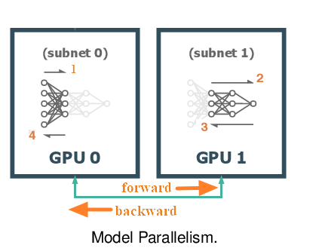
Model parallelism
the operators (e.g. layers) in a DNN model are partitioned across the available workers, with each worker hold a subset of the model’s parameters
each worker (e.g. GPU) evaluating and performing updates for all the inputs
For example, we may split a model occupying 40GB of GPU memory into 4 partitions each occupying 10GB, respectively.
Notes:
Then let’s talk about M parall
the operators (e.g. layers) in a DNN model are partitioned across the available workers, with each worker evaluating and performing updates for only a subset of the model’s parameters for all inputs. The amount of data communicated is the size of intermediate outputs (and corresponding gradients) that need to be sent across workers.

Slide 8
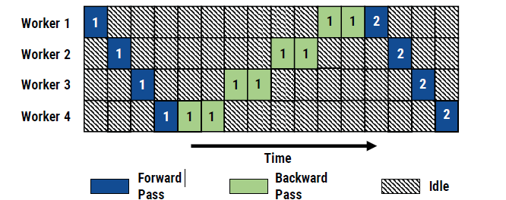
Model parallelism
Although model parallelism enables training of very large models, pure model parallelism is rarely used to accelerate DNN training because it suffers from two major limitations:
Model parallel training results in under-utilization of compute resources. Because the latter layer wouldn’t work until the prior layer has finished. That means only one device can be utilized at once.
The burden of partitioning a model across multiple GPUs is left to the programmer, resulting in point solutions.
Notes:
Figure 2: Model parallel training with 4 workers. the Numbers indicate batch ID, and backward passes takes twice as long as forward passes. For simplicity, we assume that communicating activations/gradients across workers has no overhead.
2. For example, if we have 200 layers in this model, it is our duty to decide which GPU get how many layers. that’s not easy, because every layer has various number of parameters.

Slide 9
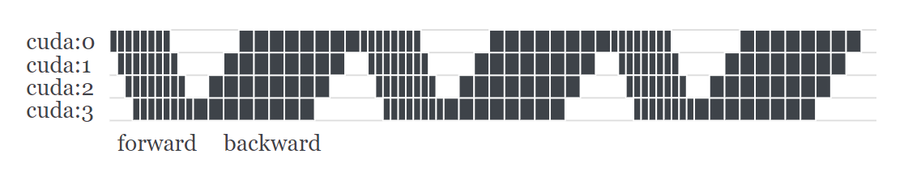
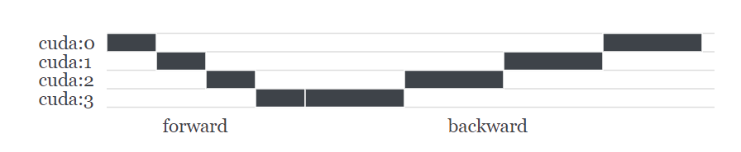
Pipeline parallelism
GPipe splits a mini-batch into multiple micro-batches to make the devices work as parallel as possible.
It is called pipeline parallelism.
Basically, pipeline parallelism is a stack of small data parallelism. When each partition has finished processing a micro-batch, it can toss the output to the next partition and immediately can start to work on the next micro-batch. Now the partitions can be overlapped.
Pipeline parallelism
model parallelism
Notes:
To address these challenges, we introduce GPipe, a flexible library that enables efficient training of large neural networks.

Slide 10
Pipeline parallelism
Mini-batch
The optimization algorithm of deep learning is gradient descent. There are two ways to update the parameters each time.
Batch gradient descent: read all the samples in the data set
expensive overhead and low speed
stochastic gradient descent: Read a single sample in every training
hard to converge
Therefore, people adopt a new method called mini-batch. This method divides the whole dataset into several batches, and updates the parameters according to batches.
Micro-batch
To reduce bubble time, the author splits a mini-batch into multiple micro-batches to make the devices work as parallel as possible. bubble overhead will be negligible when (number of micro-batches) > 4 X partitions.
Notes:
In case you guys confuse the concept of mini-batch and micro-batch, I want further-more explain them
In this way, a group of data in a batch determines the direction of this gradient together, and it is not easy to run off when falling, reducing randomness. On the other hand, because the number of samples in the batch is much smaller than the entire data set, the amount of calculation is not very large.

Slide 11
Pipeline parallelism
To address these challenges, we introduce GPipe, a flexible library that enables efficient training of large neural networks.

Slide 12
Batch

Slide 13
Chunk

Slide 14
Chunk

Slide 15
Chunk

Slide 16
Chunk

Slide 17
Auto balance
Balance by time

Slide 18
Auto balance
Balance by size

Slide 19
Performance Overhead Breakdown
Balance by size

Slide 20
Benchmark
Balance by size

Slide 21
Communication overhead
Re-computation or Discard
Forward and backward
Check point

Slide 22
Trade-off between efficiency and capacity
Re-computation or Discard
Forward and backward
Check point

Slide 23
Related work
PipeDream: Efficient Training of Giant Neural Networks using Pipeline Parallelism
Yanping Huang, Youlong Cheng, Ankur Bapna
NeurIPS’ 2019

Slide 24
Auto balance
Ba

Slide 25
Summary
Ba

Slide 26
DNN is everywhere

