Slide 1


GPipe: Efficient Training of Giant Neural Networks using Pipeline Parallelism
Yanping Huang, Youlong Cheng, Ankur Bapna
NeurIPS’ 2019
Reporter: Mingcan Xiang
Sem. 14, 2020

Slide 2
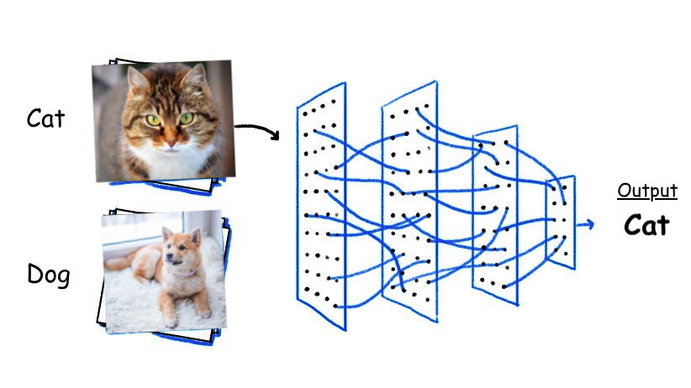
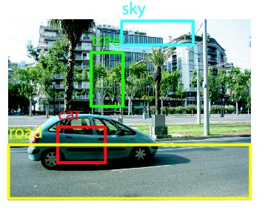
DNN is everywhere
Image Classification
Accurate on ImageNet
Image Object Detection
Larger and deeper model always outperform their simple and shallow counterparts!
Natural Language Processing
Notes:
As we all known, Deep neural network has seen great progress over the last decade, and achieved great successes in many areas, partially thanks to the development of methods that facilitated scaling effective capacity of neural networks.
This trend has been most visible for image classification, as demonstrated by the accuracy improvements on ImageNet with the increase in model capacity.
A similar phenomenon can also be observed in natural language processing (NLP) where the Larger and deeper model always outperform their simple and shallow counterparts!
Almost every researcher uses neural network in their current work, causing the fancy trend. This give us the illusion that we will be outdated if we don’t use neural network. So DNN is everywhere

Slide 3
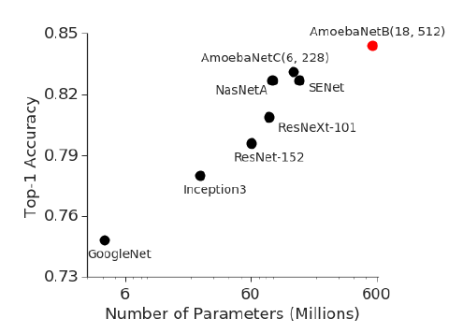
DNN is everywhere
Larger and deeper model always outperform their simple and shallow counterparts!
Figure 1 shows the evidence.
Strong correlation between top-1 accuracy on ImageNet dataset and model size for representative state-of-the-art image classification models in recent years. There has been a 60 x increase in the model capacity. Red dot depicts 84% top-1 accuracy for the 550M parameter AmoebaNet model.
We can see a linear growth in accuracy with the respect to model size.

Slide 4

Existing problem
It does not work for some use cases where the model is too large to fit into a single GPU.
In many cases, increasing model capacity beyond the memory limit of a single accelerator (e.g. GPU or CPU) has required developing special algorithms or infrastructure.
There are some traditional ways to allocate large model over multiple-GPUs
Data parallelism
Model parallelism
However, these traditional ways still suffer from executing efficiency and memory capacity.
So, the author proposes GPipe, using pipeline parallelism to solve these deficiencies.
Notes:
So, is that means We should always choose the Larger and deeper neural network model? The answer is No way.

Slide 5
Category
Traditional way to train giant neural network
Data parallelism
Model parallelism
Gpipe’s pipeline parallelism
Pipeline algorithm
Automatic balancing
Mini-batch and micro batch(chunk)
Benchmark-memory
Benchmark-speed
Performance Overhead Breakdown
Trade-offs between efficiency and capacity
Trade-offs of micro-batches number
PipeDream’s pipeline parallelism
Improvement 1:model Partitioning
Improvement 2:Work Scheduling
Notes:
This page is the category, you can just have a brief review to know what I’m going to talk. don’t be affrad, I’ll show you again in the summary.

Slide 6
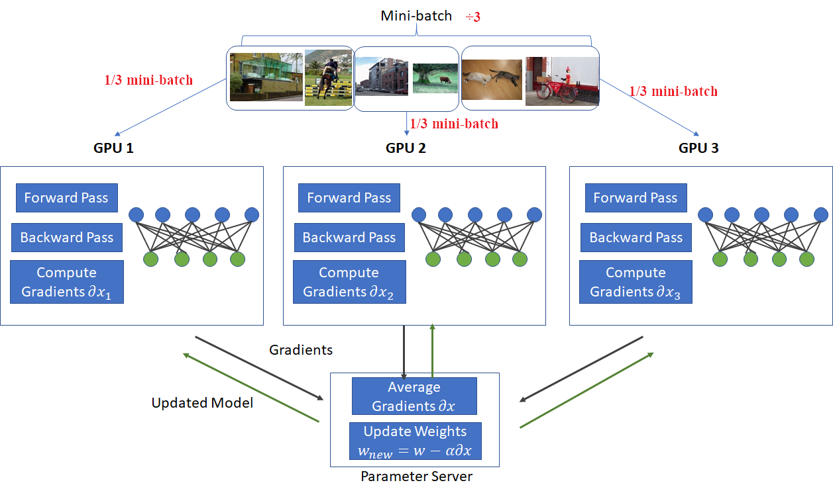
Data parallelism
The model on different GPU is the same
Highlight:
All the parameters
Every GPU holds a replicated whole model
Inputs are evenly partitioned across workers
Inputs are trained on its own partition
Periodically synchronize weights with other GPUs, using either collective communication primitives (e.g. all_reduce) or parameter servers to update model parameters.
Notes:
Before going to pipeline parallelism, I want to give you some intuition about the data parallelism and model parallelism. Because pipeline parallelism somehow bases on both of these.
So what’s the data parallelism? It’s easy to understand, you just need to evenly spread all the input data over the multiple-GPUs, and they do the training process synchronously. At the end, add all the outputs together. We will get the training result.
In general, there are four steps.
In this graph, we use parameter server to update the weights.

Slide 7
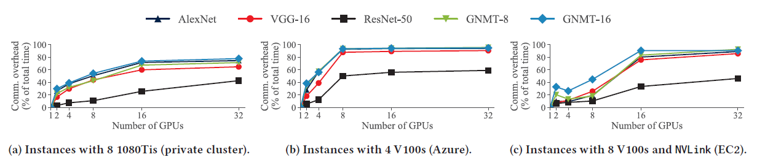
Data parallelism
Deficiency:
Less parameters
Communication overhead of data-parallel training using different multi-GPU server instances and models
As the number of data-parallel workers increases, communication overheads increase at the same time for all models
When the number is closed to 32, communication overhead take the most part. (e.g. 80%)
Notes:
So Why I call it the traditional method? Yes, because of its drawback.
This picture quantitatively shows the fraction of training time spent in communication with data parallelism for different classes of DNNs using three types of servers.
We se … it doesn’t work well, when we want to use lots of GPUs. 读ppt最下面的
BTW, the reason why ResNet-50’s (square icon) communication overhead is much lower compare to other model is that ResNet-50 has a large number of convolutional layers, meaning the parameters are much less.

Slide 8
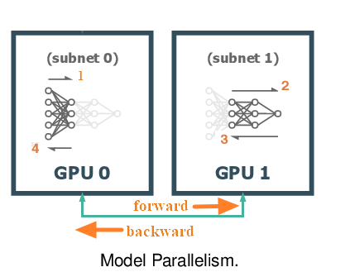
Model parallelism
the layers in a DNN model are partitioned across the available workers, with each worker hold a subset of the model’s parameters
each worker (e.g. GPU) training and performing updates for all the inputs
For example, we may split a model occupying 40GB of GPU memory into 4 partitions each occupying 10GB, respectively.
Notes:
Then let’s talk about M parall
The mechanism of these two methods is totally different. In data parallelism, we spread input data over multiple GPUs. However, in model parallelism we should spread the model over multiple GPUs. And train all the input data in these sequential GPUs.
There are two major steps.
So, when the model is split, we can chose to fit in a much larger model than before.

Slide 9
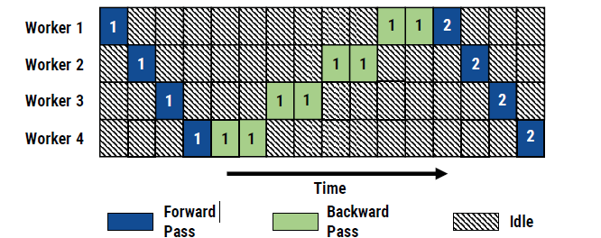
Model parallelism
Deficiency:
Although model parallelism enables training of very large models, pure model parallelism is rarely used to accelerate DNN training because it suffers from two major limitations:
Model parallel training results in under-utilization of compute resources. Because the latter layer wouldn’t work until the prior layer has finished. That means only one device can be utilized at once.
The burden of partitioning a model across multiple GPUs is left to the programmer, resulting in point solutions.
Notes:
Of course, it has its own deficit.
as for this problem, you can see this graph. Work2’s input is worker1’s output. So all the latter workers need to wait for the intermediate output

Slide 10
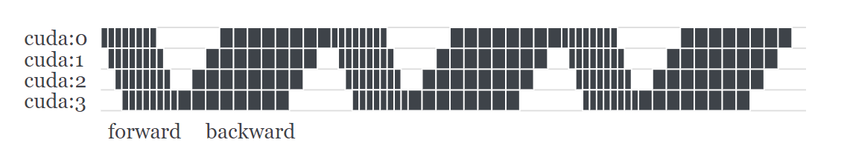
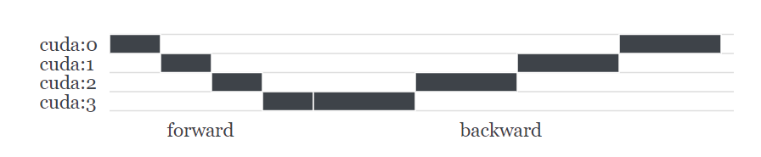
Pipeline parallelism
GPipe splits a mini-batch into multiple micro-batches to make the devices work as parallel as possible.
It is called pipeline parallelism.
Basically, pipeline parallelism is a stack of small data parallelism. When each partition has finished processing a micro-batch, it can toss the output to the next partition and immediately can start to work on the next micro-batch. Now the partitions can be overlapped.
Pipeline parallelism
Bubble time
model parallelism
Notes:
To address all these challenges, the author introduces GPipe, a flexible library that enables efficient training of large neural networks.

Slide 11
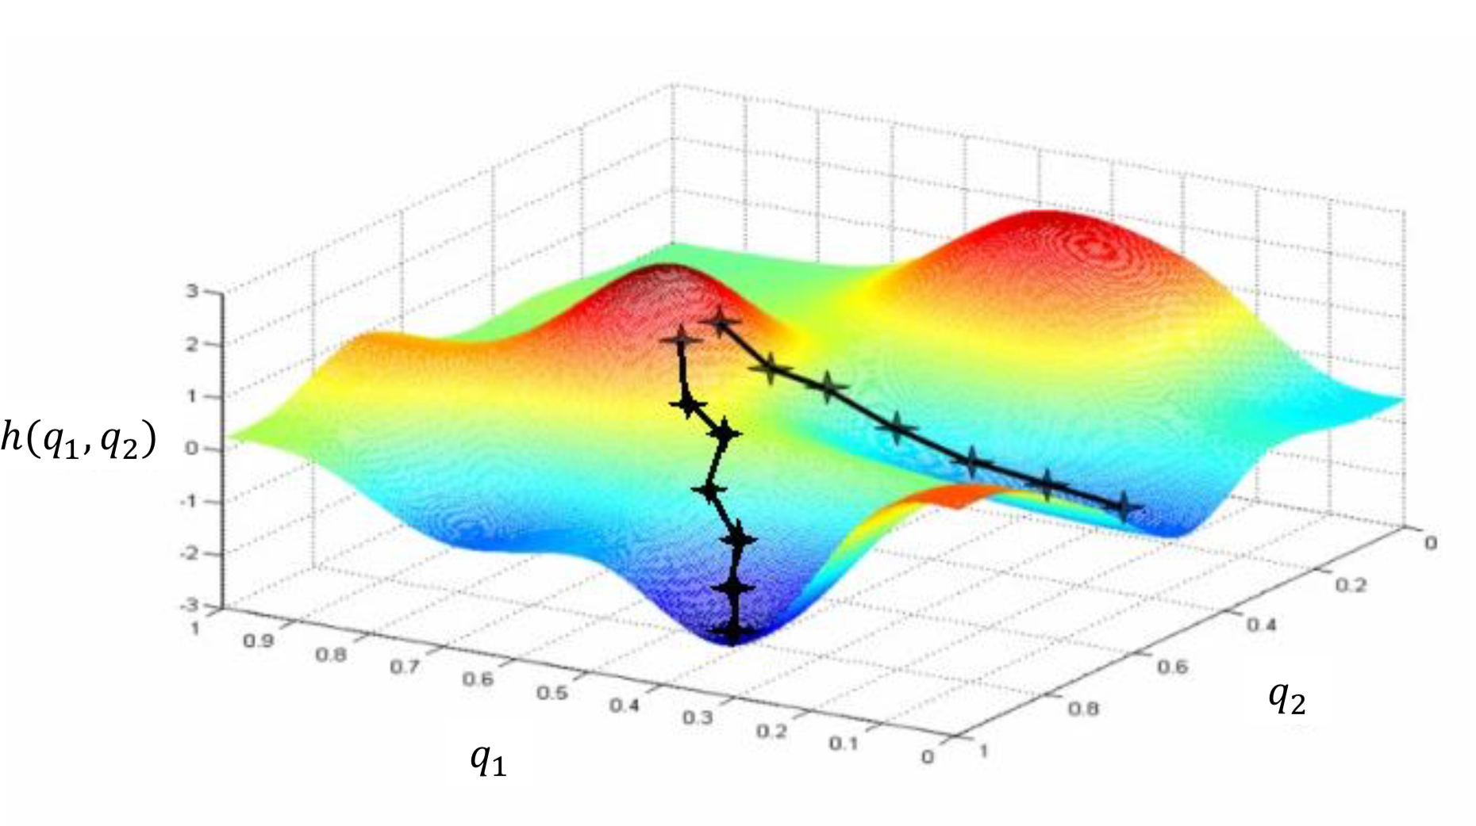
Pipeline parallelism
Mini-batch
The optimization algorithm of deep learning is gradient descent. There are two ways to update the parameters each time.
Batch gradient descent: in training process read all the samples in the data set
expensive overhead and low speed
stochastic gradient descent: Read a single sample in every training
hard to converge
Therefore, people adopt a new method called mini-batch.
This method divides the whole dataset into several batches,
and updates the parameters according to batches.
Micro-batch
To reduce bubble time mentioned before, the author splits a mini-batch into multiple micro-batches to make the devices work as parallel as possible. BTW, bubble overhead will be negligible when “number of micro-batches” > 4 X partitions.
Notes:
In case, you guys may confuse the concept of mini-batch and micro-batch, I want to further-more explain them
In this way, a group of data in a batch determines the direction of this gradient together, and it is not easy to run off when falling, reducing randomness. On the other hand, because the number of samples in the batch is much smaller than the entire data set, the amount of calculation is not very large.

Slide 12
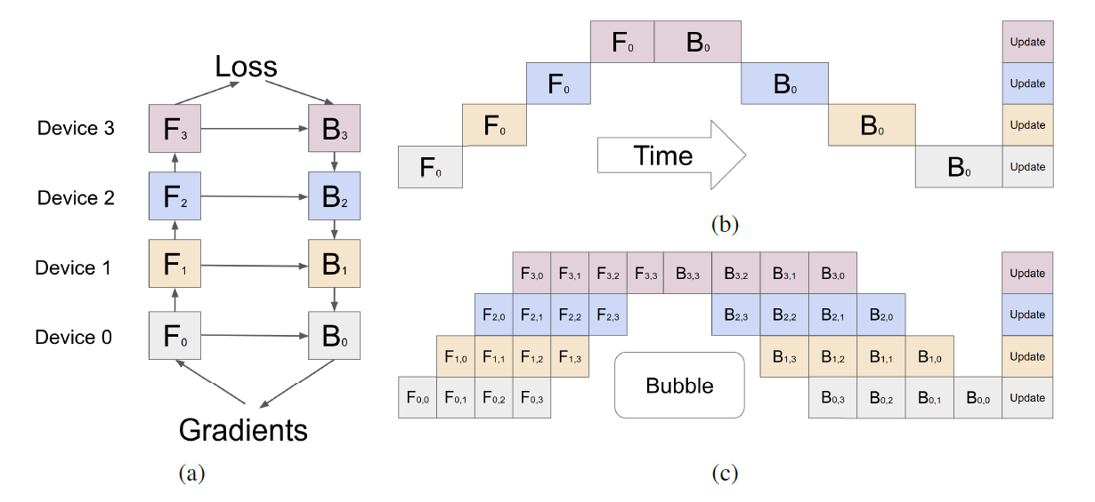
Pipeline parallelism
(a) An example neural network with sequential layers which is partitioned across four accelerators.
Fk represents the forward computation function. Bk is the back-propagation function, which depends on both Bk+1 from the upper layer and Fk.
Notes:
Let’s look back at pipeline parallelism again.

Slide 13
Pipeline parallelism
(b) Naive model parallelism strategy, leading to severer under-utilization due to the sequential dependency of the network.

Slide 14
Pipeline parallelism
(c) Pipeline parallelism divides the input mini-batch into multiple smaller micro-batches, enabling different accelerators to work on different micro-batches simultaneously. Gradients are applied synchronously at the end.

Slide 15
Pipeline parallelism
The GPipe interface is extremely simple and intuitive, requiring the user to specify:
the number of model partitions K
the number of micro-batches M --called chunk
the sequence and definition of layers that define the model.
User-defined model
model: nn.Module = unet(depth=5, num_convs=5, base_channels=64, input_channels=3, output_channels=1) model = GPipe(model, temp_balance, devices=[0, 1, 2, 3], chunks=8)
?
4 GPUs devices
4 partitions
Divide mini-batch into 8 micro-batch
Notes:
Let’s see how to implement a pipeline parallelism model.
So, what does temp_balance means? It means the responding List that partition model layers over multiple GPUs. We will talk it later

Slide 16
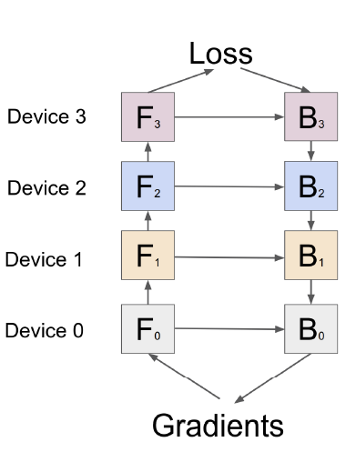
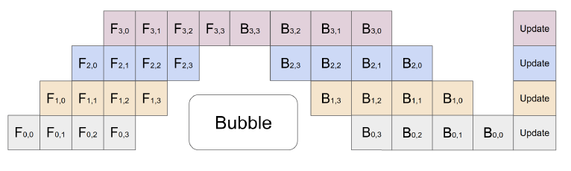
Pipeline parallelism
K = 4
M = 4
time
GPipe partitions the model layers into 4 cells on the separate accelerators
The partitioning algorithm minimizes the variance in the estimated costs of all cells in order to maximize the efficiency of the pipeline by syncing the computation time across all partitions.
During the forward pass, GPipe firstly divides every mini-batch of size N into 4 equal micro-batches, which are pipelined through the 4 accelerators.
During the backward pass, gradients for each micro-batch are computed based on the same model parameters used for the forward pass.
At the end of each mini-batch, gradients from all 4 micro-batches are accumulated and applied to update the model parameters across all accelerators
Notes:
Once the user defines the sequence of model layers in their network, 1.
4….. This sequence of operations is illustrated in the upper graph.
So, How do we partition this model? How do the partition algorithm works? We will talk it now!

Slide 17
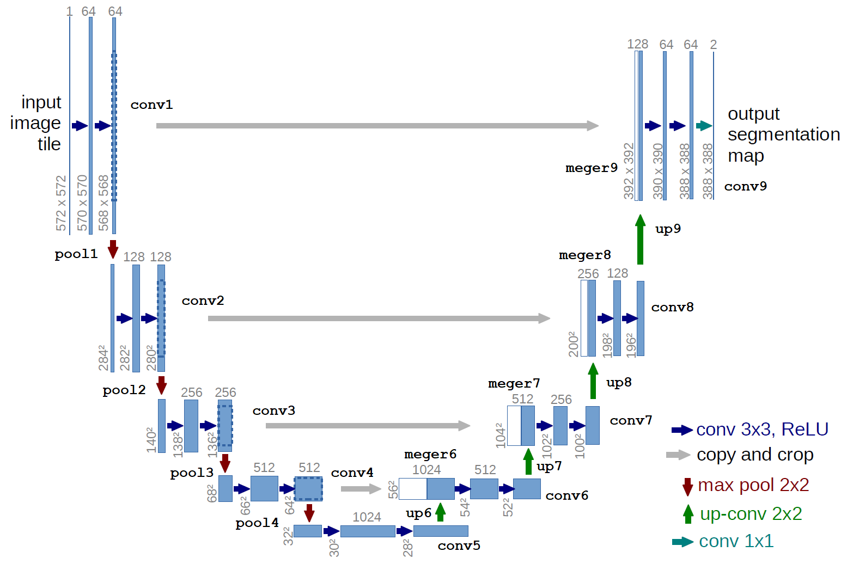
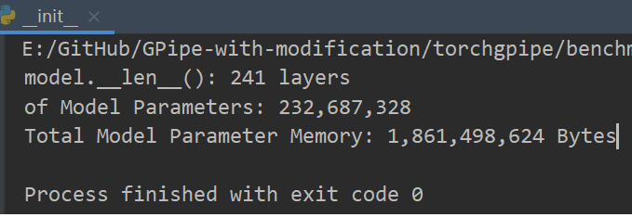
About U-net model
U-net(5, 64):
Notes:
Before partition the model, you should firstly know what’s the model architecture. For example, how many layers in this model? Is that convolutional layer, pooling layer, or active layer?
Like the image showing here, the U-net model, which I use as an example, apply large amount of convolutional functions.
You got to know for U-net(5, 64), it has totally 241 layers. Total model parameter memory is 1.8GiB.

Slide 18
Auto balance
It could be very hard for user to determine the optimal balance of a model. In particular, if you are still designing a model, the model architecture may change over time.
In this case, Gpipe provides us with a convenient API: Auto balancing. This won’t give you the optimal balance, but a good-enough balance.
There are two balancing tools, Both are based on per-layer profiling.
balance_by_time()
balance_by_size()
Just like PyTorch, you need to feed a sample input into the model. balance_by_time() traces elapsed time of each layer, while balance_by_size() detects the CUDA memory usage of each layer.
sample = torch.rand(128, 3, 224, 224) balance = balance_by_time(partitions, model, sample)
Image size: 224 x224 x3
Batch size: 128
Notes:
Finally, here we are: partition algorithm.

Slide 19
Auto balance
sample = torch.rand(128, 3, 224, 224) balance = balance_by_time(partitions, model, sample)
Image size: 224 x224 x3
Batch size: 128
Balance by time:
GPU0
GPU1
GPU2
GPU3
GPU0: layer[1, 2, 3, 4]
GPU1: layer[5, 6, 7, 8]
GPU2: layer[9, 10, 11]
GPU3: layer[12, 13, ,14, 15]
Balance = [4, 4, 3, 5]
Elapsed time
Test for U-net(5, 64) in 2 GPUs (total 241layers)
Balance = [80, 161]
Layers
Notes:
I’ll show you a simple example about the balance_by_time().
Suppose that we have a model including 16 layers, and we want to divide this model over 4 GPUs. Firstly, We should do per layer time profiling to define which layer will take more time or less time. For this purpose, we generate a data sample, the image size is 224 * 224* 3, and the batch size is 128. then we run the balance_by_time() and get the per layer time profiling like the image showing below. Here we use a naïve partition algorithm to make each 4 partition have the same runtime approximately.
So, the sequential GPUs get 4, 4, 3, 5 layers of the model respectively. This ‘List’ is the input parameter of balance.
I test U-net(5, 64) model in 2 GPUs, and get the balance equal to [80, 161].
Balance by size is the same. You can switch the “elapsed time” into “occupied memory size”

Slide 20
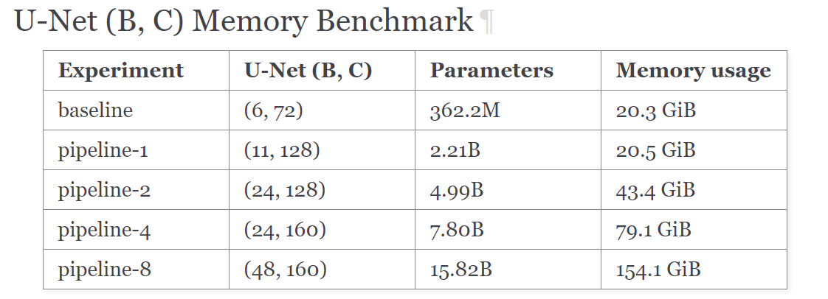
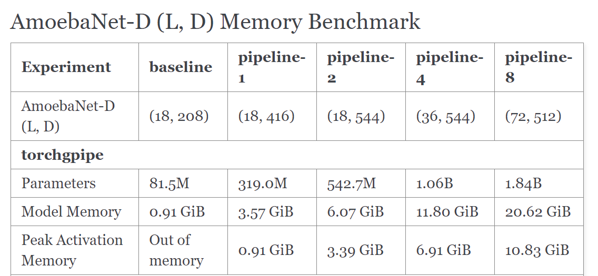
Benchmark-memory
The table shows how GPipe facilitates scaling U-Net models.
baseline denotes that without pipeline parallelism nor checkpointing
pipeline-1, -2, -4, -8 denotes that the model is trained with GPipe with the corresponding number of partitions.
The reproducible code and experiment details are available in
benchmarks/unet-memory.
Notes:
Here we see how Gpipe perform with respect to memory usage and training speed.
Here we used a simplified U-Net architecture. The size of a model is determined by hyperparameters B and C which are proportional to the number of layers and filters, respectively.
May I have your attention at this line? You see with a single GPU device, pipeline parallelism can hold larger model parameters with the same memory usage, Instead pipeline parallelism sacrifices its running speed. I’ll show you the evidence latter. to sum up, using pipeline parallelism, with the accelerator increases, you can get an approximately linear increase in memory usage.

Slide 21
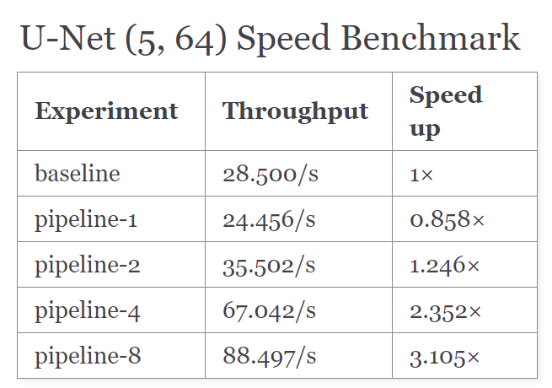
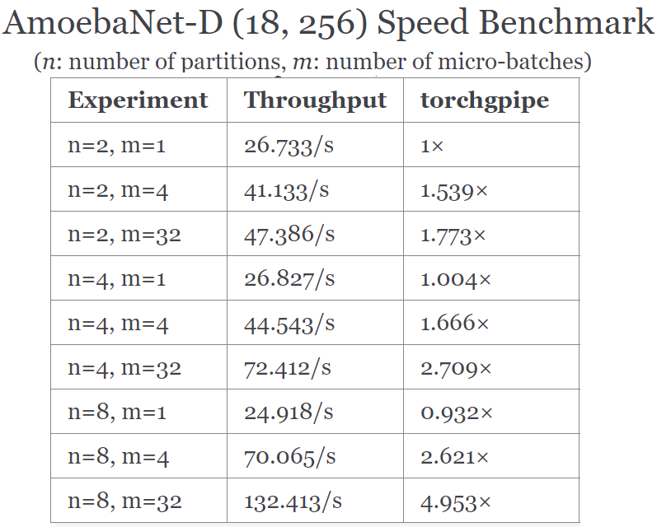
Benchmark-speed
The reproducible code and experiment details are available in
benchmarks/amoebanetd-speed.
Notes:
Here is speed performance.
Firstly, let’s review the evidence that the speed of pipeline-1 is lower than baseline. Because pipeline parallelism split mini into multiple micro , communicaition overhead occurs in this process. between multiple micro.
Still, you can see an approximately linear increase in speed when accelerator increases.

Slide 22
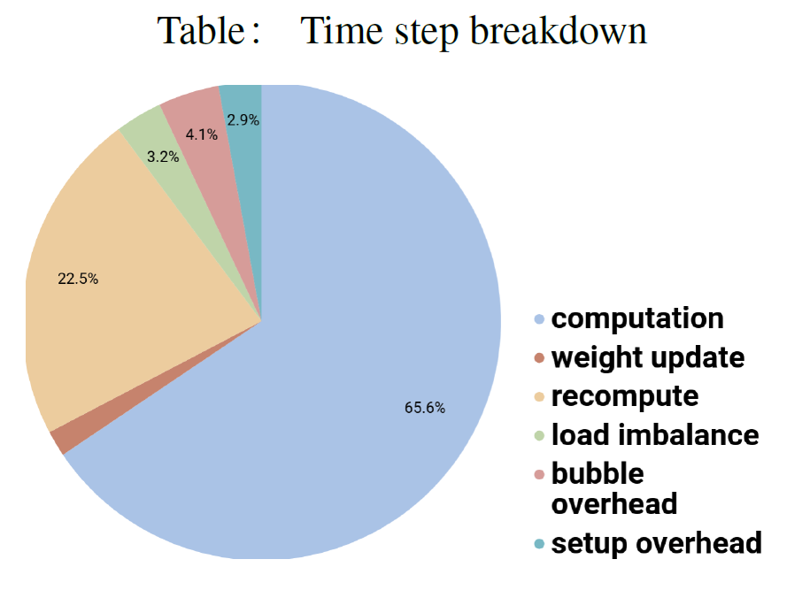
Performance Overhead Breakdown
re-computation time was the main contributor to GPipe overhead, taking up to 22.5% of the total step time
load imbalance(communication oh). With two partitions, overhead caused by load imbalance was only 3.2%.
bubble overhead was slightly lower than the theoretical value partly because re-computation was scheduled early to overlap with the bubble.
Weight update time for gradient aggregation at the end of pipeline was also small, thanks to high-speed interconnections between the accelerators. (e.g. PCIe, NVLink)
Notes:
To study opportunities for future performance, I identified the key factors that affect the performance of GPipe on accelerators. I measured the time spent on different activities listed in ‘Table’.
We found that re-computation time was the main contributor to GPipe overhead, taking up to 22.5% of the total step time.
Another source of overhead was load imbalance. With two partitions, overhead caused by load imbalance was only 3.2%.
The observed bubble overhead was slightly lower than the theoretical value partly because re-computation was scheduled early to overlap with the bubble.
Weight update time for gradient aggregation at the end of pipeline was also small, thanks to high-speed interconnections between the accelerators.

Slide 23
Trade-offs between efficiency and capacity
Checkpointing is applied to each partition to minimize the overall memory consumption by a model. During forward propagation, only the tensors at the boundaries between partitions are remembered. All other intermediate tensors are volatilized, and recomputed during back propagation when necessary. Specifically, hidden layers consume the memory which is required by only a single micro-batch with checkpointing.
Checkpointing is a trade-off between performance and memory, because re-computation spends time just as much as the forward propagation.
The default set of checkpoint = ‘activate’, meaning you want take memory to remember intermediate tensor
or
If you set the checkpoint = ‘never’, meaning you discard the tensor for the sake of memory, and you should re-computer during backward pass.
Notes:
finally let's talk about the tricky trade-offs

Slide 24
Trade-offs of micro-batches number
Number of micro-batches has a trade-off between GPU utilization per micro-batch and total area of bubble. We need to find the best number of micro-batches for your model.
GPU may slow down when processing many small micro-batches compared to larger micro-batches. GPU will not be fully utilized if each CUDA kernel is too cheap to compute, hence too small micro-batches cause underutilization.
On the other hand, the area of bubble is minimized when the size of each micro-batch is minimal.
Ideally, we should choose the largest number of micro-batches that doesn’t underutilize GPUs.
Notes:
Another tricky trade-off is the number of micro-batches
2. You can imagine that

Slide 25
Related work
PipeDream: Generalized Pipeline Parallelism for DNN Training
Deepak Narayanan, Aaron Harlap, Amar Phanishayee
MicroSoft, CMU, Stanford
SOSP’ 2019
Notes:
Last week, I have read some similar papers on pipeline parallelism implementation.
I found that this work PipeDream, published on SOSP’2019, has much overlap with Gpipe. Furthermore, showing some improvements. So, I want to share some ideas with you.

Slide 26
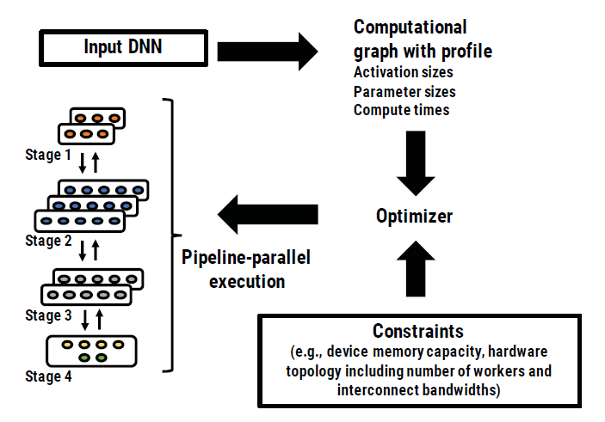
Improvement 1:model Partitioning
Motivation: Gpipe’ imbalanced model partition
PipeDream first profiles the input DNN, to get estimates for each layer’s computing time and output size. Using these estimates, PipeDream’s optimizer partitions layers across available machines
Deepak Narayanan, Aaron Harlap, Amar Phanishayee
PipeDream’s optimizer outputs a balanced pipeline.
Its algorithm partitions DNN layers into stages such that each stage computes at roughly the same rate, while trying to minimize communication across workers in a topology-aware way.
To further improve load balancing, PipeDream allows a stage to be replicated (i.e., data parallelism is used on the stage). This partitioning problem is to minimize the time taken by the slowest stage of the pipeline.
PipeDream’s automated mechanism to partition DNN layers into stages.
Notes:
As I mentioned before, Gpipe may output some imbalanced model in some cases. So PipeDream does this.
1.(for example, large outputs should be sent over higher bandwidth links if possible).

Slide 27
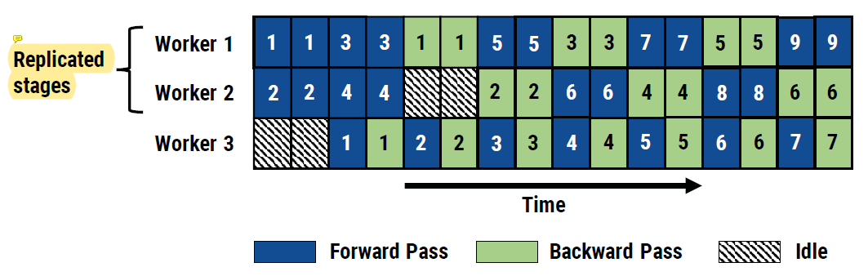
Improvement 1:model Partitioning
we can assume worker1 and worker2 as a whole replicated stages for the purpose that keep pace with worker3.
An example PipeDream pipeline with 3 workers and 2 stages.
In summary, the partitioning algorithm takes the output of the profiling step, and computes:
a partitioning of layers into stages
the replication factor (number of workers) for each stage
optimal number of mini-batches to keep the training pipeline busy.
Notes:
In this graph, we can assume worker1 and worker2 as a whole replicated stages for the purpose that keep pace with worker3. all these operations are not allowed in Gpipe.
For the figure, We assume that forward and backward passes in the first stage take two time units, while forward and backward passes in the second stage take only a single time unit. The first stage in this pipeline is replicated twice so that each stage sustains roughly the same throughput

Slide 28
Improvement 2:Work Scheduling
PipeDream involves a bi-directional pipeline. Each active minibatch in the pipeline may be in a different stage, either in the forward pass or backward pass. As a result, each worker in the system needs to determine whether it should
perform its stage’s forward pass for a minibatch, pushing the minibatch to downstream workers
or
perform its stage’s backward pass for a different minibatch, pushing the minibatch to upstream workers.
1F1B：1 forward 1 backward:
1F1B ensures that every GPU is occupied with a minibatch in a balanced pipeline, with each stage producing outputs in aggregate at roughly the same rate. It also ensures backward passes from inputs are applied at regular intervals of time.
Notes:
The author chooses the strategy: 1F1B.

Slide 29
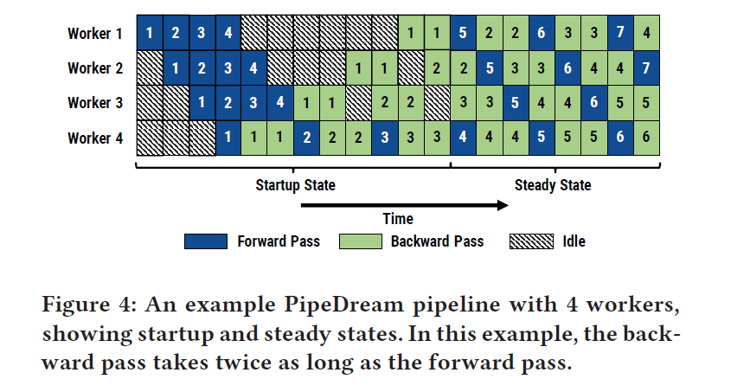
Improvement 2:Work Scheduling
In the startup phase, the input stage admits enough minibatches to keep the pipeline full in steady state.
Once in steady state, each stage alternates between performing its forward pass for a minibatch and its backward pass for an earlier minibatch. We call this the one-forward-one-backward (1F1B) schedule.
Notes:
I’ll give you an example/
So, that’s all of the improvement. And all of my presentation, too. Thank you!

Slide 30
Summary
Traditional way to train giant neural network
Data parallelism
Model parallelism
Gpipe’s pipeline parallelism
Pipeline algorithm
Automatic balancing
Mini-batch and micro batch(chunk)
Benchmark-memory
Benchmark-speed
Performance Overhead Breakdown
Trade-offs between efficiency and capacity
Trade-offs of micro-batches number
PipeDream’s pipeline parallelism
Improvement 1:model Partitioning
Improvement 2:Work Scheduling

Slide 31
notes
1. Slightly imbalanced model partition
2. Low efficiency
With a focus on training a large model like AmoebaNet, GPipe optimizes for memory efficiency; it uses existing techniques such as weight gradient aggregation and trades computation for memory by discarding activation stashes between the forward and the backward pass, instead opting to re-compute them when needed in the backward pass [14]. As a result, it can suffer from reduced hardware efficiency due to re-computation overheads and frequent pipeline flushes if number of micro-batch is large.

