Slide 1
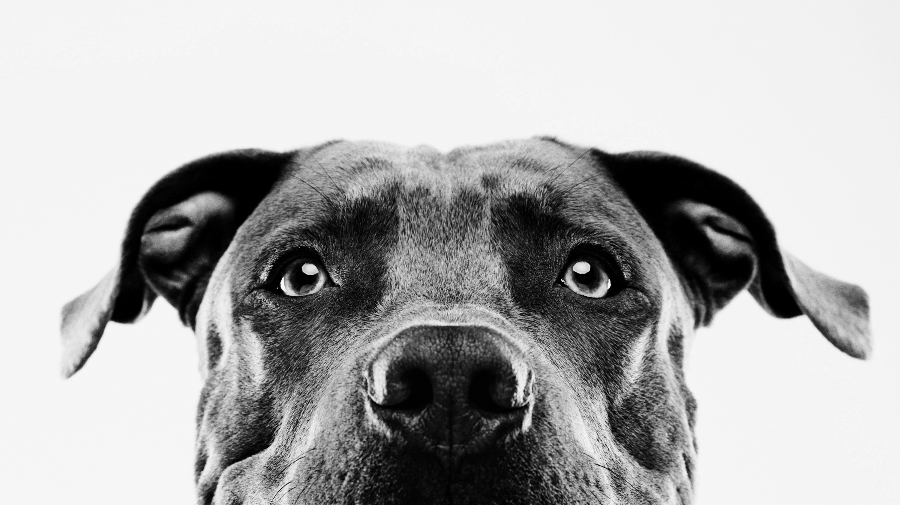
POWDERHOUNDS
Contributors: Anna Sours, Erich Mitchell, TJ Ossola, Spencer Davis, Jason Sheridan, Lisa Caruana, Baylie Taber
Special Thanks: Kevin Lee, Adrienne Tecza and Leah Stucky
An interactive website to help plan your next powder-chasing Colorado vacation utilizing decision tree machine learning and historical weather data.

Slide 2





Project Goal
Create a website that helps users decide where to go in Colorado to find powder throughout the year based on historical snowfall data.
Gather user data on how people are using the website and trip goals.

Slide 3
Decision tree machine learning model
Historical weather data source downloaded from Natural Resources Conservation Services.
A Random Forest Machine Learning model was produced but was too large to be stored on GitHub.
Model and data uploaded to a PostgreSQL database, which also stores user input.

Slide 4

Machine Learning Models
Concatenated data in Jupyter notebook with Pandas.
Ran through multiple Machine Learning models:
Line Regression – 30%
KNN – 69%
Decision Tree – 76%
Neuro network – 82%
Random Forest – 82%

Slide 5
APP.PY

Slide 6
Racing bar chart

Slide 7
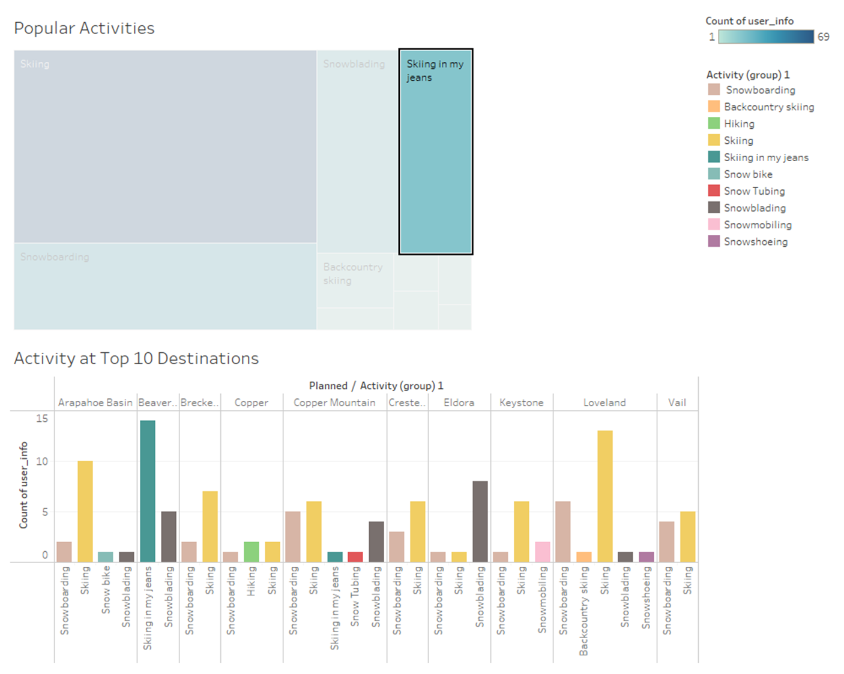
DATA VISUALIZATIONS
One key feature of the website is collecting user data: user location (ZIP code), trip dates, dream Colorado trip, planned Colorado trip and planned winter activity.
The PostgreSQL database was connected to Tableau, which was then used to generate a series of dashboards and charts analyzing user input.

Slide 8



snafus
Issues with transforming and shaping Machine Learning model
Size of data – sharing, importing and hosting
Knowledge of the meteorology
Publishing on Tableau Public required extracting the data – Tableau visualizations do not update with new user input.

Slide 9

Where to from here
Ideally this website should scrape for the most recent snowfall data to add to the database and incorporate analysis based in meteorology.
Include a Daily Top Ten snowfall locations bar chart
Include markers for closest ski resorts
Use dropdowns for the user input section to retain data integrity (standardized spellings, capitalizations and limit locations/activities)

