Slide 1


Summer internship - I
Name :- Kush Shah
ID :- 20DCE114
Company :-Keryar IT Solutions

Slide 2
OUTLINES
REFRENCES
TOOLS AND TECHNOLOGY
MY ROLE
PROJECTS WORKED ON
SCREENSHORTS
TAKEAWAYS

Slide 3
Projects Worked on:
Live Projects Static websites:
The Kruncheez Cafe
R2R(Event Management Company)
Dynamic websites: (Angular)
Angrez: The Salon
BAPS

Slide 4
MY Role as an intern:
For Static Websites: (Café & R2R)
In both the static sites, we worked on designing UI/UX and learned the necessary skills for team work required to complete a live project.
For Angular Project: (Angrez & BAPS)
As before this, we have worked on static sites to gain some experience as web developer, further in dynamic websites we worked on frontend and backend as well.
And in both the websites, we worked on frontend and backend for the modules like customer-registration, forgot password, otp-box.

Slide 5






TOOLS AND TECHNOLOGY USED
Frontend Tools:
HTML
CSS
JavaScript
Backend Tools:
Express.js
Node.js
Frameworks:
Bootstrap
Angular

Slide 6
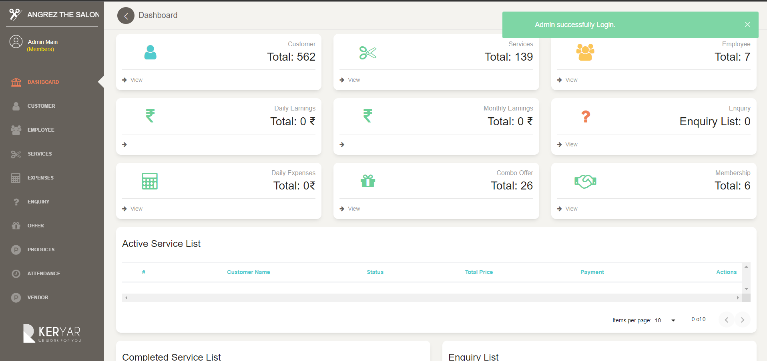
ScreenShots:

Slide 7
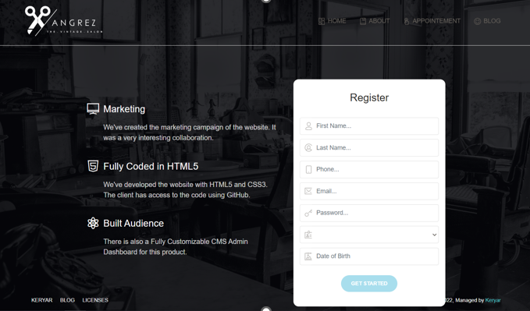
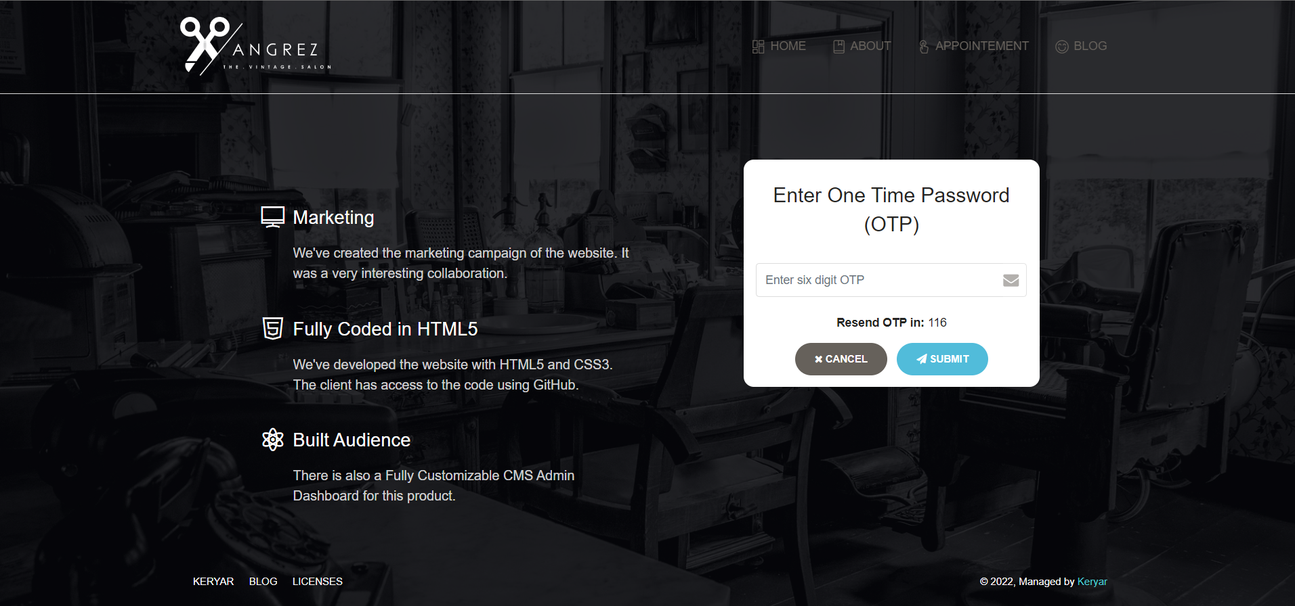

Slide 8
References:
https://stackoverflow.com/questions/50455347/how-to-do-a-timer-in-angular-5
https://www.geeksforgeeks.org/how-to-detect-click-event-outside-angular-component/
https://www.w3schools.com/
https://www.udemy.com/
https://angular.io/
https://nicepage.com/
https://dribbble.com/

Slide 9
Takeaways from Internship
Technical Skills:
More experience and understanding of HTML, CSS & Javascript
Necessary skills to enhance the user’s experience
Explored new technology and exposure to live projects
Soft Skills:
Critical Thinking
Problem Solving
Teamwork
Patience
Work ethics

Slide 10

THANK YOU

