Slide 1

A
Case Study Presentation
of
AWS Certification Portal
Prepared by
Mitesh Mayavanshi

Slide 2
Introduction
AWS(Amazon Web Services) Certification Portal is an all-in-one online platform that provides various services.
It allows users to register for an exam , view registered exam details ,access and manage their certification activities, exam progress, apply voucher, make a payment and other benefits all in one place

Slide 3
Why AWS Certification Portal needed?
Before AWS portal there was no convenient way for user to manage all their AWS exam related activities.
The old platform was used only to register for the exam. Certification were emailed to the user after completing the exam.
The exam details were also mailed over to the user for the reference.
If user somehow lost the certificate, then he/she has to request for the new one and so on.

Slide 4
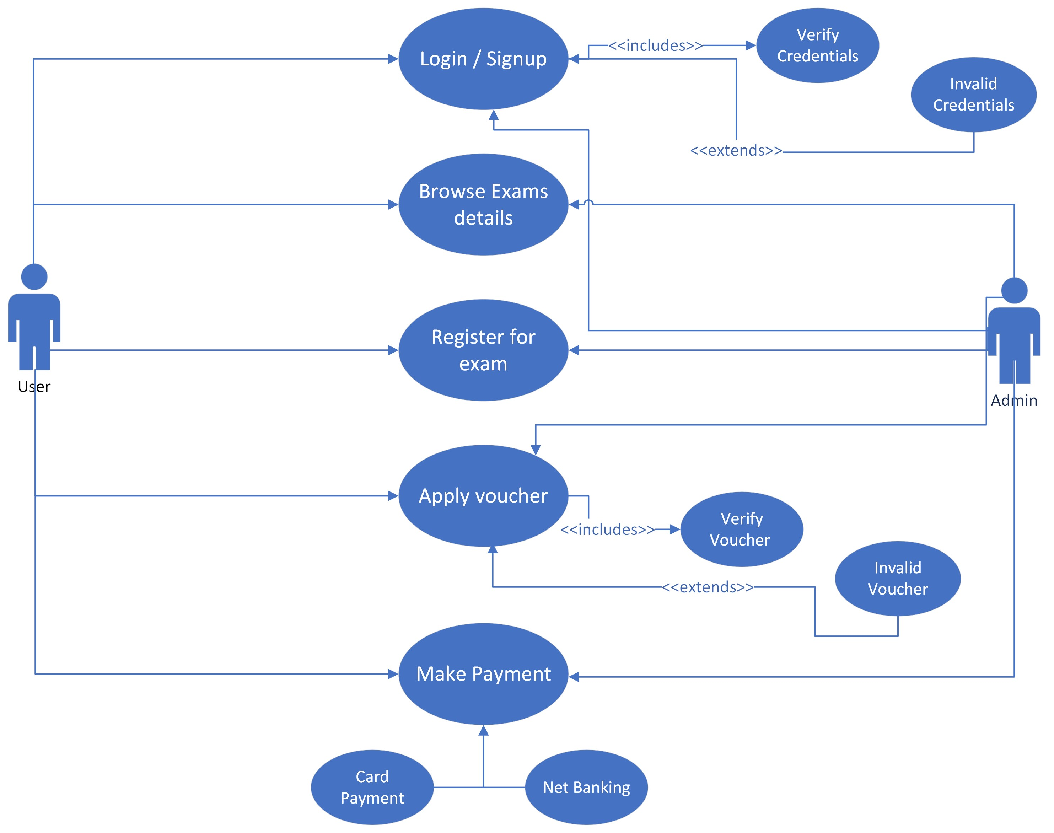
AWS Certification Portal Use case

Slide 5
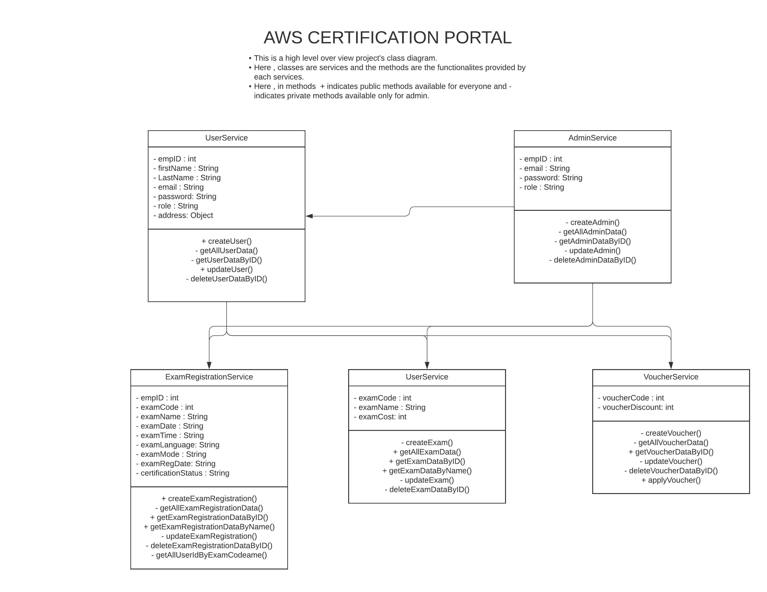
AWS Certification Portal Class Diagram

Slide 6
Thank You

