Slide 1


Slide 2
Trainer Guidelines for Conducting Class
Solve questions live by creating new blank files (Excel, Python, Jupyter notebook, Dashboard) during the session, rather than sharing completed solutions.
Review teaching materials and solutions beforehand, and prepare additional examples to reinforce learning.
Ensure online students can hear you and see the screen clearly at all times.
Test your computer and necessary software before class begins.
Check with online students every 15-20 minutes to see if they understand the material and have any questions.

Slide 3

Agenda: Tableau
Introduction to Tableau Prep
Data Connections, Cleaning, and Transformation
Tableau Desktop: Data Source Connection and Navigation
Basic Visual Analytics: Sorting and Filtering Data
Interactivity in Tableau
Calculated Fields, Aggregations, and Level of Detail (LOD) Expressions
Creating Charts and Dashboards in Tableau
Datasets for Hands-On Exercises

Slide 4
Introduction to Tableau Prep
Definition and Purpose
  Tableau Prep: A data preparation tool for cleaning and shaping data.
  Purpose: Streamlines and automates data cleaning for Tableau analysis.
Key Features
Data Connection Wizards
Data Cleaning Steps
Data Profiling
Join and Union Operations

Slide 5
Introduction to Tableau Prep
Use Cases in Data Science
  Creating a clean dataset for analysis
  Handling complex data structures
  Integrating multiple data sources efficiently

Slide 6
Data Connections
Connecting to Various Data Sources
  Tableau supports diverse data sources: databases, spreadsheets, cloud services.
  Seamless integration with popular platforms: Excel, SQL, Google Sheets, etc.
Importing Data into Tableau
  Data Source Connection: Establishing a link to the chosen data source.
  Data Source Page: Previewing and selecting tables or sheets for analysis.
  Data Source Tab: Where you manage and customize your data source.

Slide 7
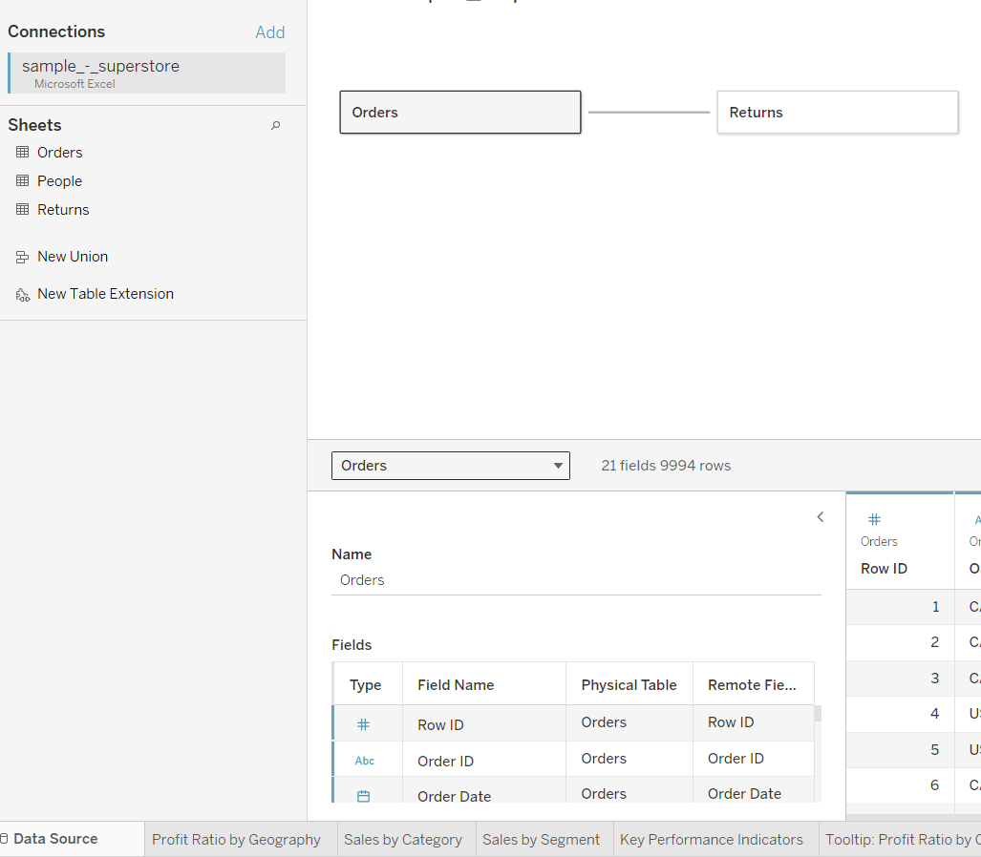
Data Connections
Live vs. Extract Connections
Live Connection: Directly interacts with the data source in real-time.
Extract Connection: Extracts a subset of data into Tableau for faster performance.

Slide 8
Data Cleaning & Transformation
Handling Missing Data
Identifying and understanding missing values in datasets.
Strategies: removal, imputation, or utilizing default values.
Imputing and Transforming Data
Imputing:
    Null Values: Replacing with statistical measures (mean, median, mode).
    Categorical Data: Filling with the mode.
Transforming:
    Changing Data Types: Ensuring compatibility for analysis.
    Scaling and Normalizing: Standardizing numerical values.

Slide 9
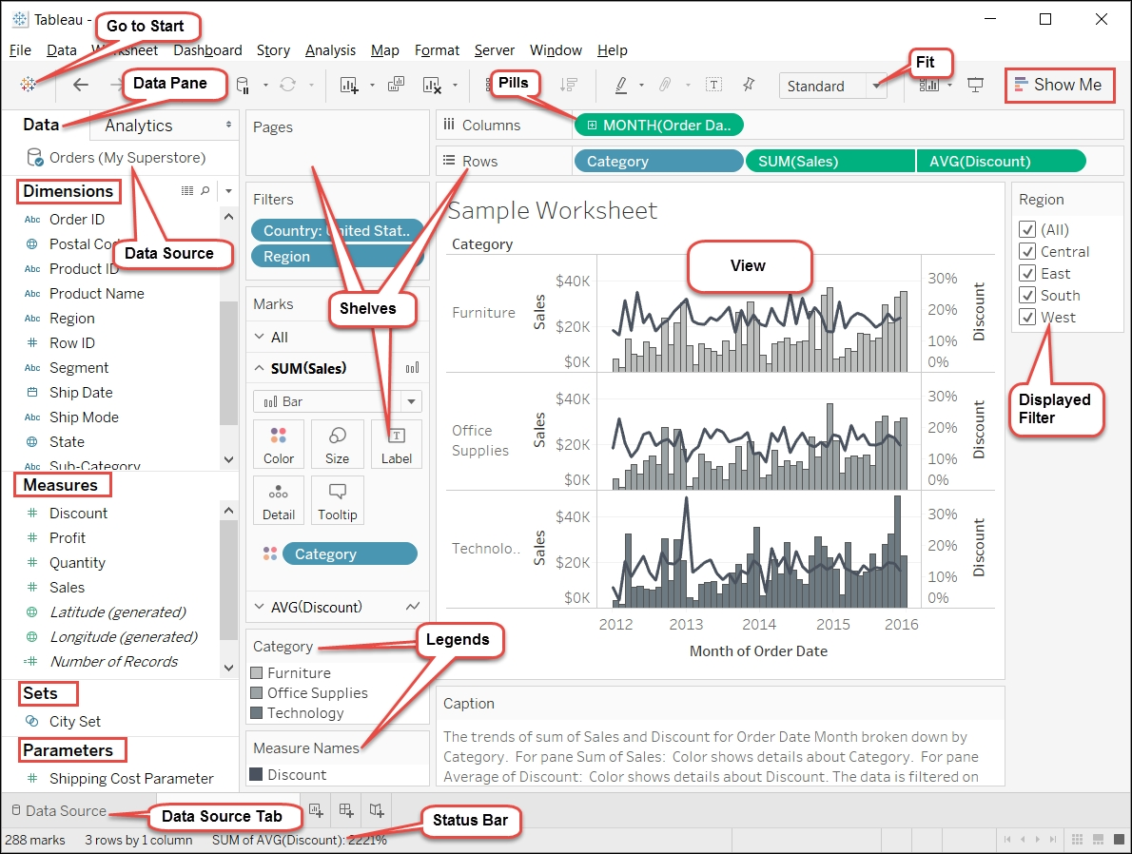
Tableau Desktop Basics

Slide 10
Tableau Desktop Basics
Understanding the Tableau Interface
Workspace Overview:
  Data Pane: Displaying all available fields.
  Shelves: Columns, Rows, Pages, and Marks.
  Cards: Details on data and visual elements.
Navigating Worksheets and Dashboards
Worksheets:
  Building Blocks: Columns, Rows, and Marks cards.
  Show Me Menu: Quickly changing visualization types.
Dashboards:
  Layout and Design: Arranging and formatting elements.
  Interactivity: Filters, parameters, and actions.

Slide 11
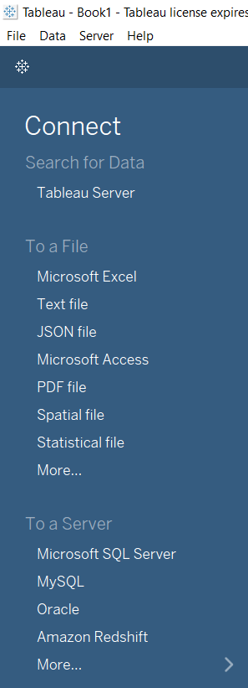
Data Source Connection & Navigation
Connecting to Data in Tableau Desktop
Connecting to Various Sources:
  Excel, CSV, databases, and more.
  Establishing live connections or importing data.
Data Source Filters
Filtering Data at the Source:
  Using SQL queries.
  Limiting data before importing.
Navigating Large Datasets
Efficient Exploration:
  Handling large datasets in Tableau.
  Utilizing data source options for performance.

Slide 12
Basic Visual Analytics
Overview of Visual Analytics
Definition: Visual analytics is the science of analytical reasoning facilitated by interactive visual interfaces.
Purpose: Turning data into insights through visual representation.
Importance in Data Science
Enhanced Understanding: Visuals aid in comprehending complex patterns.
Effective Communication: Communicating findings to non-technical stakeholders.

Slide 13
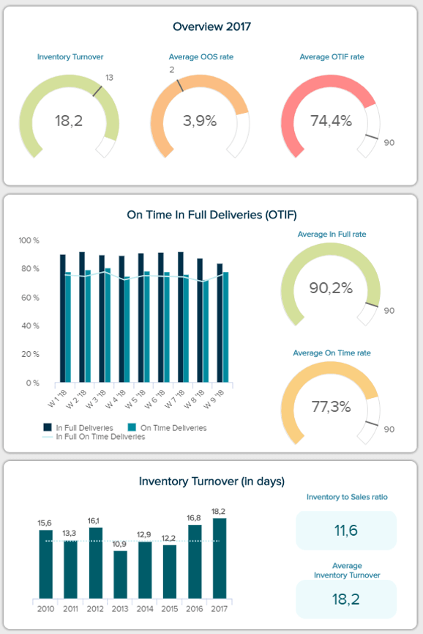
Basic Visual Analytics
Types of Visualizations
Charts:
  Bar charts
  Line charts
  Pie charts
Graphs:
  Scatter plots
  Network graphs
  Geospatial maps
Tables:
  Tabular representation of data
  Useful for detailed examination

Slide 14
Sorting and Filtering Data
Sorting Options in Tableau
Ascending and Descending: Arrange data in ascending or descending order.
Manual Sort: Customize the sort order based on specific requirements.
Quick Sort: Use quick sorting options for efficiency.
Filters and Their Applications
Data Source Filters: Filtering data at the source level.
Extract Filters: Applying filters to extracted data.
Context Filters: Using context to filter specific data points.

Slide 15
Interactivity
Enhancing Dashboards with Interactivity
Drill-downs: Provide detailed insights by allowing users to drill into specific data points.
Highlighting: Use highlighting to emphasize selected elements for better comprehension.
URL Actions: Connect Tableau dashboards to external resources for a richer user experience.
Parameters and Actions
Parameters: Empower users to control certain aspects of the visualization.
Dashboard Actions: Create interactive links between sheets and dashboards.

Slide 16
Calculated Fields
Introduction to Calculated Fields
Definition: Calculated fields are user-defined formulas that perform computations on the data.
Purpose: Enable users to create custom metrics and derive insights not present in the original dataset.
Creating Basic Calculations
Arithmetic Operations: Addition, subtraction, multiplication, and division.
Logical Functions: IF statements for conditional calculations.
Date Calculations: Manipulating date fields for analysis.

Slide 17
Calculated Fields
Use Cases in Data Science
Performance Metrics: Calculate conversion rates, growth percentages, etc.
Segmentation: Classify data into segments based on calculated criteria.
Predictive Modeling: Create calculated fields to support predictive analytics.

Slide 18
Aggregations & LOD Expressions
Understanding Aggregations
Definition: Aggregations in Tableau involve performing a mathematical operation on a set of values to return a single aggregated value.
Examples: SUM, AVG, MIN, MAX, COUNT, etc.
Importance: Aggregations are fundamental for summarizing and analyzing data.
Introduction to Level of Detail (LOD) Expressions
Definition: LOD expressions allow you to control the granularity of the aggregation independently of the view in Tableau.
Types: FIXED, INCLUDE, and EXCLUDE.
Flexibility: LOD expressions provide flexibility in defining the scope of analysis.

Slide 19
Aggregations & LOD Expressions
Real-World Examples
Scenario 1: Analyzing regional sales independently of the overall country sales.
Scenario 2: Comparing product performance considering specific customer segments.

Slide 20
Charts and Dashboards Using Tableau
Creating Effective Charts
Principles: Follow best practices for creating clear and impactful charts.
Visualization Types: Explore various chart types, including bar charts, line charts, scatter plots, etc.
Customization: Leverage Tableau's customization options for enhanced visual appeal.
Designing Dashboards
Components: Understand the key components of Tableau dashboards.
Layout: Arrange sheets, images, and text to create an intuitive dashboard layout.
Interactivity: Incorporate interactive elements for a dynamic user experience.

Slide 21
Charts and Dashboards Using Tableau
Tips for Dashboard Layout and Design
Consistency: Maintain a consistent color scheme, font, and layout throughout the dashboard.
White Space: Use white space effectively to reduce clutter and improve readability.
Testing: Test the dashboard with potential users to ensure usability and clarity.

Slide 22
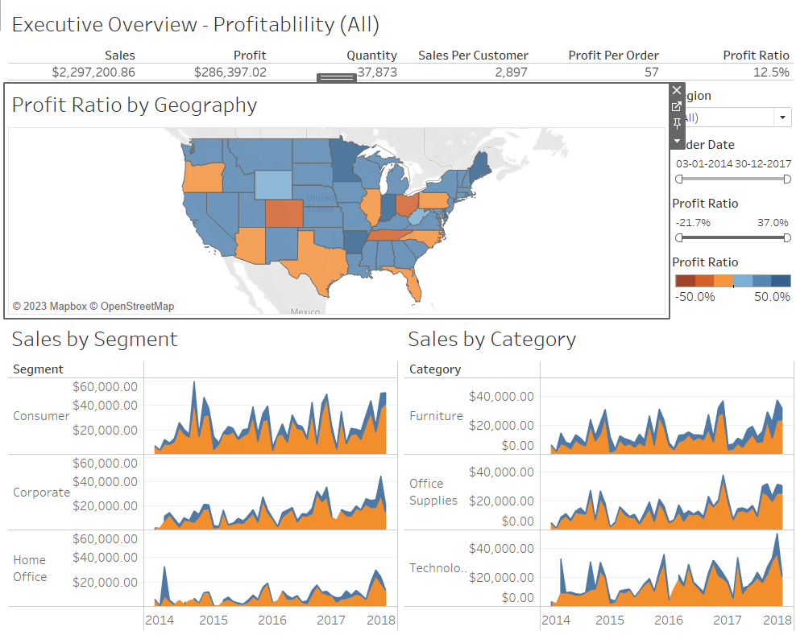
Hands-On : Create a Tableau Dashboard
Dataset : Sample Superstore

Slide 23
Questions ?

Slide 24
Thank You !

