Slide 1
Financial Data Analysis and Business Recommendations

Slide 2
Trainer Guidelines for Conducting Class
Solve questions live by creating new blank files (Excel, Python, Jupyter notebook, Dashboard) during the session, rather than sharing completed solutions.
Review teaching materials and solutions beforehand, and prepare additional examples to reinforce learning.
Ensure online students can hear you and see the screen clearly at all times.
Test your computer and necessary software before class begins.
Check with online students every 15-20 minutes to see if they understand the material and have any questions.

Slide 3
Overview of Data Visualization
Importance of Data Visualization in Financial Analytics
Complex Data Simplification: Financial data is often intricate and multilayered. Visualization simplifies complex datasets, making it easier for analysts and decision-makers to comprehend information quickly.
Visual Pattern Recognition: Visualization tools enable the identification of trends, patterns, and outliers in financial data that may not be apparent in raw numbers. This is essential for making informed strategic decisions.
Visual Decision Support: Visualizations enhances the decision-making process by presenting complex information in an intuitive manner.

Slide 4

Pandas Introduction
Pandas is a Python library designed for data manipulation and analysis.
It offers powerful DataFrame and Series data structures.
Pandas simplifies data tasks, from reading and cleaning data to analysis and visualization.
Throughout this presentation, we'll explore how Pandas revolutionizes data work

Slide 5
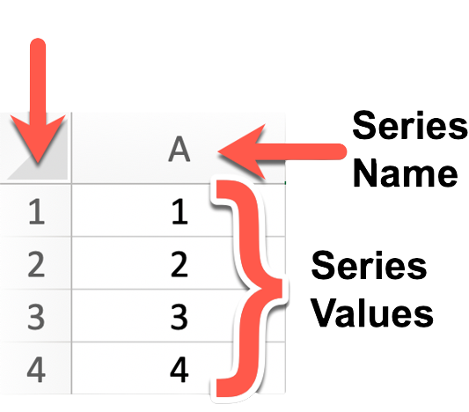
Data Structure in Pandas
Panda Series
A Pandas Series is a one-dimensional array-like data structure that can hold data of various types, including integers, floats, strings, and more.
It's essentially a labeled array where each element has an associated index or label. This label allows for easy data access and manipulation.

Slide 6

Matplotlib Library
  Python Visualization Library: Matplotlib is a Python library.
  Wide Usage: It's used for creating 2D and 3D visualizations.
  Ease of Use: Provides a user-friendly interface.
  Flexibility: Offers extensive customization options.
  Various Plot Types: Supports diverse plot types.
  Integration: Easily integrates with other Python libraries.
  Community: Active user community with extensive resources.
  Publication Quality: Suitable for creating high-quality plots
  To import:
    Import matplotlib.pyplot as plt
Notes:
# Question 1: for loop with strings
input_string = "Python is awesome!"
reversed_string = ""
for char in input_string:
reversed_string = char + reversed_string
print("Reversed string:", reversed_string)
# Question 2: nested for loops - pattern
n = 5
for i in range(1, n + 1):
for j in range(n - i):
print(" ", end="")
for k in range(2 * i - 1):
print("*", end="")
print()
for i in range(n - 1, 0, -1):
for j in range(n - i):
print(" ", end="")
for k in range(2 * i - 1):
print("*", end="")
print()
# Question 3: while loop with file handling
search_word = "Python"
count = 0
with open("sample.txt", "r") as file:
line = file.readline()
while line:
if search_word in line:
count += 1
line = file.readline()
print(f"Number of lines containing '{search_word}': {count}")
# Question 4: nested while loops - matrix
row = 1
while row <= 10:
col = 1
while col <= 10:
product = row * col
print(f"{row} * {col} = {product}\t", end="")
col += 1
print()
row += 1
# Question 5: for loop with dictionary
student_scores = {"Alice": [85, 90, 88], "Bob": [92, 88, 94], "Charlie": [78, 85, 80]}
average_scores = {}
for student, scores in student_scores.items():
average = sum(scores) / len(scores)
average_scores[student] = average
print("Average Scores:")
for student, average in average_scores.items():
print(f"{student}: {average:.2f}")

Slide 7
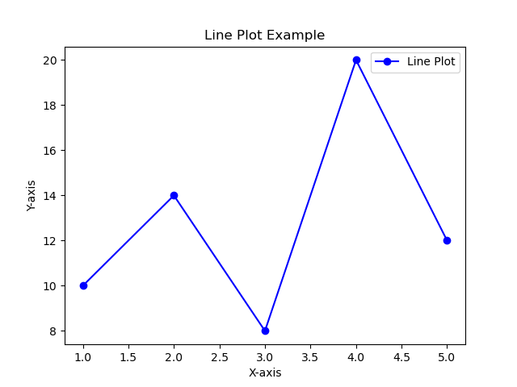
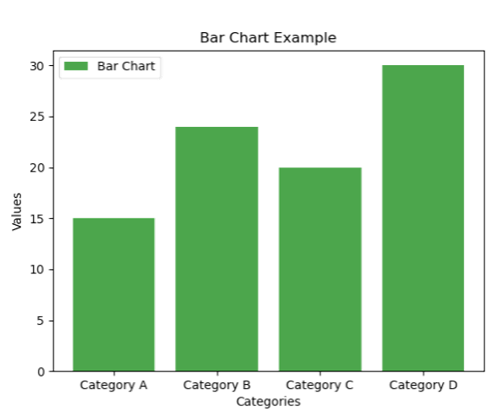
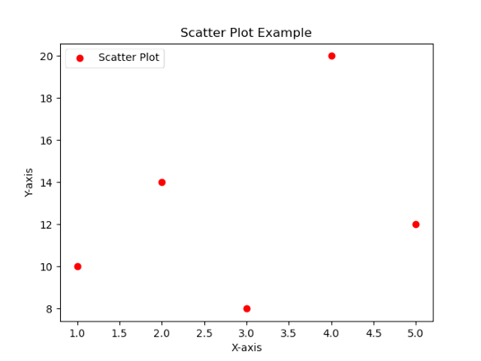
Creating Basic Plot
Line Plot
Scatter Plot
Bar Chart

Slide 8

Introducing Seaborn
  Seaborn is a data visualization library.
  Built on top of Matplotlib.
  Designed for creating beautiful and informative statistical plots.
  import seaborn as sns
  Statistical Plot:
    Histogram
    Box Plot
    Violin Plot
    Pair Plot
    Heatmap

Slide 9
Introduction to Working on Financial Data for Analysis
Analyzing financial data involves a series of steps, from retrieving data to uncovering meaningful insights that can guide strategic choices.
key stages in working with financial data are as
emphasizing data cleaning
Visualization
exploratory data analysis (EDA)
pattern recognition
deriving actionable business recommendations

Slide 10
Business Problem
The bank is facing challenges in retaining customers, leading to increased churn rates.
Understanding the key drivers of churn is crucial for implementing targeted retention strategies. The bank aims to identify patterns and insights in its customer data to proactively address issues contributing to churn.

Slide 11
Objectives:
Identify Churn Drivers: Determine the factors that contribute most to customer churn, such as low credit scores, account balance, or dissatisfaction with services.
Enhance Customer Engagement: Identify patterns in customer behavior and interactions to enhance personalized engagement and communication.
Optimize Products and Services: Analyze the influence of the number of products, credit cards, and active memberships on churn, and optimize offerings accordingly.

Slide 12
Dataset features
CreditScore: Numerical value representing the credit score of the customer.
Geography: Categorical variable indicating the geographical location of the customer (e.g., France, Germany, Spain).
Gender: Categorical variable specifying the gender of the customer (e.g., Male, Female).
Age: Numerical value representing the age of the customer.
Tenure: Numerical value indicating the number of years the customer has been with the bank.
Balance: Numerical value representing the account balance of the customer.
NumOfProducts: Numerical value indicating the number of bank products the customer uses.

Slide 13
Cont...
HasCrCard: Binary variable indicating whether the customer has a credit card (1 for Yes, 0 for No).
IsActiveMember: Binary variable indicating whether the customer is an active member (1 for Yes, 0 for No).
EstimatedSalary: Numerical value representing the estimated salary of the customer.
Exited: Binary variable indicating whether the customer exited (churned) or not (1 for Yes, 0 for No).

Slide 14
Importing data
import pandas as pd
bank_data = pd.read_csv("Bank_customers.csv")
# Display the first few rows of the dataset to check if it loaded successfully
bank_data.head()

Slide 15
Data Cleaning:
# Check for missing values
bank_data.isnull().sum()
# Drop irrelevant columns (RowNumber, CustomerId, Surname)
bank_data = bank_data.drop(['RowNumber', 'CustomerId', 'Surname'], axis=1)

Slide 16
Data Visualization
Pairplot
It provides an overview of the relationships between these features and how they vary for customers who churned and those who did not.
# Pairplot for selected features
sns.pairplot(bank_data[['CreditScore', 'Age', 'Balance', 'NumOfProducts', 'Exited']], hue='Exited', markers=['o', 's'])
plt.suptitle('Pairplot of Selected Features by Churn Status', y=1.02)
plt.show()

Slide 17
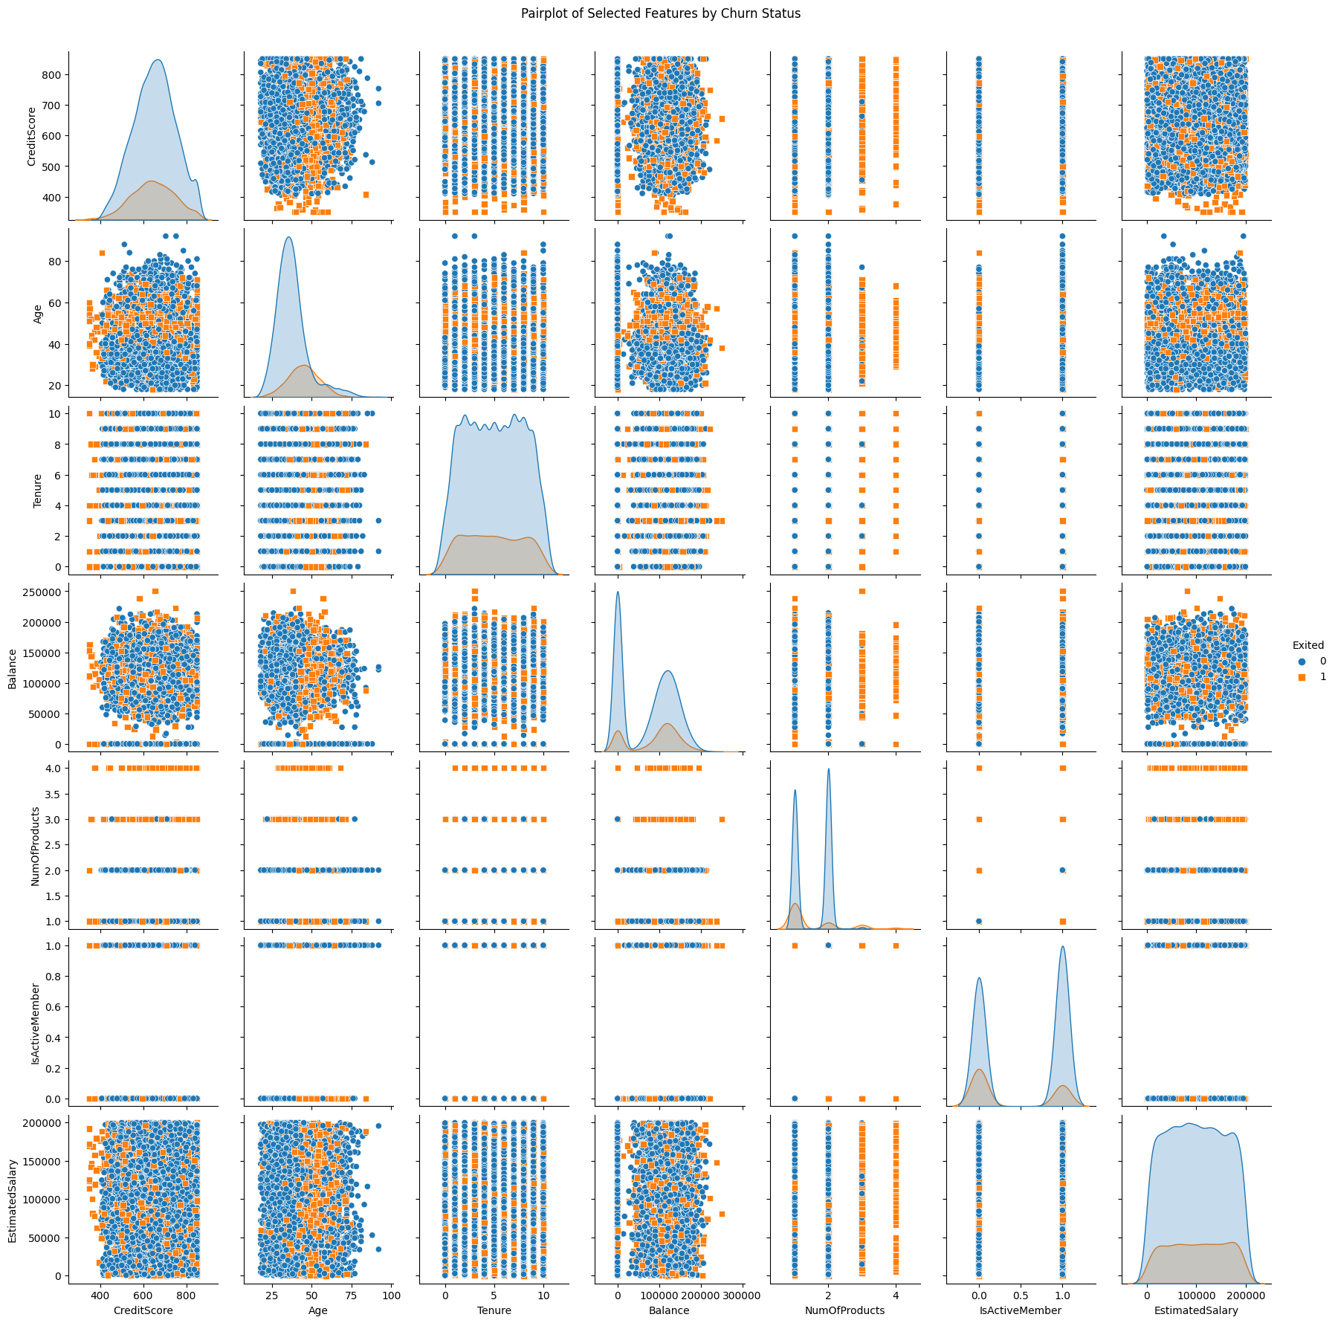

Slide 18
Interpretation of pair plot
Credit score and age do not show a strong linear relationship.
Credit score and account balance seem to have a weak linear correlation.
Credit score doesn't exhibit a strong linear correlation with the number of products.
Age and account balance appear to be weakly correlated.
Age and the number of products show no strong linear correlation.
Account balance and the number of products have a weak or no linear correlation.

Slide 19
Histogram: Age Distribution by Churn Status
The histogram shows the distribution of customer ages, differentiated by churn status.
# Age Distribution by Churn
plt.figure(figsize=(10, 6))
sns.histplot(data=bank_data, x='Age', hue='Exited', multiple='stack', kde=True, palette='viridis')
plt.title('Age Distribution by Churn Status')
plt.xlabel('Age')
plt.ylabel('Count')
plt.show()

Slide 20
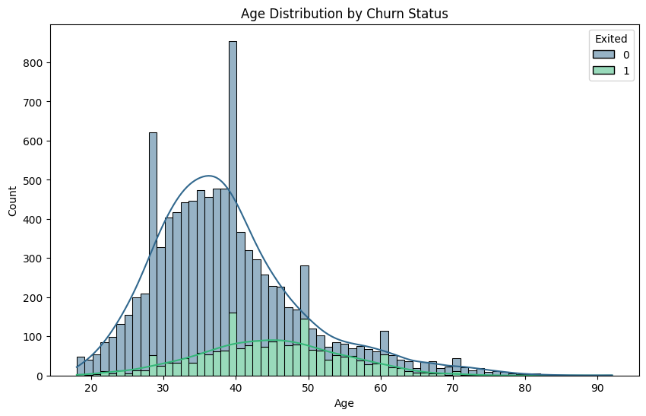
Interpretation of Histogram
The visual comparison of the two histograms suggests that, in general, younger customers are less likely to churn, while there is a slightly higher likelihood of churn among customers in their 40s and 50s.

Slide 22
Correlation Matrix Heatmap
The heatmap visualizes the correlation matrix of all numerical features.
Darker colors indicate stronger correlations.
# Correlation Matrix Heatmap
correlation_matrix = bank_data.corr(numeric_only=True)
plt.figure(figsize=(10, 8))
sns.heatmap(correlation_matrix, annot=True, cmap='coolwarm', fmt=".2f", linewidths=.5)
plt.title('Correlation Matrix - Bank Churn Data')
plt.show()

Slide 23
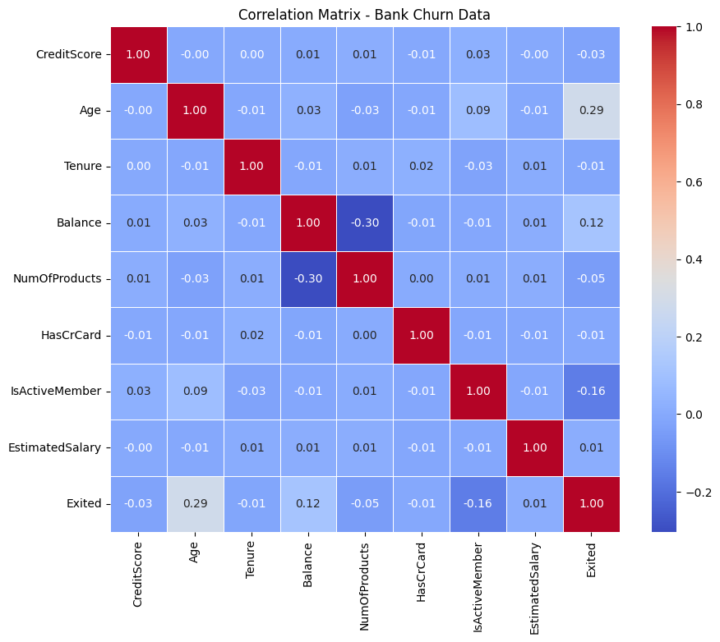

Slide 24
Interpretation of Correlation Heatmap
IsActiveMember and Exited: A negative correlation of approximately -0.16 suggests an inverse relationship.
Age and Exited: A positive correlation of approximately 0.29 indicates a positive relationship.

Slide 25
bar chart :Churn by Gender
The bar chart illustrates the count of churned and non-churned customers by gender.
# Bar Chart: Churn by Gender
plt.figure(figsize=(6, 4))
sns.countplot(x='Gender', hue='Exited', data=bank_data, palette='pastel')
plt.title('Churn by Gender')
plt.xlabel('Gender')
plt.ylabel('Count')
plt.show()

Slide 26
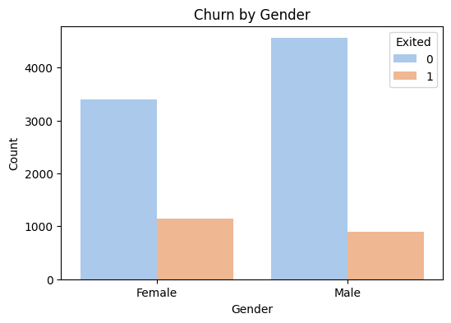
Interpretation of bar chart ​
By comparing the heights of the bars, Female gender has a higher count of customers who have churned.

Slide 27
Boxplot: Balance by Churn Status
The boxplot compares the distribution of account balances for customers who churned and those who did not.
# Boxplot: Balance by Churn Status
plt.figure(figsize=(8, 6))
sns.boxplot(x='Exited', y='Balance', data=bank_data, palette='Set2')
plt.title('Balance Distribution by Churn Status')
plt.xlabel('Churn Status')
plt.ylabel('Balance')
plt.show()

Slide 28
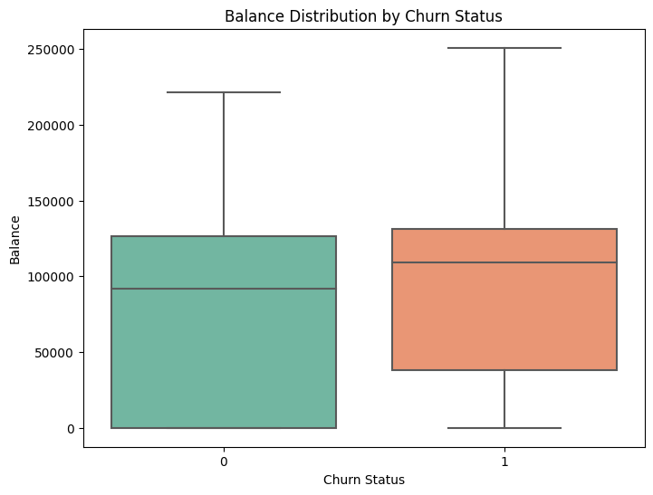
Interpretation of Boxplot
As the boxes for churned and non-churned customers significantly overlap, it indicates a less pronounced difference in the distribution of account balances.

Slide 29
Violin Plot: Age by Churn
The violin plot depicts the distribution of customer ages for churned and non-churned customers.
# Violin Plot: Age by Churn
plt.figure(figsize=(8, 6))
sns.violinplot(x='Exited', y='Age', data=bank_data, palette='Set3')
plt.title('Age Distribution by Churn Status')
plt.xlabel('Churn Status')
plt.ylabel('Age')
plt.show()

Slide 30
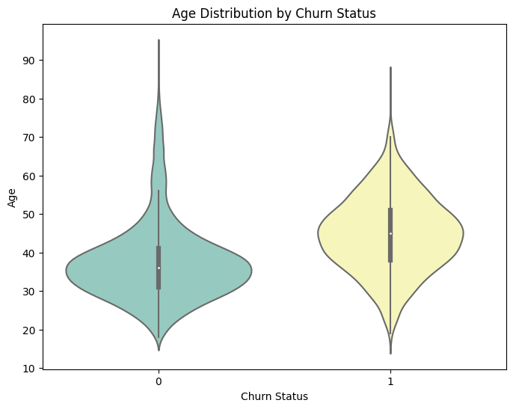
Interpretation of Violin plot
one of the violins is wider at a particular age range, it suggests a higher concentration of customers in that age group.

Slide 31
Business recommendations
Targeted Customer Engagement:
Identify and target specific age groups, such as customers in their 40s and 50s, who have shown a higher propensity to churn.
Design targeted marketing campaigns, loyalty programs, or personalized communication strategies to engage and retain customers in these age brackets.
Enhance Active Memberships:
Recognize the weak negative correlation between being an active member and churn. Encourage customers to actively participate in the bank's services and programs.
Offer incentives, rewards, or exclusive benefits to active members to boost their engagement and decrease the likelihood of churn.

Slide 32
Balance Monitoring and Support:
Acknowledge the slight positive correlation between higher account balances and churn. Provide additional support or exclusive services to customers with substantial account balances to enhance their satisfaction and loyalty.
Implement financial advisory services to assist high-balance customers in optimizing their financial portfolios.

Slide 33
Thank You

