Slide 1

Shri Maneklal M. Patel Institute of Sciences and Research,
B.Sc.CS, Gandhinagar.
LIBRARY MANAGEMENT SYSTEM

Slide 2
Internal Project Guide
Baljeetkaur Dave
Asst. Professor
Department of B.Sc. CS
Prof. (Dr) B. R. Pandya
Head of Department: M.Sc. IT & B.Sc.CS
Group Name
Mitesh Rathod

Slide 3
Objective
Library Management is a project which aims in developing a computerized system to maintain all the daily work of library.
It has a facility of admin login through which the admin Can Monior the whole system.

Slide 4
Admin module are add new book, view books , issue book and update book.
Overall this project of ours is being developed to help the library administration, maintain the library in the best way possible and also reduce the human efforts.

Slide 5
LIBRARY MANAGEMENT
Admin
Record library activities
Registration
Manage books
Add book
Delete book
Categories

Slide 6
Manage student
Update
Add
Delete
View issued
Defaulter list
Issue book

Slide 7
Admin:-
Record library activities:-
This feature allows librarians to enter various records into the system
Manage books:-
This feature allow librarian to keep track of the library’s books by adding new books or removing them.

Slide 8
Add book:-
To add book the admin has to enter details about the book through the form given and add ISBN number and update books and remove also.
Delete book:-
Only admin can delete the books.
Category:-
To Locate books easily by categories or Genre

Slide 9
Manage student:-
This feature allow librarian to keep track of number of students and their details.
Update student :-
To update student details the admin insert the student id and update the details needed.

Slide 10
Delete student :-
To delete user the admin delete it.
Issue Book
These features allow users in borrowing books from the library by recording the transaction and updating the availability status.

Slide 11
View issued books:-
This feature allows librarians to view all issued books with their status.
Defaulter list:-
This feature allows librarians to show the details of the student who did not return
the books before the deadline.
This feature enables librarians to view a list of students who have failed to return their books within the 15-day deadline, displaying detailed information for each defaulter.

Slide 12
User:-
New user’s registration:-
This feature allows new users (user, teachers, etc.) to sign up for the system by providing the necessary details.
user login:-
This feature provides authenticated access for registered users to use the system with the help of email.

Slide 13
Search book:-
This feature allows users to search for book name, or author name, category enhancing the case of locating desired materials.
Issue book:-
This feature allows users in borrowing books from the library by recording the transaction and updating the availability status.
Future work:-
Email verification
Online payment

Slide 14
Data Dictionary
Admin table:
Sr.no | Column name | Data type | constraints | description
1. | Admin_id | Int(10) | Primary key | Id of admin
2. | Email | Varchar(20) | Not null | Email id of admin
3. | Password | Varchar(15) | Not null | Password of admin

Slide 15
Example:
ID | Email | Password
1 | John.doe123@gmail.com | hashed_123
2 | Alice.smith456@gamil.com | hashed_456
3 | Bob.johnson789@gmail.com | Johnson_980
4 | Michael.lee432@gamil.com | Michael_900
5 | Sophia.brown788@gmail.com | Brown_990

Slide 16
User :-
Sr.no | Column_name | Data type | constraints | description
1. | User_id | Int(11) | Primary key | Id of user
2. | Name | Varchar(100) | Not null | Name of user
3. | Email | Varchar(100) | Foreign key | Email of user
4. | Password | Varchar(100) | Not null | password
5. | Mobile | Int(12) | Not null | Mo. no user

Slide 17
Example:-
User_id | Name | Email | password | role | User_id
1 | Carol Jones | Carol.jones345@gamil.com | jones_190 | Student | 1
2 | David White | David.white123@gmail.com | white_899 | Admin | 2

Slide 18
Authors table:
Sr.no | Column name | Data type | constraints | description
1. | Author_id | Int(11) | Primary key | Id of author
2. | Author_name | Varchar(20) | Not null | Name of author
Example:
Author_id | Author_name
1 | J.K. Rowling
2 | Jane Austen
3 | Mark Twain
4 | J.R.R. Tolkien
5 | Agatha Christie

Slide 19
Category table:
Sr.no | Column name | Data type | constraints | description
1. | Cat_id | Int(11) | Primary key | Id of catagory
2. | Cat_name | Varchar(100) | foreign key | Name of catagory
Example:
Cat_id | Cat_name
1 | Dystopian
2 | Fantasy
3 | Math’s
Cat_id | Cat_name
1 | Dystopian

Slide 20
Book details:
Sr.no | Column name | Data type | constraints | description
1. | Book_id | Int(5) | Primary key | Id of admin
2. | Title | Varchar(25) | Not null | Book of title
3. | Author_Id | Varchar(13) | Foreign key | Book of author details
4. | Category_id | Varchar(15) | Foreign key | Category of book
5. | isbn | int | Unique, not null | International standard book
6. | Available_copies | Int(11) | null | No. of available copies
7. | Total_copies | Int(500) | null | Total no. of copies

Slide 21
Example:
Book_id | title | Isbn | Author_id | Available_ copies | Cat_id
1 | 1984 | 9780451524935 | Secker & Warburg | 20 | 1
2 | Harry potter & the philosopher’s stone | 978074532743 | bloomsbury | 26 | 1
3 | Brave New world | 9780060850524 | Harper &brothers | 1 | 2
4 | The Hobbit | 9780547928227 | Houghton Mifflin Harcourt | 21 | 3

Slide 22
Book author:
Sr.no | Column name | Data type | constraints | description
1. | author_id | int(5) | Primary key | Book of author details
2. | Name | varchar(20) | Not null | Name of book author

Slide 23
Example:
Book author_id | Name
1 | Krish
2 | mitesh
3 | sujal
4 | het
Book author_id | Name

Slide 24
Issue book:-
Sr.no | Column name | Data type | constraints | description
1. | Issue_id | Int(11) | Primary key | Issue detail
2. | user_id | Int(11) | Foreign key | Id of user
3. | Book_id | Int(11) | Foreign key | Id of book
4. | Issue_date | date | Null | Date of issue
5. | Return date | Date | null | Date of return
6. | fine | Int(6) | null | Fine of book
7. | Return status | Enum(‘issued’,’returned’) | Not null | Id of date
8. | Due date | date | Not null | Due date

Slide 25
Example:
Issue_header | user_id | Book_id | Issue_date | Return_date | status
1 | 1 | 1 | 2024-09-01 | 2024-09-16 | returned
2 | 2 | 2 | 2024-09-05 | 2024-09-20 | returned
3 | 3 | 3 | 2024-08-17 | 2024-08-29 | returned
4 | 4 | 4 | 2024-09-20 | 2024-09-27 | returned
5 | 5 | 5 | 2024-10-10 | 2024-10-20 | returned

Slide 26
Fine:-
Sr.No | Column_name | Data_type | Constraint | Description
1 | Fine_id | Int(11) | Primary key | Id of fine
2 | User_id | Int(11) | Foreign key | Id of user
3 | Issue_id | Int(11) | Foreign key | Id of issued book
4 | Amount | Int(11) | Null | Amount of fine
5 | status | Enum(‘unpaid’,’paid’) | Null | Fine was paid or unpaid
6. | Payment_date | Timestamp | Null | Date of payment

Slide 27
Example:-
Fine_id | user_id | issue_id | amount | status | Payment_date
1 | 1 | 1 | 60 | Paid | 20/2/2025
2 | 2 | 2 | 20 | Unpaid | 10/3/2025
3 | 3 | 3 | 50 | Paid | 15/3/2025
4 | 4 | 4 | 10 | Unpaid | 17/3/2025

Slide 28
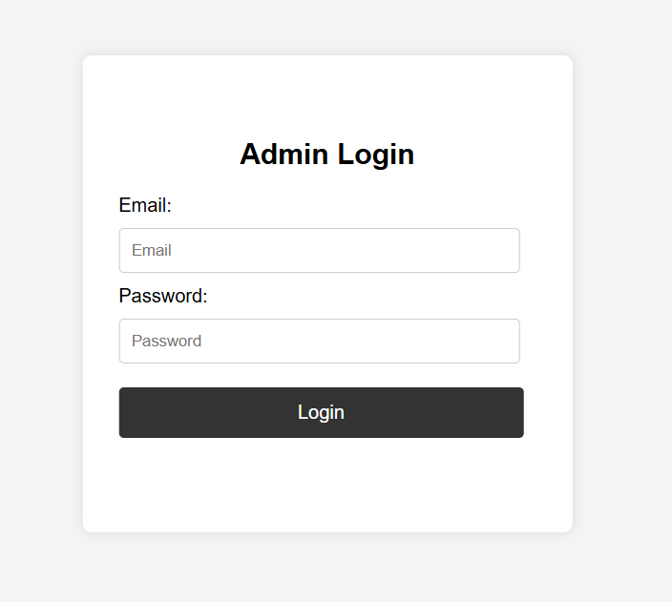
Screenshots :-
ADMIN PAGE :-

Slide 29
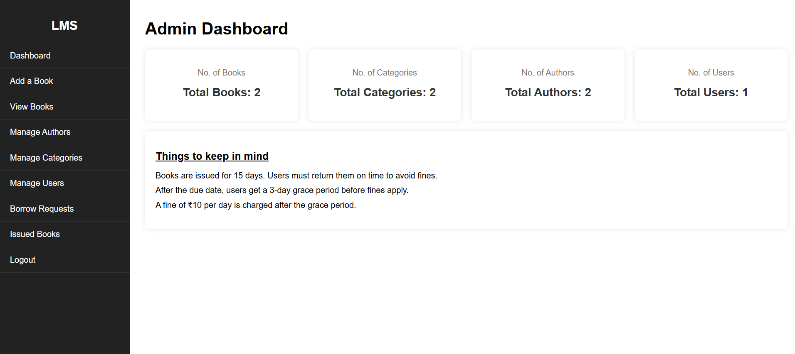
Description: This feature allows librarians to enter various records into the system, such as,
returns, and non-availability of books.

Slide 30
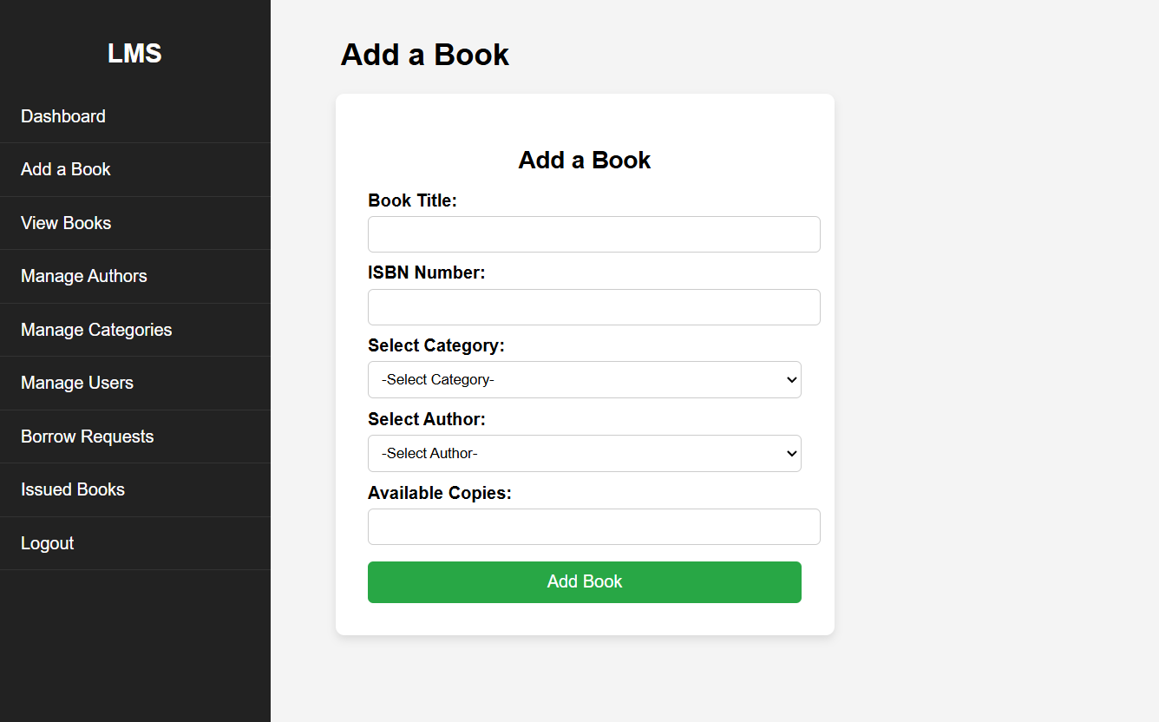

Slide 31
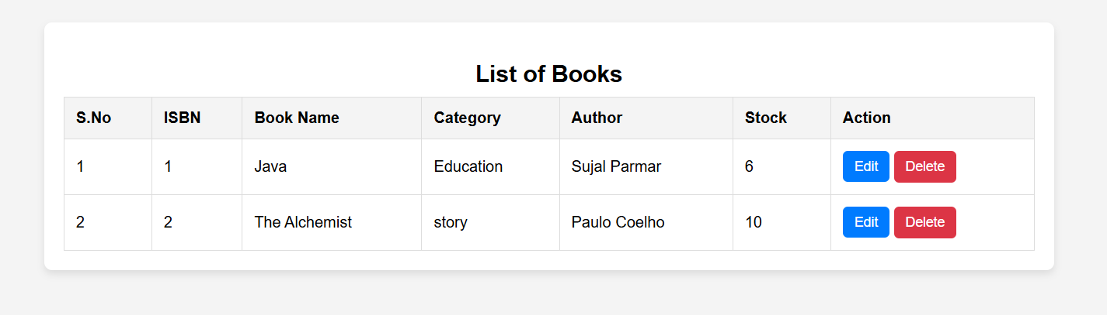

Slide 32
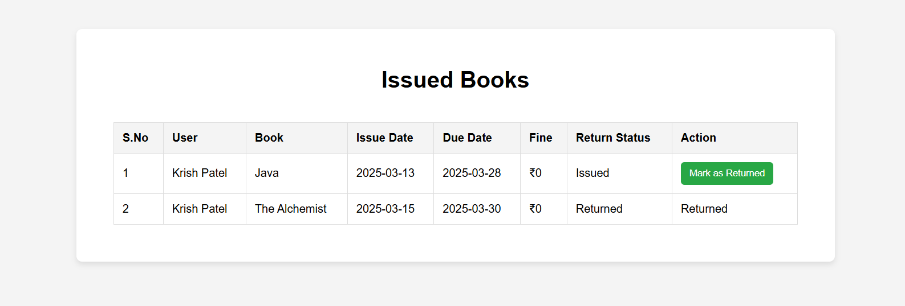

Slide 33
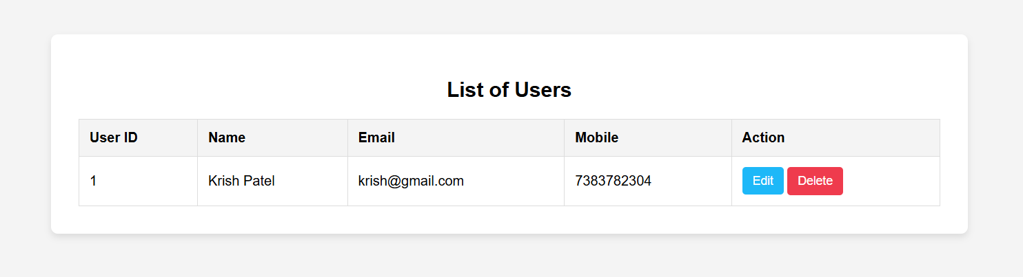

Slide 34
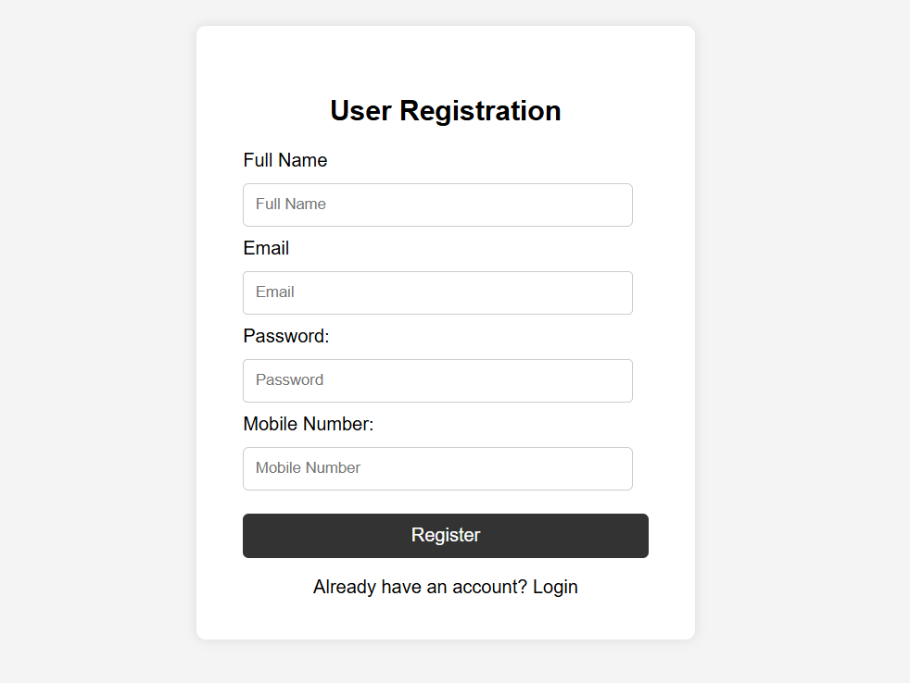

Slide 35
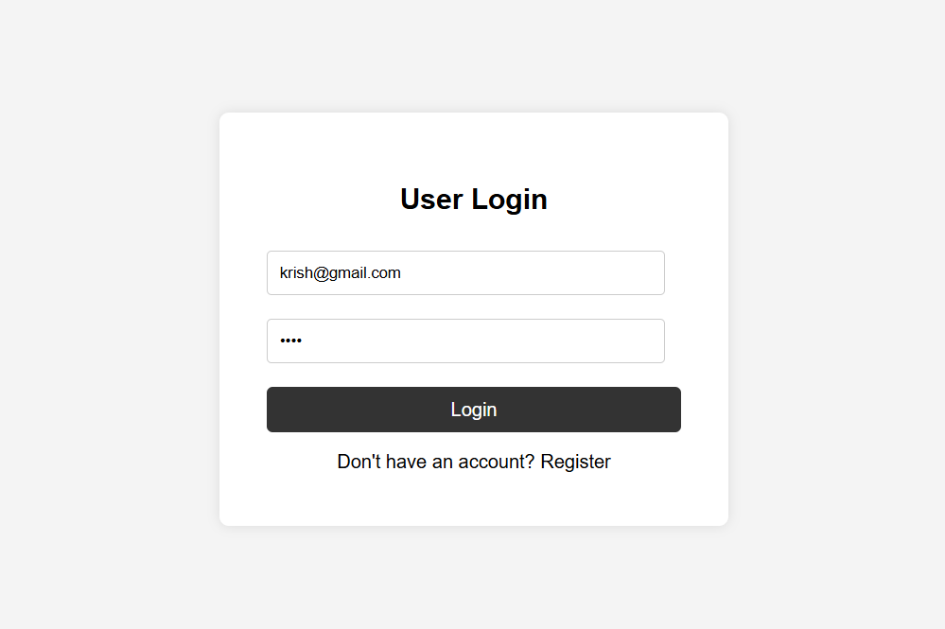

Slide 36
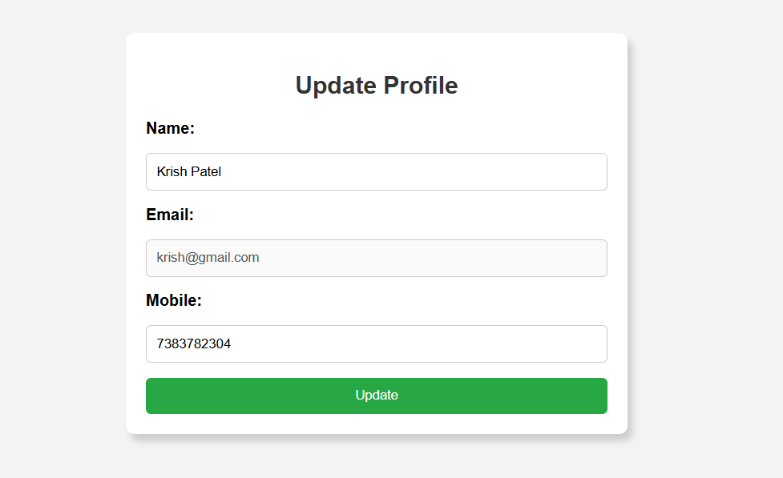

Slide 37
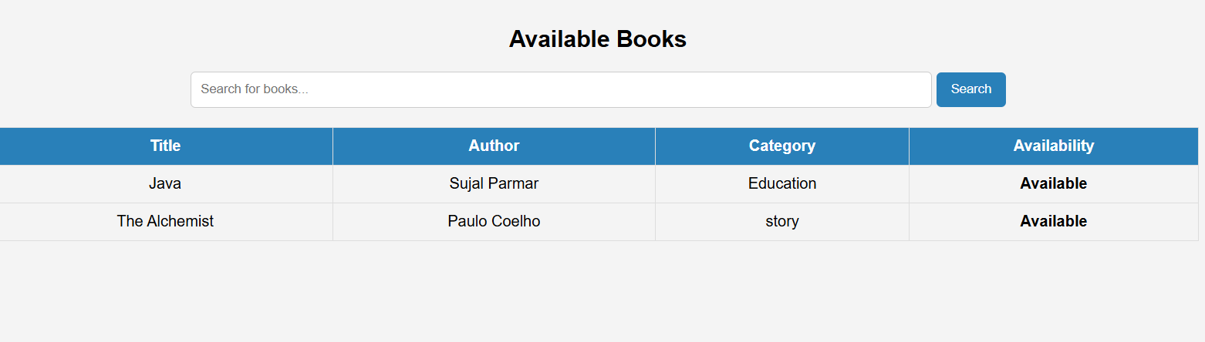

Slide 38
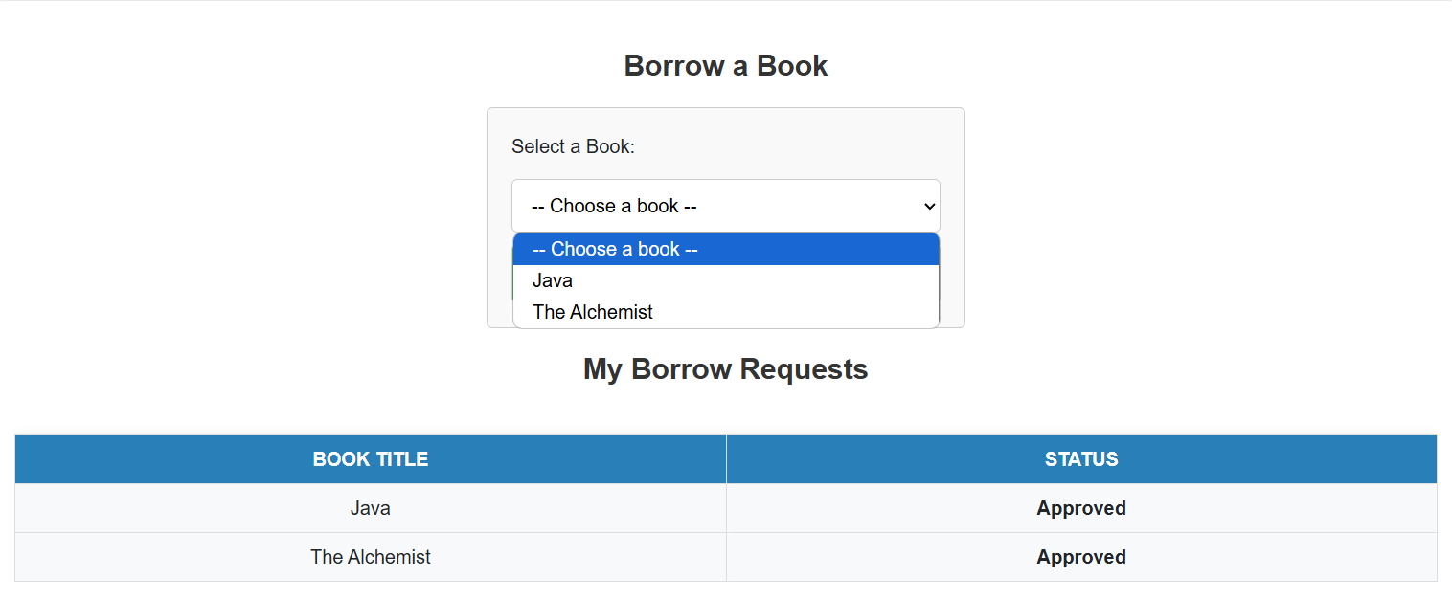

Slide 39
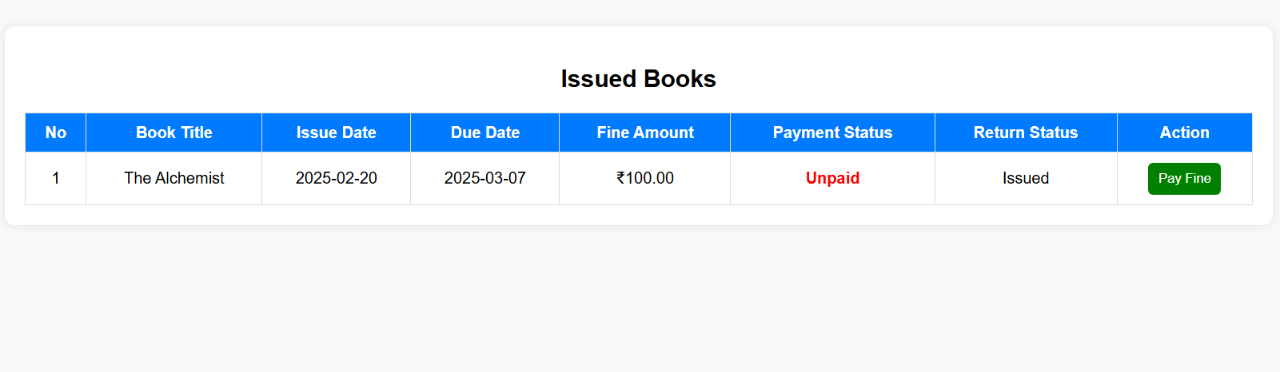

Slide 40
THANK YOU

