Slide 1
Online Notes Sharing Site
Guided By: Prof.Prajkta Shirke Presented By: Mr.Kishor Chavan

Slide 2
Introduction
In this project “ Online Notes Sharing ” student and faculty can upload/download all subject notes.
Through the notes sharing process, user can upload, download and also view the study notes uploaded by others.
User can also edit the notes uploaded by him.
In this project two major Modules that have been are administrator module and user module

Slide 3
Admin Module
Manage(views/Delete) User.
Manage(views/Delete) Notes.
Accept or Reject Notes.
Manage contact(Queries).
Change Password.
User Module:
Upload Notes.
Search Notes via stream, title and subject.
Download Notes.
Delete and update our Notes.
Change Password.

Slide 4
Software And Hardware Requirement
Software Requirement
Hardware Requirement
Technology: Python Django
IDE: Pycharm.
Client Side Technology: HTML, CSS, Java script, Bootstrap
Server Side Technology: Python
Database Server: SQLite
Processor: Pentium-III or (Higher).
Ram:64M or Higher
Hard Disk:80 GB or Higher.
Operating System : Microsoft Windows

Slide 5
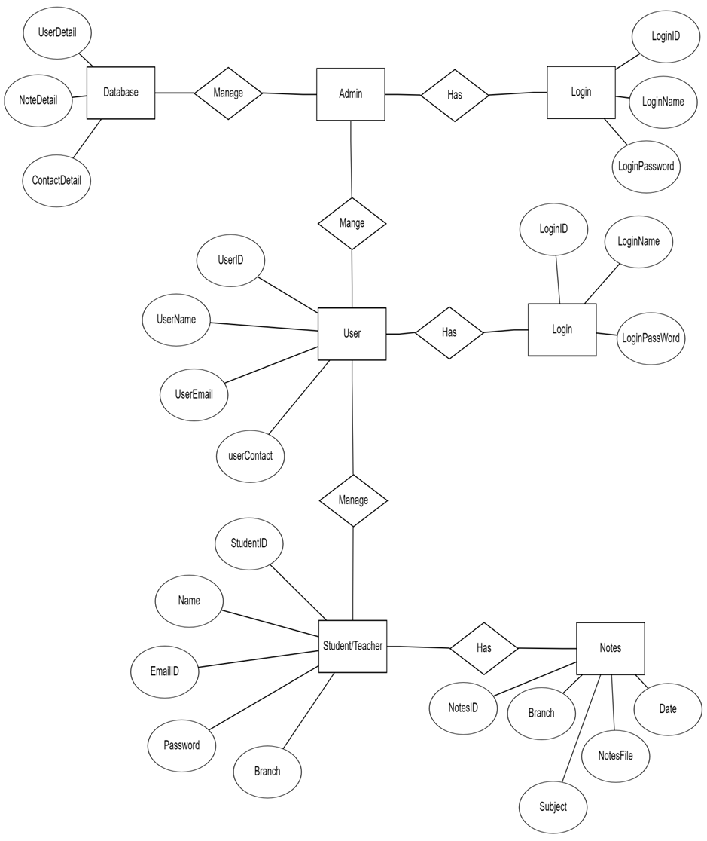
ER Diagram

Slide 6
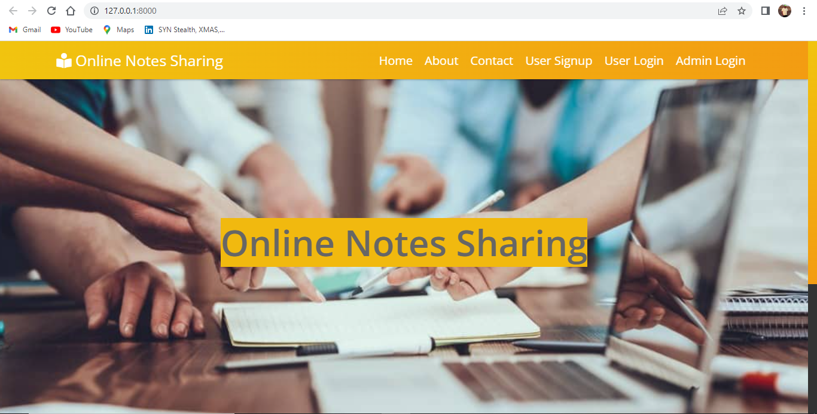
Home Page

Slide 7
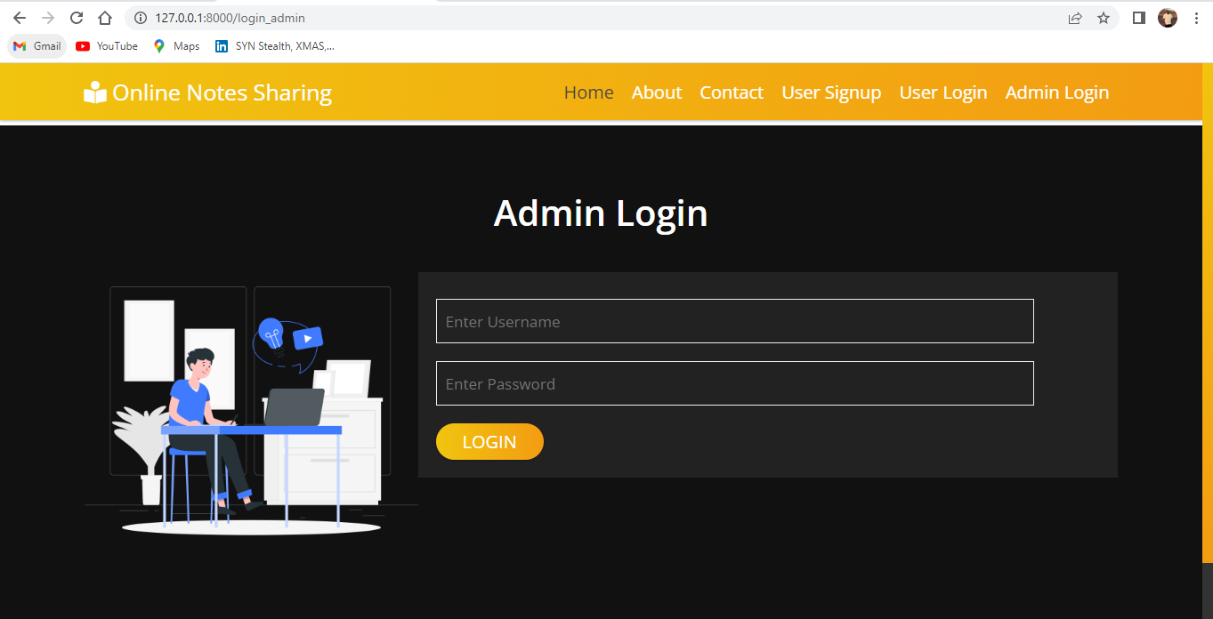
Login Page

Slide 8
Advantages And Limitation
Advantages: Online notes sharing site provides various features, which is complement the information system and increases the productivity of the system.
Intelligent User Form Design.
Data access and Manipulation through same form.
Access to most required information
Data Security.
Restrict data access, as per login assigned only.
No decay of old Records.

Slide 9
Limitation: Beside the above achievements and the successful completion of the project, we still feel the project has some limitation.
It is not large scale system.
Only limited information provided by this system.
Since it is online project, customer need internet connection.
People who are not familiar with computer can’t use this software

Slide 10
Future Scope And Conclusion
Future Scope: This application involves almost all the features of the online file sharing. The future implementation will be online help for the user and chatting with website administrator.
Conclusion: This project has several advantages. Managing the levels of the project is pretty easy and so it storing the notes. It is easy to maintain up to date information and is cheaper to maintain. Also, manual tracking is not required

Slide 11
Thank You.........!

