Slide 1

InMovies – An investment on entertainment by Kotak App
By – Mitesh Gohil
7-9 min read

Slide 2
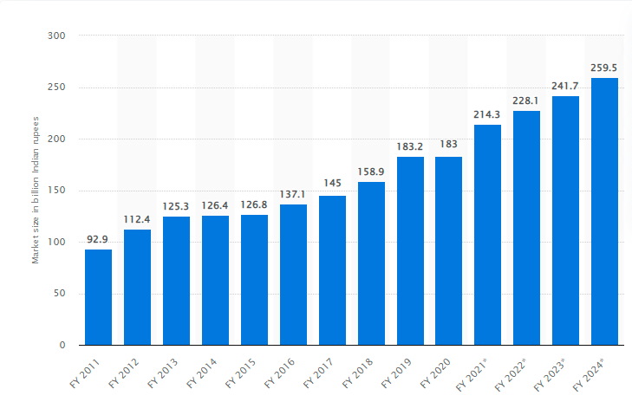
Problem Statement
To add a feature within Kotak Mobile banking app which allows Kotak customers to invest in movies, web series, and TV shows of the Indian region.
Agenda
Business case and Strategy document:
Understand feature viability
Expected Impact on customers and business
Strategic value for bank
KPI of the project
Go to market strategies.
Risk
Compliance
Competition
Functional Requirement document:
Concept
Overall list of features
Sub features
Wireframe samples
Source: www.statista.com , last updated: 19th March 2021
The market size of India's total film industry was around 183 billion Indian rupees in financial year 2020, same as from the previous year. This is projected to go up to around 260 billion rupees by financial year 2024 and 300 billion by 2026.

Slide 3
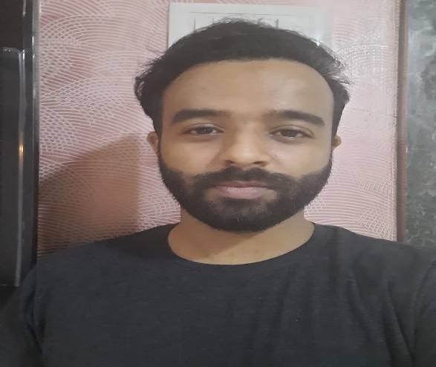

User Persona
Frustation: Mitesh Gohil is an ardent fan and follower of some of the best production houses, directors, scriptwriters, and actors.
Mitesh always wanted to invest a small ticket share into films produced by a team of these people or their role in the individual film.
Understanding movies or web-series business is not difficult for a lot of consumers, but being a small ticket investor in the movie to be released is difficult for them
Need:Having a platform which makes it easy for non-professional retail investor to invest for their choice of movie project by providing them with the kind of details necessary to analyze expected outcome of movie performance overall. Keeping in mind to just provide a gist of story and not the complete detail.
Name: Mitesh Gohil
Product Manager
Age: 27, Mumbai
Frustation: Mr. S S Rajamauli is a famous director, scriptwriter who is known to give one of the highest grossing movies in an era of Indian Cinema.
S S Rajamauli once said that, I believe in creating high stature movies which not only involves amazing stories but comes with component of world class visual effects, studios and much more. Depending on institutional investor for same can be a gruesome task.
Need: Facilitating investment through crowdfunding by providing platform to new directors, scriptwriters and overall team for implementing their project or showing a prototype.
Investing in large scale production house will give easy access to big production house for money and with intermediary company handling these investment can simplify management of investment and returns
Name: S S Rajamouli
Movie Director
Age: 48, Telangana

Slide 4
Feature Viability
Feature Objective: Facilitating the investment process for a retail investor or even a newbie non-professional investor who can invest in upcoming movies, web series, or TV shows projects in which the investor has faith depending on its experience as a viewer/consumer of that brand of cinema. This in turn leads to a major share of crowdfunding for direct producers involved in the project or PE(Private equity) investment company who can manage crowdfunding for the producers. The user can even buy/sell their existing share before the release of movies/series.
What is our market?
Ans: a)80% of people who watch entertainment in any form(movies, series, TV shows) and through any medium(TV, OTT, Youtube).
b) Teenage crowd who are more into movies and can invest in movies compared to less understanding in shares, bonds etc.
INMovie as a feature will have enough opportunity to get new customers on Kotak app due to an opportunity to Invest in 3 billion
Dollar worth industry, where the concept of crowdfunding or ticket size investment have been very less.
Problem we solve?
Ans: We are not solving any specific problem but are coming up with new mode of investment which can help people earn good returns in short span of time(with-in a year or two when movie releases).
Existing hurdle to the feature/business?
Ans: A company name “OneDoor” in Santa Barbara has raised approx 2 million dollar amount for implementing crowdfunding in Hollywood movies. By far, Indian startups are not working on same because of its low reach to HNI and producers along with no customer base. This gives Kotak a good opportunity due to its high customer base and high value in market name.

Slide 5
Strategic value to Bank
Feature Importance for Users: The user will get new set of options like movies, web-series, TV-shows and all possible data related to it for investing apart from existing way of investment. Entertainment industry has grown multi-folds in recent years with better scripts, visual effects, real-life stories, highly qualified and visionary directors along with some of the best talent across India which includes regional cinema’s as well. OTT platforms have increased and so does the consumer in the same.
Ex: Paid subscriber of an OTT platform called SonyLiv jumped by 700% when it released a series called “The Harshad Mehta”.
Guessing an approximate value of 200 crore plus which the series would have been profited.
Feature Importance for Kotak Banking App: Kotak mobile banking app already have a 1 crore plus app using customer which can become a ready made investor for new movie, series or TV shows project.
App Growth projections post releasing this feature:
a) We can predict increase in customers from the age group of 18-25 years who might not have bank account at all or can have account in some other bank.
b) Customer retention and repetition on using app will increase for checking new movie project listed and its associated opportunities.
c) Simplifying investment for both the parties(investors & producers) will help bank to sell other banking services and increase its portfolio by multi-folds.
d) Analyzing customer behavior through this feature will help Kotak team take best decision to sell credit card, loans or BNPL services to the customer.

Slide 6
KPI of the Project(Product and Business)
Business Performance
Product usage KPI’s
Product Quality KPI’s
Market Position
Time to X
Customer counts
Product
Business
Net Promoter score
Support tickets on product & escalation
Product Defect rate
Monthly users

Slide 7
Product KPI’s
Business KPI’s
Product usage KPI’s: The product usage KPI’s will help understand how the product is performing within existing and new investors. The more you track and report in this space, the better informed you will be about where and how to improve the product.
Product Quality KPI’s : To maintain a trade-off between Product quality and Delivery timeliness. It's more likely for an unhappy customer to jump on social media before an organization has a chance to try and fix the problem, so ensuring that quality control is tracked can minimize this.
Time to X: Measuring how long it takes for users to perform a certain action on feature implemented can help understand how they interact with that process. slower 'time to x' will indicate friction and usually increase support requirements.
Support ticket on Product & escalation: Will help in understanding blocker bugs on user behaviour.
Product defect rate: Number of users divided by frequency of bugs
Business Performance : To check rise in customers post feature on prod along with other metrics like customer engagement, retention, customer lifetime value, customer visiting frequency, customer ratings, investment patterns and profit rise due to addition of Inmovies.
Market Position: To check increase in market share of Kotak banking app with ratio in customer increase after release of Inmovies. Also check ratio of customer signing-in due to Inmovies compared to other services to know the market position of Inmovies as a feature.
Customer counts: This metric can be used to measure the addition of new customer due to Inmovies feature. Plus behaviour of existing user on the added feature. Customer time spent on feature and customer buying other service when visiting the Inmovies feature will also be considered.
Net Promoter score: The NPS helps in understanding customer ratings and comments from them for the new and related feature.
Monthly users: Tracking monthly users growth and behavior to check scaling and addition of new features if the volume grows.

Slide 8
Go to market strategy
Market research
Beta Launch
Soft launch with existing users
On-board big budget Production house
On-board small budget films
Same concept business
Their Business model
Acceptance and revenue
Launch with dummy features
Within Beta testing customers
With existing kotak app customers
After Beta suggestions/changes
With good track record of profit
With big brand actors
Small budget film.
Medium or new actors
Launch the product in Market
Improve the product
Analyze overall Customer Behaviour
Publish feature through various notifications
For non Kotak’s banking app users
Using customer ratings and feedback from the existing Soft launch use
Age range, visit-to-signup ratio, signup-to-invest ratio, investment behavior(big budget/Small budget), min/max ticket size investment trend, overall feature rating, comments(suggestions & problem faced)
Send notification to existing user using app notification
SMS, Tele-calling

Slide 9
Product(p) & Business(b) Risk
Low
Medium
High
Low Feature Adoption rate (p) | Poor response from existing Kotak’s customer (b) | Technical glitch on prod real time (p) | Payment glitch while investing (p) | Third party vendor issue (p) | Poor implementation strategy (b)
Low customer retention (b) | Unsatisfied movie production company (b) | Tedious process of buying and selling (p) | Difficult to understand UI/UX design (p) | Poor projected load of customer rise (b) | Poor customer ratings and reasons (p)
Customer retention rate till movie releases (b) | Delayed delivery of expected feature (p) | Faulty business decision after customer behavior analysis (b) | Poor Budget and resource allocation (b) | Bad strategy of scaling the feature (b) | Critical impacts on existing feature due to launch (p)

Slide 10
Compliance – Legal Framework
As buying shares under movie production project does not have a legal framework at place. It will need more acceptance from people of both parties(Production house and Investee) to get a legal framework developed by concerned bodies.
For now, buying a share in movies can come under equity crowdfunding which is illegal in India but can be done in a different way.
The Companies Act, 2013
SECURITIES CONTRACTS (REGULATION) ACT, 1956
Compliance Act for Investment in projects
Securities Exchange Board of India Act 1992
Depositories Act, 1996.
A registered Indian firm who has authority from all compliance firm to invest in different businesses/Projects. These are HNI or investment company who can crowdfund and manage from small ticket investors and invest a huge sum on their behalf. These investment company can manage overall portfolio of small ticket investee with Kotak InMovies app feature.
Small ticket investee via Kotak App
SEBI registered investment firms
Movie Production house
Movie release
Total amount collection
Returns post Tax deduction updated via App in real time

Slide 11

Competitor Analysis
Opening the Door to More Equitable Film Funding: OneDoor Studios Raises $2 Million in Successful Revenue-Share Crowdfunding Campaign for "Calculated" Film Development Fund; Looks Ahead to $6 Million Reg A Launch Early Next Year
Cinema: Hollywood
Based in: Santa-Barbara, USA
https://www.onedoorstudios.com/
Least ticket size of Investment : $100
Other Small players in the same : Only Hollywood
Junction – closed
Indiegogo – Poor traction
Seed & Spark – 2 million dollar raised for production
Slated – 30000 producers, 15000 writers, 8000 actors, 2000 investors, 1800 distribution agents
The Bottom Line - Closed
Indian market or startups have so far not experimented such concept or have failed at initial stage as researched from web

Slide 12
Functional requirement document
Feature concept:
A feature under Kotak Banking app which will allow user to invest in upcoming movie projects which are under development or story completion phase. The investment can be of minimum ticket size where the investor can gain returns or bear the loss as per movie performances when it releases. Direct investment as Equity crowdfunding is illegal in India so retail/newbie investor can invest in Investment company by signing its terms and condition under Kotak bank app itself, along with other T&C of Kotak bank and proceed with buying a small share of the movie project(Movie project, TV shows, OTT web series)
List of features: (P1 – High priority, P2 – Medium Priority, P3 – Low Priority)
InMovies as a feature on Home page of app(P1)
Big budget, Small Budget, OTT, TV shows
Movies/Projects Production house data(script, actors, directors, expected release, current status etc) and past record display page.
Investment company associated to raise funds portfolio to be displayed.
Option to invest in Investment company associated with the project of the production house
Option to sell existing shares into another projects
Option to buy shares of another project at their present rate( which differs from time to time)
Changes in shares price as to be displayed under their portfolio as per variation in share due to multiple reason
Reasons to be displayed for change(increase/decrease) of share value(ex: delay in release, crash with another movie release and so on)

Slide 13
Detail Features
Wire frame 1
Display InMovies Feature as New tag on the Kotak Bank App screen
Wire frame 2
Display About InMovies and how it is a good investment feature
Display different boxes dividing Big budget, Small budget, OTT platforms, TV shows as different category
Wire frame 3:
Display different production house, freelancers projects, OTT platforms , TV shows along with additional details like their last business records, Owner name etc.
Wire frame 4:
When user clicks on Individual production house or OTT platform or freelance projects then projects under that production is displayed along with details like Movie name, expected release date, actors involved, project status, overall project report as PDF can be downloaded or viewed on screen
User will also be displayed an above and below arrow, size of which will indicate the amount raised and investors trust level . Green indicates good performance expectation, Red indicates poor rating
A customer can even click on arrows to understand other investors comment for their positive or negative response. The user can itself click there and give ratings accordingly.
Wire frame 5:
All details about movie and associated budget, along with investment company which will facilitate equity crowdfunding and manage customer investment portfolio
Provide button to buy, sell existing share, check owns portfolio, perform more(more button) action like news related to that movie, actor etc

Slide 14
Resource used
Harshad mehta 700 subscriber
https://gadgets.ndtv.com/entertainment/news/sony-liv-paid-subscribers-700-percent-growth-june-2020-2021-million-mau-2503077
One door funding
https://www.prnewswire.com/news-releases/opening-the-door-to-more-equitable-film-funding-onedoor-studios-raises-2-million-in-successful-revenue-share-crowdfunding-campaign-for-calculated-film-development-fund-looks-ahead-to-6-million-reg-a-launch-early-next-year-301445245.html
For Go-to-market strategy
https://www.revuze.it/blog/new-product-launch/
Equity crowdfunding and its players In US:
https://nofilmschool.com/equity-crowdfunding-finance-your-film

