Slide 1
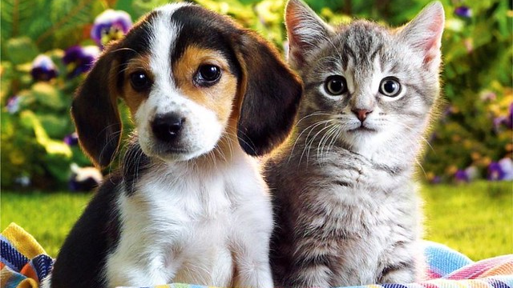
PETME
Every buddy needs a Buddy! –
By TEAM FULLSTACKERS
{Michael, Faithful, Mitesh, Bobby}

Slide 2

ELEVATOR PITCH
No health issues, regular visits to the doctors, pill intake, nor even the common denominator of all - depression! Above all, a world filled with fit adults bringing up strong, responsible, empathetic kids! How is that even possible? - you may ask!
Do not worry, we have got the answer for you here at Pet Me Shelters. All guests who made a stop at our shelter, ended up leading healthy lives afterwards. At Our Shelter, we are dedicated to ensuring you live your best lives. Get Started with a Buddy!

Slide 3

MOTIVATION FOR DEVELOPMENT
Due to the situation in our world today, the high decline in human health, animal cruelty, irresponsible adults, We as a team had the strong need to create pet me shelter.
This shelter will be of huge help to families, it would help in the increase of mentally healthy individuals,
Family bonding, and even create job opportunities in the future.

Slide 4

USER STORY
Given that I'm a guest user, when I open the home page, I would like to choose a pet option, I want to be able to view an image gallery depicting different pets, in order to make the right adoptive choice and view donation opportunities. When I click on the image, it reveals detailed information about the pet and allows me to make purchases.
This application should also help users that are going through depression, loneliness, family's bond, encourage a sense of responsibility in kids and their overall health.
DESCRIPTION
"Everybuddy needs a Buddy" as the saying goes.
Pet Me is an application designed to assist people looking for that special pet. We facilitate pet adoption and ensure everyone makes the right buddy choice.

Slide 5
TECHNOLOGIES AND FRAMEWORKS USED
W3schools.com:
Bootstrap:
MDN web docs Mozilla:
MySQL:
NodeJS, Sequelize, Express, Express-Handlebars
Stripe:
Node mailer:
Multer
Google.com

Slide 6
API REFERENCES
Geocoding
AdoptaPet / Petfinder.com
Stripe
Mailgun
Stripe
Dialogflow

Slide 7
BREAKDOWN OF TASKS AND ROLES
Roles were assigned at the beginning of the project to ensure we worked as efficiently and productive as possible.
Tasks were assigned and picked up by anyone as we worked through the project.
Michael Powell - Backend Developer, Database/ORM SME
Faithful - Frontend Developer, Scrum Master
Robert Phillizaire - Frontend Developer. UI/UX Designer
Mitesh Modi - Backend Developer, Product Owner

Slide 8
CHALLENGES ENCOUNTERED
What happened? It just crashed… git issues, my code just broke, whoa! I can’t find the error, different perspectives on ideas. All these and many more – were the encounters we faced as a Team during this project.
However, it only just made us forge ahead.
SUCCESS
We were able to accumulate so much knowledge during the span of time spent on the project, got quite used to git commands, learnt how to debug much better, and much more…! Also, we were able to bring our vision to life while working as a team.

Slide 9

DEMO

Slide 10

LINKS
Github repository: https://github.com/Miteshmodi003/PetMe
Deployed Application: https://limitless-inlet-32977.herokuapp.com/login

