Slide 1
Analysis of Regression Models for estimating the main bearing loads of wind turbines
Master Thesis
Mithun Nagesh Shet
Aachen, 12.08.2022

Slide 2
Structure
1
1
Motivation
Background
Objective
Methodology
Result Study
Summary and Outlook
2
2
3
3
4
5
4
6
5
6
Analysis of Regression Models for estimating the main bearing loads of wind turbine
Mithun Nagesh Shet

Slide 3
MOTIVATION
Analysis of Regression Models for estimating the main bearing loads of wind turbine
Mithun Nagesh Shet

Slide 4
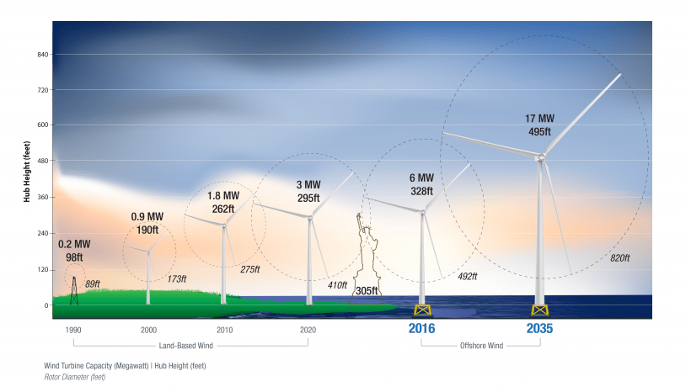
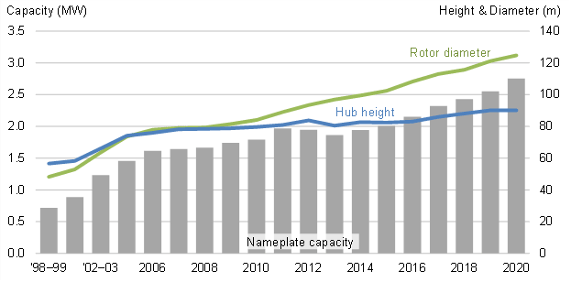
Motivation
Wind is set for largest increase in renewable energy generation growing by 275TW by 2021.
The trend shows that there is substantial increase in diameter of turbine blades and size of hub every decade by an amount of 40 percent every decade.
This increased size has significantly increased the torque and non torque loads.
Source : Office of energy efficiency and renewable energy
Analysis of Regression Models for estimating the main bearing loads of wind turbine
Mithun Nagesh Shet

Slide 5
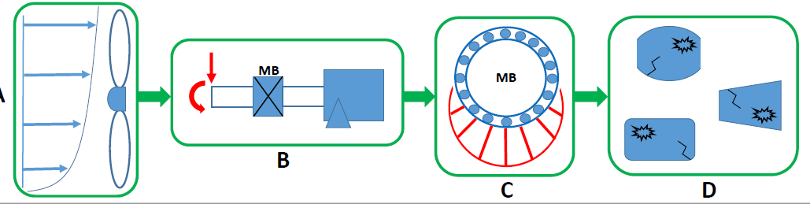


Motivation
High Operation cost and less service life
Under ideal conditions, lifespan of wind tubine is around 20 years.
In actual , the wind turbine lasts for about 6 years.
Reason:
Fatigue mechanism
Wear and tear due to bearing misalignment
Bearing unseating, skewing and sliding due to high axial to radial loads.
Solution:
Load monitoring system to monitor loads and send signals prior to observed failures.
Analysis of Regression Models for estimating the main bearing loads of wind turbine
Mithun Nagesh Shet

Slide 6
BACKGROUND
Analysis of Regression Models for estimating the main bearing loads of wind turbine
Mithun Nagesh Shet

Slide 7
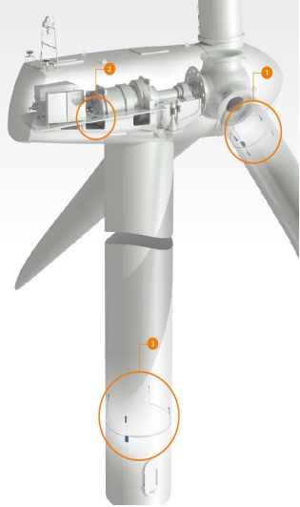
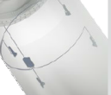
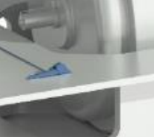
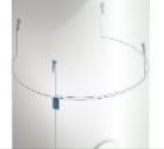
Background
Strain Gauge
Main Bearing loads
Strains
Rotor Blades
Currently strain based load estimation is used.
Measurement based on linear relationship between strains and loads.
Vulnerable to calibration error and signal drift.
Limited lifetime.
A better technology is necessary which is long-lasting and robust.
Machine Frame
Tower and Foundation
Source : Leine Linde Systems
Analysis of Regression Models for estimating the main bearing loads of wind turbine
Mithun Nagesh Shet

Slide 8
OBJECTIVE
Analysis of Regression Models for estimating the main bearing loads of wind turbine
Mithun Nagesh Shet

Slide 9
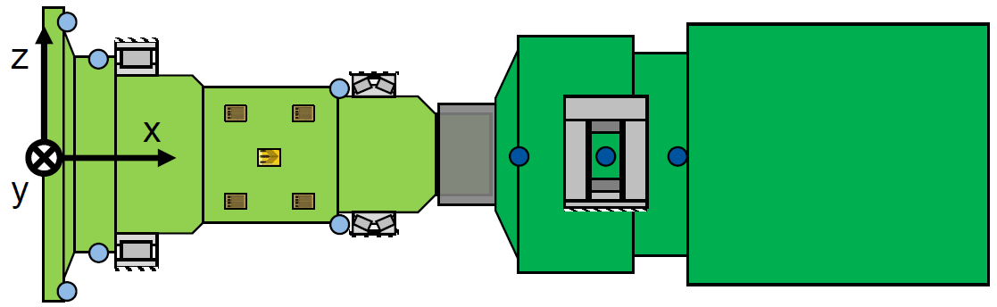


Objective
Model Robustness
ML Model
Displacements
Main Bearing loads
Gain
Error
Offset
Error
Value
Value
0
20%
0
5
Gain Error (%)
Offset Error (%)
Eddy current sensor
Linear variable differential transformer
+1
Ideal characteristic curve
Strain gauge for measuring bending moments
Strain gauge for measuring torque
Replacing the traditional method of using strain gauges by machine learning models.
Training, building and testing the models from displacement signals recorded by Eddy current sensors to predict loads.
Checking robustness of models to errors like Gain error, Offset error and sinewave error.
Amplitude
Error
0
Shaft Rotation (radians)
-1
Analysis of Regression Models for estimating the main bearing loads of wind turbine
Mithun Nagesh Shet

Slide 10
METHODOLOGY
Analysis of Regression Models for estimating the main bearing loads of wind turbine
Mithun Nagesh Shet

Slide 11
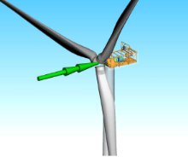

Methodology
True Main Bearing loads
Test Data
Machine Learning Models
Model Evaluation
Test Data
Displacement
Predicted
Loads
Moderate Turbulence data
Displacement
Training Data
Load-time series input
Low and High turbulence data
eMBS model
Test Bench
Analysis of Regression Models for estimating the main bearing loads of wind turbine
Mithun Nagesh Shet

Slide 12
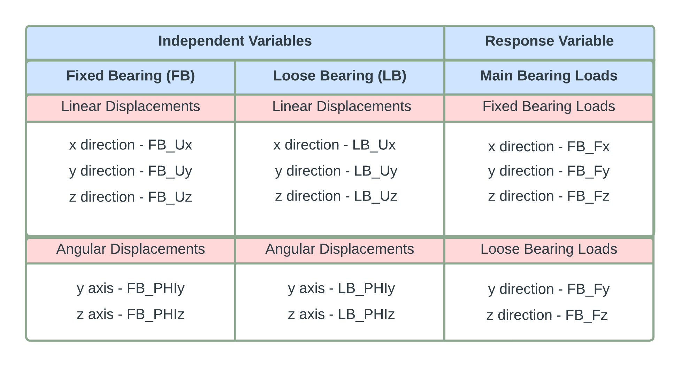
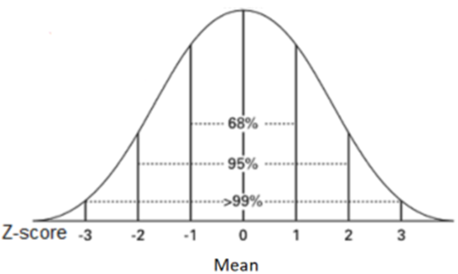
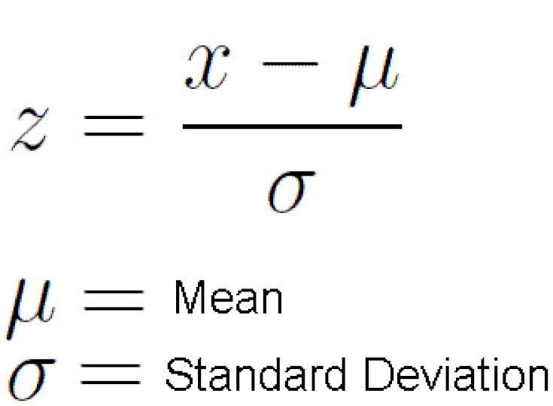
EDA and Feature Engineering
EDA
EDA
Variables study
Outlier Detection
LPR
LPR
LB_Uz
TM
TM
SVR
SVR
FB_Uz
GPR
GPR
Performance of regression models depend on quality of data and outliers can lead to high variance.
The training data was split in 80% for training and 20 % for validation.
The data was normalized using Z-score method.
Normalization
EBT
EBT
ANN
ANN
Analysis of Regression Models for estimating the main bearing loads of wind turbine
Mithun Nagesh Shet

Slide 13
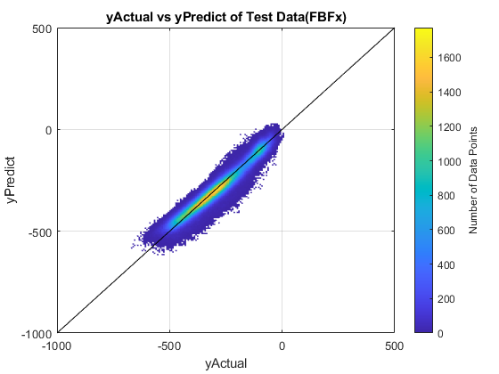
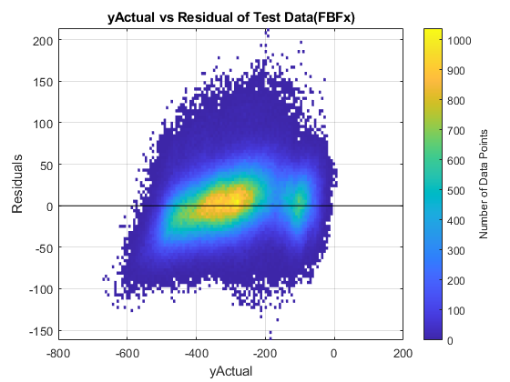
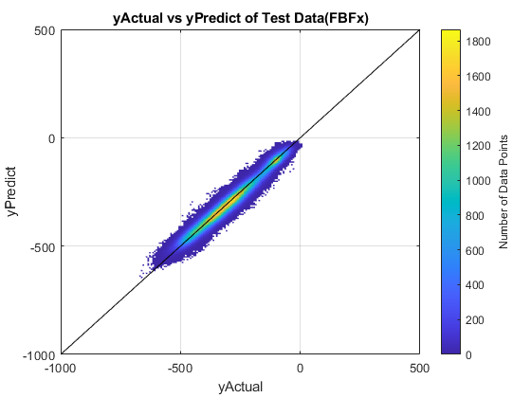
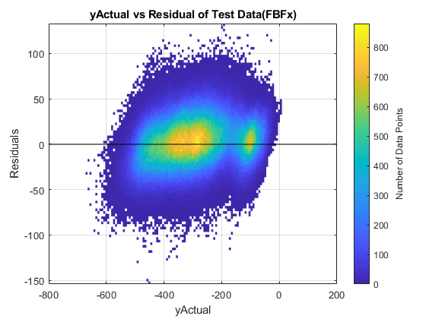


Linear and Polynomial Regression
EDA
EDA
Linear Regression for FB_Fx
Polynomial Regression for FB_Fx
Best Fit Line
LPR
LPR
y
y
Best Fit Line
TM
TM
x
x
SVR
SVR
GPR
GPR
EBT
EBT
Simple model and used as reference.
Residual error range
-120kN to +180kN.
Residual error range -100kN to +100kN.
ANN
ANN
Analysis of Regression Models for estimating the main bearing loads of wind turbine
Mithun Nagesh Shet

Slide 14
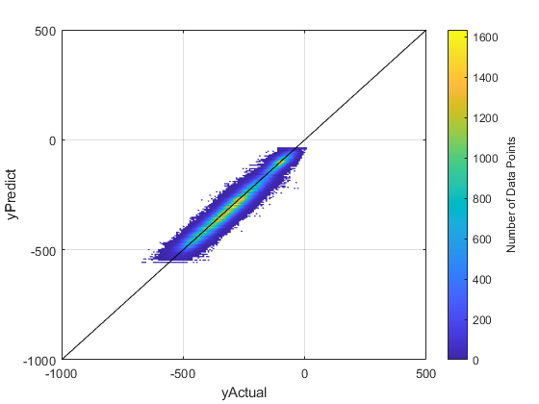
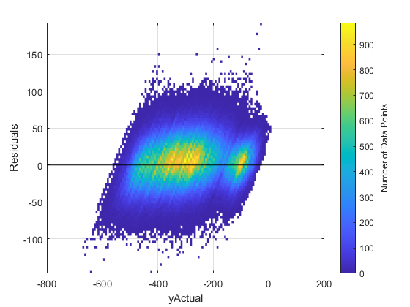

Regression Tree Model
EDA
EDA
Root node
Splits
LPR
LPR
Decision Node
TM
TM
Terminal Node
SVR
SVR
GPR
GPR
Flexibility to capture nonlinear predictor-response relationship.
Minimum leaf size set at 35 to 40 for balanced fit.
Residual error varying between ±110kN with high density points found at around ±25kN
EBT
EBT
ANN
ANN
Analysis of Regression Models for estimating the main bearing loads of wind turbine
Mithun Nagesh Shet

Slide 15
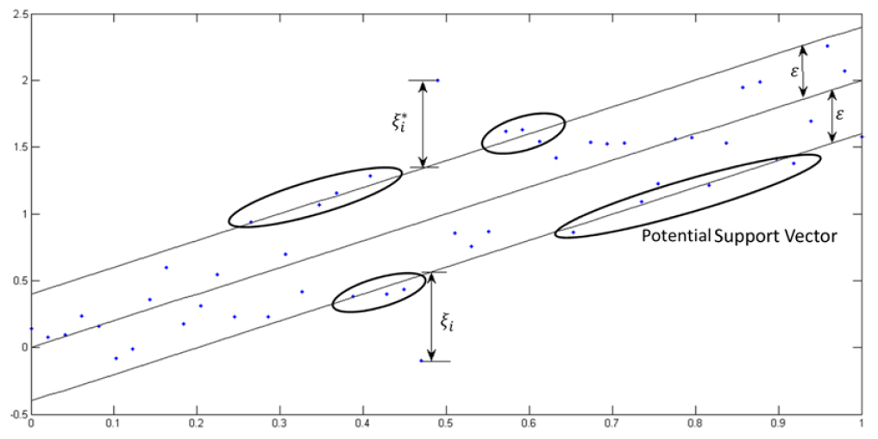
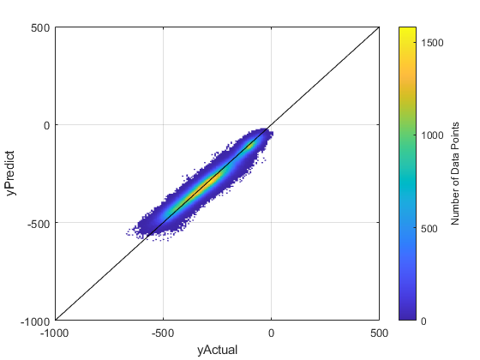
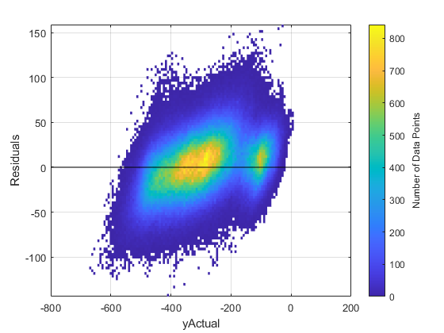

Support Vector Regressor
EDA
EDA
LPR
LPR
TM
TM
SVR
SVR
GPR
GPR
Consists of Є tube which reformulates the optimization problem to find best tube that approximates continuous valued function.
The kernel was set as polynomial of order 2.
The residual error varied between ±120kN with high density of points seen around ±35kN.
EBT
EBT
ANN
ANN
Analysis of Regression Models for estimating the main bearing loads of wind turbine
Mithun Nagesh Shet

Slide 16
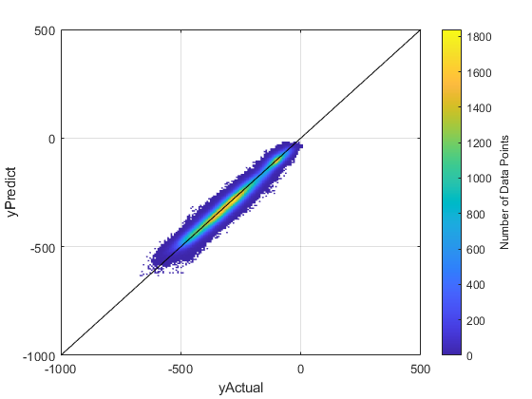
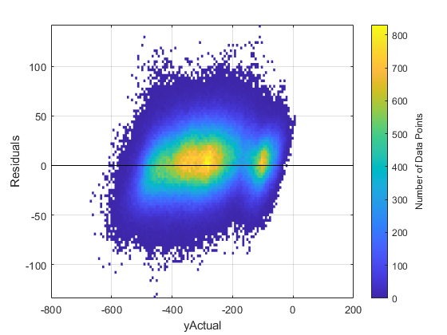



Gaussian Process Regressor
EDA
EDA
Two points have close covariance and uncertainty is low.
$$f(x)$$
Two points are far apart and uncertainty is very high.
LPR
LPR
Upper bound of CI
σ
TM
TM
σ Deviation
Lower bound of CI
SVR
SVR
Prediction
$$x$$
Actual data
GPR
GPR
Gaussian process regression (GPR) models are nonparametric kernel based probabilistic models.
Kernel function used is squared exponential based on the data distribution.
The residual error varies between ±95kN with high density of points seen around ±25kN.
EBT
EBT
ANN
ANN
Analysis of Regression Models for estimating the main bearing loads of wind turbine
Mithun Nagesh Shet

Slide 17
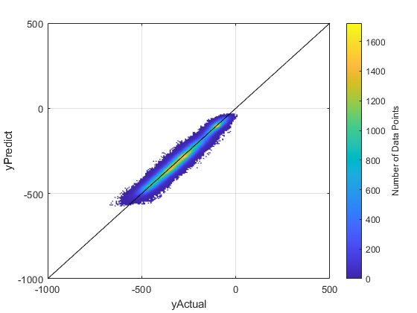
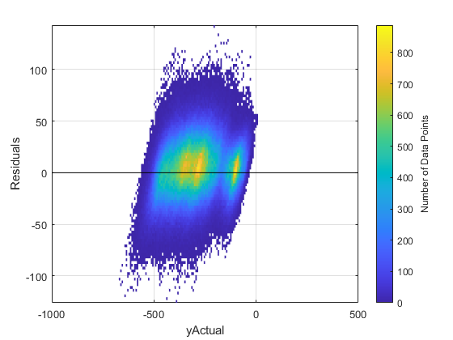

Ensemble Bagged Tree
EDA
EDA
Initial Dataset
LPR
LPR
Bootstrap 1
Bootstrap 2
Bootstrap n
TM
TM
Subset 1
Subset 2
Subset n
SVR
SVR
Tree Model 1
Tree Model 2
Tree Model n
GPR
GPR
A bagged ensemble tree is a machine learning algorithm where multiple tree models are trained to solve the same problem and combined to get better results.
Bagged ensembles help to avoid the problem of overfitting.
The model becomes resilient to generating errors.
Residual error varying between ±90kN with high density of points seen around ±20kN .
EBT
EBT
Prediction 1
Prediction 2
Prediction n
ANN
ANN
Final Prediction
Analysis of Regression Models for estimating the main bearing loads of wind turbine
Mithun Nagesh Shet

Slide 18

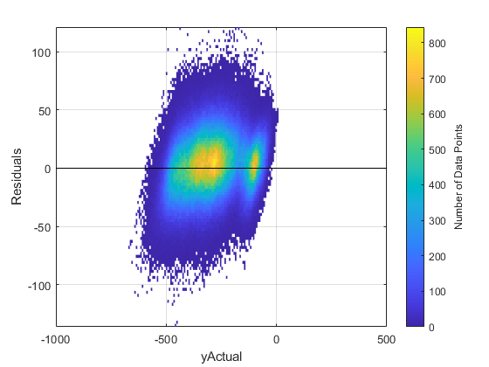





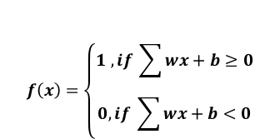


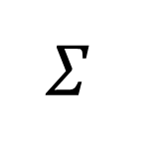





Artificial Neural Network
EDA
EDA
$$x1$$
$$w1$$
$$f\left(x\right)=\left\{\begin{aligned}1 ,if \sum{wx+b≥0} \\ 0,if \sum{wx+b<0}\end{aligned}\right.$$
LPR
LPR
$$x2$$
$$w2$$
$$\sum_{i=1}^{m}{\left(w_{i}x_{i}\right)+bias}$$
$$\hat{y}$$
$$w3$$
$$x3$$
TM
TM
$$w4$$
$$x4$$
$$Σ$$
SVR
SVR
Inputs
Weights
Summation and bias
Activation
Output
GPR
GPR
EBT
EBT
Residual error varying between ±80kN with high density of points seen around ±20kN .
To model a better nonlinear correlation between the displacements and the loads.
The model was built with 2 hidden layers with RELU as activation function.
ANN
ANN
Analysis of Regression Models for estimating the main bearing loads of wind turbine
Mithun Nagesh Shet

Slide 19
RESULT STUDY
Analysis of Regression Models for estimating the main bearing loads of wind turbine
Mithun Nagesh Shet

Slide 20
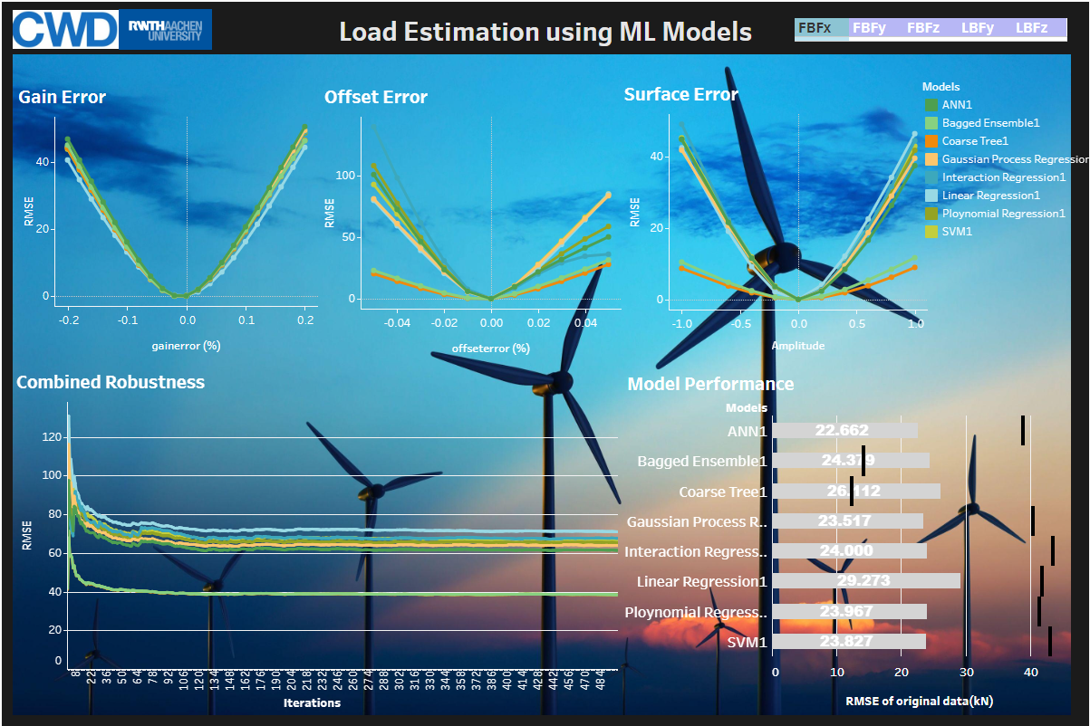
Result Study
The results of each model and its performance for each main bearing loads is discussed in dashboard which can be accessed using below link.
https://public.tableau.com/views/Thesisresults_dashboard_v3/Dashboard1?:language=en-US&publish=yes&:display_count=n&:origin=viz_share_link
Analysis of Regression Models for estimating the main bearing loads of wind turbine
Mithun Nagesh Shet

Slide 21
Summary and Outlook
Analysis of Regression Models for estimating the main bearing loads of wind turbine
Mithun Nagesh Shet

Slide 22
Summary and Outlook
Summary:
With approach presented in thesis, Regression models can estimate main bearing loads from displacement values with certain degree of error.
Apart from linear model, all models could capture nonlinearity due to bearing surface and clearance with Bagged ensemble showing highest robustness.
Bagged Tree ensemble model consistently showed strong robustness for all main bearing loads.
ANN model showed good performance with original dataset and captured nonlinearity but was inconsistent in robustness test.
Compromise made between the accuracy and robustness.
Outlook:
Models can be further trained with dataset consisting all kinds of error for better performance to capture nonlinearities.
Further study is needed on the minimum threshold for accuracy and robustness required to be implemented in real world.
Analysis of Regression Models for estimating the main bearing loads of wind turbine
Mithun Nagesh Shet

